Slide 1
Wentzville School District
Solution-Focused Therapy
Bob Bertolino, Ph.D. Professor, Maryville University-St. Louis
Senior Clinical Advisor, Youth In Need, Inc.
Senior Associate, International Center for Clinical Excellence

Slide 2
Tidbits
For copyright reasons and confidentiality some of PowerPoint slides may be absent from your handouts.
To download a PDF of this presentation, please go to: www.bobbertolino.com.
Please share the ideas from this presentation. You have permission to reproduce the handouts. I only ask that you maintain the integrity of the content.
Contact: rbertolino@youthinneed.org
bobbertolino.com

Slide 3
PRACTICES
“What we do”
↑
THEORY/MODELS
“How we think”
↑
PERSONAL PHILOSOPHIES
“Who we are”

Slide 4
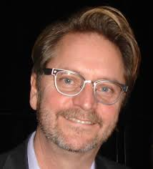
Solution-Focused/Oriented Therapies Prominent Figures
Steve de Shazer
Insoo Kim Berg
Bill O’Hanlon
Scott Miller
Michele Weiner-Davis
Eve Lipchik
Jon Walter & Jane Peller
Yvonne Dolan

Slide 5
1988
2003
2012
1997
2007

Slide 7
A Solution & Outcome-Focus
Franklin, Trepper, Gingerich, & McCollum (2011)
Gillaspy & Murphy – Chapter 5: “Incorporating Outcome and Session Rating Scales in Solution-Focused Brief Therapy”
Bertolino
Chapter 4: Directions: Information-Gathering and Planning
Chapter 7: Exchanges: Progress and Transitions
ICCE
Manual 2: Feedback-Informed Clinical Work

Slide 8
Solution-Focused Therapy (SFT)
Notes:
EBP is the language of the land. And

Slide 9
Background
Gained prominence with changes in the funding climate.
The Third Wave was in response to pathology-laden and problem-focused approaches of the first two “waves,”
Emerged out of the Mental Research Institute (MRI) problem-solving approach and the work of Milton Erickson.
Emphasis on health, well-being, and competency
Major Variations
Solution-Focused (MRI)
Solution-Oriented (Erickson)

Slide 10
Pathology vs. Solution-Focused
Traditional View
Identify, uncover, discover—deficits, impairments, pathology
Belief is people are bad, have hidden agendas, and as resistant
Practitioner finds and administers cures
The practitioner is the “expert”
Focus is on the past/past events
Expression of emotion considered necessary for change
Practitioners diagnose stuckness
Emphasis is on finding identity and personality problems
Solution-Focused
Identify competencies/abilities
Focus is on promoting well-being
Belief is people have good intentions, are cooperative
Focus is on identifying small changes that lead to bigger ones
Services are collaborative with shared expertise
Focus is on the present and future
Practitioners validate experience
Practitioners are change-oriented
Emphasis is on action and process descriptions

Slide 11
Solution-Focused Therapy Assumptions
If it isn't broken, don't fix it.
If it works, do more of it.
If it's not working, do something different.
Small steps can lead to big changes.
The solution is not necessarily directly related to the problem.
The language for solution-development is different from that needed to describe a problem.
No problem happens all the time; there are always exceptions that can be utilized.
The future is both created and negotiable.
de Shazer, S., & Dolan, Y. (Eds.) (2007). More than miracles: The state of the art of solution-focused brief therapy. New York: Haworth.

Slide 12
Problem Formation
Problems are seen to maintain themselves simply because they maintain themselves and because clients depict the problem as always happening.
For every “problem” there is an exception. An exception refers to “times when the . . . problem does not happen even though the client has reason to expect it to happen” (de Shazer, 1991, p. 83).
Although these exceptions are open to view, they are not seen by the client as differences that make a difference. For the client, the problem is seen as primary (and the exceptions, if seen at all, are seen as secondary), while for therapists the exceptions are seen as primary; interventions are meant to help clients make a similar inversion, which will lead to the development of a solution. (de Shazer, 1991)

Slide 13
The Therapist’s Role in SFT
Focus on what is right and what is working.
Every problem has exceptions that can be turned into solutions.
Little changes lead to bigger changes.
Goals are always set in positive terms.
People do want to change for the better.
Don’t ask a client to do something that he or she has not succeeded at before.
Avoid analyzing the problem.
Be efficient! Don’t look for problems or solutions that won’t work.
Focus on the present and the future, not the past.

Slide 14
Three Types of Clients
Customers: These clients are active and want to do something about their situation.
Complainants: These clients don’t want to do anything themselves but want someone or something else to change.
Visitors: Client who do not know or cannot verbalize their complaints or problems.

Slide 15
The Therapeutic Alliance
The therapeutic alliance refers to the quality and strength of the collaborative relationship between the client and therapist and is comprised of four empirically established components:
agreement on the goals, meaning or purpose of the treatment;
agreement on the means and methods used;
the client’s view of the relationship (including the therapist being perceived as warm, empathic, and genuine); and,
accommodating the client’s preferences.
Consumer
Preferences
Goals, Meaning or Purpose
Means or Methods
Client’s View of the
Therapeutic Relationship

Slide 16
Stages in SFT
The first session
Experiencing the client’s story
Acknowledging and validating
Co-constructing a problem and goal
Identifying and amplifying exceptions
Co-constructing tasks
After the first session
Identifying and amplifying exceptions derived from tasks
Re-evaluating the problem and goal

Slide 17
Stages in SFT: The First Session
First Session Task
Co-constructing a problem and goal
Action-talk
Identifying progress
Identifying and amplifying exceptions
Between Session Task (General)
Co-constructing tasks (Specific)

Slide 18
3-Point Strategy
Problem Description: What needs to change?
Scaling questions
Vision of the Future: How will we know that change has been achieved?
Miracle question, crystal ball, time machine, etc.
General future-oriented questions
Scaling questions (revisited)
Movement: How will we know that progress is being made?
Scaling questions (revisited)
Notes:
Exercise

Slide 19
Co-Constructing Problems and Goals
Clarify ambiguous, nondescript statements of problems (i.e., non-action-talk).
Use action-talk to gain clarity about what happens in problem situations (i.e., how clients “do” their problems”).
Also apply action-talk to discussion about goals.
Goals represent what clients want to have happen in their lives or situations instead of the problem.
Goals are to be clear, observable, and descriptive.

Slide 20
Non-Action-Talk
Cab driver talk
Opinions, evaluations, assessments, judgments
Politician talk
Vague, general, not specific as to person, place, time, thing, or action
“Someday” talk
Vague as to time or frequency

Slide 21
Action-Talk
Action-Talk/Videotalk
Move from vague, non-sensory-based descriptions to clear, observable, behaviors
Using Action-Talk to Clarify Meanings
Action complaints – specifics about what one doesn’t like or one wants to have change
Action requests – specifics about what one would like to have happen
Action appreciation – specifics about what has liked about something and would like more of
Specific to person, place, time, thing, action, or result
Who is to do what by when?
Who did what, when?

Slide 22
Co-Constructing Problems and Goals (cont.)
To gain an idea of what the client would like to have different, use:
The Miracle Question
The Crystal Ball
Alfred Adler’s “The Question”
Time Machine
Magic Door
Future-Oriented Questions
“Looking ahead a few weeks/months, what would be happening to indicate to you that the problem that brought you here is no longer interfering with your life?”
Let’s say that six months from now, the main problem you’ve been facing has been resolved. What will be different? What will you be doing?

Slide 23
Identifying Progress
How will you know that things have started to turn the corner with the problem or your situation? What might be a sign?
What will be an indication to you that you’re starting to get the upper hand with the problem that brought you to therapy?
What could happen to let you know that your situation is starting to improve?
Who will be he first to notice that positive change has started in your lfe?

Slide 24
Preparation for Change
Relationship to problems: Learn how clients situate themselves in relation to concerns and problems. Listen for “I,” “Me,” “Myself,” or “We” statements as opposed “You,” “He,” “She,” “Him,” “Her,” “They,” “Them” statements (Note: Be aware of cultural differences in language)
Explore coping style
Explore readiness for change
Learn from clients the problematic patterns that repeat
Identify specific incidents to find descriptions and patterns

Slide 25
Pathway 1: Identify and Amplifying Exceptions
Continue to acknowledge and validate.
Exceptions represent strengths and resources.
Search for small exceptions.
Examples:
“Tell me about a time that you could have __________ but did not. What was different? What did you do? Did others help? If so, in what way(s)?
“Tell me about a time that the problem happened but didn’t reach the point of being out of control. What was different about that time?” How did you make it happen?
How is that different from how you have dealt with the problem in the past?
What did you tell yourself to make it happen?
What does this say about you and your ability to deal with the problem?
Build accountability through exceptions.

Slide 26
Exceptions in the Client’s Social Network
1
Client
2
Family
3
Friends/
Social Relation-
ships
4
Community
5
Outside Helpers
6
School/
Education
7
Work/
Employment
8
Other
Use assessments as opportunities to explore both risks and strengths.
Identify and assist with developing supportive social systems, resources, and networks.
Notes:
1. Learn about strengths and supports; 2) Use “types of questions” to learn more about supports

Slide 27
Beyond Exceptions Types of Questions (Handout)
4WH: Who, What, When, Where, How
Utilization
Exceptions
Difference
Influence (Problem or Person over)
Coping
Splitting
Linking
Contexts of Competency
“One Thing”
Smaller Step
Accomplishment
Highlighting
Pre-service/session/meeting
Description
Relationship to Problem

Slide 28
Pathway 2: Shift Attention
Change language
Broaden Perspectives (consider different points of view)
Suggest Alternative Viewpoints that Fit the Same Evidence
Find a Vision for the Future
Encourage Clients to Cast Doubt on Their Thoughts
Change Some Quality of Remembered Experience
Shift between the Past, Present, and Future
Shift Focus from Internal Experience to the External Environment or Other People or Vice Versa
Shift sensory attention

Slide 29
Language: The Costs of Negativity
Research shows that extensive discussions of problems and encouragement of ‘‘problem talk,’’ rehashing the details of problems, speculating about problems, and dwelling on negative affect in particular, leads to a signiﬁcant increase in the stress hormone cortisol, which predicts increased depression and anxiety over time. (Byrd-Craven, Geary, Rose, & Ponzi, 2008)
People who are in a more positive mood are better liked by others and more open to new ideas and experiences. (Fredrickson, 1998)
Byrd-Craven, J., Geary, D. C., Rose, A. J., & Ponzi, D. (2008). Co-ruminating increase stress hormone levels in women. Hormones and
Behavior, 53, 489–492.
Fredrickson, B. (1998). What good are positive emotions? Review of General Psychology, 2, 300-319.

Slide 30
Language: The Costs of Negativity (cont.)
Recent studies by the University of Pennsylvania demonstrated a link between language used on social media (i.e., Facebook, Twitter, etc.) and heart disease—expressions of negative emotions such as anger, stress and fatigue in tweets were associated with higher heart disease risk. (Eichstaedt, et al., 2015a, 2015b)
The same researchers also found that positive emotions like excitement and optimism were associated with lower risk of heart disease. (Eichstaedt, et al., 2015a, 2015b)
Ireland, Schwartz, Chen, Ungar, and Albarracin (2015) studied HIV prevalence and learned that sexually transmitted infection rates and references to risky behavior on Twitter were associated with higher HIV prevalence in all counties except those with high rates of future orientation.
Eichstaedt, J. C., Schwartz, H. A., Kern, M. L., Park, G., Labarthe, D. R., Merchant, R. M., Jha, S., Agrawal, M., Dziurzynski, L. A., Sap, M., Weeg, C., Larson, E. E., Ungar,
L. H., & Seligman, M. E. P. (2015a). Psychological language on Twitter predicts county-level heart disease mortality. Psychological Science, Vol 26(2), 159-169.
Eichstaedt, J. C., Schwartz, H. A., Kern, M . L., Labarthe, D. L., Merchant, R. M.,Jha, S., Agrawal, M., Dziurzynski, L. A., Sap, M., Weeg, C., Larson, E. E., Ungar, L. H., &
Seligman, M. E. P. (2015b). Psychological language on Twitter predicts county-level heart disease mortality. Psychological Science, 1-11.
Ireland, M. E., Schwartz, H. A., Chen, Q., Ungar, L. H., & Albarracin, D. (2015). Future-oriented tweets predict lower county-level HIV prevalence in the United States. Health
Psychology, 34, 1252-1260.

Slide 31
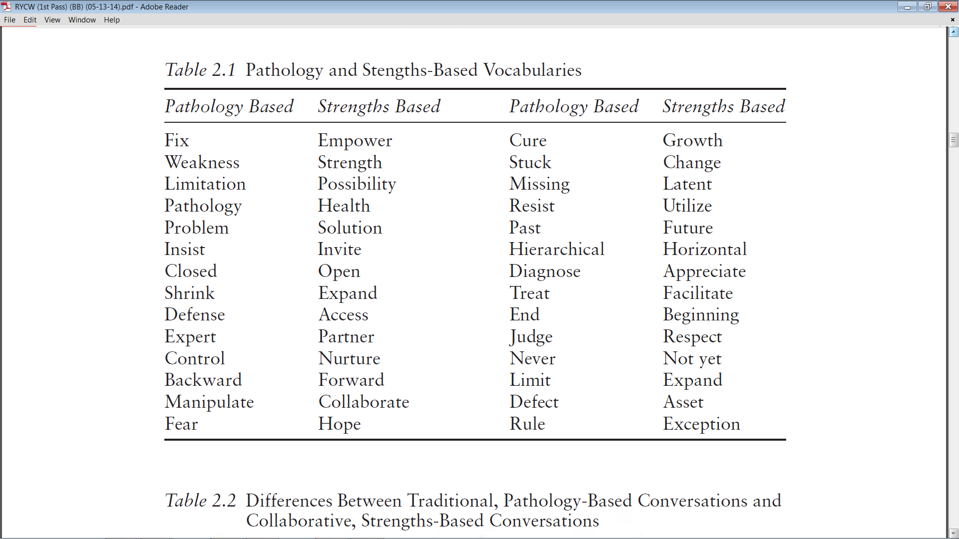
Bertolino, B. (2015). The residential youth care worker in action: A collaborative, strengths-based approach.
New York: Routledge.

Slide 33
Acknowledgment, Validation, & Possibility Dissolving Impossibility Talk
Reflect client statements in the past tense.
From: “It’s always that way.”
To: “It’s been that way.”
Move from global (“everybody,” nobody,” “always,” “never”) to partial (“recently,” “somewhat more,” “a lot”).
From: “I’m always in trouble.”
To: “You’ve been in trouble a lot.”
Move from truth/reality to perception (“It seems to you,” “You’ve gotten the idea”).
From: “Things will never get better.”
To: “It really seems to you that it will never get better.”

Slide 34
Acknowledgment, Validation, & Possibility Future Talk: Acknowledgment and a Vision for the Future
Assume the possibility of future change and/or solutions by using words such as “yet” and “so far.”
From: “It’s always going to be this way.”
To: “So far you haven’t found any evidence that things will be different than the way they are
now.”
Recast the problem statement into a statement about a preferred future or goal.
From: “I’ll never be able to have the life I really want.”
To: “So you’d like to be able to move toward the life you really want.”
Presuppose that changes and progress toward goals will occur by using words such as “when” and “will.”
From: “No one wants to be around me.”
To: “So when you begin to notice that there are people who enjoy your company and want
to be around you what will be different for you?”
Notes:
Exercise

Slide 35
Possibility Language Giving Permission
Give permission “to,” “not to have to,” and both
From: “I shouldn’t be angry.”
To: “It’s okay to be angry.”
From: “People keep saying that it really should make me angry.”
To: “It’s okay to not be angry about it.”
From: “Sometimes I’m angry and sometimes I’m not. I must be crazy!”
To: “It’s okay to be angry and you don’t have to be angry and you’re not crazy.”

Slide 36
Co-Constructing Tasks
Ensure clients are at the preparation, action, or maintenance stages.
Collaborate with clients on determining which tasks or activities provide the best fit.
Ensure tasks are “do-able.”
Encourage clients to commit to at least trying any agreed-upon exercises.
Primarily Pathways 3 and 4.

Slide 37
Pathway 3: Depatterning
Find and alter repetitive patterns of action and interaction that are involved with the problem (Aspects of Context)
Change the frequency
Change the timing
Change the duration
Change the location

Slide 38
Pathway 4: Repatterning
Find and use solution patterns of action and interaction
Search for exceptions in patterns of action
Find out about any helpful changes that have happened before services began (preservice change)
Find out what happens when the problem ends or starts to end
Search for contexts in which the client, family member, or other feels competent and has good problem-solving or creative skills
Find out why the problem isn’t worse
Rituals of continuity and connection

Slide 39
Subsequent Sessions
Refer to results of tasks.
Did clients do the tasks? What were the results? Amplify change.
How did the results relate to the overall goals?
Re-examine the focus of therapy, if needed.
If no change, reevaluate the client’s readiness for change and if needed, shift to Pathways 1 and 2.
Listen for: 1) Reports of new concerns; or 2) Reports that are vague.
Refer to ORS (outcome) scores.
Improvement or no improvement or deterioration?
Observe for patterns of outcome response.

Slide 40
Responding to Unimprovement and Improvement
How have you managed to keep things the same?
What specifically seems worse?
How has that affected you?
What is one thing that you’ve noticed about your concern that tells you things haven’t gotten out of hand?
What prevented things from deteriorating further? What else?
How has that made a difference for you/with this situation?
What kind of help from others, if any, do you need to ensure that that happens?
What else might help in the future?
What is the smallest thing that you could do after leaving her today that might make even more of a difference with your situation?
What would it take for that to happen a little now?
What do you need to set that in motion?
What might help you to hold steady once you set that in motion?
What will you think to do the next time you feel yourself slipping?

Slide 41
Responding to Improvement
What have you noticed that has changed with your concern/problem/self/situation?
What specifically seems to be going better?
Who first noticed that things had changed?
Who else noticed the change?
When did you first notice that things had changed?
What did you notice happening?
How did the change happen?
What do you think might have influenced that positive change (e.g., family, supportive others, etc.)?
What worked for you to bring about this change?
What specifically did you do?
How did you get yourself to do that?
How was what you did different than before?
Where did you get the idea to do things that way?
What role, if any, did others play in helping to move things forward?
How specifically did others support and/or help you?

