Slide 1
Missouri Coalition of Children’s Agencies Training
and Conference
“Making a Difference that Matters”
Strengths-Based Supervision
Excellence and Innovation
Bob Bertolino, Ph.D. Associate Professor, Maryville University-St. Louis
Sr. Clinical Advisor, Youth In Need, Inc.
Sr. Associate, International Center for Clinical Excellence

Slide 2
Tidbits
For copyright reasons and confidentiality some of PowerPoint slides may be absent from your handouts.
To download a PDF of this presentation, please go to: www.bobbertolino.com.
Please share the ideas from this presentation. You have permission to reproduce the handouts. I only ask that you maintain the integrity of the content.
Contact: bertolinob@cs.com; 314.852.7274
bobbertolino.com
Notes:
My site with updates & resources; YIN; Maryville; ICCE
Active Note-taking & 3) We will practice reflection

Slide 4
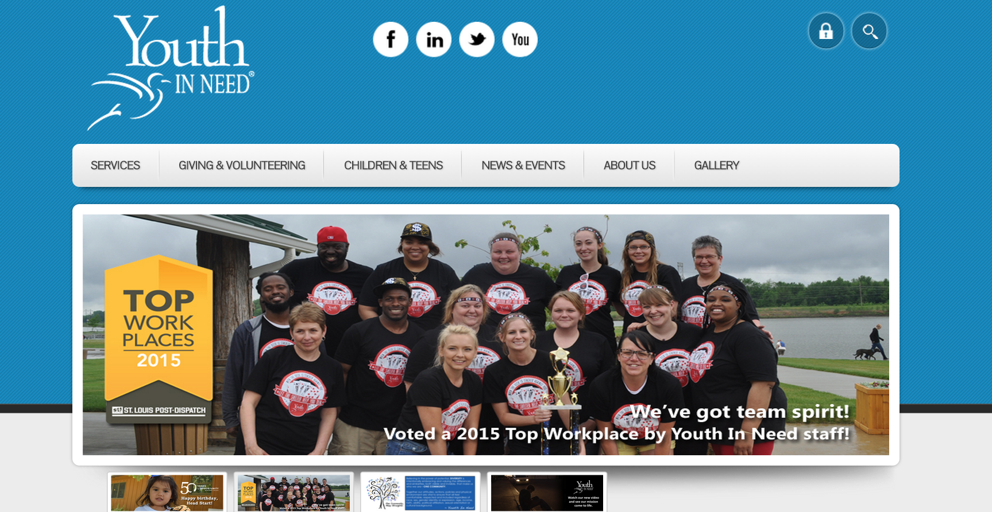

Slide 6
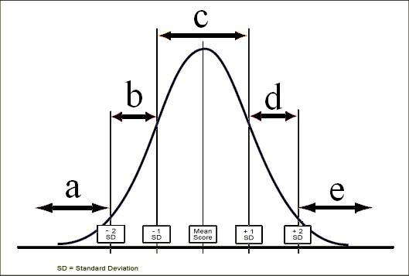

Slide 7
Underperformers

Slide 9
The Costs and Benefits of Performance
Under (Poor)
High
Less efficient
Poorer quality work (and outcomes); more errors, accidents
Weaker client engagement
More conflict with coworkers; negative impact on team
More likely to be part of staff infections
More supervisory time spent managing everyday situations
Are more likely to stay on the job
More efficient
Better quality work (and outcomes); fewer errors; better safety
Better client engagement
Get along with coworkers; positive impact on team
More likely to be supportive of others when facing difficulty
Better problem-solvers, knowing how to use supervision as a support
Notes:
Gawande – The Bell Curve & CF

Slide 10
Poor Performance and Accountability
Poor performance is tied to accountability, and accountability is everyone’s concern.
To hold someone accountable is to care about them enough to risk having them blame you for pointing out their deficiencies.
Accountability involves routine support around clear goals with proper follow-up.
Peer-to-peer accountability is the primary and most effective source of accountability on leadership team.
Notes:
Gawande – The Bell Curve & CF

Slide 11
High Performers

Slide 12
Benefits of Higher Performers
Tend to have flexible and open mindsets
Exercise independence and persistence
Are willing to step out of their comfort zones
Are eager to learn from others
Are more confident, but not egocentric
Are more future-focused
Are more interested in being part of the solution, not the problem
Focus more on their actions than those of others
Used strengths-based language
Often think they are average performers

Slide 13
Creating a Culture
Of Excellence

Slide 15
From Philosophy to Practice
PRACTICES
“What we do”
↑
THEORY/MODELS
“How we think”
↑
PERSONAL PHILOSOPHIES
“Who we are”

Slide 16
What is My Philosophy?
What are my core beliefs, ideas, or assumptions about the clients with whom I work?
How did I arrive at those beliefs?
What has most significantly influenced my beliefs, ideas, and assumptions as they relate to my clients?
How have my beliefs, ideas, and assumptions affected my work with clients? With colleagues/peers? With larger communities?

Slide 17
What is My Philosophy (cont.)?
How do I believe that change occurs?
Do I believe that some degree of change is possible with every client? (If you answered “yes” then end here.)(If you answered “no,” proceed to the next question.)
How do I work with clients whom I believe cannot (or do not want to or are resistant to) change? What do I do?
If I do not believe that every client (and/or family) can experience some degree of change, what keeps me in doing this kind of work?
Notes:
Next: Patch Adams; Then, David Whyte

Slide 18
From Pathology to Strengths
“What we have learned over 50 years is that the disease model does not move us closer to the prevention of these serious problems. Indeed the major strides in prevention have largely come from a perspective focused on systematically building competency, not correcting weakness. Prevention researchers have discovered that there are human strengths that act as buffers against mental illness: courage, future-mindedness, optimism, interpersonal skill, faith, work ethic, hope, honesty, perseverance, the capacity for flow and insight, to name several… We need now to call for massive research on human strength and virtue. We need to ask practitioners to recognize that much of the best work they already do in the consulting room is to amplify strengths rather than repair the weaknesses of their clients.” (p. 6-7)
Seligman, M. E. P., & Csikszentmihalyi, M. (2000). Positive psychology: An introduction. American Psychologist, 55(1),
5–14.

Slide 19
A Strengths-Based Foundation
A strengths-based perspective emphasizes the abilities and resources people have within themselves and their support systems to more effectively cope with life challenges. When combined with new experiences, understandings and skills, those abilities and resources contribute to improved well-being, which is comprised of three areas of functioning: individual, interpersonal relationships, and social role. Strengths-based practitioners value relationships convey this through respectful, culturally-sensitive, collaborative, practices that support, encourage and empower. Routine and ongoing real-time feedback is used to maintain a
responsive, consumer-driven climate to ensure the greatest
benefit of services.
Bertolino, B. (2014). Thriving on the front lines: Strengths-based youth care work. New York: Routledge.
Notes:
Lincoln Quote

Slide 20
A Focus On Strengths Is Not Ignoring Problems
Deficit Model
Strengths Model
Deficit, personality and character problems
Focus on weaknesses
Overcoming deficiencies
Avoiding pain
Running from unhappiness
Neutral state (0) as ceiling
Tensionless as ideal
Well-being, satisfaction, joy, excitement, happiness
Focus on strengths
Building competencies
Seeking pleasure
Pursuing happiness
No ceiling
Creative tension as ideal

Slide 21
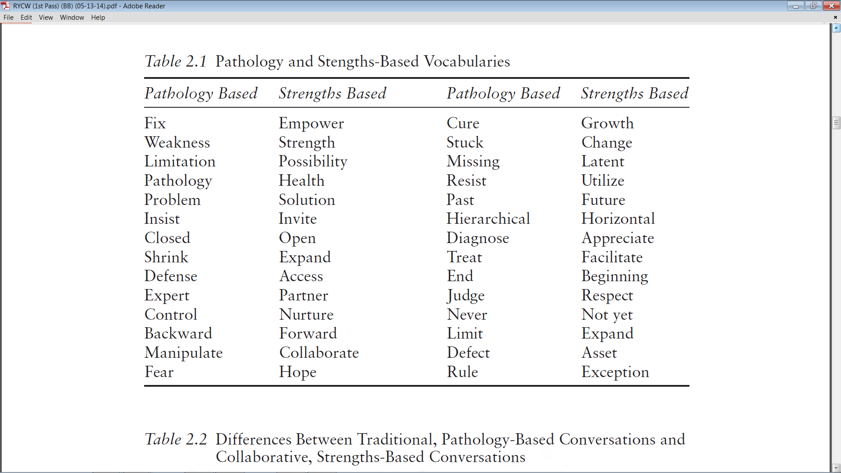
Bertolino, B. (2015). The residential youth care worker in action: A collaborative, strengths-based approach.
New York: Routledge.

Slide 22
Strengths-Based Supervision

Slide 23
Strengths-Based Principles & Supervision
Clients are the Most Significant Contributors to the Success of Services.
In Supervision: Maximize supervisees’ contributions to the supervisory process
The Therapeutic Relationship Makes Substantial and Consistent Contributions to Outcome
In Supervision: Engage supervisees through the working alliance
Culture Influences and Shapes All Aspects of Clients’ Lives
In Supervision: Convey respect for supervisees and their cultures

Slide 24
Strengths-Based Principles & Supervision (cont.)
Effective Services Promote Growth, Development, and Well-Being
In Supervision: Utilize strategies that empower supervisees
Expectancy and Hope are Catalysts of Change
In Supervision: Demonstrate faith in the value of supervision

Slide 25
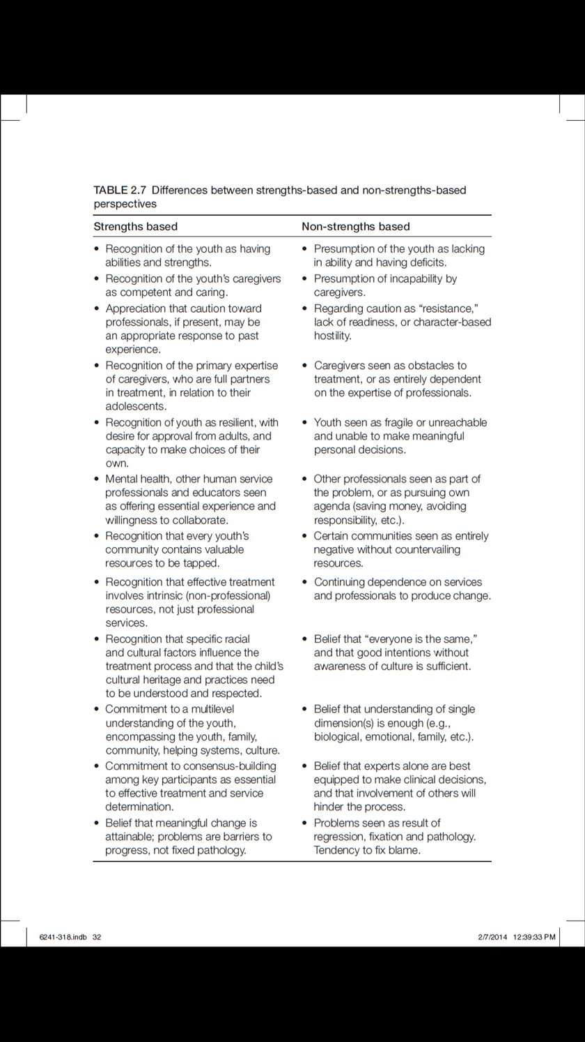

Slide 26
Considerations for Supervision
Discuss the dual roles of both the supervisee and supervisor.
Explore (and periodically revisit) the supervisee’s hopes and expectations, including developmental goals.
Describe your expectations, hopes, and goals as a supervisor, for the supervisee.
Emphasize personal well-being
Notes:
Gawande – The Bell Curve & CF

Slide 27
Considerations for Supervision (cont.)
Convey empathy and positive regard (acknowledge and validate)
Continuously monitor the alliance
Practice transparency
Maintain an open door
Learn from high-performers
Learn from staff with higher well-being

Slide 28
Orienting Questions
What ideas do you have about how supervision might help you?
In what ways do you learn best?
How can I support you?
At the end of our meeting how would you know that our conversation had been helpful? What would be different for you? What else?
What would leave you feeling just a little more hopeful?

Slide 29
As Supervision Progresses
Walk the talk.
Think-Act-Reflect (TAR)
Practice understanding situations from at least three different points of view.
Lead from the side.
John Wooden: Explanation, Demonstration, Imitation, Repetition
Identify Positive Deviants: Champions of your team, program, and the agency.
Request and respond to feedback.

Slide 30
“People will forget what you said, people will forget what you did, but people will never forget how you made them feel.” – Maya Angelou

Slide 32
Practice Examples
Notes:
Gawande – The Bell Curve & CF

Slide 33
Scenario 1
A therapist in a residential program says, “How am I supposed to be therapeutic with these kids when one minute they are telling me about the abuse they have suffered then later in the day I have to talk with them about a problem they had with threatening another resident. I can’t be their therapist and be the person that gives them consequences too!
Notes:
Gawande – The Bell Curve & CF

Slide 34
Scenario 2
A staff person is regularly late to work. When you talked with her about it she said, “It’s only a few minutes and Liz (coworker) doesn’t care. She’s always there finishing up paperwork when I get there anyway.”
Notes:
Gawande – The Bell Curve & CF

Slide 35
Scenario 3
In meetings you notice that a staff member seems disengaged. You consistently observe her with arms folded, a dissatisfied look on her face, sighing when others talk, and using sarcasm when she does speak up. Other staff have noticed and are beginning to do some of the same things. The quality of staff meetings has deteriorated.
Notes:
Gawande – The Bell Curve & CF

Slide 36
Scenario 4
A therapist routinely falls short of scheduling the expected number of clients per week despite there being a waitlist. The staff person says that when hired he was told that as long as he was doing his best that would be good enough. He says that’s what he’s doing—his best.

