Slide 1
Ericksonian Hypnosis
Bob Bertolino, Ph.D.
Co-Director, Clinical Mental Health Counseling
Professor fof Psychology, Maryville University
Sr. Clinical Advisor, Youth In Need, Inc.
Director of Ethics, International Center for Clinical Excellence

Slide 2




Tidbits
For copyright reasons and confidentiality some of PowerPoint slides may be absent from your handouts.
To download a PDF of this presentation, please go to: www.bobbertolino.com.
Please share the ideas from this presentation. You have permission to reproduce the handouts. I only ask that you maintain the integrity of the content.
Contact: bertolinob@cs.com; +01.314.852.7274
bobbertolino.com
Notes:
My site with updates & resources; YIN; Maryville; ICCE
Active Note-taking & 3) We will practice reflection

Slide 3


Slide 4
Hypnosis Defined

Slide 5
Former (Pre-2003)
Definition of Hypnosis
“Hypnosis is a procedure during which a health professional or researcher suggests that a client, patient, or subject experience changes in sensation, perceptions, thoughts or behavior.”
APA, Division 30, Society of Psychological Hypnosis.

Slide 6
Revised Definition of Hypnosis
“A focused experience of attentional absorption that invites people to respond experientially on multiple levels to amplify and utilize their personal resources in a goal-directed fashion.” (p. 7).
Yapko, M. D. (2012). Trancework: An introduction to the practice of clinical hypnosis (4th ed.). New York:
Routledge.

Slide 7
Hypnosis Redefined
“Hypnosis is a procedure during which a health professional or researcher suggests that a client, patient, or subject experience changes in sensation, perceptions, thoughts or behavior.”
“A focused experience of attentional absorption that invites people to respond experientially on multiple levels to amplify and utilize their personal resources in a goal-directed fashion.”

Slide 8
In hypnosis, people process information differently, and they are able to access abilities they otherwise don’t know how to elicit.

Slide 9
Thus, you have to ask yourself what you believe about people and their innate abilities
Do you believe people have more resources than they consciously realize?

Slide 10
Credentialing

Slide 11
Credentialing
In the US hypnosis is viewed as a specialized approach or method
The main certifying body is the American Society of Clinical Hypnosis (ASCH), however, certification is not required in the US (and most countries do require certification)
Hypnosis written into some agencies’ policies as an alternative practice
Best practice always includes:
  Regarding Clients: Informed-consent, discussion of benefits and risks, disclosure of experience level
  Regarding Practice: Training, ongoing supervision, ethical practice and decision-making

Slide 12


Slide 13


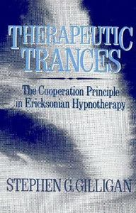

Slide 14
Why Learn Hypnosis?

Slide 15
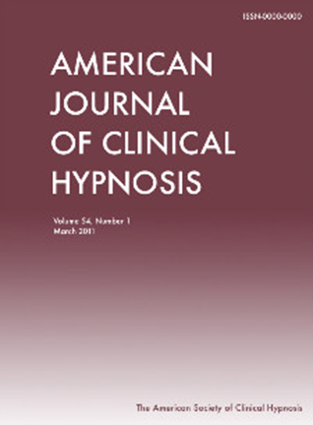

Why Learn Hypnosis?
Empirical evidence it works (i.e., hypnosis objectively enhances treatment outcomes). It is an Evidence-Based Practice (EBP).
The International Journal of Clinical and Experimental Hypnosis published two special issues back-to-back in 20007 summarizing much of the current literature on the merits of hypnosis in treating pain, depression, anxiety, asthma, headaches, PTSD, and more.
All therapy involves the use of suggestion.

Slide 16
Evidence-Based Practice (EBP)
“The integration of the best available research with clinical expertise in the context of patient characteristics, culture, and preferences.” (p. 273)
APA Presidential Task Force on Evidence-Based Practice. (2006). Evidence-based practice in psychology. American
Psychologist, 61(4), 271–285.

Slide 17
Evidence-Based Practice (EBP)
“The integration of the best available research with clinical expertise in the context of patient characteristics, culture, and preferences.” (p. 273)
APA Presidential Task Force on Evidence-Based Practice. (2006). Evidence-based practice in psychology. American
Psychologist, 61(4), 271–285.

Slide 18
Evidence-Based Practice (EBP)
“The integration of the best available research with clinical expertise in the context of patient characteristics, culture, and preferences.” (p. 273)
APA Presidential Task Force on Evidence-Based Practice. (2006). Evidence-based practice in psychology. American
Psychologist, 61(4), 271–285.

Slide 19
Clinical Expertise
The APA Task Force on EBP
“Clinical expertise… entails the monitoring of patient progress (and of changes in the patient’s circumstances—e.g., job loss, major illness) that may suggest the need to adjust treatment… If progress is not proceeding adequately, the psychologist alters or addresses problematic aspects of the treatment (e.g., problems in the therapeutic relationship or in the implementation of the goals of the treatment) as appropriate” (2006, pp. 280, 276-277).
APA Presidential Task Force on Evidence-Based Practice. (2006). Evidence-based practice in psychology. American Psychologist, 61(4), 271–285.
Lambert, M. J., Bergin, A. E., & Garfield, S. L. (2004). Introduction and overview. In M. J. Lambert (Ed.), Bergin & Garfield’s handbook of psychotherapy & behavior change (5th
ed.)(pp. 3-15). New York: Wiley.
Warren, J. S., Nelson, P. L., Mondragon, S. A., Baldwin, S. A., & Burlingame, G. A. (2010). Youth psychotherapy change trajectories and outcomes in usual care: Community
mental health versus managed care settings. Journal of Consulting and Clinical Psychology, 78(2), 144-155.

Slide 20
Evidence-Based Practice (EBP)
“The integration of the best available research with clinical expertise in the context of patient characteristics, culture, and preferences.” (p. 273)
APA Presidential Task Force on Evidence-Based Practice. (2006). Evidence-based practice in psychology. American
Psychologist, 61(4), 271–285.

Slide 21
Patient (Client) Characteristics,
Culture, and Preferences
  Client characteristics (i.e., age, gender, gender identity, ethnicity, race, social class, disability status, sexual orientation, developmental status, life stage, etc.).
  Strengths, resources, beliefs, and factors that can influence change.
  Understanding of the local knowledge and culture.
  Personal preferences, values, and preferences related to treatment (e.g., goals, beliefs, worldviews, treatment expectations).

Slide 22
Why Learn Hypnosis? (cont.)
Provides insights into subjective experience.
Enhances one’s sense of personal control.
Multi-dimensional applications.
Enhances cognitive, behavioral, and emotional flexibility.
Hypnosis is now well-integrated into the fields of psychotherapy and behavioral medicine based on substantive empirical evidence for its efficacy.
Hypnosis builds on client capacities (strengths).

Slide 23
From Pathology to Strengths
“What we have learned over 50 years is that the disease model does not move us closer to the prevention of these serious problems. Indeed the major strides in prevention have largely come from a perspective focused on systematically building competency, not correcting weakness. Prevention researchers have discovered that there are human strengths that act as buffers against mental illness: courage, future-mindedness, optimism, interpersonal skill, faith, work ethic, hope, honesty, perseverance, the capacity for flow and insight, to name several. Much of the task of prevention in this new century will be to create a science of human strength whose mission will be to understand and learn how to foster these virtues in young people. Working exclusively on personal weakness and on the damaged brains, however, has rendered science poorly equipped to do effective prevention. We need now to call for massive research on human strength and virtue. We need to ask practitioners to recognize that much of the best work they already do in the consulting room is to amplify strengths rather than repair the weaknesses of their clients.” (p. 6-7)
Seligman, M. E. P., & Csikszentmihalyi, M. (2000). Positive psychology: An introduction. American Psychologist, 55(1),
5–14.
Notes:
1) African Violet Queen; 2) Gillian Lynne

Slide 24

Strengths-Based Principles
Expectancy and hope are catalysts of change.
Clients are the most important contributors to outcome.
The therapeutic relationship makes substantial and consistent contributions to outcome.
Culture influences and shapes all aspects of human lives.
Effective services promote growth, development, well-being, and functioning.

Slide 25
Is Hypnosis a Therapy?
There are good arguments to both yes and no. My view is that hypnosis is a tool, an experiential vehicle for stimulating new, therapeutic associations in the client.

Slide 26
Does Hypnosis Cure People?
No. It’s what happens during hypnosis—the new and beneficial association the client forms.

Slide 27
What Does Hypnosis Do?
It amplifies and/or de-amplifies specific elements of experience. It generates associations and dissociations.

Slide 28
Think in these terms:
What frame of mind does someone need to be in in order to achieve the goal?
Hypnosis is about building frames of mind.

Slide 29
The Salient Question…
Is not, “Does hypnosis cure problem X?” Rather, “If one applies therapy approach Y without hypnosis and applies therapy approach Y with hypnosis, will the addition of hypnosis to the process likely enhance the treatment outcome?”
The evidence suggest the answer is yes.

Slide 30
What Does Hypnosis Add to the
Therapy Context?
Hypnosis amplifies aspects of personal experience and may make it easier to recognize how the client’s patterns of perception, thinking, interpersonal relating, etc. are contributing to distressing states;
Hypnosis stimulates experiential learning;
Hypnotic suggestion is an effective method of achieving pattern interruption;
Hypnosis helps to organize and contextualize desired responses;
Hypnosis encourages and models flexibility in perceptions and self-relations; and
Hypnosis helps create focus.

Slide 31
Contexts of Hypnosis
Medical
Dental
Forensic
Educational
Sports
Psychotherapeutic

Slide 32
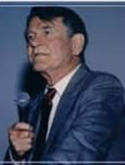


Jay Haley (1993-2007)
“The influence of hypnosis upon all forms of therapy has not been fully appreciated. It can be argued that most therapeutic approaches have their origins in that art… Out of hypnotic training comes skill in observing people and the complex ways they communicate, skill in motivating people to follow directives, and skill in using one’s own words, intonations, and body movements to influence other people. Also out of hypnosis comes a conception of people as changeable, and appreciation of the malleability of space and time, and specific ideas about how to direct people to become more autonomous.” (Haley, 1973)
Haley, J. (1973). Uncommon therapy: The psychiatric techniques of Milton H. Erickson, M.D. New York: Norton.

Slide 33
Hypnosis in Psychotherapy

Slide 34
General Ways to Use Hypnosis
Symptom management strategies (e.g., enhancing sleep, reducing anxiety)
Skill-building/resource accessing (e.g., enhancing cognitive flexibility, building problem-solving skills)
De-framing and reframing (e.g., “It’s not you, it’s the way you go about it”
Association and dissociation (e.g., shifting focus away from feelings to action, shifting focus from past to future)

Slide 35
Multiple Functions of Hypnosis
To explore consciousness
To explore spirituality
To delineate individual differences
To help people change
To heal disease or mask pain
To promote creativity

Slide 36
Whenever you do hypnosis, there’s a reason or purpose—a goal. And there’s a structure to achieving that goal.

Slide 37
Indication – Contraindication
Indicated
  Somatic/physiological difficulties unresponsive to medical interventions
  Experiential difficulties
  Obsessive automatic thinking
  Affective difficulties
  Hallucinations/flash-backs
Contraindicated
  Actions
  Interactions
  Deliberate (non-automatic) thoughts

Slide 38
Indications – Contraindications
Involuntary (Automatic) | Voluntary (Can be performed deliberately)
Somatic problems | Behavioral
Anxiety | Interpersonal
Automatic memory | Deliberate thinking or planning
Obsessions | Compulsions
Hallucinations

Slide 39
Indications – Contraindications
Example: Smoking
Involuntary (Automatic) | Voluntary (Can be performed deliberately)
Urge to smoke | Act of smoking
Tension/Anxiety | Buying cigarettes
 | Time and place of smoking

Slide 40
Indications – Contraindications
Example: School Avoidance
Involuntary (Automatic) | Voluntary (Can be performed deliberately)
Fear | Yelling at mother
Tension/Anxiety | Not doing homework
Stomach ache | Refusing to get dressed

Slide 41
Indications – Contraindications
Example: Trauma
Involuntary (Automatic) | Voluntary (Can be performed deliberately)
Fear | Physically fighting others
Anxiety | Self-Mutilation
Flashbacks | Refusing to get dressed

Slide 42
Ericksonian Hypnosis

Slide 43
Milton H. Erickson, M.D.

Slide 44
Milton H. Erickson, M.D. (1901-1980)
Two bouts with polio, nearly died at 17
Used autohypnosis to regain use of muscles and movement
Experienced substantial pain throughout his life
Had dyslexia and color-blindness
Trained as a psychiatrist
Made many seminal contributions to psychiatry and psychology including a nonpathological approach, permissiveness, inclusion, and utilization

Slide 45
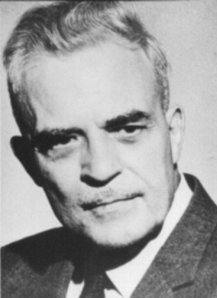
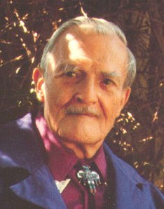
Perhaps Milton Erickson’s most significant contribution was in developing an interpersonal view of hypnosis.

Slide 46
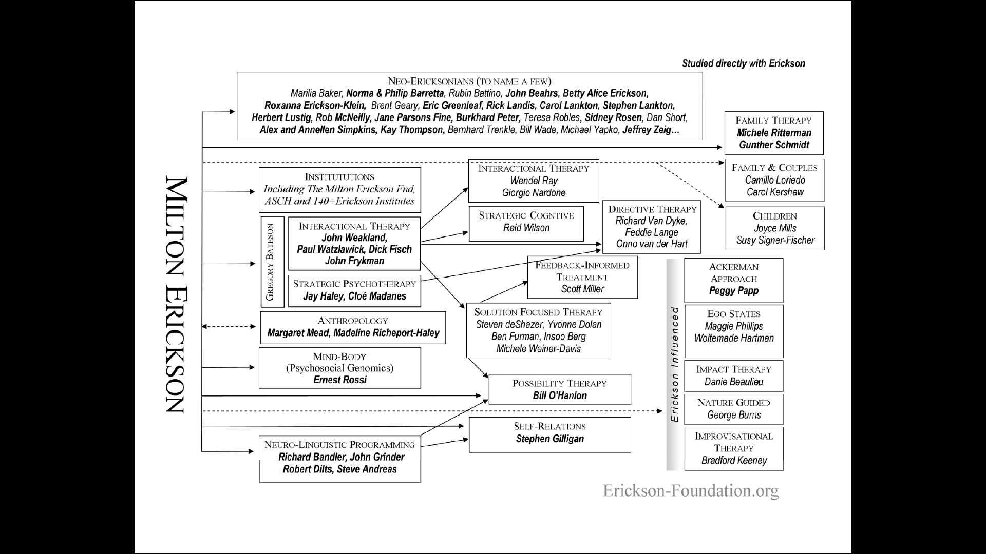

Slide 47
Traditional vs. Ericksonian
Traditional | Ericksonian
Find cause of problem | Discover/connect with resources
Discover original trauma or early decision | Present- and future-oriented
Assumption of pathology | Assumption of knowledge & ability

Slide 48
Language and Focus
Is permissive rather than authoritarian
  Offer choices rather than direction
  Use permission not prediction
  Create possibilities rather than mind-reading
Is internally rather than externally-driven
  Answers evoked from within rather than ideas and solutions given from outside
  Not based on "positive thinking" or affirmations

Slide 49
Authoritative vs. Permissive
Authoritative
Are:
  You are feeling more and more relaxed
  Your eyes are getting heavy
  You are enjoying more and more being a non-smoker
Will/won't:
  You will go deeply into a trance
  You won't hear anything around you
Can't:
  You can't open your eyes
  Your hand is stuck to your face
Permissive
Can:
  You can feel more and more relaxed
  Your eyes can begin getting heavy
  You can enjoying more and more being a non-smoker
Might/may be/could:
  You may go deeply into a trance
  You could hear anything around you
Multiple choice:
  You may not be able open your eyes or they may open automatically

Slide 50
Indicators, Suggestion, & Hypnotic Phenomena

Slide 51
Symptomatic and Healing Trances
Symptomatic Trance
Invalidation; blame; violating boundaries
Mystification; binds; double binds
Coalitions; secrets; negative dissociation
Predictions of failure or trouble; threats
Rigid role assignment; mind reading
Repetition of negative experiences/injurious/self-injurious behavior
Negative injunctions (You can’t, you shouldn’t you will, you are)
Repression; amnesia
Healing Trance
Validation; permission; respecting boundaries
Possibility words and phrases
Helpful distinctions
Post-hypnotic suggestions; presuppositions of health/healing
Positive attributions; avoidance of intrusive interpretations
Opening possibilities for changes in experience or behavior
Empowering/permissive affirmations (you can, it’s okay, you may, you could, you have the ability to)
Flexible remembering and forgetting

Slide 52
Common Trance Indicators
Flattening of facial muscles
Change in skin color
Immobility
Decrease in orienting movements
Catalepsy in a limb
Changes in blinking and swallowing
Altered breathing and pulse
Automatic motor behavior (jerkiness)
Faraway look
Fixed gaze
Changed voice quality
Time lag in response
Perseveration of response
Literalism
Dissociation
Relaxed muscles

Slide 53
Forms of Suggestion
Positive suggestions
Negative suggestions
Direct suggestions
Indirect suggestions
Process suggestions
Content suggestions
Post-hypnotic suggestions

Slide 54
Hypnotic Phenomena
Modality | + | -
External Sensory Perception | Positive Hallucination | Negative Hallucination
Internal Sensations | New or altered sensations | Analgesia or anesthesia
Orientation in Space | Reorientation | Disorientation
Memory | Hypermnesia; Creation of new memories | Amnesia; forgetting
Orientation in Time | Age progression (future) | Age regression (past)
Time Flow | Time expansion | Time contraction
Muscle Movements | Automatic movement; ideomotor; automatic handwriting | Catalepsy
Heart Rate/Blood Flow | Increased | Decreased
Temperature | Warmth/heat | Cold/cooling
Association | New Associations | Dissociation
Affect | New feeling; recovery of old feeling | Losing old feelings

Slide 55
Structure

Slide 56
A General Structure for a Hypnosis Session
Assess the complaint and identify a goal; determine if the complaint (or some aspect of it) is an automatic process
Orient the client to hypnosis
Induction
Build a response set
Introduce themes
Introduce metaphors on theme, moving from less to more direct, evoke resources, use splitting, linking, perceptual changes, etc.
Interaction regarding derived meanings
Post-hypnotic suggestions
Closure
Permissive disengagement
Debrief with client

Slide 57
Elements of Induction

Slide 58
What You Focus on, You Amplify in Your Awareness
The salient questions are, “What do we want the client to focus on, and why?”

Slide 59
Four Doorways into Altered States
Rhythm
  Rocking
  Breathing
Defocusing attention
  Daydreaming
  Defocusing eyes
Focusing attention
  Focusing eyes on one spot
  Directing attention
Dissociation
  Splitting between conscious/unconscious; mind/body; past/present/future/parts of body, etc.

Slide 60
Examples of Induction
Milton Erickson

Slide 61
Examples of Induction
Steve Gilligan

Slide 62
Induction Techniques by Age
Ages 4-6
Ages 7-11
Ages 12-18
Blowing breath out
Favorite place
Flower garden
Storytelling
Coin watching
Letter watching
Pop-up books
Television fantasy
Video
Bouncing ball
Finger lowering
Playground activity
Favorite place
Favorite activity
Cloud gazing
Flying blanket
Videogames
Riding a bike
Arm lowering
Blowing breath out
Favorite music
Listening to self on tape
Coin watching
Fixation at point on hand
Hands (or fingers) moving together
Arm rigidity
Favorite place/activity
Sports activity
Arm catalepsy
Following breathing
Videogames
Computer games
Eye fixation on hand
Driving a car
Playing or listening to music
Hand levitation
Hands (or fingers) moving together
Fantasy games

Slide 63
Elements of Induction
Permission/Validation/Observation/Utilization
Matching
Presupposition
Description
Permissive and empowering words
Splitting
Linking
Interspersal

Slide 64
Permission
Invite, include, and validate multiple possibilities for response
  It's okay to and you don't have to
  You could (or not)
  That's right
  Include the person's response or experience, including "resistance" or doubts

Slide 65
Matching
Tune in to the person
Match the person's breathing rhythm with your speaking and any other part of your behavior
Match the person's language style and words
Mirror and cross-mirror the person's body behavior

Slide 66
1a: Permission & Matching
Ask the person what their concerns or doubts are about going into trance, if any.
Speak only when the person exhales (This means you have to take a few moments and watch them before you speak).
Include permission for previously voiced doubts and and take the pressure off by giving lots of validation for whatever the person is doing or what you imagine they may be feeling/ or experiencing.

Slide 67
Presupposition
Presuppose trance and responses
  Speak and act as if trance will occur and the person will experience results
  Use presuppositional forms
    How quickly? Rate
    Before/during/after
    I wonder if you have noticed?; Awareness
  Use contextual cues in the environment and in your behavior

Slide 68
1b: Permission, Matching, & Presupposition
Speak only when the person exhales
Use permission and inclusion again
Presuppose going into trance

Slide 69
Description
Speak about only what you can observe about the person and his or her behavior
Beware of assuming internal experience from external signs
Mention things that are changing if appropriate and facilitative of trance or validation
This requires close observation

Slide 70
Permissive Language
Possibility Words
Outline Words
Politician Words: unspecified as to person, place, time, thing, or action
Directing attention and guiding associations

Slide 71
Splitting
Distinguish between two states by separating them non-verbally and verbally
Use different voice tones, voice locations, volumes
Make verbal distinctions (like "unconscious" and "conscious"; the front of your mind/the back of your mind; mind/body)

Slide 72
Splitting (cont.)
Conscious
  Lean and speak on the right side
  Increase voice volume, speak more quickly
  Attribute doubt, resistance and observation
Unconscious
  Lean and speak on the left side
  Decrease voice volume, speak more slowly
  Attribute cooperation, automatic experience and absorption

Slide 73
1c: Permission, Matching, & Splitting
Speak only when the person exhales
Use permission and inclusion again
Use presupposition
Suggest automatic responses
Use splitting, linking, or interspersal

Slide 74
Linking
Join together two previously separate things non-verbally and verbally
Use connectors (the more this, the less this; the more this, the more this; and so on)
Bridge from one thing to others ("as you listen to the sound of my voice, you can begin to notice some change, which can lead to deeper trance")

Slide 75
1d: Permission, Matching, & Linking
Speak only when the person exhales
Use permission and inclusion again
Use linking to connect different feelings, experiences, thoughts, ideas, and behaviors (observed)

Slide 76
Interspersal
I AM GOING to a place where there are no bad MAD people.

Slide 77
1e: Permission, Matching, & Interspersal
Speak only when the person exhales
Use permission and inclusion again
Use interspersal (nonverbal emphasis) to mark out certain messages
Notes:
To demonstrate how this ambivalence can play out in our interactions with others we are going to do an exercise.
[Exercise: Instruct participants to:
Find a partner.
Each of you write down something you are interested in doing but have mixed feelings about (e.g., buying a new car, quitting smoking, exercising, etc.).
Select who will speak first.
The speaker presents what it is that you would like to do (but haven’t done yet).
The listener then argues strongly in favor of one of the options or sides.
Speaker, your job is to listen and note what you are thinking and feeling.
Switch roles.]

Slide 78
Problems to Solutions:
A Framework

Slide 79
Problems to Solutions
Turn problem into processes
Focus/presenting problem
How does the person do the problem?
What type of solution is the client seeking?
What is the opposite class of experience (ability) that would solve this type of problem?

Slide 80
Problems to Solutions
Specific ------------------------> Specific Intervention ---------------------> Transfer to
Presenting Analogy Problem
Problem Anecdote Context
Trance phenomenon
Task
Interpersonal move
(DERIVE) (EVOKE)
Problem --------------------------------------------------------------------------------------------> Solution
(Pattern of experience/ resource/skill)

Slide 81
Erickson Case Example #1
Specific ------------------------> Specific Intervention ---------------------> Transfer to
Bedwetting Handwriting Practice Bedwetting
Problem
(DERIVE) (EVOKE)
Lack of Muscle Control -----------------------------------------------------------------------> Automatic Muscle Control

Slide 82
Erickson Case Example #2
Specific ------------------------> Specific Intervention ---------------------> Transfer to
Bedwetting Baseball Bedwetting
Problem
(DERIVE) (EVOKE)
Lack of Muscle Control -----------------------------------------------------------------------> Automatic Muscle Control

Slide 83
Erickson Case Example #3
Specific ------------------------> Specific Intervention ---------------------> Transfer to
Bedwetting Surprising to Bedwetting
Evoke Muscle Problem
Freezing
(DERIVE) (EVOKE)
Lack of Muscle Control -----------------------------------------------------------------------> Automatic Muscle Control

Slide 84
Erickson Case Example #4
Specific ------------------------> Specific Intervention ---------------------> Transfer to
Bedwetting Jacks Bedwetting
Bicycle Riding Problem
(DERIVE) (EVOKE)
Lack of Muscle Control -----------------------------------------------------------------------> Automatic Muscle Control

Slide 85
Problems to Solutions: Intervention
Design an intervention
  Use an analogy
  Tell a story
  Agree on a task or action
  Evoke a hypnotic shift in automatic experience
  Evoke some experience interpersonally

