Slide 1
Youth In Need, Inc.
Feedback-Informed Treatment (FIT)
Refresher
Bob Bertolino, Ph.D.
Codirector Clinical Mental Health Counseling Program, Maryville University-St. Louis
Professor of Psychology, Maryville University-St. Louis
Sr. Clinical Advisor, Youth In Need, Inc.
Director of Ehtics, International Center for Clinical Excellence

Slide 2




Tidbits
For copyright reasons and confidentiality some of PowerPoint slides may be absent from your handouts.
To download a copy of this presentation, please go to: www.bobbertolino.com.
Please share the ideas from this presentation. You have permission to reproduce the handouts. I only ask that you maintain the integrity of the content.
Contact: bertolinob@cs.com; 314.852.7274
bobbertolino.com

Slide 3

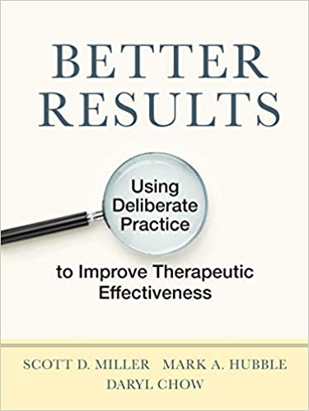

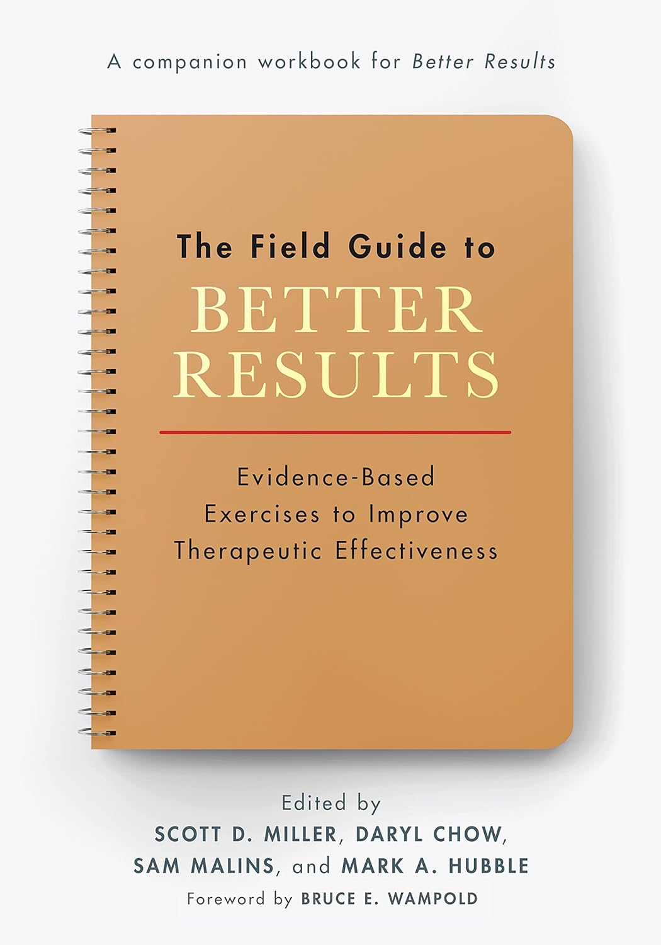

Slide 4




Slide 5
Terminology

Slide 6
Terminology
Evidence-Based Practice (EBP) vs. Empirically-Supported Treatments (EST)
1
Routine Outcome Management (ROM)
2
Feedback-Informed Treatment (FIT)
3

Slide 7
1
Evidence-Based Practice (EBP) vs. Empirically-Supported Treatments (EST)

Slide 8
Empirically-Supported Treatments (ESTs) vs. Evidence-Based Practice (EBP)
  ESTs: “Clearly specified psychological treatments shown to be efficacious in controlled research with a delineated population" (Chambless & Holon, 1998, p. 7).
  EBP is inclusive of meta-analyses, naturalistic, process-outcome, and correlational studies and delved into a broad array of factors such as the therapeutic relationship, client and therapist effects, and other elements thought to influence therapeutic outcomes.
  Professionals often cannot distinguish between the ESTs and EBP.
  In a survey of clinical psychology graduate students, the majority identified EBP as synonymous with empirically supported treatments (Luebbe, Radcliffe, Callands, Green, & Thorn, 2007).
  This confusion is easily corroborated through an internet search of the terms “empirical-supported treatments” and “evidence-based practice.” Many sites either inaccurately define the terms, describe them as the same, or use the terms interchangeably.
Chambless, D. L., & Hollon, S. D. (1998). Defining empirically supported therapies. Journal of Consulting and Clinical Psychology, 66, 7–18.
Luebbe, A. M., Radcliffe, A. M., Callands, T. A., Green, D., & Thorn, B. E. (2007). Evidence-based practice in psychology: Perceptions of graduate
students in scientist practitioner programs. Journal of Clinical Psychology, 63, 643–655.

Slide 9
EBP in Behavioral Health & Health
  APA: “The integration of the best available research with clinical expertise in the context of patient characteristics, culture, and preferences.” (1)
  SAMHSA: “EBPs integrate clinical expertise; expert opinion; external scientific evidence; and client, patient, and caregiver perspectives so that providers can offer high-quality services that reflect the interests, values, needs, and choices of the individuals served.” (3)
  IOM: “Evidence based medicine is the conscientious, explicit, and judicious use of current best evidence in making decisions about the care of individual patients. The practice of evidence based medicine means integrating individual clinical expertise with the best available external clinical evidence from systematic research.” (3)
(1) APA Presidential Task Force on Evidence-Based Practice. (2006). Evidence-based practice in psychology. American Psychologist, 61(4), 271–285.
(2) Sackett, D. L., Rosenberg, W. M. C., Muir Gray, J. A., Haynes, R. B., & Richardson, W. S. (1996). Evidence based medicine: What it is and what it
isn't: It's about integrating individual clinical expertise and the best external evidence. BMJ: British Medical Journal, 312(7023), 71-72.
(3) SAMHSA. (2016, January 6). Evidence-based practices web guide. https://www.samhsa.gov/ebp-web-Guide

Slide 10
Evidence-Based Practice (EBP)
“The integration of the best available research with clinical expertise in the context of patient characteristics, culture, and preferences.” (p. 273)
APA Presidential Task Force on Evidence-Based Practice. (2006). Evidence-based practice in psychology. American
Psychologist, 61(4), 271–285.

Slide 11
Evidence-Based Practice (EBP)
“The integration of the best available research with clinical expertise in the context of patient characteristics, culture, and preferences.” (p. 273)
APA Presidential Task Force on Evidence-Based Practice. (2006). Evidence-based practice in psychology. American
Psychologist, 61(4), 271–285.

Slide 12
Best Available Research
The Variance in Psychotherapy Outcome
Client/Extratherapeutic Factors = 80-87%
Treatment Effects = 13-20%
  Therapist Effects = 4-9%
  The Alliance = 5-8%
  Expectancy, Placebo, and Allegiance = 4%
  Model/Technique = 1%
Bertolino, B., Bargmann, S., & Miller, S. D. (2013). Manual 1: What works in therapy: A primer. The ICCE manuals of feedback informed
treatment. Chicago, IL: International Center for .Clinical Excellence.
Wampold, B. E., & Brown, G. S. (2005). Estimating variability in outcomes attributable to therapists: A naturalistic study of outcomes in
managed care. Journal of Consulting and Clinical Psychology, 73(5), 914-923.

Slide 13
Evidence-Based Practice (EBP)
“The integration of the best available research with clinical expertise in the context of patient characteristics, culture, and preferences.” (p. 273)
APA Presidential Task Force on Evidence-Based Practice. (2006). Evidence-based practice in psychology. American
Psychologist, 61(4), 271–285.

Slide 14
Clinical Expertise
The APA Task Force on EBP
“Clinical expertise… entails the monitoring of patient progress (and of changes in the patient’s circumstances—e.g., job loss, major illness) that may suggest the need to adjust treatment… If progress is not proceeding adequately, the psychologist alters or addresses problematic aspects of the treatment (e.g., problems in the therapeutic relationship or in the implementation of the goals of the treatment) as appropriate” (2006, pp. 280, 276-277).
APA Presidential Task Force on Evidence-Based Practice. (2006). Evidence-based practice in psychology. American Psychologist,
61(4), 271–285.
Lambert, M. J., Bergin, A. E., & Garfield, S. L. (2004). Introduction and overview. In M. J. Lambert (Ed.), Bergin & Garfield’s
handbook of psychotherapy & behavior change (5th
ed.)(pp. 3-15). New York: Wiley.
Warren, J. S., Nelson, P. L., Mondragon, S. A., Baldwin, S. A., & Burlingame, G. A. (2010). Youth psychotherapy change trajectories
and outcomes in usual care: Community mental health versus managed care settings. Journal of Consulting and Clinical
Psychology, 78(2), 144-155.

Slide 15
Evidence-Based Practice (EBP)
“The integration of the best available research with clinical expertise in the context of patient characteristics, culture, and preferences.” (p. 273)
APA Presidential Task Force on Evidence-Based Practice. (2006). Evidence-based practice in psychology. American
Psychologist, 61(4), 271–285.

Slide 16
Patient (Client) Characteristics,
Culture, and Preferences
  Client characteristics (i.e., age, gender, gender identity, ethnicity, race, social class, disability status, sexual orientation, developmental status, life stage, etc.).
  Strengths, resources, beliefs, and factors that can influence change.
  Understanding of the local knowledge and culture.
  Personal preferences, values, and preferences related to treatment (e.g., goals, beliefs, worldviews, treatment expectations).

Slide 17
2
Routine Outcome Management (ROM)

Slide 18

Notes:
EBP is the language of the land. And

Slide 19
Why Measure Outcome? Why Does it Matter?
Accrediting bodies including The Joint Commission, Council on Accreditation (COA), and the Commission on Accreditation of Rehabilitation Facilities (CARF) have employed standards related to reliable and valid measurement of outcomes.
For example, The Joint Commission state: “Organizations will be required to assess outcomes through the use of a standardized tool or instrument. Results of these assessments would then be used to inform goal, and objectives identified in individual plans of care, treatment, or services as needed, and evaluate outcomes of care, treatment, or services provided to the population(s) served.”
Areas of emphasis include:
  The impact of services on clients
  The quality of service delivery

Slide 20
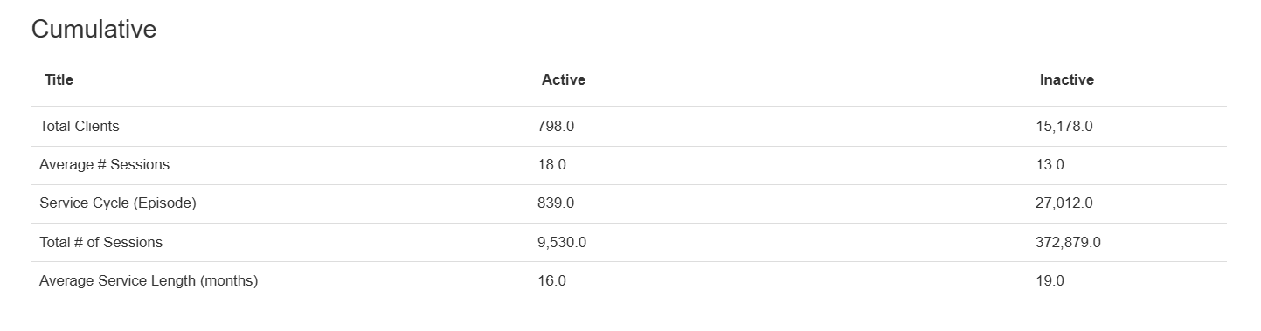
Cumulative YIN Data 2015-2025

Slide 21
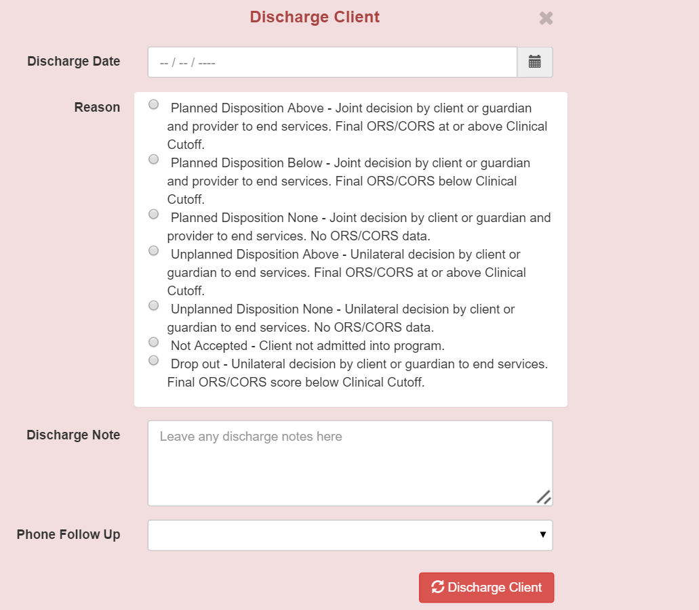

Slide 22
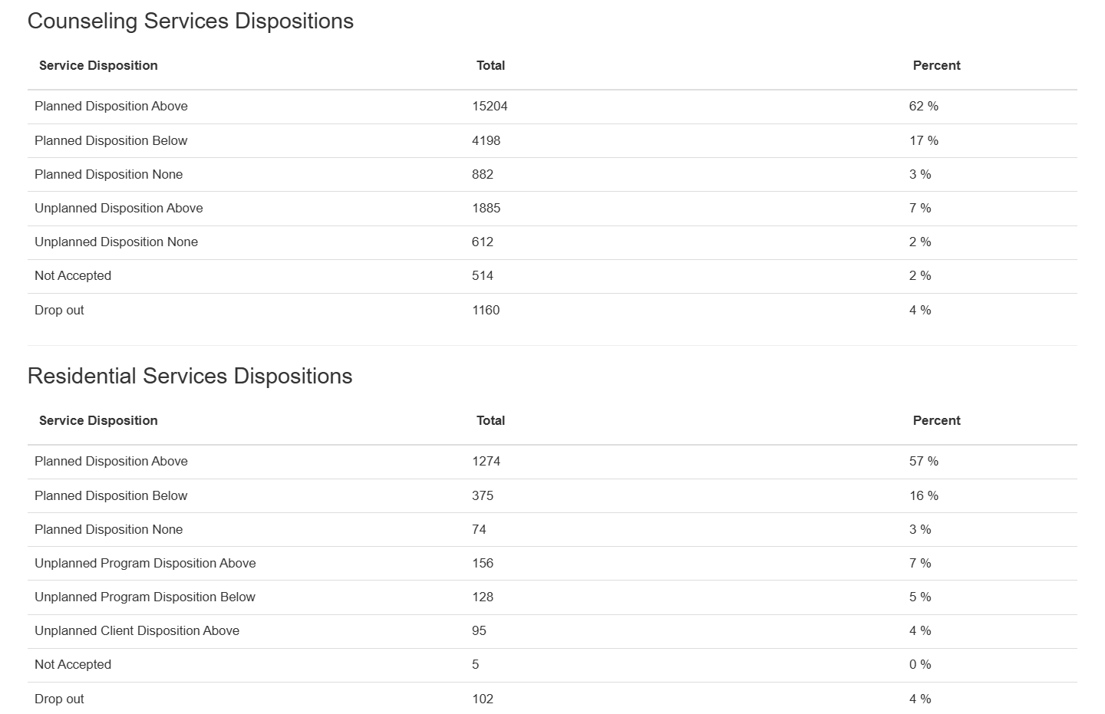
69%
68%

Slide 23
3
Feedback-Informed Treatment (FIT)

Slide 24
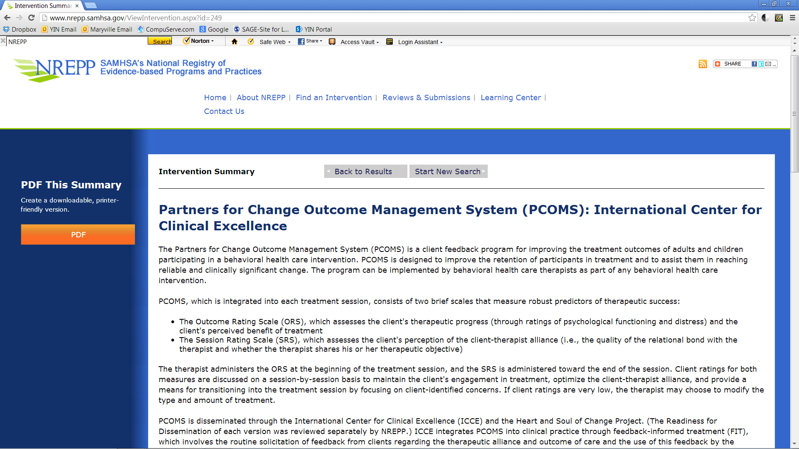

Slide 25
Introduction to Measures
  I/We are committed to helping you to have the best experience possible and achieve the results you want from our work together. To ensure these things I/we have a way of working that may be a little different than other practices/agencies. For example, I/we will check in with you periodically to get a sense of your experience. I/we might ask about what has been helpful, what has not, what is working, and what is not. This feedback will help me/us to make adjustments as we continue.
  Along with checking in with you, there are two brief questionnaires that can help me/us to learn from you how things are going and whether our work together is benefitting you. One is completed at the beginning of our meetings (or sessions or interactions) and the other at the end. The one at the beginning is called the ___________________ and will help me/us know whether or not and to what degree things are improving. If our work together is successful, you should see some indication of that sooner rather than later. In the event that things are not improving in a way that is acceptable to you then we will discuss options.
  The second questionnaire, ____________________, which is completed at the end of our meetings (or sessions or interactions), will let me/us know more about how the meeting (or session or interaction) went for you and what I/we can do differently in future sessions should you decide to continue services here. We will discuss the results of each questionnaire together. Is this okay with you?

Slide 26
Introduction to Measures (cont.)
  (Following consent)
  Thank you for your willingness to help me/us learn how I/we can best help you with your concerns. I/we would like to ask that you be as open and forthcoming as you are comfortable when I/we check in and when you complete the questionnaires. I/we also welcome any feedback you might have at any point during our work together. It is important that you achieve the results you hope for and if not, we will discuss options to provide further opportunities for you to experience the outcome you desire.

Slide 27
Introduction to the ORS: Example 1
  My first priority is to make sure that you get the results you want. For this reason, it is very important that you are involved in monitoring our progress throughout therapy. I do this by using a measure called the Outcome Rating Scale or ORS. I’ll ask you to complete the measure at the beginning of each session, and then we talk about the results. Research shows that if we are going to be successful in our work together, we should see signs of improvement earlier rather than later. If what we're doing works, then we'll continue. If not, then I'll try to change or modify the treatment. If things still don't improve, then I'll work with you to find someone or someplace else for you to get the help you want. Does this make sense to you?

Slide 28
Introduction to the ORS: Example 2
  This measure is the Outcome Rating Scale or ORS. As you can see the scale has four items: Individual, Interpersonal, Social, and Overall. These are the areas of your life that could show improvement if the work you and I do together is effective. I’d like you to score this form each time we meet, which will give me a sense of how things are progressing in your life. Today, when we are meeting for the first time, we need to get a “start score” that tells us how things have been in your life before you and I started meeting. I would like you to look back on the last week, including today, and rate how you have been feeling on each of the four items. Does that make sense to you?”

Slide 29
ORS – Individual
  + Self-esteem
  + Self-perception
  + Sense of Self
  + Internal Strengths
  + Healthy activities and behaviors
  + Coping Skills
  + Safety
  - Anxiety
  - Depression
  - Substance Abuse
  - Somatic problems (i.e., sleep, headaches, etc.)

Slide 30
ORS – Interpersonal
  + Close Relationships
  + Romantic Relationships
  + Family
  + Close Friends
  + Stable Living Environment
  + Conflict Resolution
  + Safety
  - Violence
  - Mystification
  - Disconnection

Slide 31
ORS – Social Role
  + Other Friends and Supports
  + Community Connections (to individuals, groups, and the
  community at-large)
  + Education (School, GED, Job Skills Programs)
  + Employment
  + Volunteering
  + Feeling Valued and Empowered as a Member of a Community
  (there can be more than one)
  + Safety
  - Feeling Isolated (disconnection)
  - Lack of Acceptance
  - Lack of Opportunity

Slide 32
Introduction to the SRS: Example 1
  I'd like to ask you to fill out one additional form. This is called the Session Rating Scale or SRS. This is a measure that you and I will use at the end of each session to adjust and improve the way we work together. Research shows that your experience of our work together is a good predictor of whether we'll be successful. I want to emphasize that I'm not aiming for a perfect score. Life isn't perfect, and neither am I. What I'm aiming for is feedback about even the smallest things—even if it seems unimportant—so that we can adjust our work and make sure we don't veer off course. Whatever your feedback might be, I promise I won't take it personally. I'm always learning and am curious about what I can learn from getting this feedback from you that will in time help me improve my skills. Does this make sense?

Slide 33
Introduction to the SRS: Example 2
  As we approach the end of our session, I’d like to ask that you complete one additional form. This is called the Session Rating Scale or SRS. It is a measure that you and I will use at the end of each session. Your feedback will help me to adjust and improve the way we work together. Research shows that your experience of our work together, including, did you feel understood, did we focus on what was important to you, did the approach I’m taking make sense and feel right—is a good predictor of whether we’ll be successful. I want to emphasize that I’m not aiming for a perfect score. What I’m asking for is your feedback—even if it seems small and unimportant—so we can make course corrections and ensure we don’t steer off course. Whatever your feedback, I promise I won’t take it personally. I am always learning, and I am curious about what I can learn from getting this feedback from you that will in time help me improve my skills. Does this make sense?

Slide 34
SRS Considerations
  Summarize the results of the SRS (CSRS or GSRS).
  Although the cutoff for the SRS is 36, respond to any cumulative score below 40.
  Pay specific attention to any subscale score of 8 or below.
  Invite conversation by ensuring the client that their feedback will not hurt your feelings or make you feel bad; rather, it is a way to learning how you can best your client’s needs and develop professionally.
  Discuss any aspects of the alliance that are not quite in line with the client’s views and offer options.

Slide 35
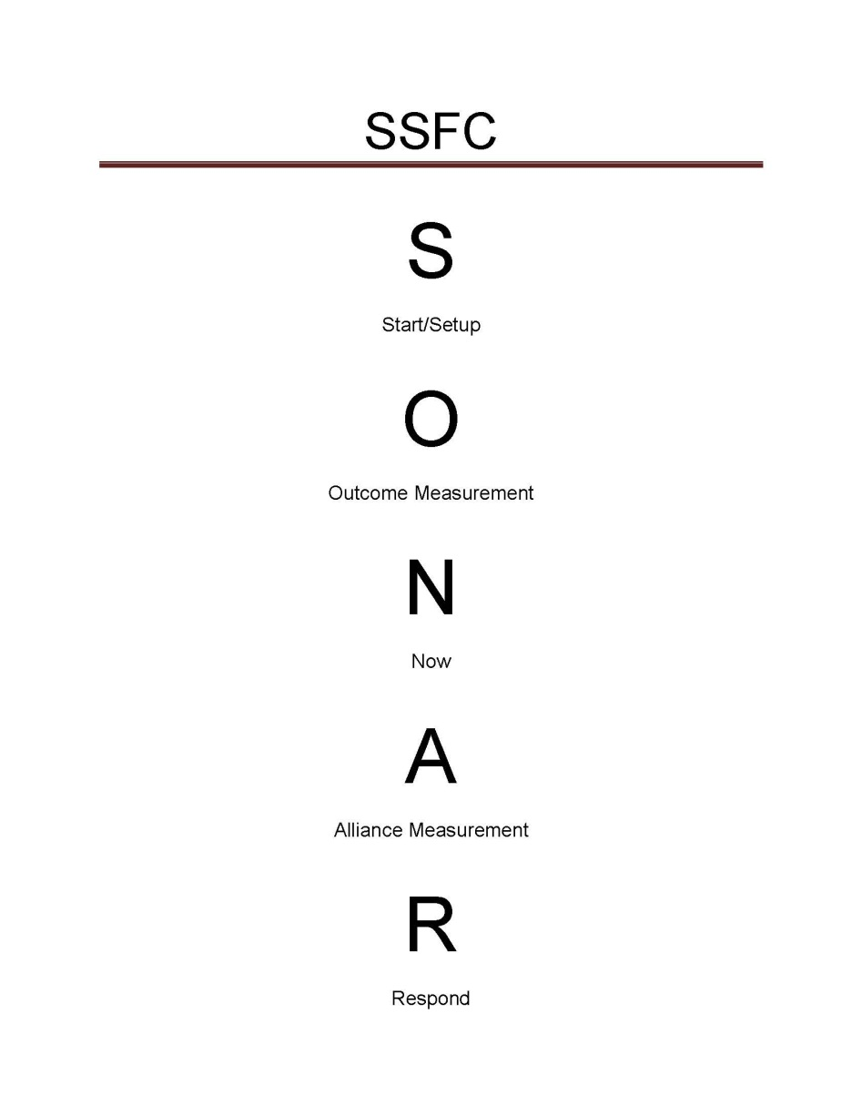
SONAR SFC
SSFC: Sonar Session Feedback Checklist
A guide for clinicians interested in eliciting feedback to measure the fit of their approach with clients and the effect of those efforts have on outcomes and the benefit of services.
The full SSFC with instructions is available for free at: https://www.bobbertolino.com/handouts

Slide 36
Improving Outcomes

Slide 37
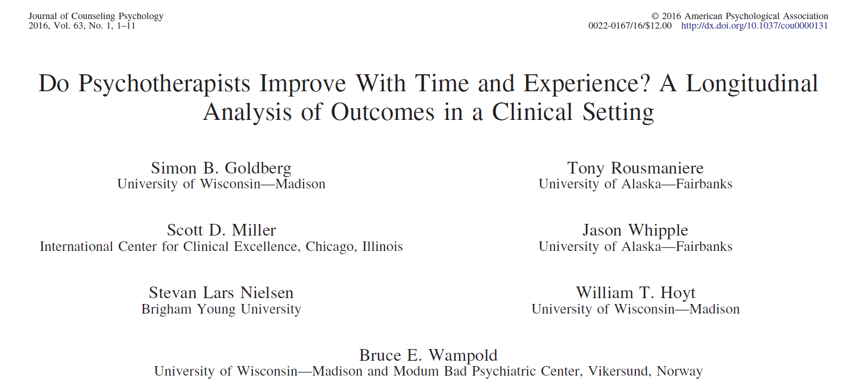
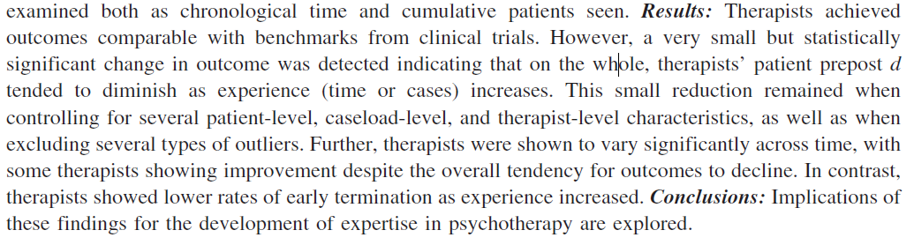
Therapist Improvement with Time and Experience
The largest study to date on the effect of experience on outcome.
170 therapists followed for 17 years.
Question: Do therapists improve over time in terms of effectiveness with more experience and training?
The answer: No.
On average therapists’ outcomes declined over time.

Slide 38
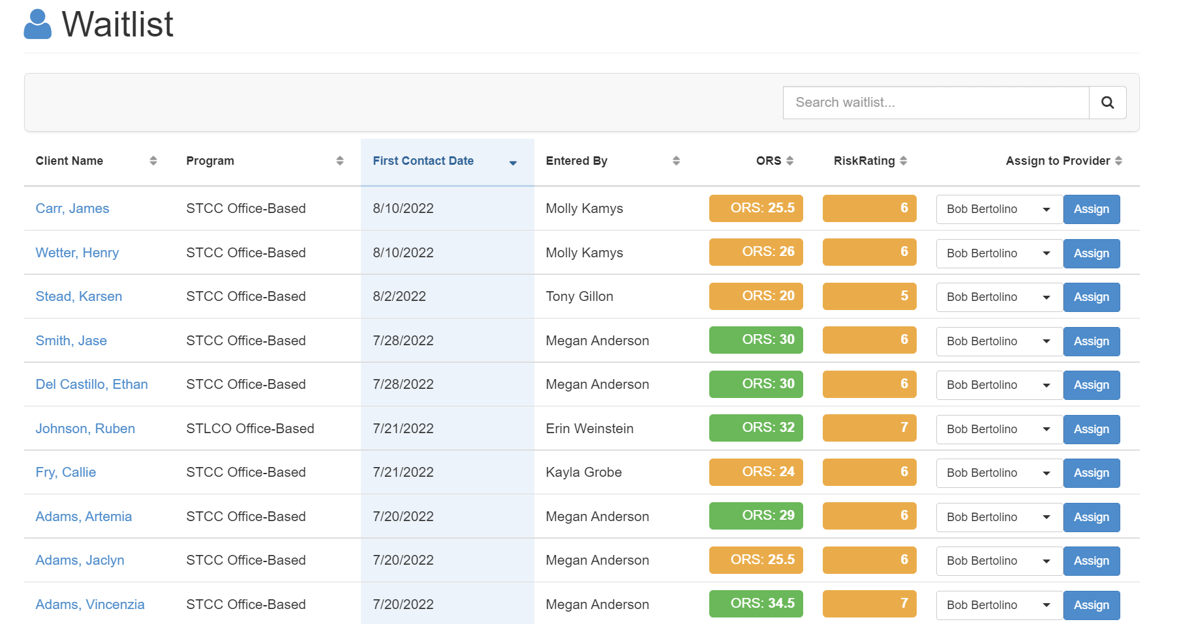

Slide 39
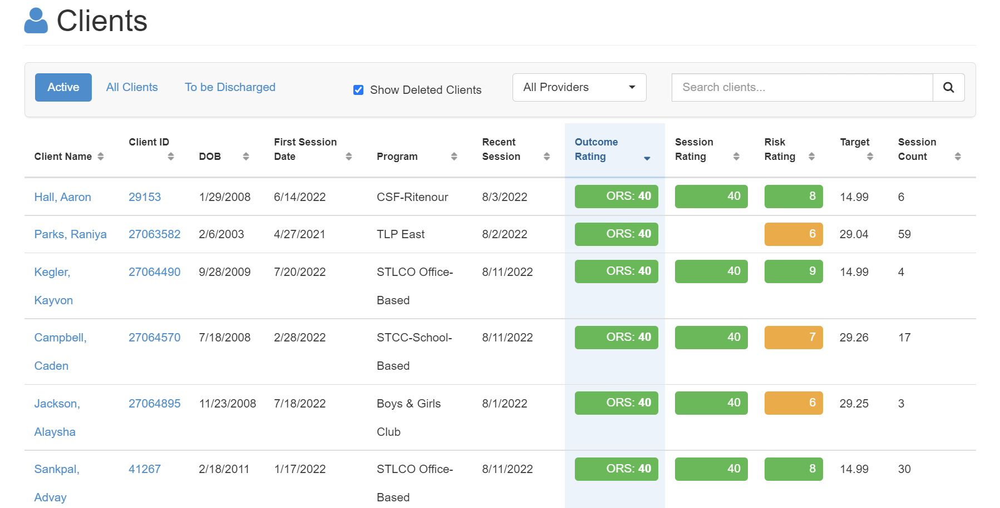

Slide 40
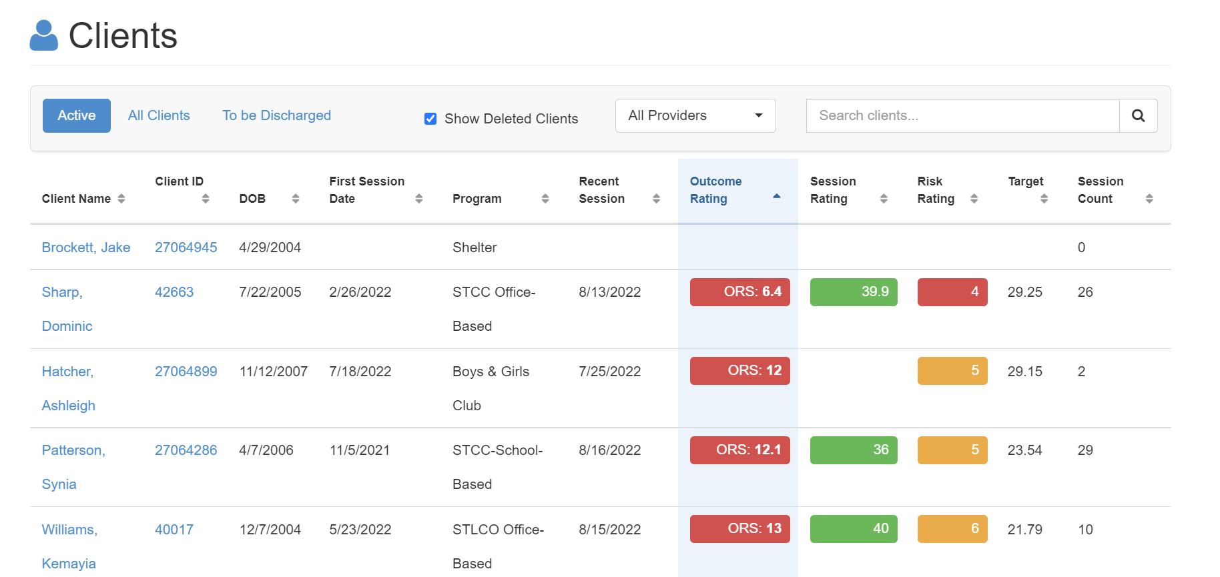

Slide 41
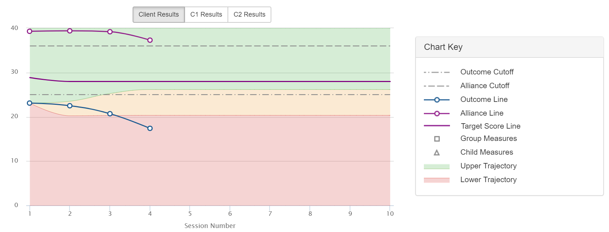
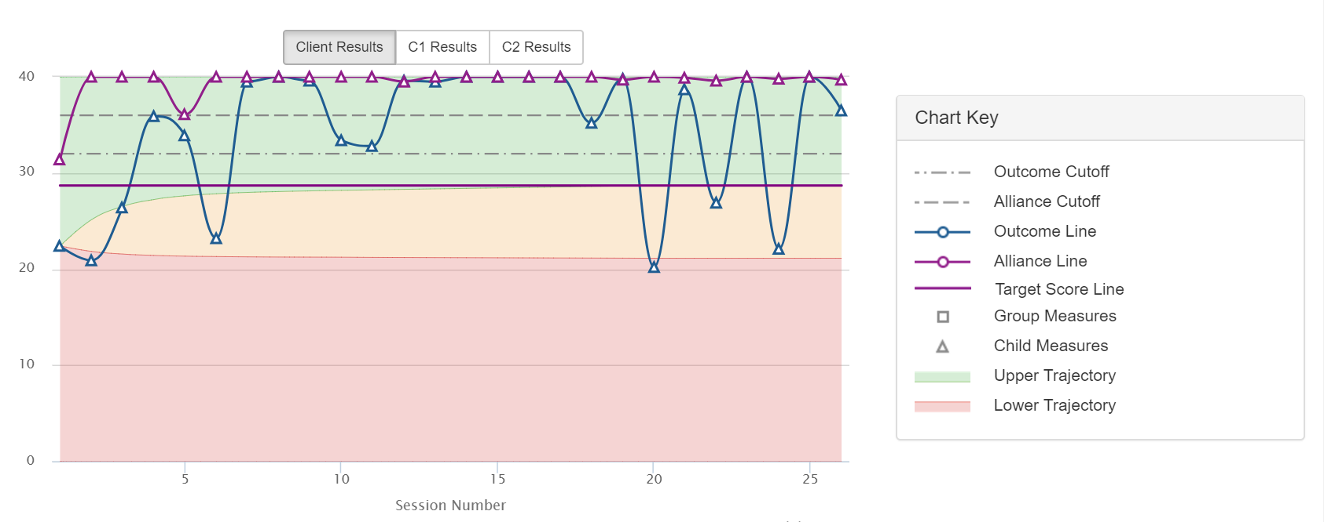
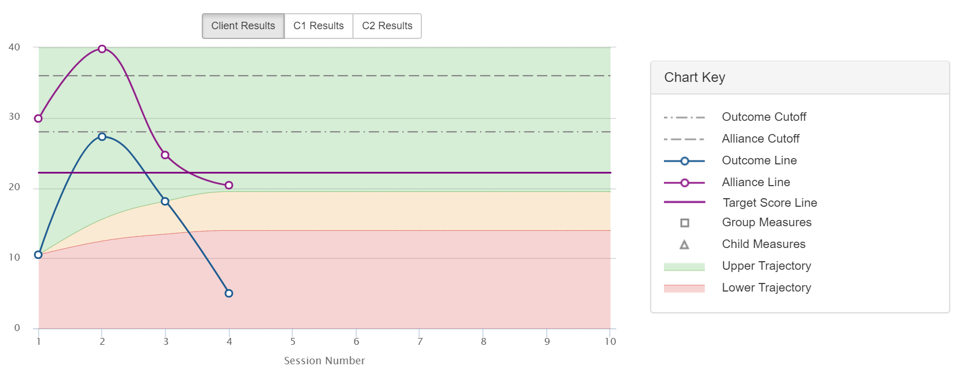
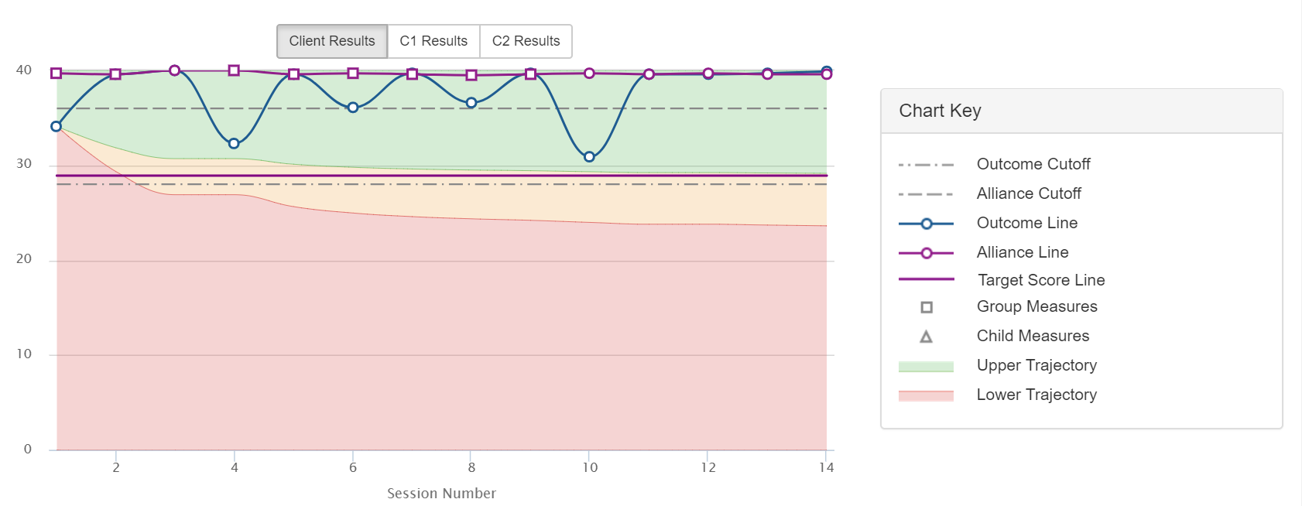
Bleeding
Seesawing/fluctuating
Dipping
Plateauing

Slide 42
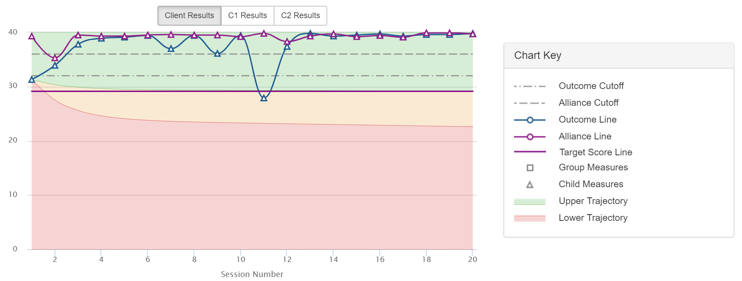
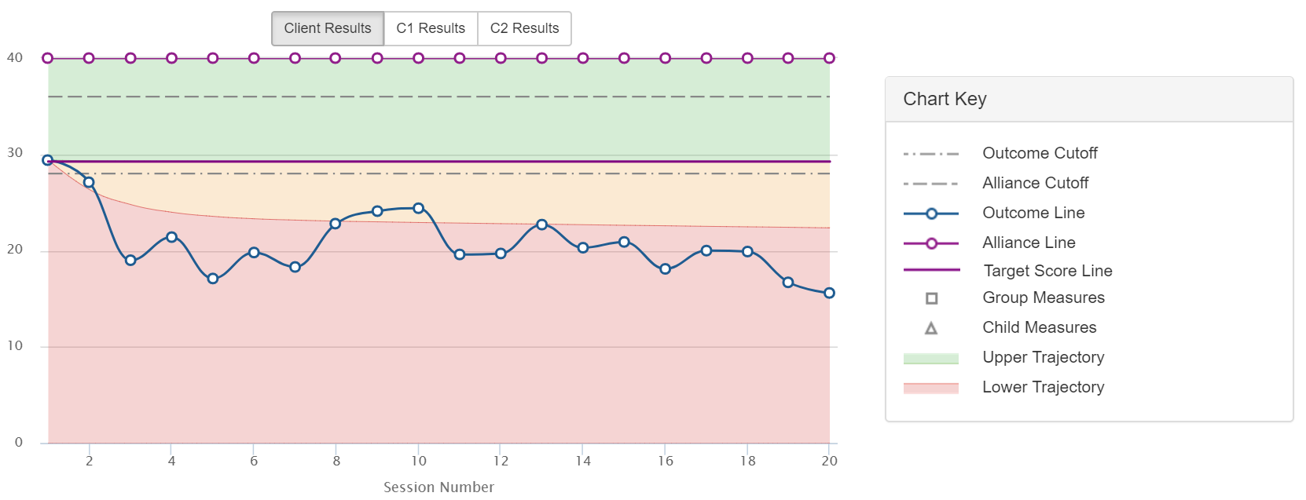
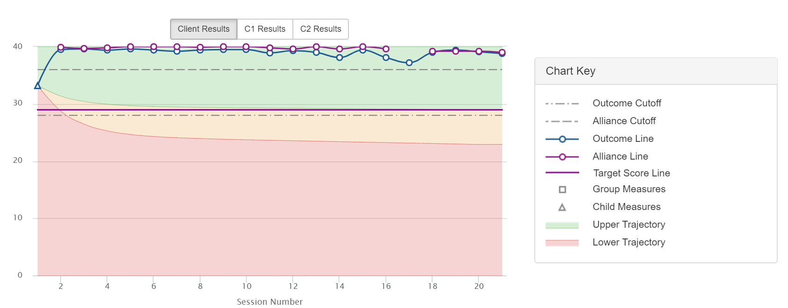
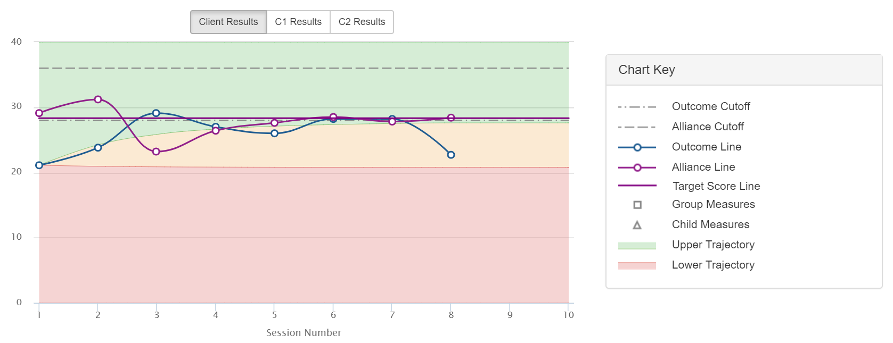

Slide 43
Selecting and Matching Interventions
Fit and Effect
Fit: The degree to which a way of working with a client matches his or her worldview, culture, and ideas about change.
  Consider assessment processes, diagnosis, the use of interventions, etc.
  Feedback that focuses on the alliance assists with increasing fit.
Effect: Did the intervention, at minimum, benefit the client, and at best contribute to a positive, measurable outcome?
  Feedback that focuses on the client’s subjective interpretation of the benefit of services assists with increasing effect.

Slide 44

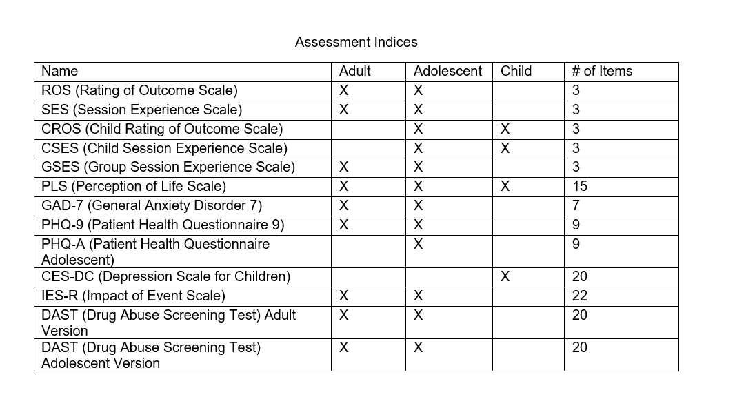

Slide 45
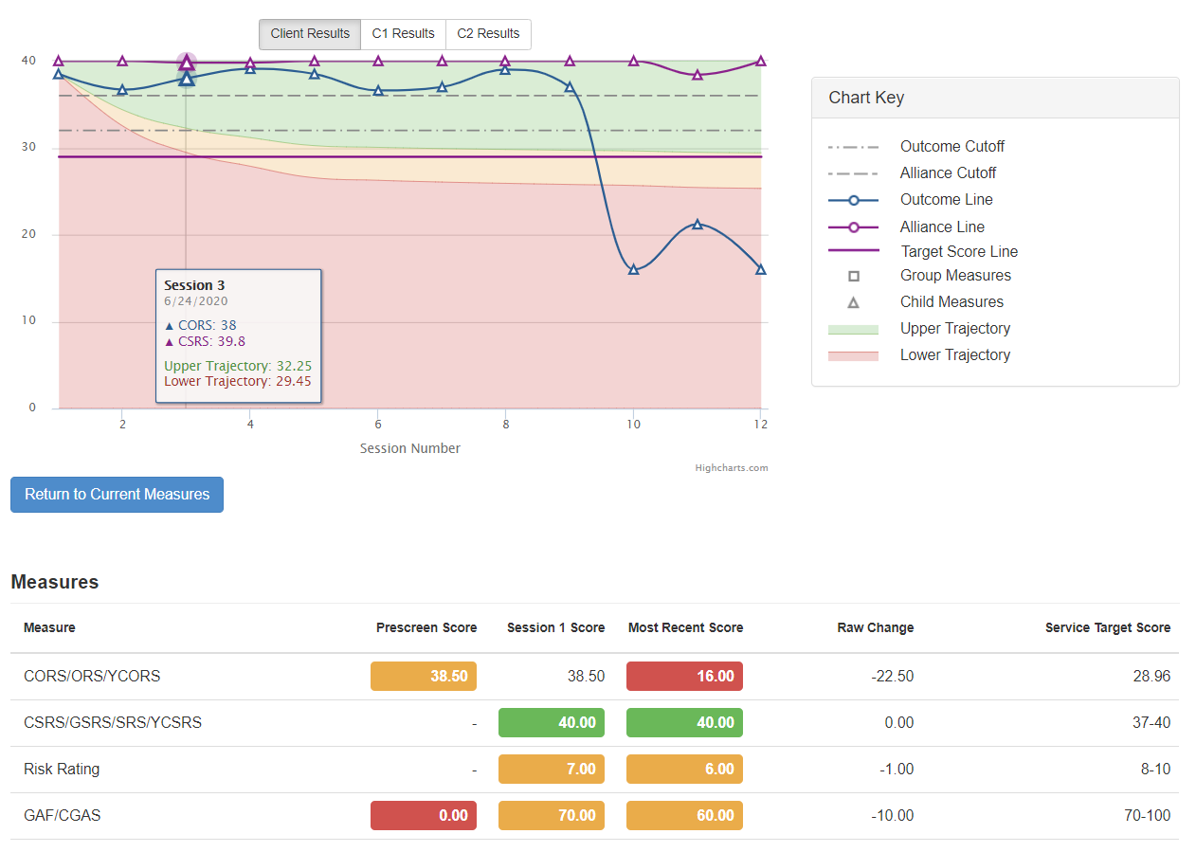

Slide 46
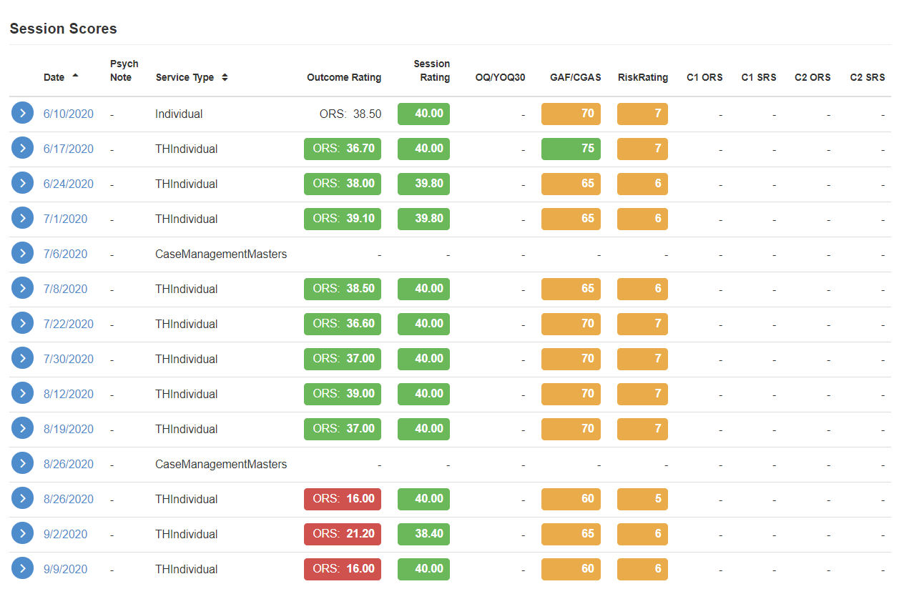

Slide 47
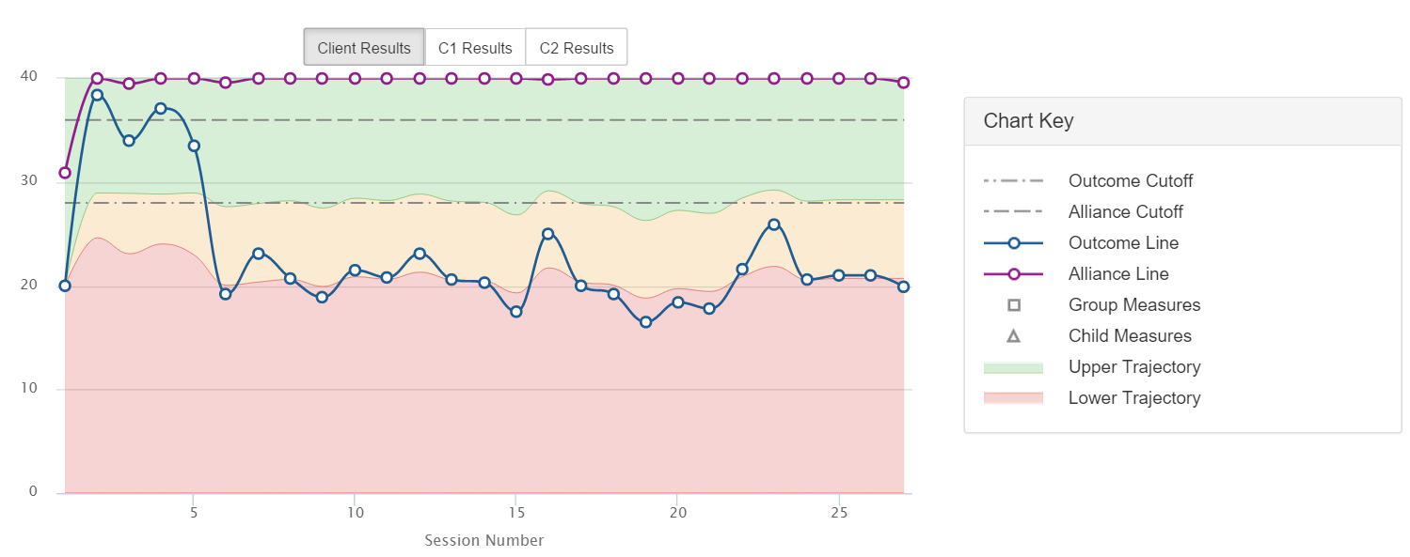
Imagine OMS – https://www.bobbertolino.com/imagine-oms

Slide 48
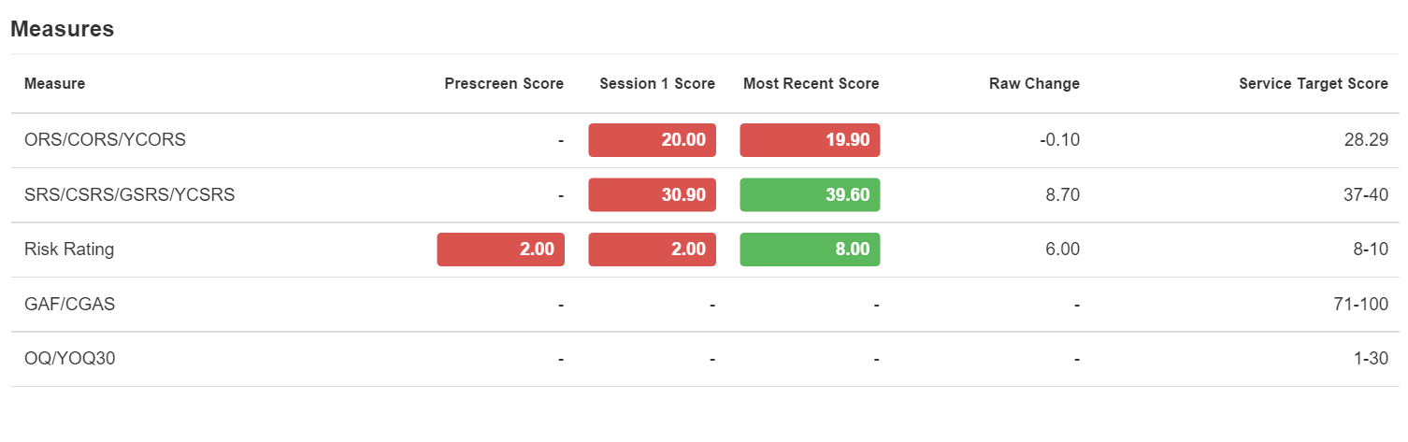
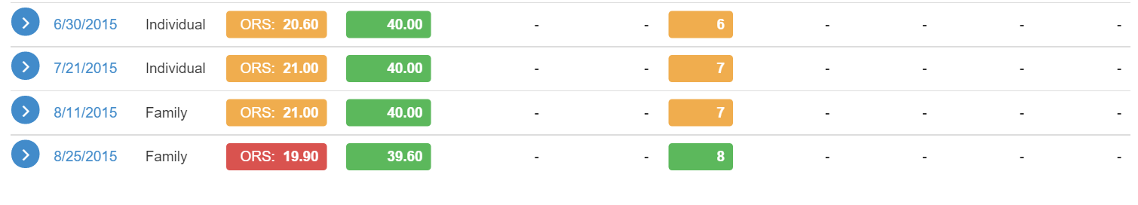
Imagine OMS – https://www.bobbertolino.com/imagine-oms

Slide 49
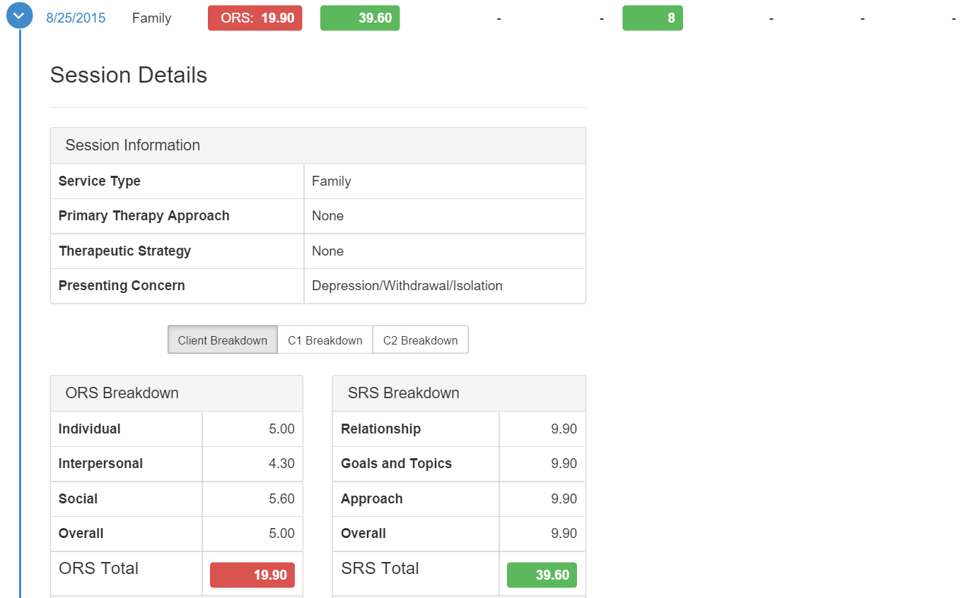
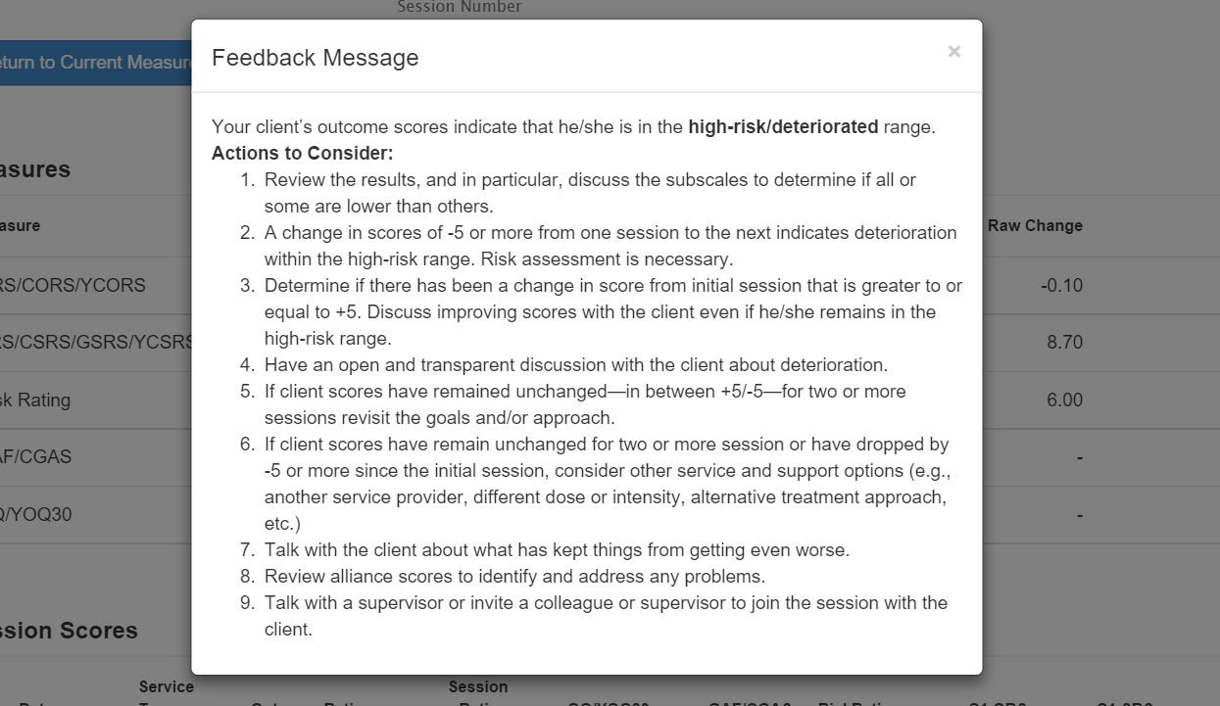
Imagine OMS – https://www.bobbertolino.com/imagine-oms

Slide 50
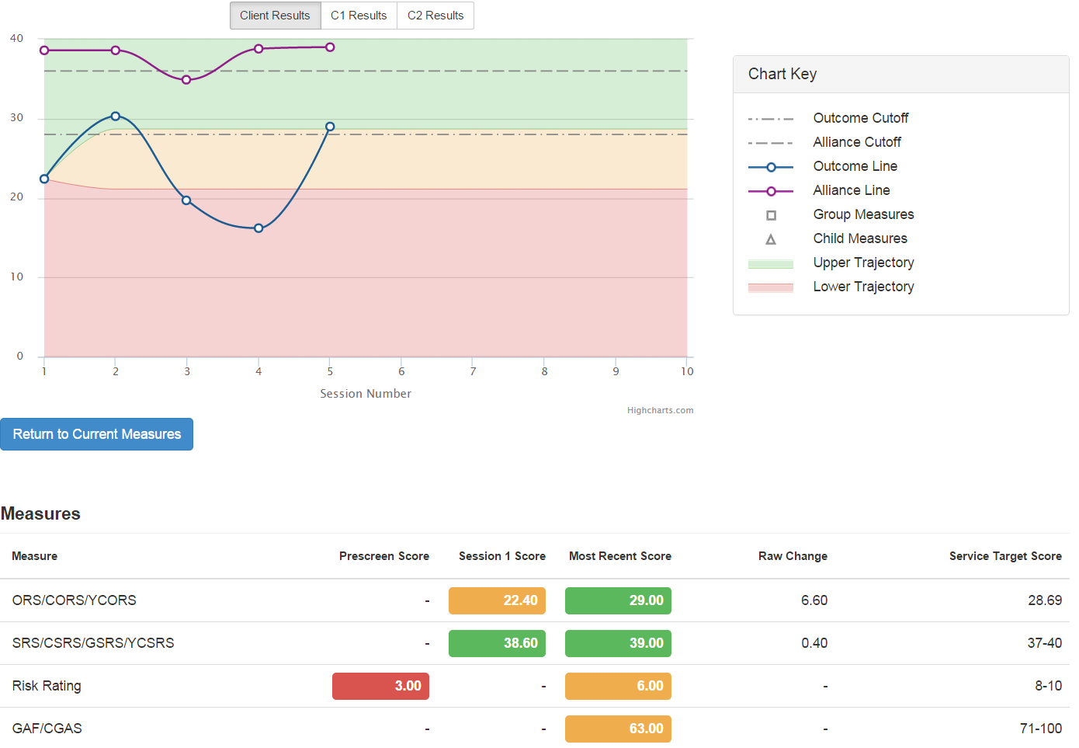
Imagine OMS – https://www.bobbertolino.com/imagine-oms

Slide 51
At-Risk Cases
Scores at or above the clinical cut-off.
Lack of progress on the ORS.
Fluctuating ORS scores (see-saw, bleeding, ditching).
Problematic alliance scores.

Slide 52
Outcomes Indicators
What statistics are most meaningful in terms of outcomes?
  Clinical Cutoffs
  Reliable Change Index
  Clinical Significance
  Effect Sizes
  Service Targets/Predictive Trajectories

Slide 53
Clinical Cutoffs
Clinical cutoff (CC) for an outcome measure: (1) Defines the boundary between a normal and clinical range of distress; and (2) Provides a reference point for evaluating the severity of distress for a particular client or client sample.
  CCs for ORS/CORS measure: 25 (>19); 28 (13-19); 32 (≤12)
  Note: 25-33% of people presenting for treatment score above the CC at intake

Slide 54
Reliable Change Index
Reliable Change Index (RCI): A measure used to assess the magnitude of change necessary to be considered statistically reliable and not due to chance, maturation (the passage of time), or measurement (statistical) error. It is an average based on the reliability or consistency of an instrument.
  The RCI for the ORS is 5-point increase between two scores

Slide 55
Clinical Significance
Clinical significance (CS) or clinically significant change, refers to reliable improvement (i.e., 5 points or more on the ORS) that is beyond a trivial amount of “day-to-day” fluctuation and also corresponds to a change in clinical status—movement from a clinical (i.e., distressed) range to a nonclinical (non-distressed, functional) range.

Slide 56
Target Scores & Predictive Trajectories
Target Scores are the best way of determining the actual benefit of services.
Service Targets/Predictive Trajectories
  Require comparative samples and are most often produced by computerized statistical packages
  The service target is the highest score of the expected treatment response (ETR) based on the intake score;
  The % reaching targets will typically be lower for active clients than inactive clients because active clients have not completed service;
  Normally will be between 64-74% for inactive clients;
  If higher than 74% then data can be suspect.

Slide 57
Achieving Better Outcomes
Remain aware of three inherent risks: Failure to identify client deterioration, overprediction of client improvement, and therapist self-assessment bias.
Begin using Routine Outcome Management (ROM).
Discuss choices of models/approaches and offer further training.
Discuss the use of additional measurement when clients are not progressing or deteriorating.
Begin by scheduling time every day, if possible, but no less than 3x per week, to practice new skills.

Slide 58
Achieving Better Outcomes
Use deliberate practice—individualized training activities designed to improve specific aspects of performance through repetitive and successive refinement.
Examples of DP activities: Reviewing video recorded sessions, simulation-based learning, behavioral rehearsal, provider-client engagement role plays, and reading case studies.

Slide 59
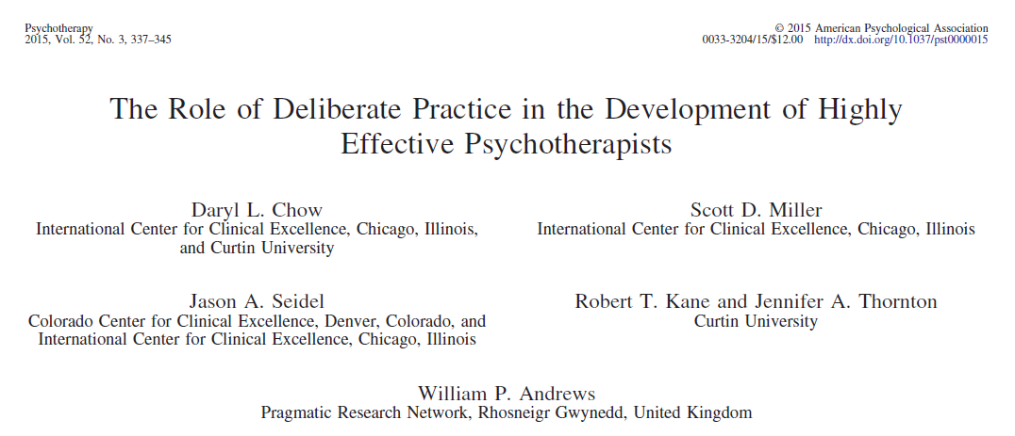
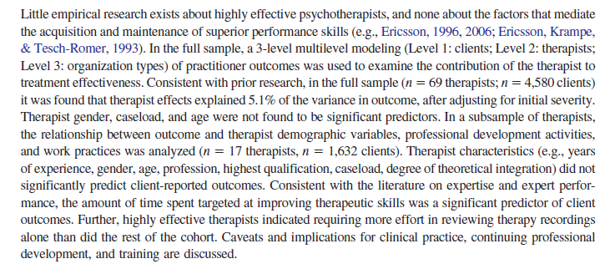
How Do Therapists Achieve Better Outcomes?
The findings from Chow and colleagues’ study showed a correlation between the time therapists spent on activities intended to improve their ability and their outcomes.
The top performers spent 2.5 to 4.5 more hours reflecting on actions, consulting about cases, reading, attending professional development activities, planning, and engaging in other learning activities than average therapists.
Researchers also estimated that that “the accumulative time spent by the top quartile (most effective therapists) was, on average, about 2.8 times more hours per week engaged in DP activities aimed at improving effectiveness than the rest of the other therapists” (p. 341).

Slide 60
Deliberate Practice
Zone of “Proximal Development”:
Reliable performance inconsistent
Identification of errors, misperceptions
Setting small process and outcome objectives
Involves planning, rehearsal, reflection
Edge of Ability
Too Easy
Too Difficult
Realm of “Reliable” Performance:
Processes executed quickly, automatically
Involves recognition, retrieval, execution
Ambit of Admiration:
Abilities of others appear flawless, magical, dramatic
Effort and attention focused on easily recognized, but non-causal factors and/or processes (superstition)
Risk of failure and injury high

Slide 61
Panic
Zone
Learning Zone
Comfort Zone

Slide 62
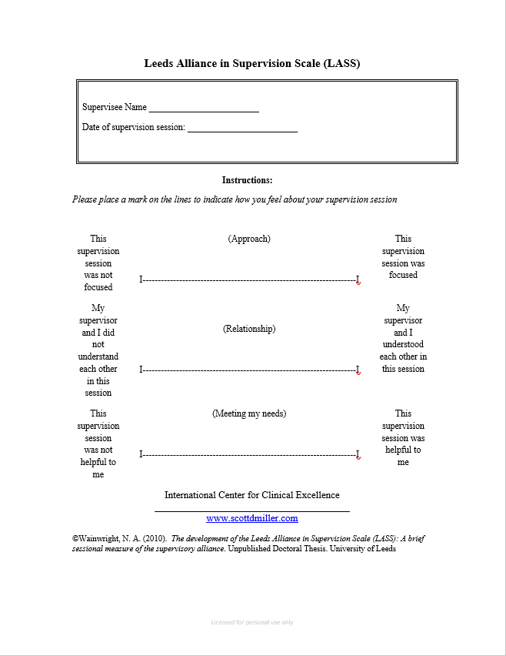

Slide 63
How Do We Improve? (Revisited)
Choose a skill to improve on.
Practice it routinely.
Use feedback.
Get coaching.
  Be clear about what you want help with;
  Someone who gives short, clear directions;
  Someone who loves teaching fundamentals;
  Willing to analyze your game;
  More corrective than critical;
  Process versus technique/tricks;
  An authority, not authoritarian;
  Able to distinguish when any challenges encountered are a result of you and your growth edge, or the coaching;
  How to become a better version of you, not a version of the coach.
  Help you stay at your growth edge.

