Slide 1
Youth In Need, Inc.
Positive Psychology
Strategies to Strengthen Well-Being
Bob Bertolino, Ph.D.
Professor, Maryville University-St. Louis
Sr. Clinical Advisor, Youth In Need, Inc.
Sr. Associate, International Center for Clinical Excellence

Slide 2




Tidbits
For copyright reasons and confidentiality some of PowerPoint slides may be absent from your handouts.
To download a PDF of this presentation, please go to: www.bobbertolino.com.
Please share the ideas from this presentation. You have permission to reproduce the handouts. I only ask that you maintain the integrity of the content.
Contact: rbertolino@maryville.edu; 314.529.9659
bobbertolino.com

Slide 3
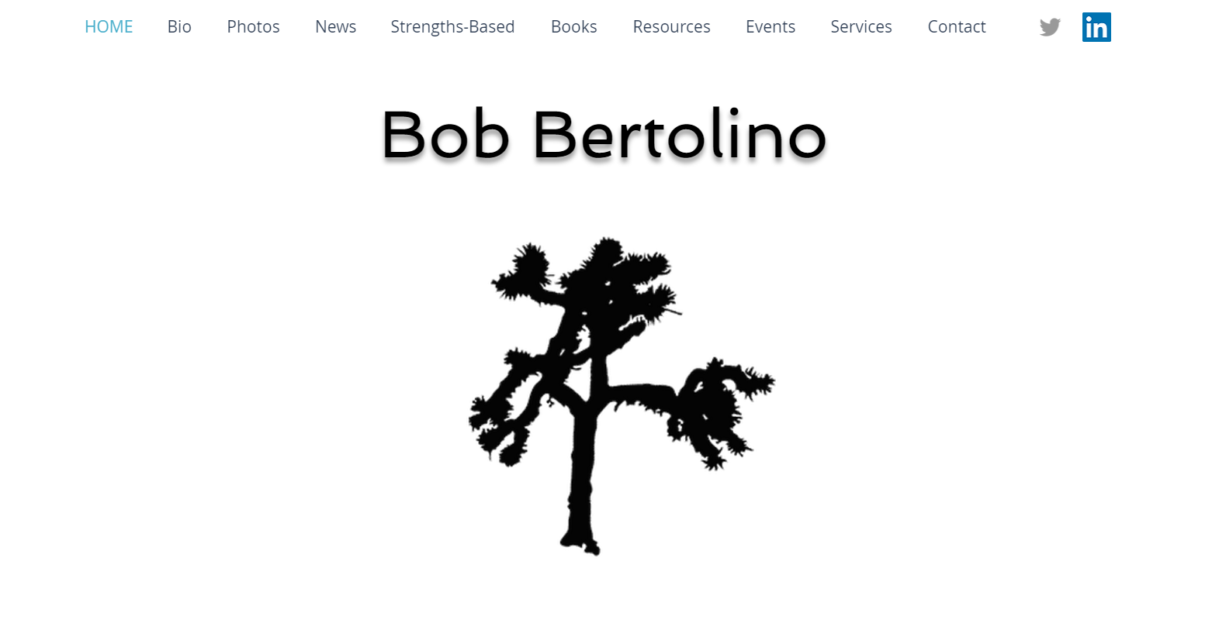

Slide 5
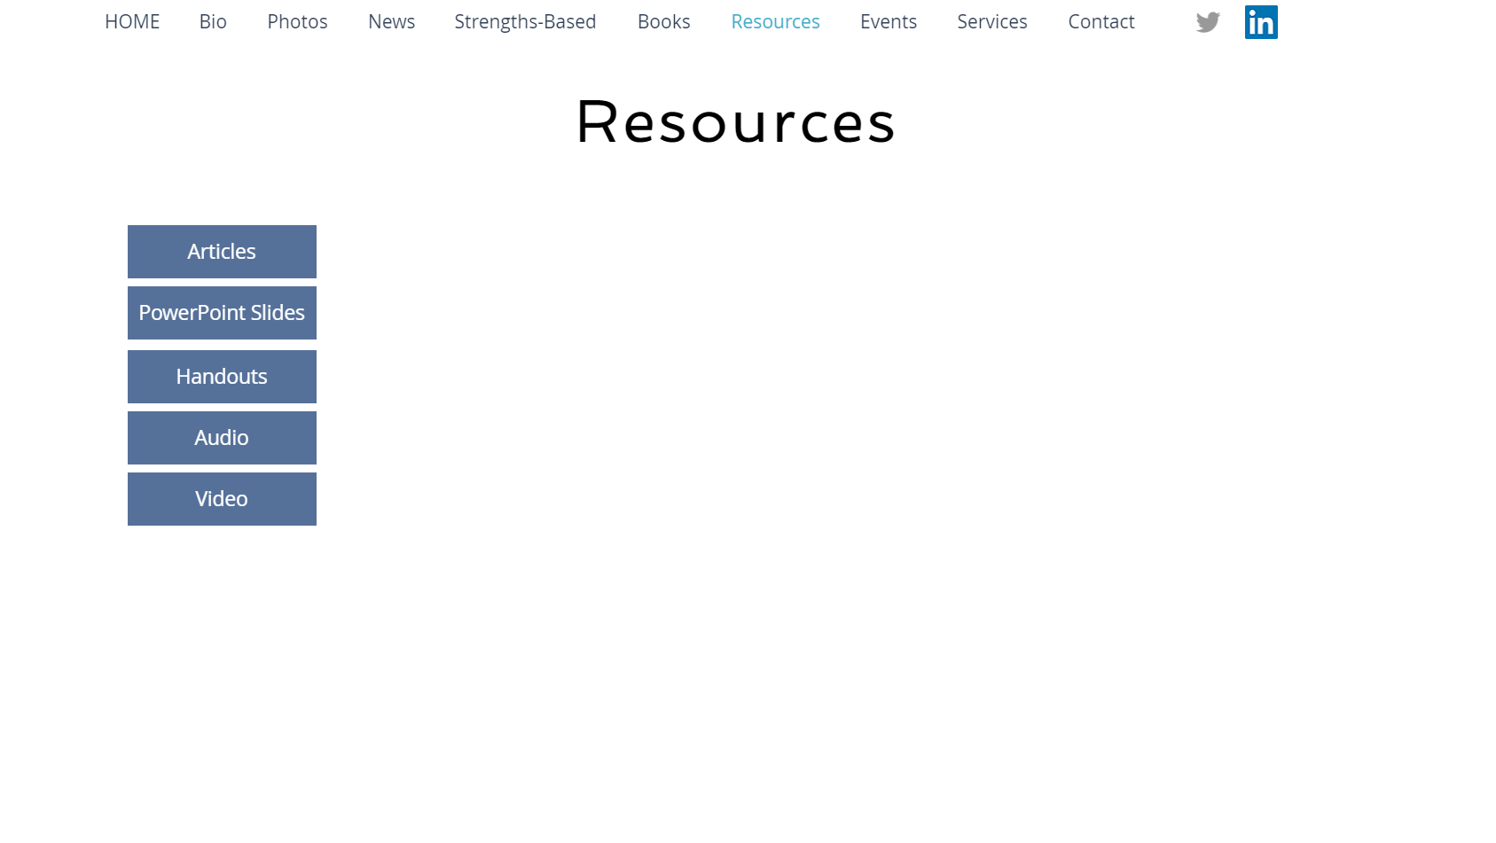

Slide 6
Slides for today’s workshop

Slide 7
The Evolution of Psychotherapy (1985)
The Convocation
“We are here to speak to commonalities that underlie successful clinical work…. In the evolution of the infant discipline of psychotherapy, the first 100 years have been divergent. It has been a period of growth, consisting of flowers and weeds. Especially in the last 40 years, there has been a proliferation of discrete schools. Perhaps we can begin this second century in a way that is more convergent (Zeig, 1987, p. xxvii).
Zeig, J. K. (1987). Introduction. In J. K. Zeig (Ed.), The evolution of psychotherapy (pp. xv-xxviii). New
York: Brunner/Mazel.
Notes:
7

Slide 8
The Evolution of Psychotherapy (1985)
The Experience
Joseph Wolpe referred to the conference as a “babble of conflicting voices” (Leo, 1985, p. 59).
In a review by Time magazine, one attendee commented, ''All the experts are here, and none of them agree'' (p. 59).
In attempting to present their own position in its clearest, least complicated, and most elementary form for the large audience, the speakers created and subsequently demolished caricatures of opposing viewpoints…. (Shapiro, 1987, p. 66)
Leo, J. (1985). A therapist in every corner: Harmony was the goal, but participants seemed out of tune. Time, 126(25), 59.
Shapiro, J. L. (1987). Message from the master on breaking old ground. The evolution of psychotherapy conference.
Psychotherapy in Private Practice, 5(3), 65-72.
Notes:
8

Slide 9
The Evolution of Psychotherapy (1985)
The Conclusion
"Here were the reigning experts on psychotherapy and I could see no way they could agree on defining the territory. Can anyone dispute, then, that the field is in disarray?" (Zeig, 1987, pp. xviii-xix).
Zeig, J. K. (1987). Introduction. In J. K. Zeig (Ed.), The evolution of psychotherapy (pp. xv-xxviii). New
York: Brunner/Mazel.
Notes:
9

Slide 10
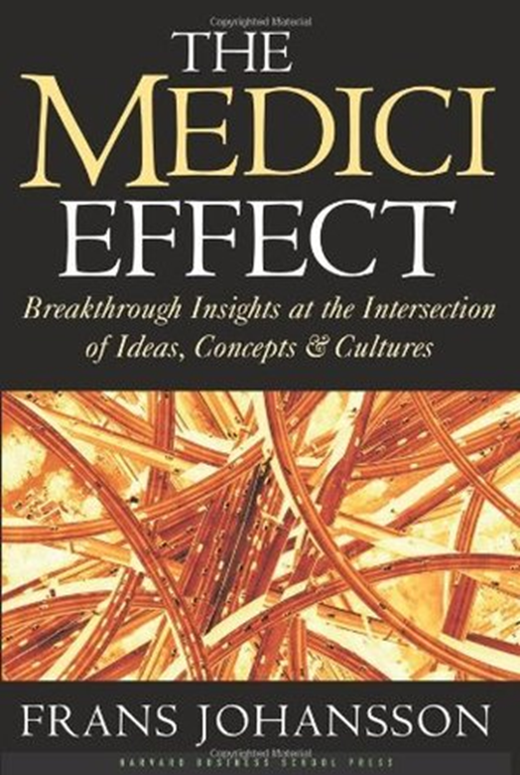
The Future is Now
An Intersection in Health and Behavioral Health
Intersections between health and behavioral health and adjoining fields continue to emerge.
One such intersection is a focus on health and well-being (growth) with both prevention and intervention.

Slide 11
Health & Well-Being
High subjective well-being correlates with lower risk of anxiety, depression, and risk-taking behavior (Lopez, Teramoto Pedrotti, & Snyder, 2015).
Shown to reduce inpatient stays, consultations with primary-care physicians, use of medications, care provided by relatives, and general health care expenditures by 60% to 90% (Chiles, Lambert, & Hatch, 1999; Kraft, Puschner, Lambert, & Kordy, 2006).
Findings demonstrated with persons with high-utilization rates of medical and health-related services (Cummings, 2007; Law, Crane, & Berge, 2003).
Chiles, J., Lambert, M. J., & Hatch, A. L. (1999). The impact of psychological interventions on medical cost offset: A meta-analytic review. Clinical Psychology,
6(2), 204–220.
Cummings, N. A. (2007). Treatment and assessment take place in an economic context, always. In S. O. Lilienfeld & W. T. O’Donohue (Eds.), The great ideas
of clinical science: 17 principles that every mental health professional should understand (pp. 163–184). New York: Routledge.
Kraft, S., Puschner, B., Lambert, M. J., & Kordy, H. (2006). Medical utilization and treatment outcome in mid- and long-term outpatient psychotherapy.
Psychotherapy Research, 16(2), 241–249.
Law, D. D., Crane, D. R., & Berge, D. M. (2003). The influence of individual, marital, and family therapy on high utilizers of health care. Journal of Marital and
Family Therapy, 29(3), 353–363.
Lopez, S. J., Teramoto Pedrotti, J., & Snyder, C. R. (2015). Positive psychology: The scientific and practical explorations of human strengths. Thousand Oaks,
CA: Sage.

Slide 12
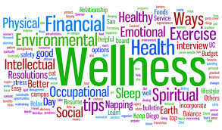

Slide 13
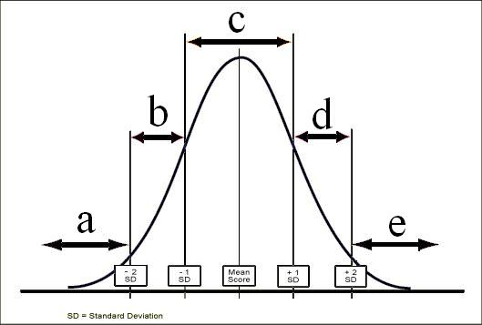

Slide 15
Posttraumatic Stress Disorder (Trauma and Stressor-Related Disorders)

Slide 16

The Therapeutic Bias
Freud thought the best we could hope was “ordinary misery” and questioned the search for happiness.
As a field, we have emphasized and focused predominantly on client pathology and problems.
Until recently, psychological publications and studies dealing with negative states outnumber those examining positive states by a ratio of 21 to 1.
The bias of both psychology and psychotherapy has been to get people back to “zero.”
A result has been the “empty person.”

Slide 17
Posttraumatic Stress Disorder (Trauma and Stressor-Related Disorders)

Slide 18
0

Slide 19
Posttraumatic Growth

Slide 20
From Pathology to Strengths

Slide 21
From Pathology to Strengths
“What we have learned over 50 years is that the disease model does not move us closer to the prevention of these serious problems. Indeed the major strides in prevention have largely come from a perspective focused on systematically building competency, not correcting weakness. Prevention researchers have discovered that there are human strengths that act as buffers against mental illness: courage, future-mindedness, optimism, interpersonal skill, faith, work ethic, hope, honesty, perseverance, the capacity for flow and insight, to name several. Much of the task of prevention in this new century will be to create a science of human strength whose mission will be to understand and learn how to foster these virtues in young people… We need now to call for massive research on human strength and virtue. We need to ask practitioners to recognize that much of the best work they already do in the consulting room is to amplify strengths rather than repair the weaknesses of their clients.” (p. 6-7)
Seligman, M. E. P., & Csikszentmihalyi, M. (2000). Positive psychology: An introduction. American Psychologist, 55(1),
5–14.

Slide 22
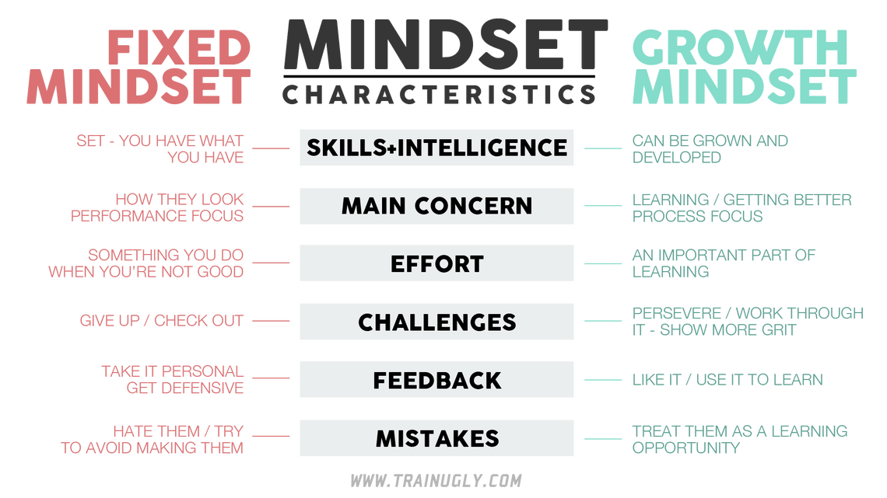

Slide 23
Mindset
Fixed: Students believe that their skills and intelligence are set—that they have what they have. That you don’t have the capacity to learn and grow. Skills are born.
Growth: Student believe that their skills and intelligence are things that can be developed and improved. That they do have the capacity to learn and grow. Skills are built.
The research shows that a growth mindset can foster grit, determination, and work ethic within students, athletes, and people of all ages.
Have the student focus on a particular problem or struggle they are encountering.
Have the student describe the problem or struggle including what they think they can and are willing to do about the situation.
If the student is not already using a growth mindset, discuss the importance of being creative, taking reasonable risks, and failure. Suggest that the student “test” using a growth mindset with the problem or struggle. Evaluate the results.
Resources: http://calserves.org/resources/calprep/additional-calprep-resources/growth-mindset/

Slide 24
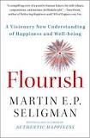
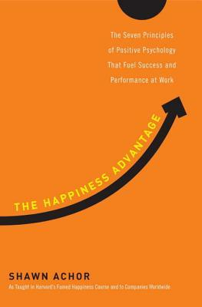

Positive Psychology Defined
Positive Psychology focuses on: “What kinds of families result in children who flourish, what work settings support the greatest satisfaction among workers, what policies result in the strongest civic engagement, and how people’s lives can be most worth living.” (p. 5)
Seligman, M. E. P., & Csikszentmihalyi, M. (2000). Positive psychology: An introduction. American Psychologist, 55(1), 5–14.

Slide 25
The Aims of Positive Psychology
We help clients to:
develop skills to flourish by reducing and preventing negative symptoms and building well-being.
have more positive emotional experiences, better relationships, more meaning in life, and accomplish what they set out to do.
live healthier lives both physically and psychologically.

Slide 26
“Happiness is the meaning and purpose of life, the whole aim and end of human existence.”
– Aristotle (384-322 BC)

Slide 27

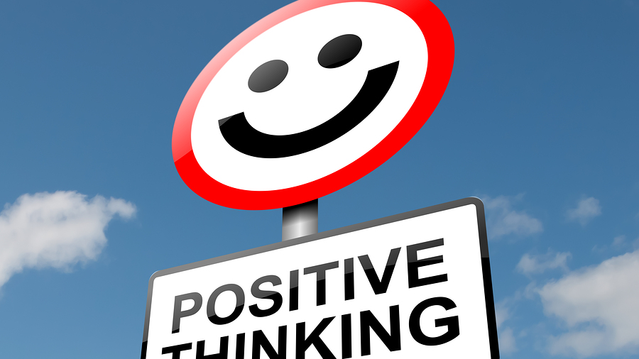

Slide 28
Happiness Around the World
Researchers have found that concept of happiness differ by country and culture.
For example, some countries “luck” or good fortune is considered an aspect of happiness.
In Western cultures, a higher priority is placed on maximizing happiness and minimizing sadness—feeling good versus feeling bad.
Non-Western cultures tend to place more value on harmony and conformity and less on individual happiness.

Slide 29
Happiness Around the World (cont.)
Countries also vary in levels of empathy—citizens ability to react to and connect with others both emotionally and intellectually.
According to a 2017 study, the countries with the highest levels of empathy were Ecuador, Saudi Arabia, Peru, Denmark, and the United Arab Emirates. The countries with the lowest levels were Lithuania, Venezuela, Estonia, Poland, and Bulgaria. The U.S. was 7th. (Chopik, O’Brien, & Konrath, 2017)
In a study of 37 countries, happiness was the most accurately recognized emotional expression as compared to anger, contempt, fear, sadness and surprise.
According to the 2018 World Happiness Report, in general, those who move to happier countries than their own will gain in happiness, while those who move to unhappier countries will tend to lose. (Helliwell, Layard, & Sachs, 2018)
Chopik, W. J., & O’Brien, E., & Konrath, S. H. (2017). Differences in empathic concern and perspective taking across 63 countries. Journal of Cross-Cultural Psychology, 48(1), 23-38.
Helliwell, J., Layard, R., & Sachs, J. (Eds.). (2018).World Happiness Report 2018. New York: Sustainable Development Solutions Network.

Slide 30
Positive Psychology Examples

Slide 31
Well-Being Contributors
Lyubomirsky, S. (2007). The how of happiness: A scientific approach to getting the life you want. New
York: Penguin.

Slide 32
Intentional Activities
“Circumstances happen to people, and activities are ways that people act on their circumstance.” (Lyubomirsky et al., 2005, p. 118)
Intentional activities involve engaging in new actions, activities, and behaviors which form new habits, routines, and patterns.
These new routines—which are forms of “mental flossing—increase well-being.
Lyubomirsky, S., Sheldon, K. M., Schkade, D. (2005). Pursuing happiness: The architecture of sustainable change.
Review of General Psychology, 9, 111-131.

Slide 33
Examples of Positive Psychology Exercises
Positivity Ratio
Your Way
Past, Present, and Future
Future Focus
Letter to Future Self
What went well?
Positivity Ratio
Savoring
Broaden-and-Build
Mindset
Signature Strengths
Language
Gratitude
Altruism
Volunteering
Mindfulness
Flow
Finding Purpose and Direction
Three Blessings
Exercise
Forgiveness
Accomplishment

Slide 34
Past, Present, and Future
Think of an event, situation, or experience from the past that you have good memories about.
Take a deep breath or two and immerse yourself as much as possible on the event.
Focus on your sensations. What you can see, hear, taste, smell, and/or feel in your body. Also notice your emotions.
Stay with and savor those pleasant sensations and emotions and develop them as much as you can.
Try to remain in the experience for 3-5 minutes.
Repeat the exercise by focusing on the present, and more recent or current experiences. Then do the same with future and “hoped-for” experiences.

Slide 35
What Went Well?
  Begin with a piece of paper or a journal. Make sure there are at least 21 lines.
  For the next week, at the end of each day, write down three things that well. Try not to repeat any item.
  For each positive event ask yourself the following questions:
    How is it that this good thing happened?
    What does the positive event mean to me?
    What do I need to do to have more of this positive experience in the future?
  At the end of the week reflect on the collection of good things.

Slide 36
Cognitive Triad

Slide 37
Future Focus
Creating a sense of a problem-free future or a future with hope and possibilities
Assume change will happen
Let your language reflect that sense of hope
Presuppose change
Tell stories of possibility without being invalidating or “too positive”
Help the person imagine a time after the problem
The miracle question

Slide 38
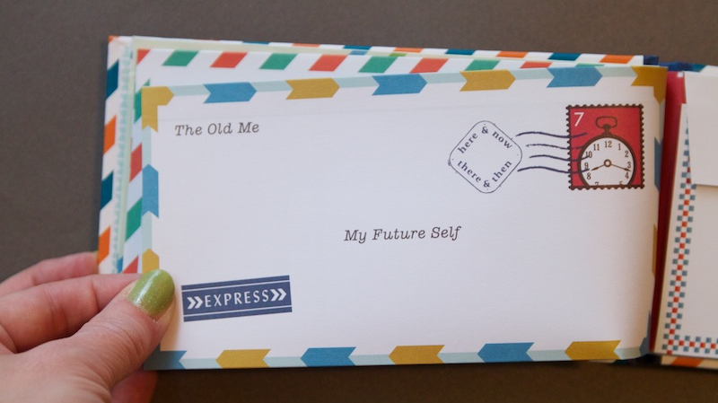

Slide 39
Letter to Future Self
Have the student write a letter to himself sometime in the near future. Because students typically think more short-term aim small (e.g., the end of the current term, school year, at the start of the next school year, after high school, etc.)
Suggest that students include things they want to stop, continue, and/or start doing. Again, aim small (e.g., pass one class, have 75% “good” days or 75% of each day be “good,” etc.)
Have student give himself or herself advice.
Have the student ask himself or herself questions.
Put the letter in a sealed envelop and give it to the student at some agreed-upon time in the future.
Consider having students write letters to themselves on an ongoing basis.

Slide 40
VIA Signature Strengths
Navigate to: http://www.viacharacter.org/www/
Create a username and password (your information will not be shared with commercial entities but will be deidentified and used for the purposes of research).
Complete the VIA Character Strengths Inventory.

Slide 41
VIA Signature Strengths (cont.)
Wisdom and Knowledge: Cognitive strengths that entail the acquisition and use of knowledge
Courage: Emotional strengths that involve the exercise of will to accomplish goals in the face of opposition, external or internal
Humanity: Interpersonal strengths that involve “tending and befriending” others
Justice: Civic strengths that underlie healthy community life
Temperance: Strengths that protect against excess
Transcendence: Strengths that forge connections to the larger universe and thereby provide meaning

Slide 42
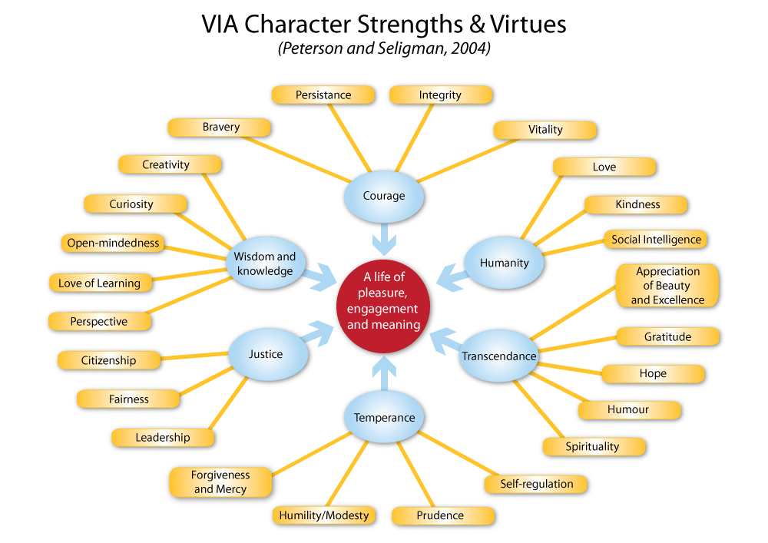

Slide 43
Signature Strengths Exercises
Take one signature strength and for the following week use that strength in a new way, every day.
Create opportunities to experience positive emotions and develop skills around character strengths that serve as buffers to specific challenges.
Peterson, C. (2006). A primer in positive psychology. New York: Oxford University Press.
Seligman, M. E. P., Steen, T. A., Park, N., & Peterson, C. (2005). Positive psychology progress: Empirical validation of
Interventions. American Psychologist, 60(5), 410-421.

Slide 44
Signature Strengths Exercises (cont.)
Choose a movie that demonstrates one or more of your top 10 character strengths. Watch the movie and write for 10 minutes about what you learned including any similarities between yourself and the character(s) who portrayed your character strength(s).
For movie options, visit psychologist Ryan Niemiec’s blog that lists his picks for the top character strengths portrayals since 2009: http://positivepsychologynews.com/news/ryan-niemiec/2018050338361

Slide 45
Character Strengths and Posttraumatic Growth
Character Strengths found to predict Posttraumatic Growth:
  Bravery
  Gratitude
  Hope
  Kindness
  Religiousness
Character Strengths found to be important mediators of success in situations characterized by significant cognitive, emotional, and physical challenges:
  Courage
  Honesty
  Leadership
  Optimism
  Self-regulation
  Teamwork
Mathews, M. D. (2008). Positive psychology: Adaptation, leadership, and performance in exceptional circumstances. In P. A. Hancock & J. L. Szalma
(Eds.), Performance under stress (pp. 163-180). Aldershot, England: Ashgate.

Slide 46
Character Strengths and Common Concerns
Presenting Problem | Potential Character Strength Utilized
Effective prevention of depression relapse | Perspective, Curiosity, Judgment, Spirituality
Residual depressive symptoms | Curiosity, Perseverance
Anxiety | Self-Regulation, Bravery, Fairness, Curiosity
Body-image issues | Gratitude, Kindness
Drug Use | Self-Regulation, Bravery
Trauma | Perseverance, Bravery, Hope
Improved attention and working memory | Self-Regulation, Love of Learning
Reduced anxiety; adaptive learning dealing with threat | Self-Regulation, Curiosity, Perspective
Improved romantic relationships | Love, Kindness, Social Intelligence
Decreased negative self-focused attention | Zest, Humor
Decreased negative affect | Zest, Hope
Rashid, T. (2009). Positive interventions in clinical practice. Journal of Clinical Psychology: In Session, 65(5), 461-466.

Slide 47
Language: The Costs of Negativity
Research shows that extensive discussions of problems and encouragement of ‘‘problem talk,’’ rehashing the details of problems, speculating about problems, and dwelling on negative affect in particular, leads to a signiﬁcant increase in the stress hormone cortisol, which predicts increased depression and anxiety over time. (Byrd-Craven, Geary, Rose, & Ponzi, 2008)
People who are in a more positive mood are better liked by others and more open to new ideas and experiences. (Fredrickson, 1998)
Byrd-Craven, J., Geary, D. C., Rose, A. J., & Ponzi, D. (2008). Co-ruminating increase stress hormone levels in women. Hormones
and Behavior, 53, 489–492.
Fredrickson, B. (1998). What good are positive emotions? Review of General Psychology, 2, 300-319.

Slide 48
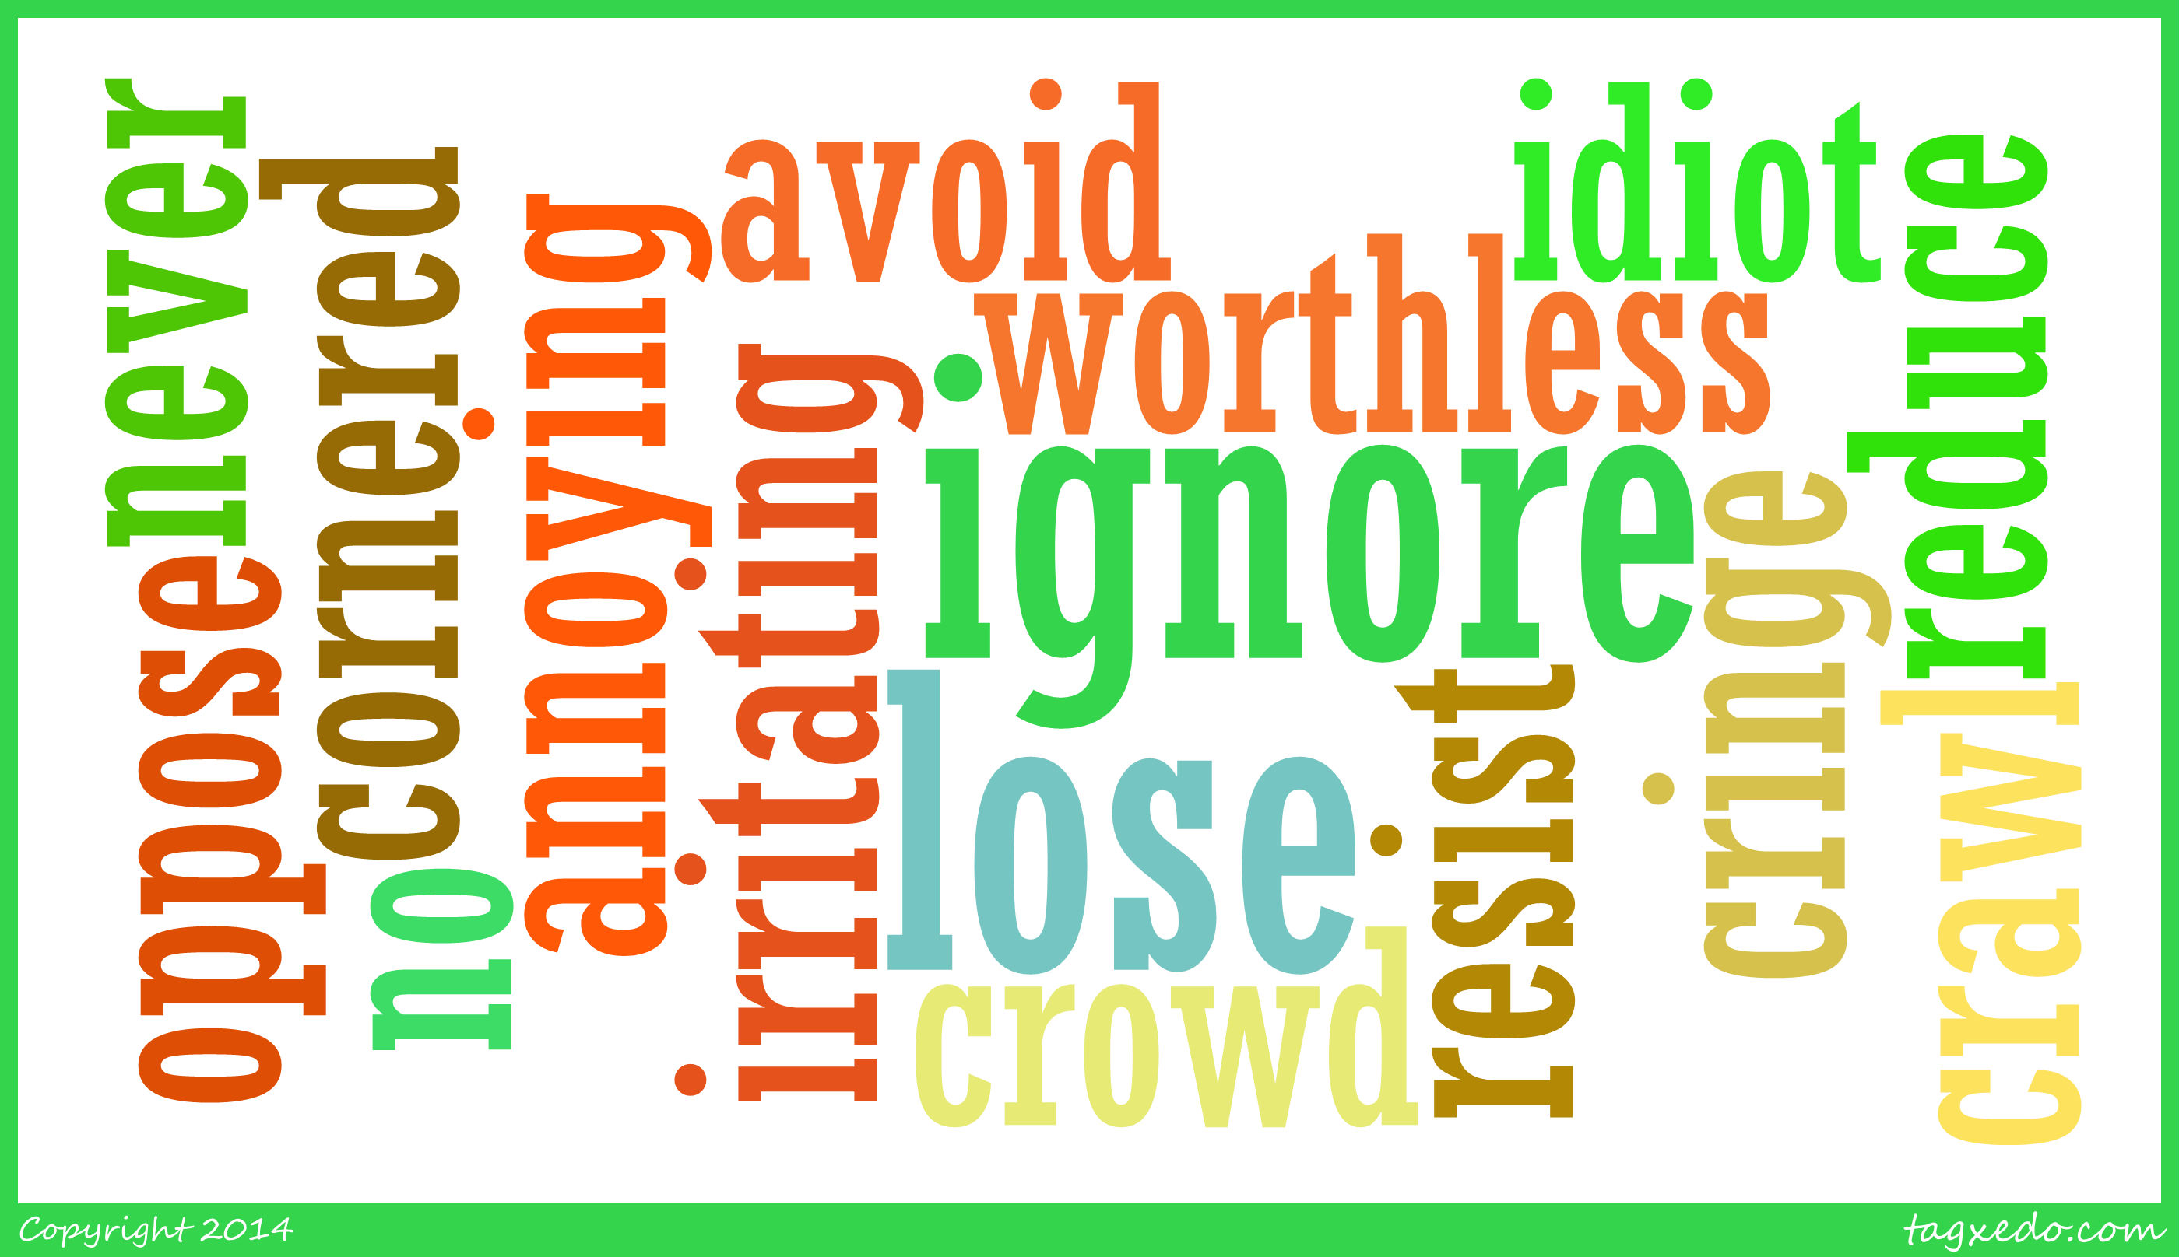
Common Words Associated with Risk

Slide 49
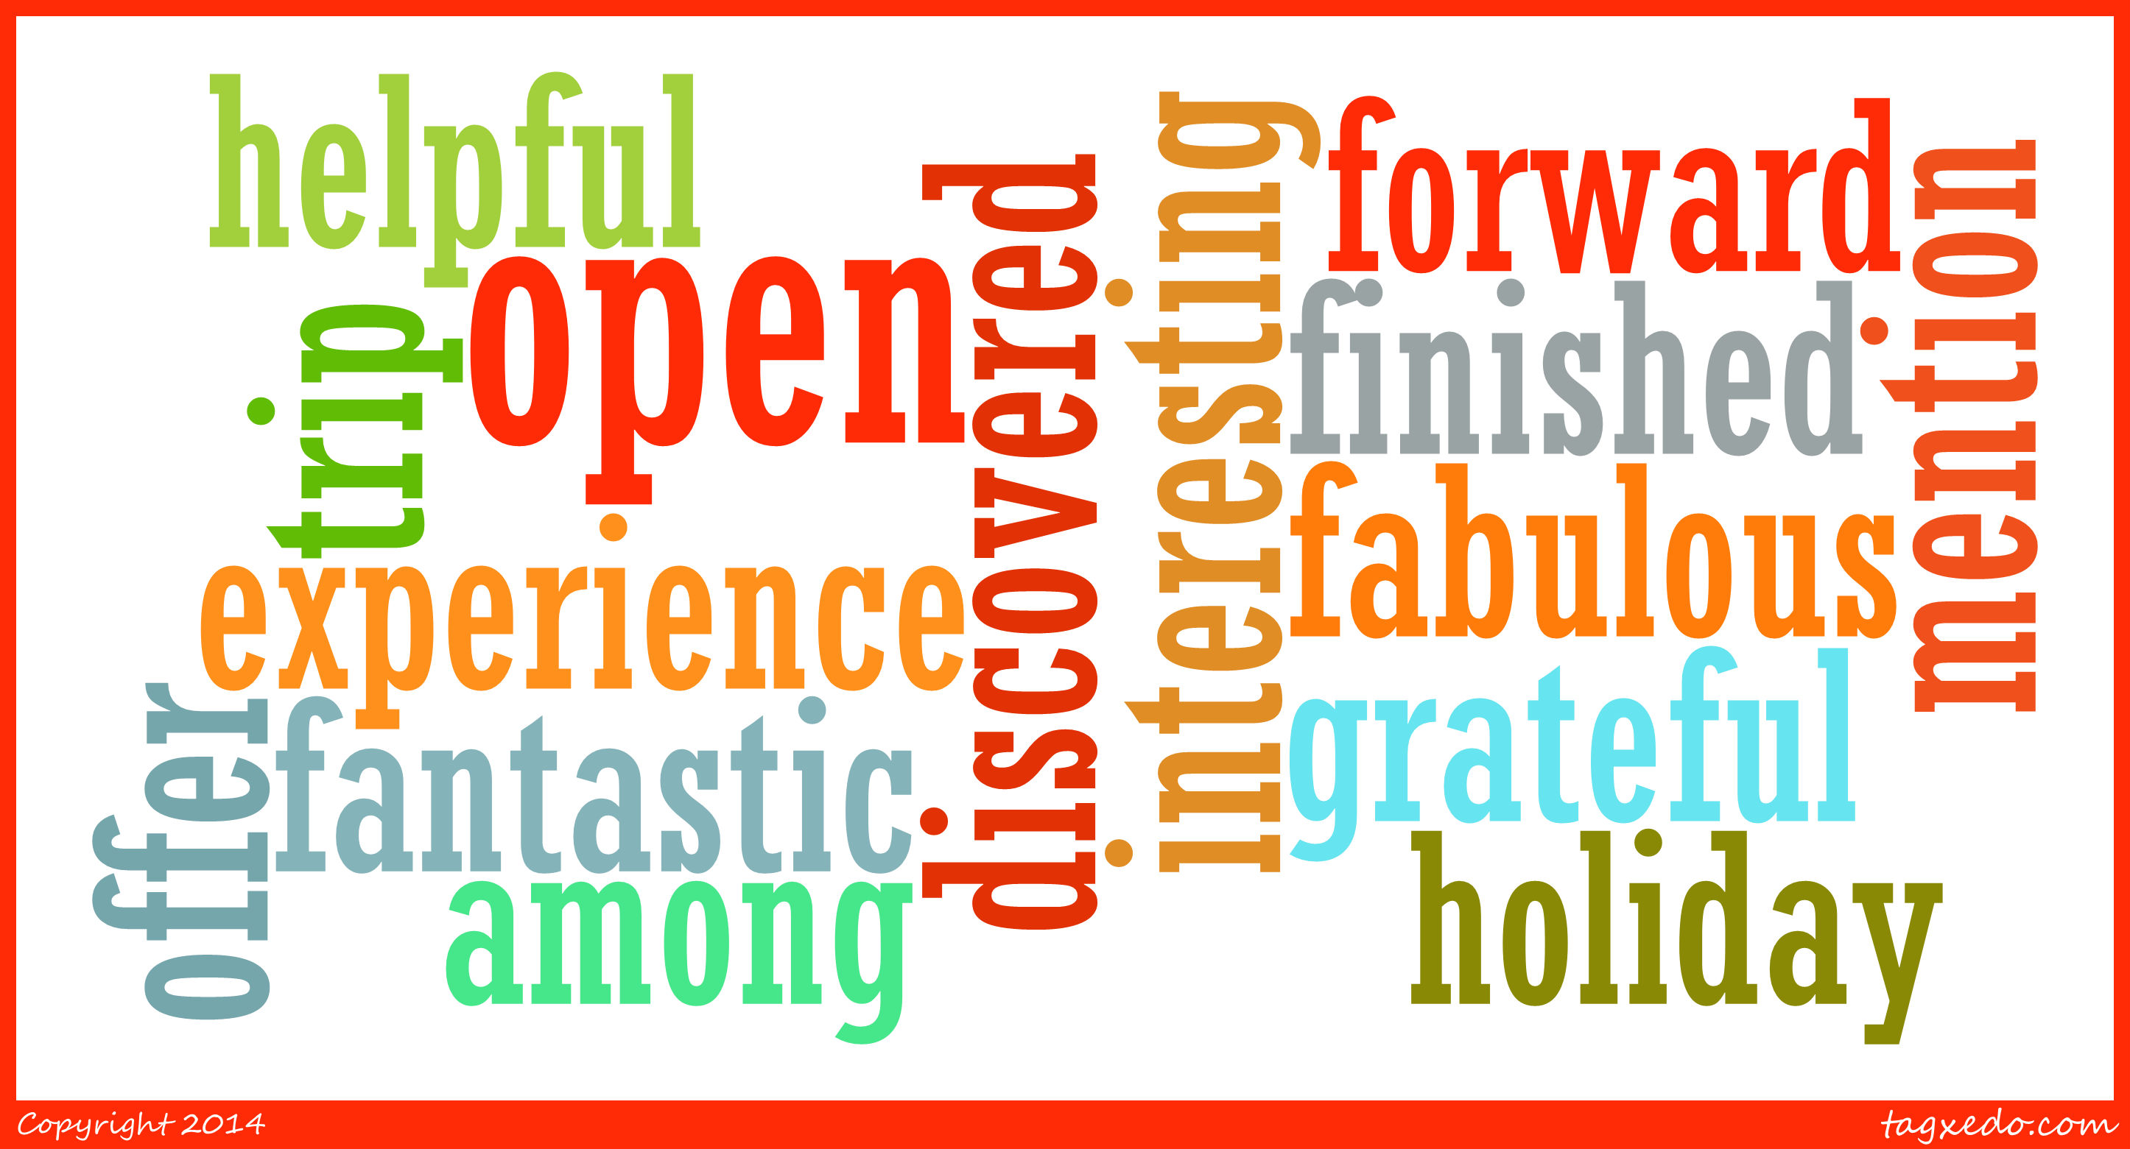
Common Words That Have Protective Qualities

Slide 50
Language: The Costs of Negativity (cont.)
Recent studies by the University of Pennsylvania demonstrated a link between language used on social media (i.e., Facebook, Twitter, etc.) and heart disease—expressions of negative emotions such as anger, stress and fatigue in tweets were associated with higher heart disease risk. (Eichstaedt, et al., 2015a, 2015b)
The same researchers also found that positive emotions like excitement and optimism were associated with lower risk of heart disease. (Eichstaedt, et al., 2015a, 2015b)
Ireland, Schwartz, Chen, Ungar, and Albarracin (2015) studied HIV prevalence and learned that sexually transmitted infection rates and references to risky behavior on Twitter were associated with higher HIV prevalence in all counties except those with high rates of future orientation.
Eichstaedt, J. C., Schwartz, H. A., Kern, M. L., Park, G., Labarthe, D. R., Merchant, R. M., Jha, S., Agrawal, M., Dziurzynski, L. A., Sap, M., Weeg,
C., Larson, E. E., Ungar, L. H., & Seligman, M. E. P. (2015a). Psychological language on Twitter predicts county-level heart disease mortality.
Psychological Science, Vol 26(2), 159-169.
Eichstaedt, J. C., Schwartz, H. A., Kern, M . L., Labarthe, D. L., Merchant, R. M.,Jha, S., Agrawal, M., Dziurzynski, L. A., Sap, M., Weeg, C., Larson,
E. E., Ungar, L. H., & Seligman, M. E. P. (2015b). Psychological language on Twitter predicts county-level heart disease mortality. Psychological
Science, 1-11.
Ireland, M. E., Schwartz, H. A., Chen, Q., Ungar, L. H., & Albarracin, D. (2015). Future-oriented tweets predict lower county-level HIV prevalence in
the United States. Health Psychology, 34, 1252-1260.

Slide 51
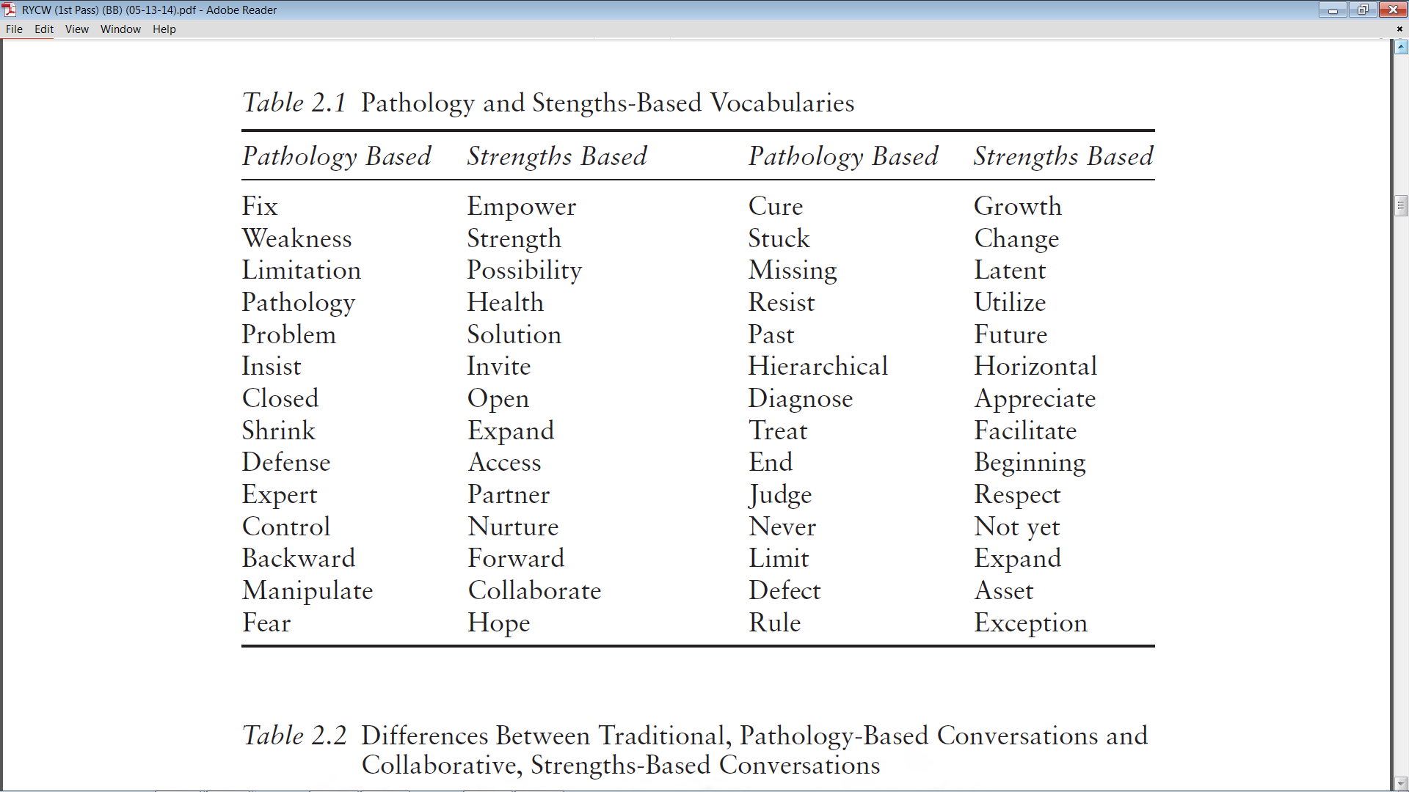
Bertolino, B. (2015). The residential youth care worker in action: A collaborative, strengths-based approach.
New York: Routledge.

Slide 52
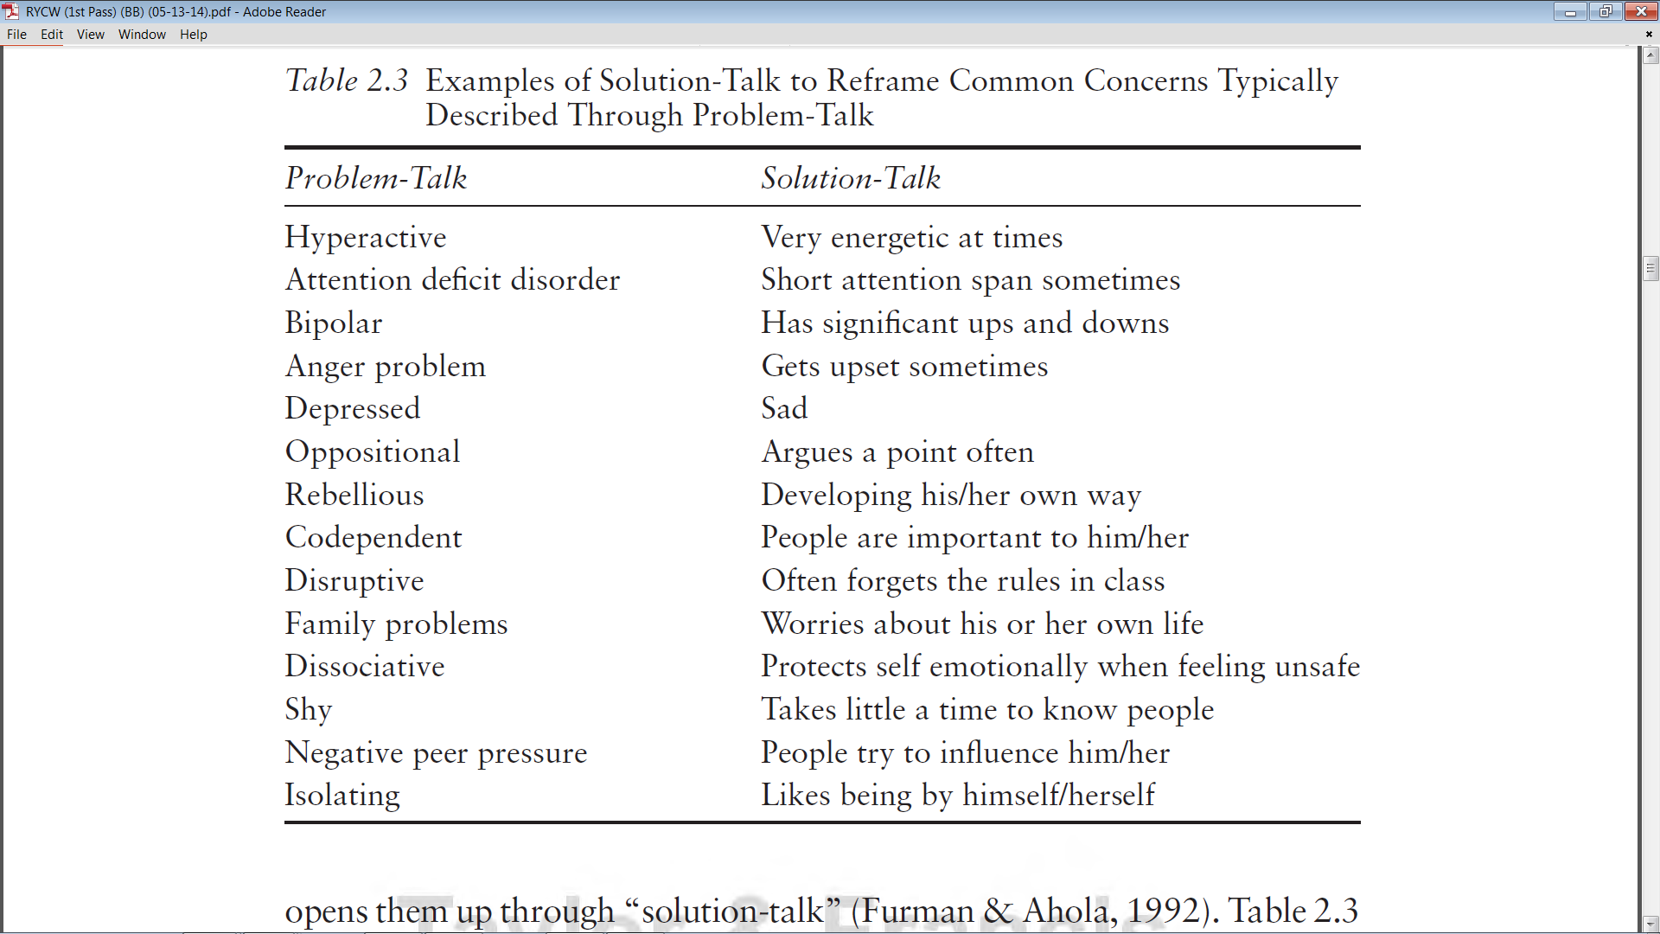
Bertolino, B. (2015). Working with children and adolescents in residential care: A strengths-based approach. New York: Routledge.

Slide 53
Gratitude
Think of someone who has done something important and wonderful for you, yet who has not been properly thanked.
Reflect on the benefits you received from this person, and write a letter expressing your gratitude for all he or she did for you.
The letter should be approximately 300 words. Rehearse the letter over and over until you know it by heart.
Arrange to deliver the letter personally, and spend some time with this person talking about what you wrote.

Slide 54
Gratitude (cont.)
Journals and Diaries: On a routine basis, write down things you are grateful for and refer back to them at the end of each week.
Post-its: Place little notes on mirrors, refrigerators, windows, doors, computer screens, etc. with expressions of gratitude to others.
Email and Notes: Each day, write a brief note to someone you would like to express gratitude.
Private and Public Expressions: Either privately or in a public forum, thank people for their contributions to your life.

Slide 55
Mindfulness Exercises
Identify key words that are validate, support, inspire, and increase optimism. Then, say those key words, repeating them in different ways while noticing the feelings, thoughts, and images that arise. When you are done, write about your experience for 5-10 minutes.
Capture a positive state (i.e., feeling joy, spontaneous, inspired, or the like) and focus on the words for 15-20 minutes, becoming fully immersed in the positive state.
Breathing space exercise is when a 3-minute exercise in which the person tunes into the present moment, focusing on the breath, and then expanding the awareness to sense the whole body.
Mindful walking and other forms of behavioral activation have been linked with increased energy and well-being.

Slide 56
Finding Life Purpose or Direction
Another way to find meaning and purpose if through four signals or life energies.
Each life signal creates opportunities to either follow and further develop a source of positive energy further or to use a source of a negative energy or wound to pursue something meaningful.
Such pursuits can be for one’s self, for something bigger than one’s self or both.
The four life energies are: Blissed, Blessed, Dissed, and Pissed.

Slide 57
Blissed
Professor of Literature and mythologist Joseph Campbell said, “Follow your bliss and the universe will open doors for you where there were only walls.”
Campbell elaborated that if a person’s follows his or her bliss, “You put yourself on a kind of track that has been there all the while, waiting for you, and the life that you ought to be living is the one you are living. Wherever you are—if you are following your bliss, you are enjoying that refreshment, that life within you, all the time.
Campbell encourages each person to let his or her “life speak.”
As a way to increase meaning, we can follow or passions and develop them in ways that contribute to a life that is more authentic and fully-lived.

Slide 58
Blissed (cont.)
The late entrepreneur and co-founder of Apple, Inc., Steve Jobs once described the importance of following your bliss.” Jobs remarked:
“You’ve got to find what you love. And that is true for your work as it is for your lovers. Your work is going to fill a large part of your life, and the only way to be satisfied is to do what you believe is great work. And the only way to do great work is to love what you do. If you haven’t found it yet, keep looking. Don’t settle. As with all matters of the heart, you’ll know it when you find it.”
Your time is limited, so don’t waste it living someone’s life. Don’t be trapped by dogma–which is living with the results of other people’s thinking. Don’t let the noise of others’ opinions drown out your own inner voice. And most important, have the courage to follow your heart and intuition. They somehow already know what you truly want to become. Everything else is secondary.”

Slide 59
Blessed
Some people feel as if they have a mission to fulfill or perhaps they were born to do something in the service of others.
Often referred to as “a calling,” this life energy can be born out of religious or spiritual beliefs or emerge from life experience and a deeper understanding of one’s self. For example, a person may have survived a life-threatening event and as a result made a decision to serve others in a way he or she had not previously done.
Still others have been told that they have a “gift” and are encouraged to share those gifts with the larger world.
In such cases, meaning can be found through pursuit of one’s blessings.

Slide 60
Dissed (Wounded)
Some life energies come from suffering.
Dissed, which is short for disrespected, is an example.
After Joseph Campbell’s dictum, “Follow your bliss,” became well-known, he grew concerned that people had misunderstood it to mean he was encouraging hedonism (i.e., self-indulgence).
Campbell reportedly responded, "I should have said, 'Follow your blisters.’” His point was that bliss is a path that can emerge from either a passion or a wound that the person transforms into life meaning.
People can experience pain or hurt, depersonalization, marginalization, being put down, and the like.
As a life energy, In time we may transform our liabilities into gifts.
The key, then, is to transform the negative energy of suffering and hurt into positive energy.

Slide 61
Dissed (Wounded) (cont.)
Here are two examples of turning wounds into positive energy:
  Novelist Ann Rice lost her daughter to leukemia at the age of 5. Rice would go on to write, “Interview with the Vampire,” a novel that featured a 5-year-old who could never die. Rice reflected, “I didn't know it at the time but it was all about my daughter, the loss of her and the need to go on living when faith is shattered. But the lights do come back on, no matter how dark it seems, and I'm sensitive now, more than ever, to the beauty of the world—and more resigned to living with cosmic uncertainty.”
  Throughout his life, Bono, singer for the band U2, has written about his wounds.
    At the age of 14 his mother passed away. Over the course of 40 years, he has written songs to help transform his wound (“I Will Follow,” “Out of Control,” “Tomorrow,” “Lemon,” “Mofo,” “Iris”).
    Bono also wrote songs to reconcile his relationship with his father (“Sometimes You Can’t Make It on Your Own,” “One Step Closer,” “Kite”).
    A third example is, “Mothers of the Disappeared,” in which Bono wrote about mothers whose children had “forcibly disappeared” in Nicaragua and El Salvador.

Slide 62
Pissed (Righteous Indignation)
There are times when people are not only wounded, they are angry or “pissed.”
Because anger can scare people, there are often efforts to dampen or get rid of it. The expression of anger in destructive ways can have steep consequences.
But anger can be quite useful and contribute to a positive life direction and contribution.
Similar to “Dissed,” the key is to transform the negative energy of anger and hurts into positive energy.
Reverend Dr. Martin Luther King stated, “Darkness cannot drive out darkness; only light can do that. Hate cannot drive out hate; only love can do that.”

Slide 63
TED Talks on Positive Psychology
Martin Seligman – “The New Era of Positive Psychology” – TED Talks, 2004 https://www.ted.com/talks/martin_seligman_on_the_state_of_psychology
Dan Gilbert – “The Surprising Science of Happiness – TED Talks, 2004
https://www.ted.com/talks/dan_gilbert_asks_why_are_we_happy#t-14307
Laura Carstensen – “Older People are Happier” – TED Talks, 2011
https://www.ted.com/talks/laura_carstensen_older_people_are_happier#t-90397
Shawn Achor – “The Happy Secret to Better Work” – TED Talks, 2011
https://www.ted.com/talks/shawn_achor_the_happy_secret_to_better_work

Slide 64
TED Talks on Positive Psychology (cont.)
Carl Dweck – “The Power if Believing that You can Improve” – TEDx, 2014
https://www.ted.com/talks/carol_dweck_the_power_of_believing_that_you_can_improve
Ryan Niemiec – “A Universal Language that Describes What’s Best in Us” – TEDx, 2017
https://www.youtube.com/watch?v=DMWck0mKGWc
Jennifer Stellar – “The Positive Effects of Positive Emotions” – TEDMED, 2016
https://www.youtube.com/watch?v=PU0QOKIPU9o
Matt Killingsworth – “Want to be Happier? Stay in the Moment – TEDxCambridge, 2001
https://www.ted.com/talks/matt_killingsworth_want_to_be_happier_stay_in_the_moment
Barbara Fredrickson – “The Positivity Ratio” – 2011
https://www.youtube.com/watch?v=_hFzxfQpLjM&t=55s

Slide 65
TED Talks on Positive Psychology (cont.)
Mihaly Csikszentmihalyi – “Flow, the Secret to happiness” – TED, 2004
https://www.ted.com/talks/mihaly_csikszentmihalyi_on_flow
Robert Waldinger – “What Makes a Good Life? Lessons from the Longest Study on Happiness” – TEDxBeaconStreet, 2015
https://www.ted.com/talks/robert_waldinger_what_makes_a_good_life_lessons_from_the_longest_study_on_happiness
Susan Pinker – “The Secret to Living Longer May Be Your Social Life” – TED, 2017
https://www.ted.com/talks/susan_pinker_the_secret_to_living_longer_may_be_your_social_life?referrer=playlist-the_secret_to_lifelong_friendship
Sherry Turkle – “Connected, but Alone?” – TED, 2012
https://www.ted.com/talks/sherry_turkle_alone_together

Slide 66
TED Talks on Positive Psychology (cont.)
Peter Gabriel – “Fight Injustice with Raw Video” – TED, 2006
https://www.ted.com/talks/peter_gabriel_fights_injustice_with_video
Jonathan Haidt – “Religion, Evolution, and the Ecstasy of Self_Transcendence” – TED, 2012
https://www.ted.com/talks/jonathan_haidt_humanity_s_stairway_to_self_transcendence
Susan Cain – The Power of Introverts – TED, 2012
https://www.ted.com/talks/susan_cain_the_power_of_introverts
Angela Duckworth – “Grit: The Power of Passion and Perseverance” – TED, 2013
https://www.ted.com/talks/angela_lee_duckworth_grit_the_power_of_passion_and_perseverance

Slide 67
TED Talks on Positive Psychology (cont.)
Simon Sinek – “Why Good Leaders Make You Feel Safe” – TED, 2014
https://www.ted.com/talks/simon_sinek_why_good_leaders_make_you_feel_safe
Carl Dweck – “The Power of Believing that You can Improve” – TEDx, 2014
https://www.ted.com/talks/carol_dweck_the_power_of_believing_that_you_can_improve
Ryan Niemiec – “A Universal Language that Describes What’s Best in Us” – TEDx, 2017
https://www.youtube.com/watch?v=DMWck0mKGWc

