Slide 1




MMHCA 2026 Annual Conference
“Authentically You: Light the Fire Within”
The Changing Landscape of Practice
What Every Clinician Needs to Know
Bob Bertolino, Ph.D.
Codirector Clinical Mental Health Counseling Program, Maryville University-St. Louis
Professor of Psychology, Maryville University-St. Louis
Sr. Clinical Advisor, Youth In Need, Inc.
Director of Ethics, International Center for Clinical Excellence
bobbertolino.com

Slide 2
Overview: The Big Six
Be Authentic
Clinicians contribute between 5-9% of the variance in outcomes.
Focus on Language
Language is a virus it can heal or harm. “Our capacity to destroy one another is matched by our capacity to heal one another.” Besel van der Kolk (2014)
Be Outcome-Informed
Track the benefit of services through Routine Outcome Monitoring (ROM).
van der Kolk, B. A. (2014). The body keeps the score: Brain, mind, and body in the healing of trauma. Viking.

Slide 3
Overview: The Big Six (cont.)
Get Onboard with Technology
Digital platforms for services and supervision, AI, Chatbots, Notetaking, Decision Support, Automation
Engage in Deliberate Practice
Demonstrate interest in your effectiveness as a clinician and engage in deliberate practice to improve domain specific knowledge and skills.
Explore Diversity in the Profession
Be thoughtful about career choices, diversify in professional activities, network, carve out time to pursue interests.
Bertolino, B. (2018). Effective counseling and psychotherapy: An evidence-based approach. Springer.

Slide 4
1. Be Authentic
Personal Philosophy
Whereas models and methods account for no more than 1% of the variance in outcome, clinicians contribute between 5-9% of the variance (Wampold & Brown, 2005; Wampold & Imel, 2015).
Who are you as a clinician?
What is your Personal Philosophy? Sort out your beliefs about change (Bertolino, 2018)
Be you: Clients will remember you, not your theories and explanations.
Why it matters
As humans, we need genuine social connection. Authentic, compassionate relationships heal.
Bertolino, B. (2018). Effective counseling and psychotherapy: An evidence-based approach. Springer.
Wampold, B. E., & Brown, G. S. (2005). Estimating variability in outcomes attributable to therapists: A naturalistic study of outcomes in managed care. Journal
of Consulting and Clinical Psychology, 73(5), 914–923.
Wampold, B. E., & Imel, Z. E. (2015). The great psychotherapy debate: The evidence for what makes therapy work (2nd ed.). Routledge/Taylor & Francis.

Slide 5
Best Available Research: The Variance in Outcome
Client/Extratherapeutic Factors = 80-87%
Treatment Effects = 13-20%
  Therapist Effects = 5-9%
  The Alliance = 5-8%
  Expectancy, Placebo, and Allegiance = 4%
  Model/Technique = 1%
Bertolino, B., Bargmann, S., & Miller, S. D. (2013). Manual 1: What works in therapy: A primer. The ICCE manuals of feedback informed
treatment. Chicago, IL: International Center for Clinical Excellence.
Wampold, B. E., & Brown, G. S. (2005). Estimating variability in outcomes attributable to therapists: A naturalistic study of outcomes in
managed care. Journal of Consulting and Clinical Psychology, 73(5), 914-923.

Slide 6
From Philosophy to Practice
PRACTICES
“What we do”
↑
THEORY/MODELS
“How we think”
↑
PERSONAL PHILOSOPHIES
“Who we are”
Bertolino, B. (2018). Effective counseling and psychotherapy: An evidence-based approach. Springer.
Bertolino, B. (2010). Strengths-based engagement and practice: Creating effective helping relationships. Allyn & Bacon.

Slide 7
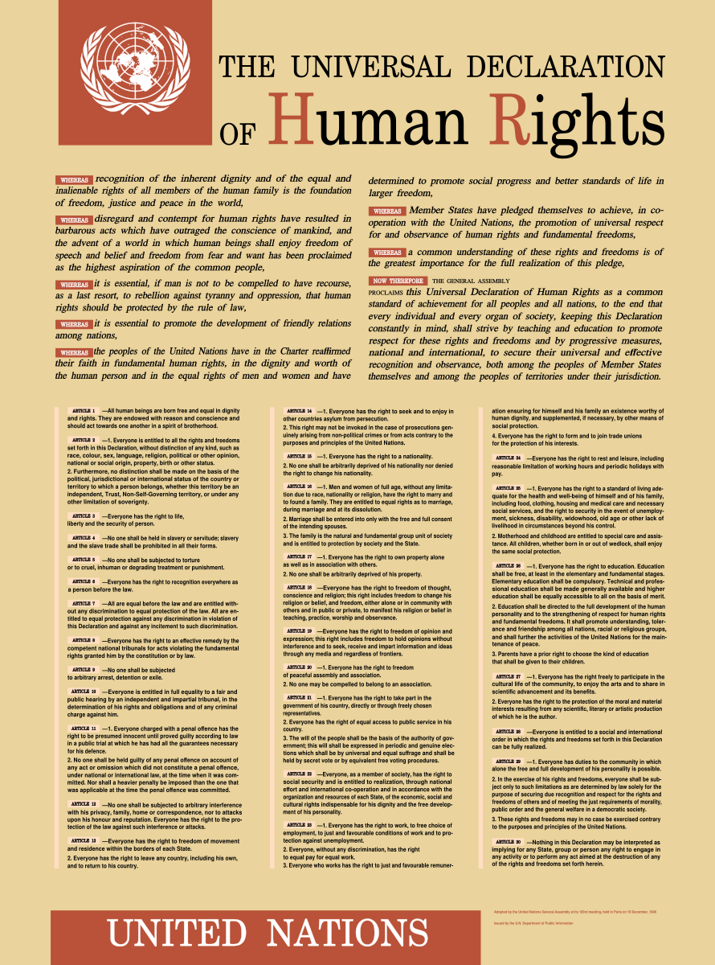
The Universal Declaration of Human Rights (UDHR) is a milestone document in the history of human rights was drafted by representatives with different legal and cultural backgrounds from all regions of the world.
The Declaration was proclaimed by the United Nations General Assembly in Paris on 10 December 1948 (General Assembly resolution 217 A) as a common standard of achievements for all peoples and all nations.
It sets out, for the first time, fundamental human rights to be universally protected.

Slide 8
2. Focus on Language
Words Matter
Psychotherapy is based on language and interaction. First and second “wave” pathology and problem-focused approaches that focus on what’s wrong with people have not led to improved outcomes.
Language can contribute to serious health and mental health issues and at-risk behavior, or it can influence positive change and serve as a protective mechanism.
Studies have demonstrated a link between language used on social media (i.e., Facebook, Twitter, etc.) and heart disease—expressions of negative emotions such as anger, stress and fatigue in tweets were associated with higher heart disease risk (Eichstaedt, et al., 2015a, 2015b).
Ireland and colleagues (2015) studied HIV prevalence and found that sexually transmitted infection rates and references to risky behavior on Twitter were associated with higher HIV prevalence in all counties except those with high rates of future orientation.
In contrast, positive emotions like excitement and optimism were associated with lower risk of heart disease (Eichstaedt, et al., 2015a, 2015b).
Why it matters
Empathy improves alliance and outcome when it is attuned, specific, and collaborative.
Eichstaedt, J. C., Schwartz, H. A., Kern, M. L., Park, G., Labarthe, D. R., Merchant, R. M., Jha, S., Agrawal, M., Dziurzynski, L. A., Sap, M., Weeg, C., Larson, E. E., Ungar, L. H., & Seligman, M. E. P. (2015a).
Psychological language on Twitter predicts county-level heart disease mortality. Psychological Science, Vol 26(2), 159-169.
Eichstaedt, J. C., Schwartz, H. A., Kern, M . L., Labarthe, D. L., Merchant, R. M.,Jha, S., Agrawal, M., Dziurzynski, L. A., Sap, M., Weeg, C., Larson, E. E., Ungar, L. H., & Seligman, M. E. P. (2015b).
Psychological language on Twitter predicts county-level heart disease mortality. Psychological Science, 1-11.
Ireland, M. E., Schwartz, H. A., Chen, Q., Ungar, L. H., & Albarracin, D. (2015). Future-oriented tweets predict lower county-level HIV prevalence in the United States. Health Psychology, 34, 1252-1260.

Slide 9
2. Focus on Language (cont.)
Words Matter
Keep in mind: Sticks and stones can break bones AND words do hurt. The consequences are greater than we knew.
Communicate empathy and positive regard through acknowledgment, validation and active listening.
Use possibility-based language that emphasizes collaboration, change, and client strengths without minimizing clients’ pain and suffering (Bertolino, 2010, 2018).
Examples: Change client statements into the past tense; challenge” all or nothing” statements (e.g., “always,” “never,” etc.); translate clients’ statements of truth or reality—the way they explain things for themselves—into perceptual statements or subjective realities (e.g., “It seems to you,” “You’ve gotten the idea,.” etc.); inject the element of possibility into closed-down statements by responding with “so far” or “yet”; and, use words like “when” and “will” to presuppose future change.
Acknowledge and validate clients internal experience (i.e., feelings, emotions) while holding them accountable for their actions (O’Hanlon & Bertolino, 1998)
Why it matters
Empathy improves alliance and outcome when it is attuned, specific, and collaborative.
Bertolino, B. (2018). Effective counseling and psychotherapy: An evidence-based approach. Springer.
Bertolino, B. (2010). Strengths-based engagement and practice: Creating effective helping relationships. Allyn & Bacon.
O’Hanlon, B., & Bertolino, B. (1998). Even from a broken web: Brief, respectful solution-oriented therapy for sexual abuse and trauma. John Wiley & Sons.

Slide 10
The Viral “Formula for Happiness”
1:1.1 or R>1
The central idea is that kindness can spread when each person who receives an act of kindness performs more than one act of kindness for someone else.
Small contributions by many people can produce a substantial collective effect.
Theorized by Professor Anette Hosoi, The Neil and Jane Pappalardo Professor of Mechanical Engineering and Mathematics at MIT in 2023.
CBS News. (2022, December 28). The gift: Kindness goes viral with Steve Hartman [Television special]. CBS.
Massachusetts Institute of Technology, Institute for Data, Systems, and Society. (2023, January 5). Kindness goes viral.
https://idss.mit.edu/news/kindness-goes-viral/

Slide 11
3. Be Outcome-Informed
ROM
Use routine outcome monitoring (ROM) (Bertolino, 2018, 2024; Miller, Hubble, & Chow, 2020).
Collect brief outcome and alliance data routinely to see who is improving, stuck, or deteriorating (Prescott, Maeschalck, & Miller, 2017).
Discuss scores openly with clients rather than treating measures as private clinician data.
If progress stalls, revisit goals, alliance, readiness, diagnosis, social determinants, and intervention fit (Bertolino, 2018, 2024).
Feedback works best when paired with humility and willingness to change course.
Establish a baseline rate of effectiveness followed by a plan to improve.
Why it matters
We must be accountable for client outcomes by using ROM to know whether clients are benefitting from services.
Bertolino, B. (2024). The therapist’s notebook for supervision and training: Activities and exercises to improve effectiveness with clients, students, trainees, and clinicians.
Routledge.
Bertolino, B. (2018). Effective counseling and psychotherapy: An evidence-based approach. Springer.
Miller, S. D., Hubble, M. A., & Chow, D. (2020). Better results: Using deliberate practice to improve therapeutic effectiveness. American Psychological Association.
Prescott, D.S., Maeschalck, C. L., & Miller, S. D. (Eds.). (2017). Feedback-informed treatment in clinical practice: Reaching for excellence. American Psychological Association.

Slide 12
What Effective Therapists Consistently Do
Build a strong alliance
Apply a coherent case frame
Agreement on goals, tasks, and bond predicts outcome across orientations.
Formulation organizes data and guides interventions without becoming rigid.
Monitor progress and adjust
Practice ethically and reflectively
Outcome and alliance feedback reduce the risk of treatment drift.
Self-awareness, consultation, and boundaries protect clients and clinicians.
Norcross, J. C., & Lambert, M. J. (Eds.). (2019). Psychotherapy relationships that work: Vol 1: Evidence-based therapist contributions (3rd ed.). Oxford University
Press.

Slide 13
Monitor Risk Continuously
SAFETY
Reassess suicide risk, self-harm, violence risk, abuse/neglect, substance misuse, psychosis, and medical concerns whenever indicators change.
Know your documentation, consultation, and crisis-response procedures before you need them.
Balance empathic exploration with direct questions; risk assessment is not the enemy of rapport.
Create specific safety plans and means-reduction strategies as needed.
Use the outcome and alliance (e.g., ORS/CORS or ROS/CROS) measures for client self-ratings.
Use the (e.g., Risk Rating, C-GAS, GAF) for therapists’ ratings of general risk.
Use risk assessments (e.g., Columbia-Suicide Severity Rating Scale [C-SSRS]).
Why it matters
Risk management is a clinical and ethical responsibility, not merely a legal task.

Slide 14
4. Get Onboard with Technology
Practice
Digital competence is now part of clinical competence.
There are many choices for digital recordkeeping, billing, etc. (SimplePractice, TherapyNotes, Sessions Health, TheraNest, Valant, etc.)
Protecting client privacy and confidentiality is essential.
Technology should enhance, not replace, the therapeutic relationship.
Technology is changing clients' lives and the issues they bring to therapy.
Understand that clients are increasingly using AI to investigate their symptoms, feelings, and experiences.
In some cases, AI is being used people’s therapists.
A growing number of clients are using digital platforms including BetterHelp, Talkspace, Grow Therapy, Headway, Brightside Health, and Amwell).
Learn about apps that can benefit clients (e.g., Calm, Headspace, Insight Timer, Finch, Happify, etc.)
Why it matters
Technology is here and will only become more prominent in clients’ and clinicians’ lives.
Bertolino, B. (2024). The therapist’s notebook for supervision and training: Activities and exercises to improve effectiveness with clients, students, trainees,
and clinicians. Routledge.

Slide 15
Social Media & Mental Health
SAFETY
Girls: More vulnerable to the social and relational consequences of social media, particularly appearance comparisons, social evaluation, exclusion, and relational aggression.
Boys: More vulnerable to problems associated with excessive gaming, pornography, online immersion, and withdrawal from real-world activities and relationships.
There are four mechanisms that affects both girls and boys:
  Social deprivation: Less time spent in face-to-face interaction, friendship, and unsupervised play.
  Sleep deprivation: Smartphone and social media use interfere with healthy sleep.
  Attention fragmentation: Notifications, multitasking, and constant digital stimulation disrupt sustained attention.
  Addiction: Some digital platforms encourage compulsive use through reward-based engagement mechanisms. (Haidt, 2024)
Why it matters
Social media use is directly correlated with mental health and well-being.
Haidt, J. (2024). The anxious generation: How the great rewiring of childhood is causing an epidemic of mental illness. Penguin
Press.

Slide 16
5. Engage in Deliberate Practice
Professional Discipline
To improve your effectiveness and outcomes you must first establish a baseline for your practice. Use your Imagine data as a starting point.
Work with your supervisor to establish a plan to improve your effectiveness. This is done by pushing beyond your already existing skill set and competence.
Deliberate practice (DP) is the primary method for improving one’s skills. It is a structured, effortful approach to skill development in which therapists intentionally work on improving specific clinical skills through focused repetition, immediate feedback, and ongoing refinement, rather than relying on routine experience alone.
DP targets specific therapist skills (e.g., empathy, alliance repair, case conceptualization). It involves clear performance goals, real-time or structured feedback (e.g., supervision, outcome data, recordings), and repeated practice with reflection and adjustment.
Why it matters
The instrument of therapy is the therapist; maintenance matters.
Chow, D., Miller, S. D., Seidel, J. A., Kane, R. T., Thornton, J. A., & Andrews, W. P. (2015).The role of deliberate practice in the development of highly effective
psychotherapists. Psychotherapy, 52(3), 337–345.
Rousmaniere, T. (2017). Deliberate practice for psychotherapists: A guide to improving clinical effectiveness. Routledge.

Slide 17
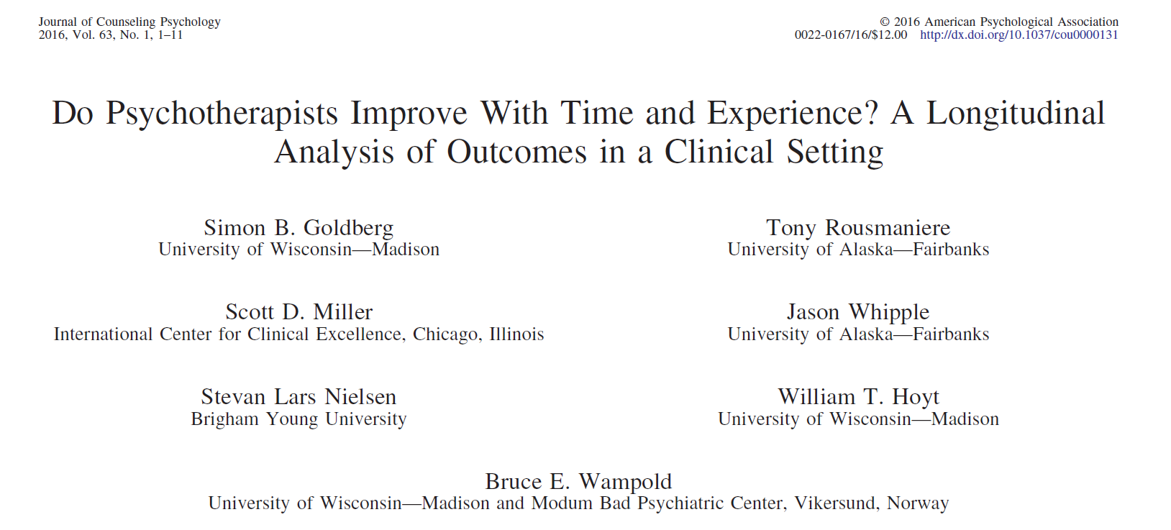
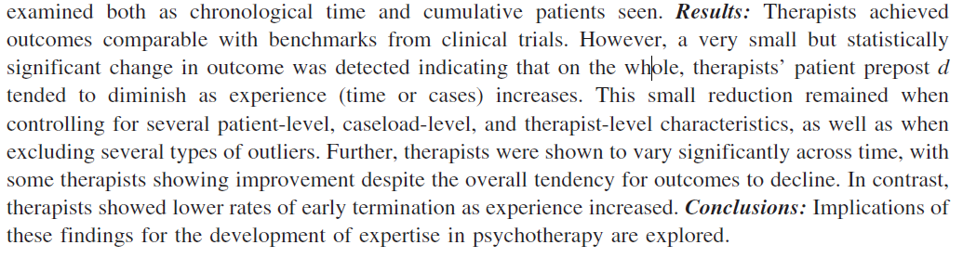
Therapist Improvement with Time and Experience
The largest study to date on the effect of experience on outcome.
170 therapists followed for 17 years.
Question: Do therapists improve over time in terms of effectiveness with more experience and training?
The answer: No.
On average therapists’ outcomes declined over time.
Goldberg, S. B., Rousmaniere, T., Miller, S. D., Whipple, J., Nielsen, S. L., Hoyt, W. T., & Wampold, B. E. (2016). Do psychotherapists improve with time and
experience? A longitudinal analysis of outcomes in a clinical setting. Journal of Counseling Psychology, 63(1), 1–11.

Slide 18
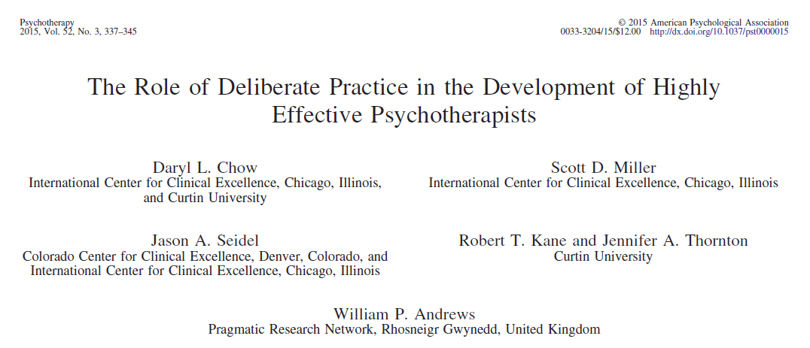
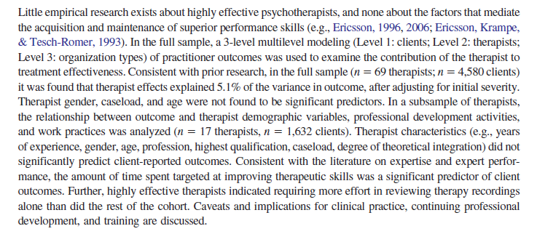
How Do Therapists Achieve Better Outcomes?
The findings from Chow and colleagues’ study showed a correlation between the time therapists spent on activities intended to improve their ability and their outcomes.
The top performers spent 2.5 to 4.5 more hours reflecting on actions, consulting about cases, reading, attending professional development activities, planning, and engaging in other learning activities than average therapists.
Researchers also estimated that that “the accumulative time spent by the top quartile (most effective therapists) was, on average, about 2.8 times more hours per week engaged in DP activities aimed at improving effectiveness than the rest of the other therapists” (p. 341).
Chow, D. L., Miller, S. D., Seidel, J. A., Kane, R. T., Thornton, J. A., & Andrews, W. P. (2015). The role of deliberate practice in the development of highly effective
psychotherapists. Psychotherapy, 52 (3), 337–345.

Slide 19
Evidence-Based Practice
Evidence-Based Practice
What Therapists & Trainees Need
“The integration of the best available research with clinical expertise in the context of patient characteristics, culture, and preferences.” (p. 273)
Stay up to date on research on the populations you serve and effective practice.
Monitor fit and effect: The fit of your approach and the impact (benefits) of it to clients.
Remain attuned to who client are, including their characteristics, cultures, & preferences.
A framework for assessment, formulation, intervention, and evaluation.
Responsiveness and flexibility as new data becomes available.
A process mindset rather than a prescriptive mindset.
An interest and investment in the impact of services and an openness to feedback.
Time to reflect on client situations.
An understanding of one’s baseline rate of effectiveness as a starting point for developing domain-specific knowledge through deliberate practice.
APA Presidential Task Force on Evidence-Based Practice. (2006). Evidence-based practice in psychology. American Psychologist, 61(4), 271–285.

Slide 20
A Collaborative, Alliance-Driven Mindset
RELATIONAL
Collaboratively define goals, tasks, and roles early in treatment; revisit them when motivation or circumstances shift.
Convey warmth, reliability, and accurate empathy while preserving professional boundaries.
Ruptures are normal. They may show up as confrontation, withdrawal, silence, over-agreement, or sudden topic shifts.
Slow down and explore the immediate interaction: what felt off, what the client needed, and how you may have contributed.
Take responsibility for your part without becoming defensive or centering your own discomfort.
Successful repair often strengthens trust because the relationship becomes more honest and resilient.
Use the SRS/CSRS/GSRS or SES/CES for client ratings of the alliance.
Why it matters
Alliance is one of the most robust predictors of outcome across therapies.
Norcross, J. C., & Lambert, M. J. (Eds.). (2019). Psychotherapy relationships that work: Volume 1: Evidence-based therapist
contributions (3rd ed.). Oxford University Press.

Slide 21
Deliberate Practice
Zone of “Proximal Development”:
Reliable performance inconsistent
Identification of errors, misperceptions
Setting small process and outcome objectives
Involves planning, rehearsal, reflection
Edge of Ability
Too Easy
Too Difficult
Realm of “Reliable” Performance:
Processes executed quickly, automatically
Involves recognition, retrieval, execution
Ambit of Admiration:
Abilities of others appear flawless, magical, dramatic
Effort and attention focused on easily recognized, but non-causal factors and/or processes (superstition)
Risk of failure and injury high

Slide 22
Extra 1: Become Strengths-Based
Client-Driven
Clients are the single most influential factor in services, contributing between 80-87% to the variance in outcome (Wampold, 2001, 2015).
Assess coping, values, social supports, prior successes, and moments when the problem is less powerful.
Use strengths to widen options and restore agency without minimizing suffering.
Name capacities you observe in session—persistence, insight, care for others, humor, willingness to return after painful weeks.
Integrate strengths into treatment plans, homework, relapse prevention, and termination.
Why it matters
A strengths lens supports hope, motivation, and more balanced case conceptualization.
Bertolino, B. (2018). Effective counseling and psychotherapy: An evidence-based approach. Springer.
Wampold, B. E. (2001). The great psychotherapy debate: Models, methods, and findings. Lawrence Erlbaum.
Wampold, B. E., & Imel, Z. E. (2015). The great psychotherapy debate: The evidence for what makes therapy work (2nd ed.). Routledge/Taylor & Francis.

Slide 23
Extra 2: Use Supervision and Consultation Effectively
TRAINING
Prepare for and actively engage in supervision.
Bring recordings, process questions, stuck points, and data for review.
Consult promptly on risk and cases where uncertainty is high.
Address clients’ lack of progress or deterioration; ruptures in the therapeutic alliance; client disengagement; mismatches in goals, expectations, or fit (Bertolino, 2024).
Effective therapists do not avoid discomfort—they use it therapeutically (Miller et al., 2020)
Clinician responsiveness is more important than rigid adherence to techniques.
Outcomes improve when therapists actively seek and respond to feedback; avoiding difficult conversations often leads to poorer outcomes and dropout (Chow et al., 2022).
Why it matters
Deliberate use of supervision accelerates competence and protects clients.
Bertolino, B. (2024). The therapist’s notebook for supervision and training: Activities and exercises to improve effectiveness with clients, students, trainees, and clinicians. Routledge.
Chow, D., Miller, S. D., Seidel, J. A., Kane, R. T., Thornton, J. A., & Andrews, W. P. (2022).Improving responses to challenging scenarios in therapy: A randomized controlled trial of a
deliberate practice training program. Psychotherapy, 59(3), 372–384.
Miller, S. D., Chow, D., Wampold, B. E., Hubble, M. A., Del Re, A. C., Maeschalck, C., & Bargmann, S. (2020). To be or not to be (an expert)? Revisiting the role of deliberate practice in
improving performance. High Ability Studies, 31(1), 5–15

Slide 24
Extra 3: Sustain Yourself for a Long Career
Professional Discipline
Therapists need routines for restoration, collegial connection, boundaries, and manageable caseload design.
Burnout is easier to prevent than to reverse.
Track your own functioning: sleep, irritability, dread, numbness, avoidance, documentation backlog, and decreased curiosity.
Responsible self-care includes using leave, consultation, personal therapy, and organizational advocacy when needed.
Engage with other clinicians for networking, training, to explore cases, discuss professional issues, and for support.
Explore career paths that are an extension of your knowledge, skills, and expertise (e.g., Become a speaker/trainer, write a blog/article/book, serve as an expert witness, etc.)
Look outside of the field and do other things. It will make you a better clinician!
Why it matters
The instrument of therapy is the therapist; maintenance matters.

