Slide 1
16th National Conference on Adolescents
and Young Adults
From Pathology and Deficits to Strengths and Well-Being
Strategies for Increasing Well-Being with
Adolescents and Young Adults
Bob Bertolino, Ph.D. Professor, Maryville University-St. Louis
Sr. Clinical Advisor, Youth In Need, Inc.
Sr. Associate, International Center for Clinical Excellence

Slide 2
Tidbits
For copyright reasons and confidentiality some of PowerPoint slides may be absent from your handouts.
To download a PDF of this presentation, please go to: www.bobbertolino.com.
Please share the ideas from this presentation. You have permission to reproduce the handouts. I only ask that you maintain the integrity of the content.
Contact: bertolinob@cs.com; 314.852.7274
bobbertolino.com

Slide 3
The Therapeutic Bias
Freud thought the best we could hope was “ordinary misery” and questioned the search for happiness.
As a field, we have emphasized and focused predominantly on client pathology and problems.
Until recently, psychological publications and studies dealing with negative states outnumber those examining positive states by a ratio of 21 to 1.
The bias of both psychology and psychotherapy has been to get people back to “zero.”
A result has been the “empty person.”

Slide 4
Better Than Zero From Pathology to Strengths

Slide 5
From Pathology to Strengths
“What we have learned over 50 years is that the disease model does not move us closer to the prevention of these serious problems. Indeed the major strides in prevention have largely come from a perspective focused on systematically building competency, not correcting weakness. Prevention researchers have discovered that there are human strengths that act as buffers against mental illness: courage, future-mindedness, optimism, interpersonal skill, faith, work ethic, hope, honesty, perseverance, the capacity for flow and insight, to name several. Much of the task of prevention in this new century will be to create a science of human strength whose mission will be to understand and learn how to foster these virtues in young people… We need now to call for massive research on human strength and virtue. We need to ask practitioners to recognize that much of the best work they already do in the consulting room is to amplify strengths rather than repair the weaknesses of their clients.” (p. 6-7)
Seligman, M. E. P., & Csikszentmihalyi, M. (2000). Positive psychology: An introduction. American Psychologist, 55(1),
5–14.

Slide 6
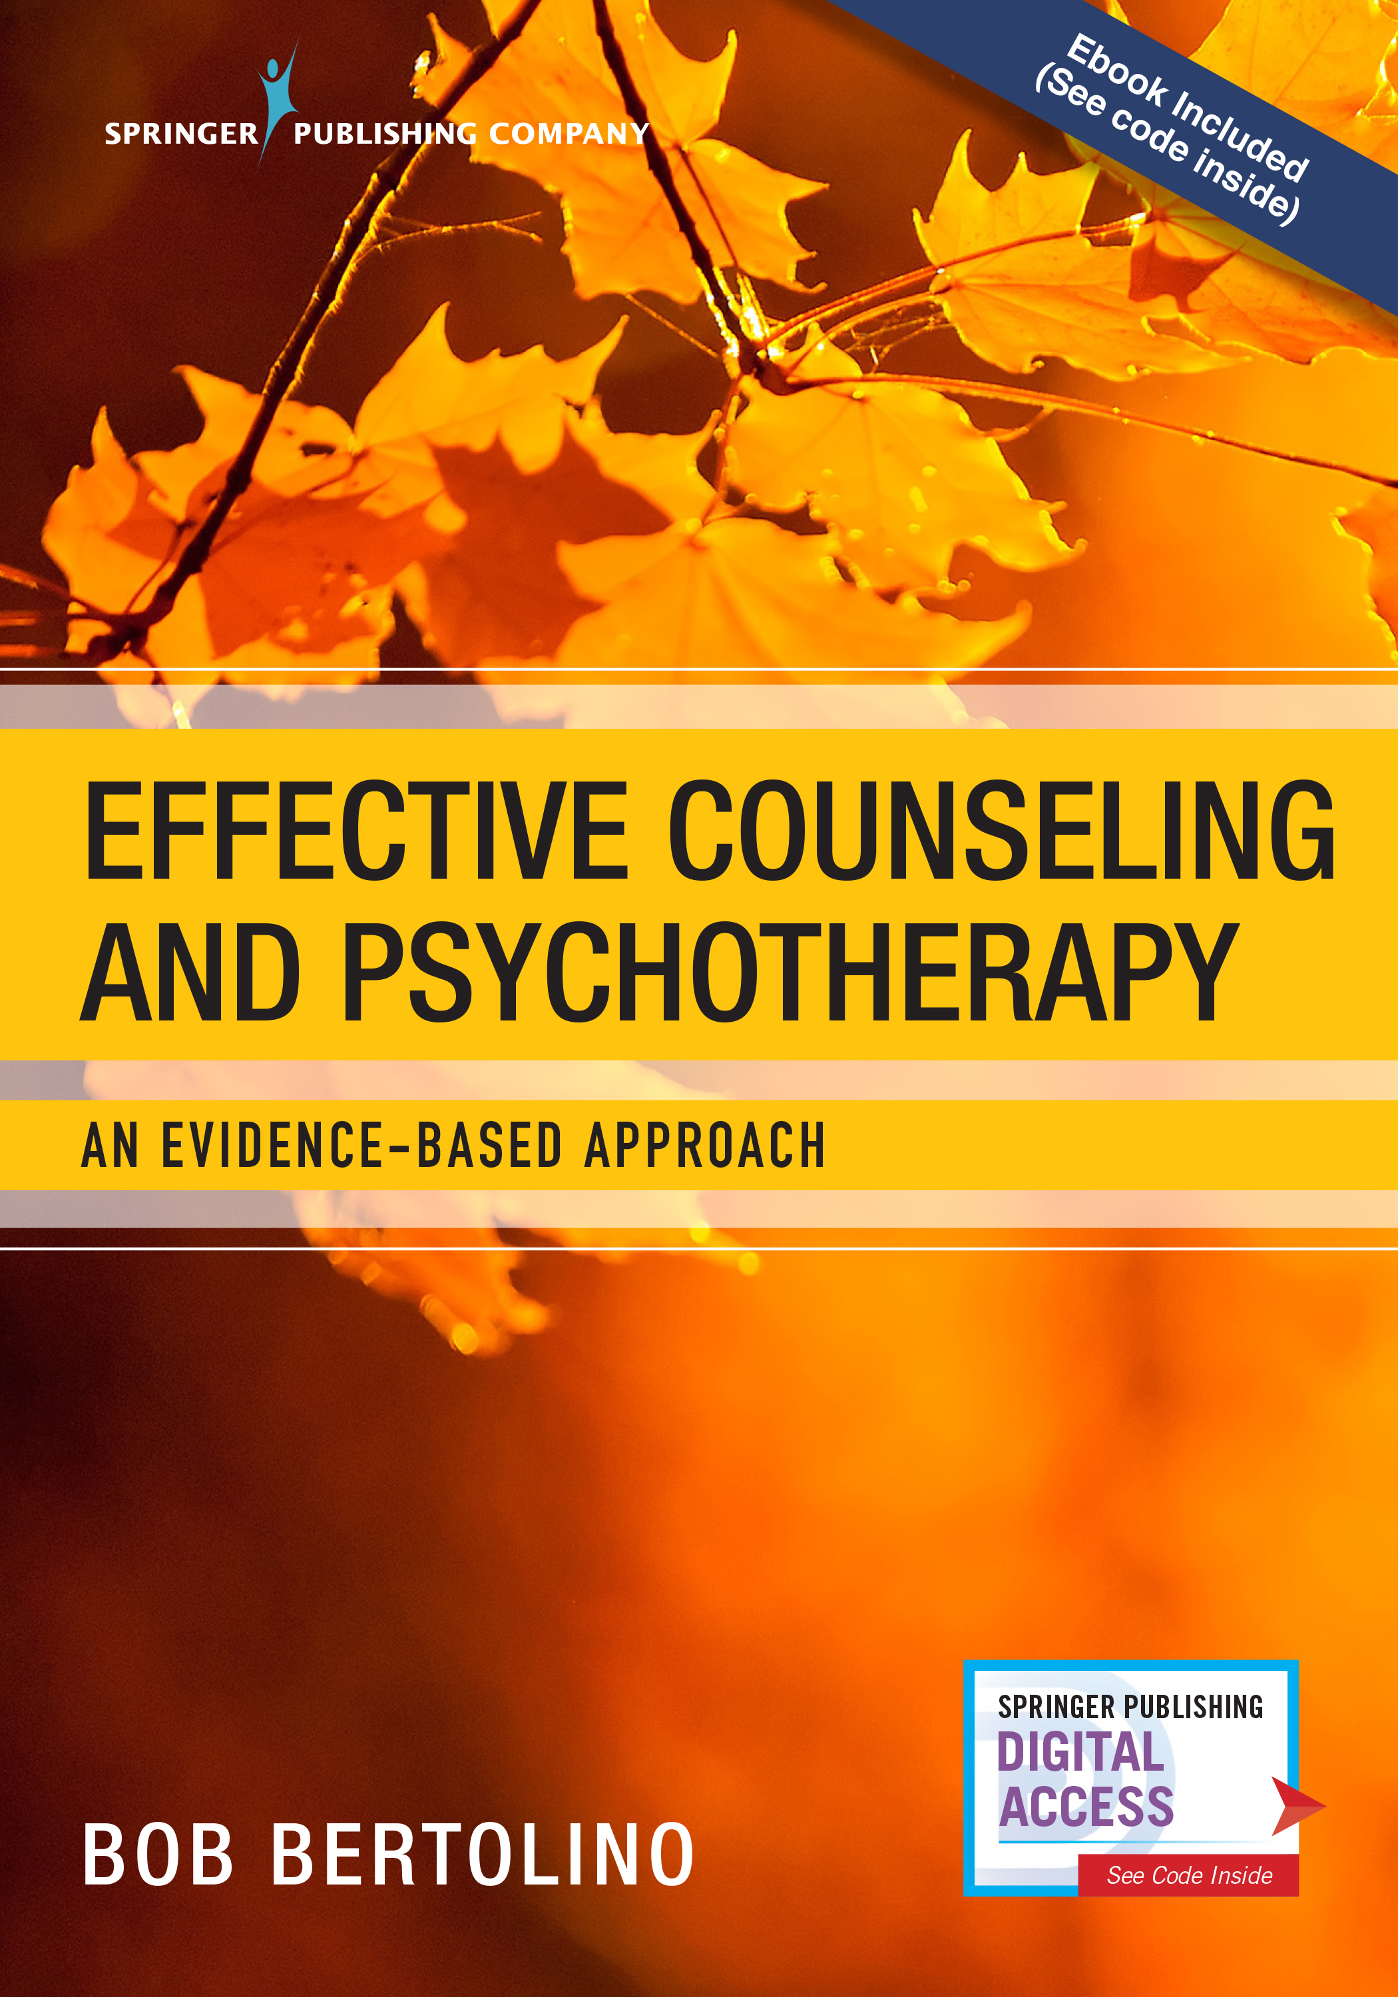
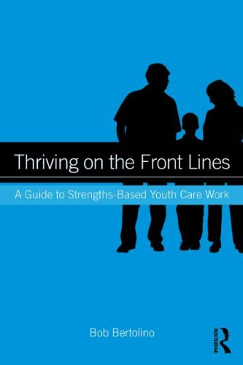
What is Strengths-Based?
A strengths-based perspective emphasizes the abilities and resources people have within themselves and their support systems to more effectively cope with life challenges. When combined with new experiences, understandings and skills, these abilities and resources contribute to improved well-being and outcome, which is comprised of three areas of functioning: individual, interpersonal relationships, and social role. Strengths-based practitioners value relationships and convey this through respectful, culturally-sensitive, collaborative, practices that support, encourage and empower. Routine outcome monitoring (ROM) is used to create and maintain a culture of feedback—a responsive, consumer-driven climate to ensure the greatest benefit of services.
Bertolino, B. (2018). Effective counseling and psychotherapy: An evidence-based approach. New York:
Springer
Bertolino, B. (2014). Thriving on the front lines: Strengths-based youth care work. New York: Routledge.

Slide 7
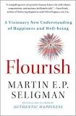
Positive Psychology Defined
1) Positive Psychology focuses on: “What kinds of families result in children who flourish, what work settings support the greatest satisfaction among workers, what policies result in the strongest civic engagement, and how people’s lives can be most worth living.” (p. 5)
2) Positive psychology is the field of study dealing with the human experiences and strengths that make life most worth living. This field encompasses the understanding and facilitation of valued qualities such as happiness and well-being, optimal experiences, good health, optimism, responsibility, and good citizenship that enable both individuals and the broader culture to thrive.
Seligman, M. E. P., & Csikszentmihalyi, M. (2000). Positive psychology: An introduction. American Psychologist, 55(1), 5–14.

Slide 8
The Aim of Positive Psychology
We aim to help adolescents and young adults to:
develop skills to flourish by reducing and preventing negative symptoms and building well-being.
have more positive emotional experiences, better relationships, more meaning in life, and accomplish what they set out to do.
live healthier lives both physically and psychologically.

Slide 9
Positive Youth Development (PYD)
An ongoing process of engaging youth in safe, secure environments through activities, interventions, and programs that promote growth, development, and overall well-being.
Rewarding bonding
Fostering resilience
Promoting social, emotional, cognitive, behavioral, and moral competence
Fostering self-determination
Fostering spirituality
Fostering clear and positive identity
Building belief in the future
Providing recognition for positive behavior
Providing opportunities for prosocial development
Fostering prosocial norms
Bertolino, B. (2014). Thriving on the front lines: Strengths-based youth care work. New York: Routledge.

Slide 10
Well-Being Contributors
Lyubomirsky, S. (2007). The how of happiness: A scientific approach to getting the life you
want. New York: Penguin.

Slide 11
Intentional Activities
“Circumstances happen to people, and activities are ways that people act on their circumstance.” (Lyubomirsky et al., 2005, p. 118)
Intentional activities involve engaging in new actions, activities, and behaviors which form new habits, routines, and patterns.
These new routines—which are forms of “mental flossing—increase well-being.
The result is improved well-being, which is correlated with higher life satisfaction, better learning and retention, more creativity, and greater resiliency.
Lyubomirsky, S., Sheldon, K. M., Schkade, D. (2005). Pursuing happiness: The architecture of sustainable change.
Review of General Psychology, 9, 111-131.

Slide 12
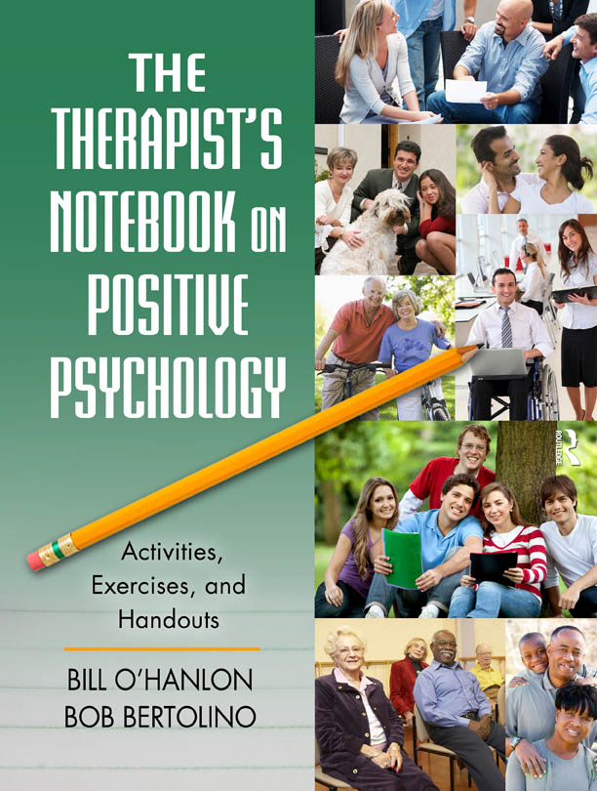
Considerations for Intentional Activities
Focus on fundamental skills such as listening, attending, and eliciting feedback and respond to that feedback immediately as a means of strengthening the therapeutic relationship.
Collaborate with adolescents and young adults to determine which exercises provide the best fit.
Consider cultural and contextual factors with positive interventions.
Encourage adolescents and young adults to try agreed-upon exercises in a routine and ongoing manner, continue those exercises that have proven beneficial, and experiment with new ones as needed.
Package exercises to increase the likelihood of benefit.

Slide 13
Five Pillars of Well-Being (PERMA) (Intentional Activities)
Positive Emotion: Happiness (and lastingly happier); Joy; Life Satisfaction
Engagement: “Being at one” with some absorbing activity (Flow)
Relationships: Building positive relationships and social connections
Meaning: Using what is best inside you to belong to and serve something bigger than you are (the “larger” world and society)
Accomplishments: Achievement, Competence, Mastery, Development of New Skills over life span
Seligman, M. E. P. (2011). Flourish: A visionary new understanding of happiness and well-being. New York: The Free Press.

Slide 14
Examples of Positive Psychology Exercises
Positivity Ratio
Your Way
Past, Present, and Future
Future Focus
Letter to Future Self
What went well?
Savoring
Broaden-and-Build
Mindset
Signature Strengths
Language
Gratitude
Altruism
Mindfulness
Flow
Finding Purpose and Direction
Three Blessings
Exercise
Forgiveness
Accomplishment

Slide 15
Past, Present, and Future
Think of an event, situation, or experience from the past that you have good memories about.
Take a deep breath or two and immerse yourself as much as possible on the event.
Focus on your sensations. What you can see, hear, taste, smell, and/or feel in your body. Also notice your emotions.
Stay with and savor those pleasant sensations and emotions and develop them as much as you can.
Try to remain in the experience for 3-5 minutes.
Repeat the exercise by focusing on the present, and more recent or current experiences. Then do the same with future and “hoped-for” experiences.

Slide 16
What Went Well?
For one week, identify and write down three good things that went well each day;
Write down what influenced those things;
At the end of the week reflect on the collection of good things and if comfortable, share your experience with another person.

Slide 17
Broaden-and-Build
Positive emotions expand what an individual feels like doing at any given time.
Have the student listen to a song, watch a movie, or read a passage from a book.
Have the student identify one of five emotions he or she feels (i.e., joy contentment, fear, anger, or neutral).
Have the student list everything he or she would like to do at that moment.

Slide 18
Mindset
Fixed: Some people believe that their skills and intelligence are set—that they have what they have. That you don’t have the capacity to learn and grow. Skills are born.
Growth: Others believe that their skills and intelligence are things that can be developed and improved. That they do have the capacity to learn and grow. Skills are built.
The research shows that a growth mindset can foster grit, determination, and work ethic with students, athletes, and people of all ages.
Have the client focus on a particular problem or struggle they are encountering.
Have the client describe the problem or struggle including what they think they can and are willing to do about the situation.
If the client is not already using a growth mindset, discuss the importance of being creative, taking reasonable risks, and failure. Suggest that the client “test” using a growth mindset with the problem or struggle. Evaluate the results.
Resources: http://calserves.org/resources/calprep/additional-calprep-resources/growth-mindset/

Slide 19
VIA Signature Strengths
Complete the VIA Survey of Character Strengths.
Go to: www.authentichappiness.org.
Go to “Questionnaires” and click on “Get Started.”
Click on “Questionnaire Center.”
Scroll down to “VIA Survey of Character Strengths” or “VIA Strength Survey for Children.”
Complete the questionnaire to learn about how your character strengths rank in comparison to “like” others.

Slide 20
VIA Signature Strengths (cont.)
Wisdom and Knowledge: Cognitive strengths that entail the acquisition and use of knowledge
Courage: Emotional strengths that involve the exercise of will to accomplish goals in the face of opposition, external or internal
Humanity: Interpersonal strengths that involve “tending and befriending” others
Justice: Civic strengths that underlie healthy community life
Temperance: Strengths that protect against excess
Transcendence: Strengths that forge connections to the larger universe and thereby provide meaning

Slide 22
Signature Strengths Exercises
Take one signature strength and for the following week use that strength in a new way, every day.
Create opportunities to experience positive emotions and develop skills around character strengths that serve as buffers to specific challenges of adolescents and young adults.
Peterson, C. (2006). A primer in positive psychology. New York: Oxford University Press.
Seligman, M. E. P., Steen, T. A., Park, N., & Peterson, C. (2005). Positive psychology progress: Empirical validation of
Interventions. American Psychologist, 60(5), 410-421.

Slide 23
Character Strengths and Posttraumatic Growth
Character Strengths found to predict Posttraumatic Growth:
Bravery
Gratitude
Hope
Kindness
Religiousness
Character Strengths found to be important mediators of success in situations characterized by significant cognitive, emotional, and physical challenges:
Courage
Honesty
Leadership
Optimism
Self-regulation
Teamwork
Mathews, M. D. (2008). Positive psychology: Adaptation, leadership, and performance in exceptional circumstances. In P. A. Hancock & J. L. Szalma
(Eds.), Performance under stress (pp. 163-180). Aldershot, England: Ashgate.

Slide 24
Character Strengths and Common Concerns
Presenting Problem | Potential Character Strength Utilized
Effective prevention of depression relapse | Perspective, Curiosity, Judgment, Spirituality
Residual depressive symptoms | Curiosity, Perseverance
Anxiety | Self-Regulation, Bravery, Fairness, Curiosity
Body-image issues | Gratitude, Kindness
Drug Use | Self-Regulation, Bravery
Trauma | Perseverance, Bravery, Hope
Improved attention and working memory | Self-Regulation, Love of Learning
Reduced anxiety; adaptive learning dealing with threat | Self-Regulation, Curiosity, Perspective
Improved romantic relationships | Love, Kindness, Social Intelligence
Decreased negative self-focused attention | Zest, Humor
Decreased negative affect | Zest, Hope
Rashid, T. (2009). Positive interventions in clinical practice. Journal of Clinical Psychology: In Session, 65(5), 461-466.

Slide 25
Language: The Costs of Negativity
Research shows that extensive discussions of problems and encouragement of ‘‘problem talk,’’ rehashing the details of problems, speculating about problems, and dwelling on negative affect in particular, leads to a signiﬁcant increase in the stress hormone cortisol, which predicts increased depression and anxiety over time. (Byrd-Craven, Geary, Rose, & Ponzi, 2008)
People who are in a more positive mood are better liked by others and more open to new ideas and experiences. (Fredrickson, 1998)
Byrd-Craven, J., Geary, D. C., Rose, A. J., & Ponzi, D. (2008). Co-ruminating increase stress hormone levels in women. Hormones
and Behavior, 53, 489–492.
Fredrickson, B. (1998). What good are positive emotions? Review of General Psychology, 2, 300-319.

Slide 26
Language: The Costs of Negativity (cont.)
Recent studies by the University of Pennsylvania demonstrated a link between language used on social media (i.e., Facebook, Twitter, etc.) and heart disease—expressions of negative emotions such as anger, stress and fatigue in tweets were associated with higher heart disease risk. (Eichstaedt, et al., 2015a, 2015b)
The same researchers also found that positive emotions like excitement and optimism were associated with lower risk of heart disease. (Eichstaedt, et al., 2015a, 2015b)
Ireland, Schwartz, Chen, Ungar, and Albarracin (2015) studied HIV prevalence and learned that sexually transmitted infection rates and references to risky behavior on Twitter were associated with higher HIV prevalence in all counties except those with high rates of future orientation.
Eichstaedt, J. C., Schwartz, H. A., Kern, M. L., Park, G., Labarthe, D. R., Merchant, R. M., Jha, S., Agrawal, M., Dziurzynski, L. A., Sap, M., Weeg,
C., Larson, E. E., Ungar, L. H., & Seligman, M. E. P. (2015a). Psychological language on Twitter predicts county-level heart disease mortality.
Psychological Science, Vol 26(2), 159-169.
Eichstaedt, J. C., Schwartz, H. A., Kern, M . L., Labarthe, D. L., Merchant, R. M.,Jha, S., Agrawal, M., Dziurzynski, L. A., Sap, M., Weeg, C., Larson,
E. E., Ungar, L. H., & Seligman, M. E. P. (2015b). Psychological language on Twitter predicts county-level heart disease mortality. Psychological
Science, 1-11.
Ireland, M. E., Schwartz, H. A., Chen, Q., Ungar, L. H., & Albarracin, D. (2015). Future-oriented tweets predict lower county-level HIV prevalence in
the United States. Health Psychology, 34, 1252-1260.

Slide 27
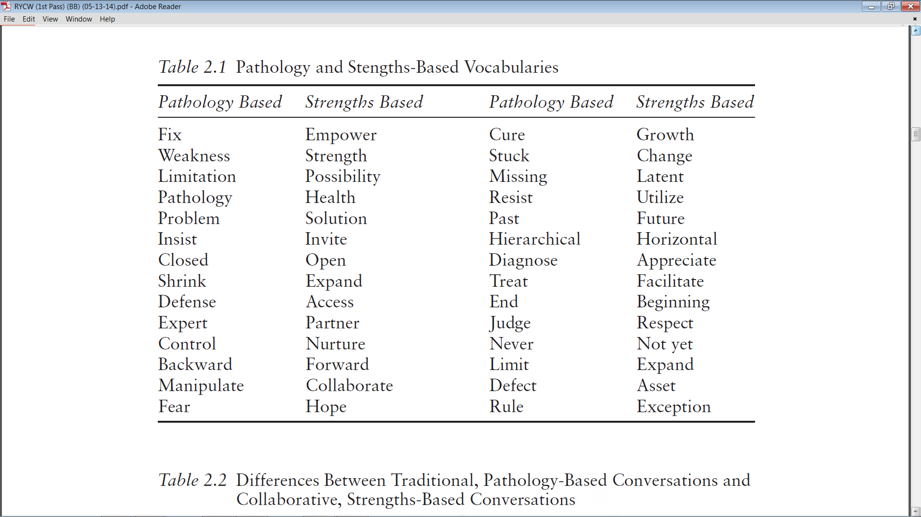
Bertolino, B. (2015). The residential youth care worker in action: A collaborative, strengths-based approach.
New York: Routledge.

Slide 28
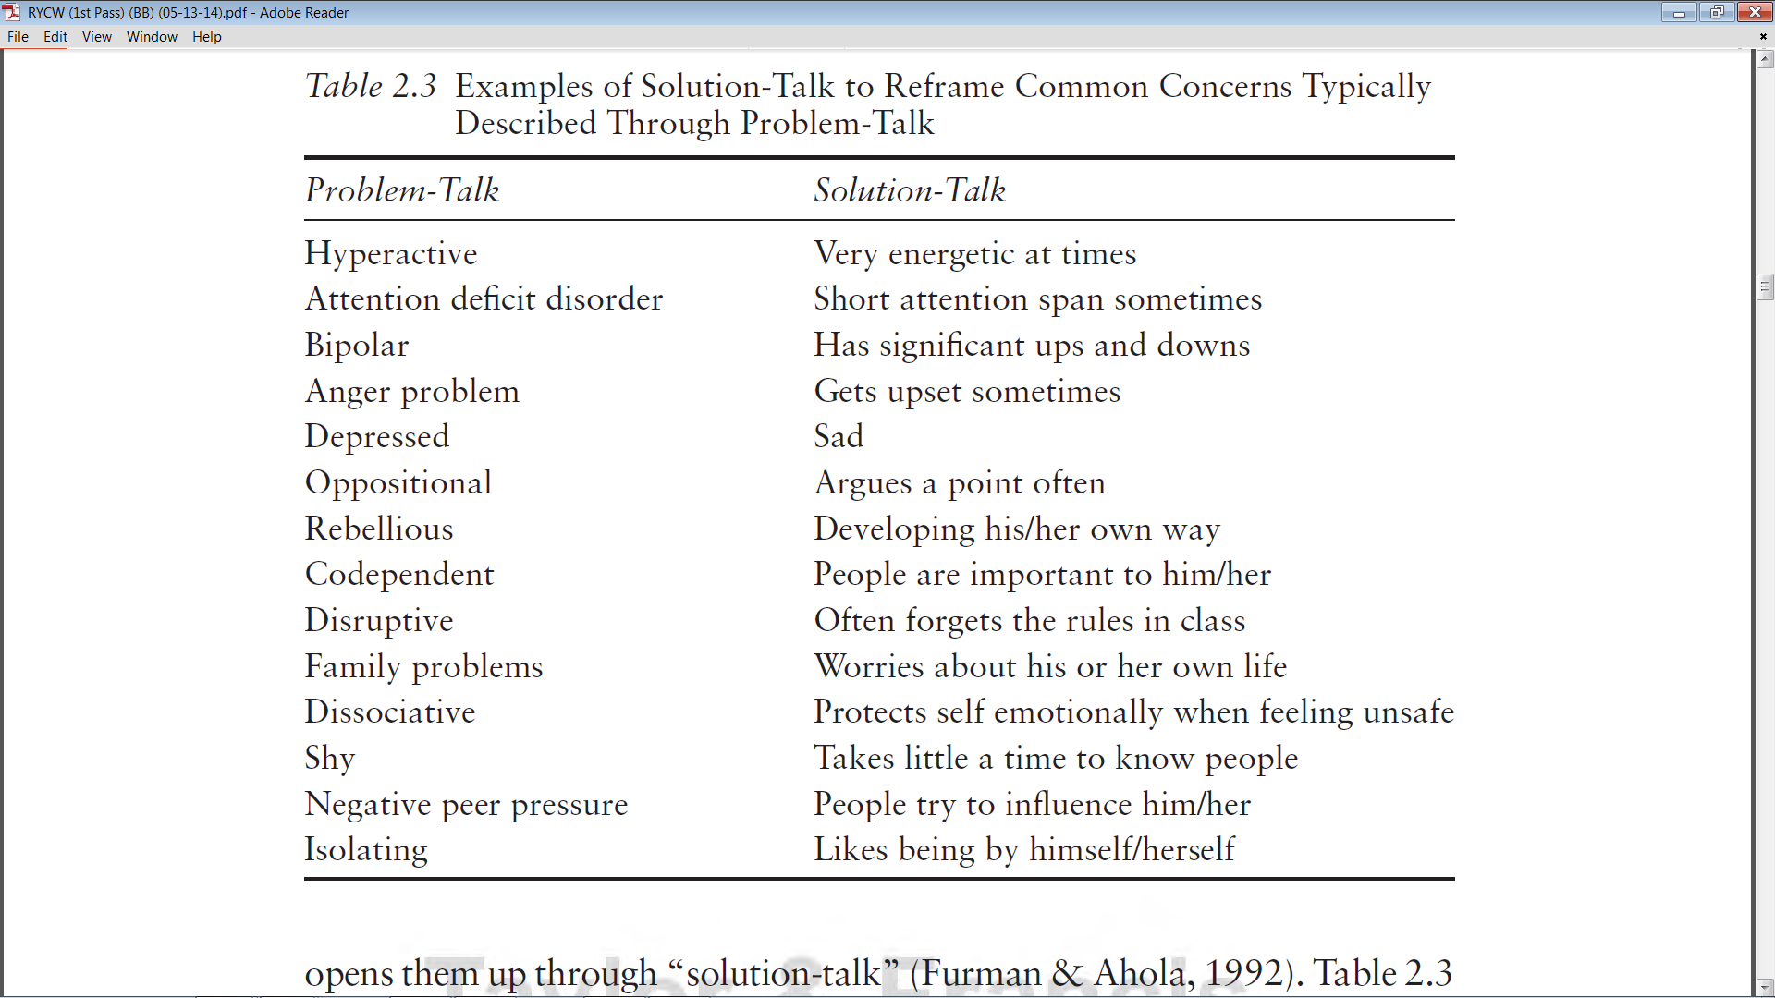
Bertolino, B. (2015). Working with children and adolescents in residential care: A strengths-based approach. New York: Routledge.

Slide 29
Gratitude Visit & More
Think of someone who has done something important and wonderful for you, yet who has not been properly thanked.
Reflect on the benefits you received from this person, and write a letter expressing your gratitude for all he or she did for you.
The letter should be approximately 300 words. Rehearse the letter over and over until you know it by heart.
Arrange to deliver the letter personally, and spend some time with this person talking about what you wrote.
Modify the exercise for adolescents and young adults.
Further examples: Journals; Diaries; Post-its; Bulletin or Poster Boards
Can be private or public expressions

Slide 30
Altruism
Random acts of kindness: Feel happier by doing things for others.
Put a human face on suffering: When reading or watching the news, look for profiles of specific individuals and try to imagine what their lives have been like.
Give thanks: Grateful people are more generous, perhaps because they’re paying forward the gifts they appreciate receiving from others. Receiving gratitude can also encourage altruism.
Lead by example: Reading about extraordinary acts of kindness makes people more generous, perhaps because they experience the warm, uplifting feelings psychologists call “elevation.” But people who consistently display altruism are encouraging others to follow suit. Research suggests altruistic children have parents or other caregivers who deliberately model helpful behavior or stress altruistic values.

Slide 31
Volunteering
Volunteering has been shown to dramatically increase well-being and reduce both depression and anxiety.
Help the adolescent or young adult to select an area that he or she thinks a difference can be made.
Investigate opportunities in that area.
Have the adolescent or young adult begin by giving a small portion of his or her time to that cause.
Have the adolescent or young adults take time to sit back and reflect on his or her experience.
Have the adolescent or young adult journal and/or share with others.

Slide 32
Mindfulness Exercises
Identify key words that are validate, support, inspire, and increase optimism. Then, say those key words, repeating them in different ways while noticing the feelings, thoughts, and images that arise. When you are done, write about your experience for 5-10 minutes.
Capture a positive state (i.e., feeling joy, spontaneous, inspired, or the like) and focus on the words for 15-20 minutes, becoming fully immersed in the positive state.
Breathing space exercise is when a 3-minute exercise in which the person tunes into the present moment, focusing on the breath, and then expanding the awareness to sense the whole body.
Mindful walking and other forms of behavioral activation have been linked with increased energy and well-being.

Slide 33
Flow
Optimal performance that exists between overexertion and underexertion—where we are able to not only perform at our best but also enjoy what we are doing.
Choose an activity that the adolescent or young adult can focus on without interruption (e.g., a creative endeavor, conversation, etc.).
Have the adolescent or young adult engage in the activity for a minimum of 20 minutes.
Immediately following the activity, have the adolescent or young adult write down what he or she remembers about the experience.

Slide 34
Accomplishment
Become a “donor” – Collect to give
Become an “accumulator” – Collect to increase your sense of accomplishment
“Spread the Word” through diaries, journals, scrapbooks
Create artwork, music
Public speaking
Learn something new (e.g., a language, appreciation for art, etc.)

Slide 35
Finding Life Purpose or Direction
Four signals or life energies:
Blissed
Blessed
Pissed
Dissed
What do you feel inspired to change around you or in the world?
What are you grateful for that you would like to share with others?
What would you talk about if given an hour of prime time television to influence the nation or the world?
What frustrates you off that you would like to correct in the world or other people?
What can’t you sit still for?
Adapted from the work of Bill O’Hanlon

