Slide 1
Part 2: Frozen in Time
Advances in the Treatment of
Sexual Abuse and Trauma
Bob Bertolino, Ph.D. Professor, Maryville University
Sr. Clinical Advisor, Youth In Need, Inc.
Sr. Associate, International Center for Clinical Excellence

Slide 2
Increasing Well-Being

Slide 3
Post-Traumatic Growth
Only a percentage of people who experience serious distress and/or traumatic events develop symptoms of PTSD.
Examples include: Bereavement, bone marrow transplantation, breast cancer, chronic illness, heart attack, military combat, natural disaster, physical assault, and refuges displacement.
Most, cope sufficiently, having various ups and downs but few catastrophic lows.
And, a percentage of people actually grow from their traumatic experiences.

Slide 4
Post-Traumatic Growth (cont.)
Growth from events that traumatic situations and conditions has been referred to as Adversarial Growth or Post-Traumatic Growth (Calhoun & Tedeschi, 2013; Tedeschi, Park, & Calhoun, 1998).
What kind of growth do people experience?
Spirituality
Compassion for others
Openness
Even, eventually, overall life satisfaction
Calhoun, L. G., & Tedeschi, R. G. (2013). Posttraumatic growth in clinical practice. New York: Routledge.
Tedeschi, R. G., Park, C. L., & Calhoun, L. G. (1998). Posttraumatic growth: Positive changes in the aftermath of crisis. New Jersey: Lawrence Erlbaum.

Slide 5
Post-Traumatic Growth (cont.)
What distinguishes the people who find growth in traumatic experiences from those who do not?
Mindset: How people conceive of the cards they have been dealt.
Positive reinterpretation of the situation or event.
Optimism.
Acceptance.
Focusing on the problem head-on (rather than trying to avoid it).
Calhoun, L. G., & Tedeschi, R. G. (2013). Posttraumatic growth in clinical practice. New York: Routledge.
Tedeschi, R. G., Park, C. L., & Calhoun, L. G. (1998). Posttraumatic growth: Positive changes in the aftermath of crisis. New Jersey: Lawrence Erlbaum.

Slide 6
Five Pillars of Well-Being (PERMA) (Intentional Activities)
Positive Emotion: Happiness (and lastingly happier); Joy; Life Satisfaction
Engagement: “Being at one” with some absorbing activity (Flow)
Relationships: Building positive relationships and social connections
Meaning: Using what is best inside you to belong to and serve something bigger than you are (the “larger” world and society)
Accomplishments: Achievement, Competence, Mastery, Development of New Skills over life span
Seligman, M. E. P. (2011). Flourish: A visionary new understanding of happiness and well-being. New York: The Free Press.

Slide 7
Examples of Positive Psychology Exercises
Positivity Ratio
Your Way
Past, Present, and Future
Future Focus
Letter to Future Self
What went well?
Savoring
Broaden-and-Build
Mindset
Language
Gratitude
Altruism
Mindfulness
Volunteering
Character Strengths
Flow
Finding Purpose and Direction
Exercise
Forgiveness
Accomplishment

Slide 8
Language: The Costs of Negativity
Research shows that extensive discussions of problems and encouragement of ‘‘problem talk,’’ rehashing the details of problems, speculating about problems, and dwelling on negative affect in particular, leads to a signiﬁcant increase in the stress hormone cortisol, which predicts increased depression and anxiety over time. (Byrd-Craven, Geary, Rose, & Ponzi, 2008)
People who are in a more positive mood are better liked by others and more open to new ideas and experiences. (Fredrickson, 1998)
Byrd-Craven, J., Geary, D. C., Rose, A. J., & Ponzi, D. (2008). Co-ruminating increase stress hormone levels in women. Hormones
and Behavior, 53, 489–492.
Fredrickson, B. (1998). What good are positive emotions? Review of General Psychology, 2, 300-319.

Slide 9
Language: The Costs of Negativity (cont.)
Recent studies by the University of Pennsylvania demonstrated a link between language used on social media (i.e., Facebook, Twitter, etc.) and heart disease—expressions of negative emotions such as anger, stress and fatigue in tweets were associated with higher heart disease risk. (Eichstaedt, et al., 2015a, 2015b)
The same researchers also found that positive emotions like excitement and optimism were associated with lower risk of heart disease. (Eichstaedt, et al., 2015a, 2015b)
Ireland, Schwartz, Chen, Ungar, and Albarracin (2015) studied HIV prevalence and learned that sexually transmitted infection rates and references to risky behavior on Twitter were associated with higher HIV prevalence in all counties except those with high rates of future orientation.
Eichstaedt, J. C., Schwartz, H. A., Kern, M. L., Park, G., Labarthe, D. R., Merchant, R. M., Jha, S., Agrawal, M., Dziurzynski, L. A., Sap, M., Weeg,
C., Larson, E. E., Ungar, L. H., & Seligman, M. E. P. (2015a). Psychological language on Twitter predicts county-level heart disease mortality.
Psychological Science, Vol 26(2), 159-169.
Eichstaedt, J. C., Schwartz, H. A., Kern, M . L., Labarthe, D. L., Merchant, R. M.,Jha, S., Agrawal, M., Dziurzynski, L. A., Sap, M., Weeg, C., Larson,
E. E., Ungar, L. H., & Seligman, M. E. P. (2015b). Psychological language on Twitter predicts county-level heart disease mortality. Psychological
Science, 1-11.
Ireland, M. E., Schwartz, H. A., Chen, Q., Ungar, L. H., & Albarracin, D. (2015). Future-oriented tweets predict lower county-level HIV prevalence in
the United States. Health Psychology, 34, 1252-1260.

Slide 10
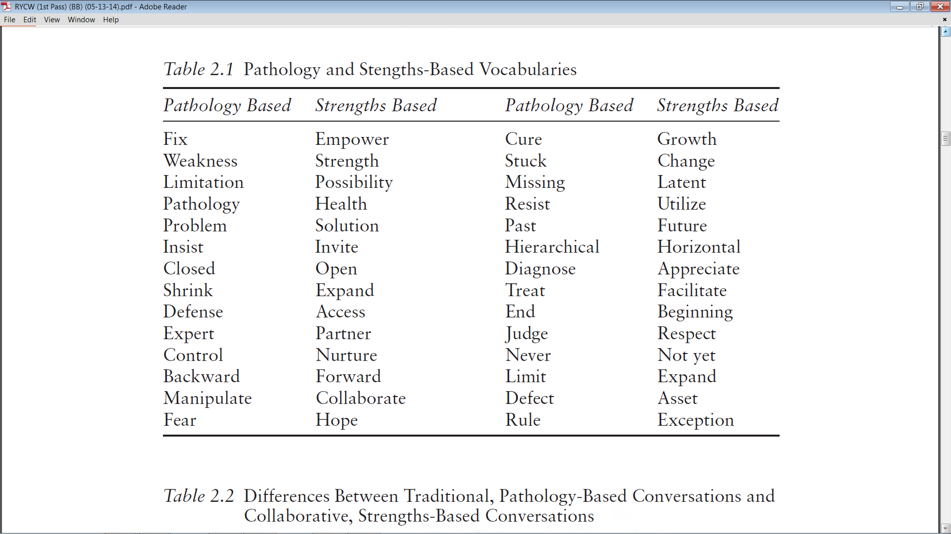
Bertolino, B. (2015). The residential youth care worker in action: A collaborative, strengths-based approach.
New York: Routledge.

Slide 11
Mindfulness Exercises
Identify key words that are validate, support, inspire, and increase optimism. Then, say those key words, repeating them in different ways while noticing the feelings, thoughts, and images that arise. When you are done, write about your experience for 5-10 minutes.
Capture a positive state (i.e., feeling joy, spontaneous, inspired, or the like) and focus on the words for 15-20 minutes, becoming fully immersed in the positive state.
Breathing space exercise is when a 3-minute exercise in which the person tunes into the present moment, focusing on the breath, and then expanding the awareness to sense the whole body.
Mindful walking and other forms of behavioral activation have been linked with increased energy and well-being.

Slide 12
Volunteering
Volunteering has been shown to dramatically increase well-being and reduce both depression and anxiety.
Help the client to select an area that he or she thinks a difference can be made.
Investigate opportunities in that area.
Have the client begin by giving a small portion of his or her time to that cause.
Have the client take time to sit back and reflect on his or her experience.
Have the client journal and/or share with others.

Slide 13
VIA Signature Strengths
Wisdom and Knowledge: Cognitive strengths that entail the acquisition and use of knowledge
Courage: Emotional strengths that involve the exercise of will to accomplish goals in the face of opposition, external or internal
Humanity: Interpersonal strengths that involve “tending and befriending” others
Justice: Civic strengths that underlie healthy community life
Temperance: Strengths that protect against excess
Transcendence: Strengths that forge connections to the larger universe and thereby provide meaning

Slide 15
Character Strengths and Posttraumatic Growth
Character Strengths found to predict Posttraumatic Growth:
Bravery
Gratitude
Hope
Kindness
Religiousness
Character Strengths found to be important mediators of success in situations characterized by significant cognitive, emotional, and physical challenges:
Courage
Honesty
Leadership
Optimism
Self-regulation
Teamwork
Mathews, M. D. (2008). Positive psychology: Adaptation, leadership, and performance in exceptional circumstances. In P. A. Hancock & J. L. Szalma
(Eds.), Performance under stress (pp. 163-180). Aldershot, England: Ashgate.

Slide 16
Character Strengths and Common Concerns
Presenting Problem | Potential Character Strength Utilized
Effective prevention of depression relapse | Perspective, Curiosity, Judgment, Spirituality
Residual depressive symptoms | Curiosity, Perseverance
Anxiety | Self-Regulation, Bravery, Fairness, Curiosity
Body-image issues | Gratitude, Kindness
Drug Use | Self-Regulation, Bravery
Trauma | Perseverance, Bravery, Hope
Improved attention and working memory | Self-Regulation, Love of Learning
Reduced anxiety; adaptive learning dealing with threat | Self-Regulation, Curiosity, Perspective
Improved romantic relationships | Love, Kindness, Social Intelligence
Decreased negative self-focused attention | Zest, Humor
Decreased negative affect | Zest, Hope
Rashid, T. (2009). Positive interventions in clinical practice. Journal of Clinical Psychology: In Session, 65(5), 461-466.

Slide 17
Finding Life Purpose or Direction
Four signals or life energies:
Blissed
Blessed
Pissed
Dissed
Adapted from the work of Bill O’Hanlon

Slide 18
Measuring Well-Being
PERMA
Outcome Rating Scale (ORS)
Positive Emotion
Engagement
Relationships
Meaning
Accomplishments
Individual
Interpersonal
Social Role

Slide 19
Pushing the Envelope

Slide 20
Pushing the Envelope
Available studies indicate that fluoxetine (Prozac) produces better outcomes than CBT, which has better outcomes than PET. In most clinical trials the outcomes of all three do not statistically exceed placebo conditions. (van der Kolk, 2014)
However, three approaches have achieved outcomes that far exceed other treatments.
van der Kolk, B. (2014). The body keeps the score: Brain, mind, and body in the healing of trauma. New York: Viking.

Slide 21
Pushing the Envelope (cont.)
MDMA (ecstasy): In a review of current literature, researchers found an overall remission rate of 66.2% and low rates of adverse effects have been found in the six phase two trials conducted in clinical settings with 105 blinded subjects with chronic PTSD. The results seem to support MDMA’s safe and effective use as an adjunct to psychotherapy (Thal & Lommen, 2018).
Thal, S. B., & Lommen, M. J. J. (2018). Current perspective on MDMA-assisted psychotherapy for Posttraumatic Stress
Disorder. Journal of Contemporary Psychotherapy. Published online, Jan 6, 2018.

Slide 22
Pushing the Envelope (cont.)
Ketamine: A growing body of research demonstrate the benefits Ketamine with persons experiencing PTSD and who had, in many cases, been unresponsive to conventional therapies.
In one study, researcher found that following treatment, inpatient hospital days were reduced by 70%, and hospital admissions were reduced by 65%. The dose of ketamine patients required was stable over time with no evidence of tolerance building. There were no serious adverse events and no long-term negative effects associated with ketamine (Hartberg, Garrett-Walcott, & De Gioannis, 2018).
Hartberg, J., Garrett-Walcott, S., & De Gioannis, A. (2018). Impact of oral ketamine augmentation on hospital admissions in
treatment-resistant depression and PTSD: A retrospective study. Psychopharmacology, 325(2), 393-398.

Slide 23
Pushing the Envelope (cont.)
Eye Movement Desensitization and Reprocessing (EMDR): EMDR is widely recognized as an acceptable and appropriate treatment methodology for trauma.
24+ RCTs; 20 RCTs on efficacy of eye movements
Examples: 84% of single trauma clients no longer fit the criteria for PTSD after three 90 minute sessions; 100% no longer fit criteria after six 50 minute sessions.
The research is composed of meta-analyses, random clinical trials, non-randomized studies and other supporting studies
A comprehensive list of clinical trials can be found at: EMDR Institute: The Efficacy of EMDR
I

Slide 24
EMDR as a Trauma Treatment
Uses the natural processing of the brain
Minimizes retraumatization of the traumatized person
Focuses on processing (BLS)
Traumatic memory fragmentation
Processing occurs at a heightened speed, not all elements are discussed as in talk therapy
Mirrors REM sleep, which is how we process information (if we learn a skill but do not achieve REM sleep the skill is lost)
Tap into information processing that moves unresolved memories to resolution

Slide 25
EMDR as a Trauma Treatment (cont.)
Three-pronged approach: Addresses the past memory, current trauma reminders, and future anticipation of trauma reminders.
Like CBT with a trauma focus, EMDR aims to reduce subjective distress and strengthen adaptive beliefs related to the traumatic event(s).
However, unlike CBT with a trauma focus, EMDR does not involve detailed description of the events, direct challenging of beliefs, extended exposure, or homework.
Where as CBT with a trauma focus and prolonged exposure methods increase arousal, the addition of eye movements can lead to an immediate decline in arousal.
It is hypothesized that EMDR taxes working memory, facilitates memory processing, leads to integration, and new associations.

Slide 26
Components of the Model
Phase 1: History taking and Client selection
Phase 2: Preparation Checklist
Phase 3: Assessment
Phases 4-7 (Reprocessing Procedures): Desensitization; Installation; Body Scan; Closure
Phase 8: Reevaluation

Slide 27
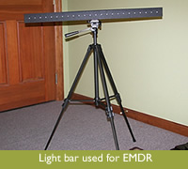
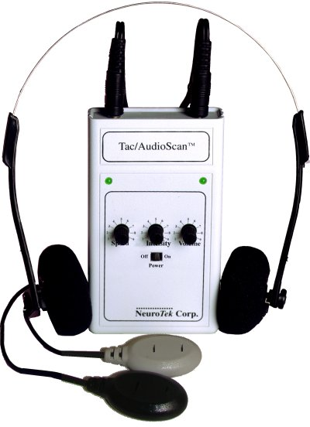
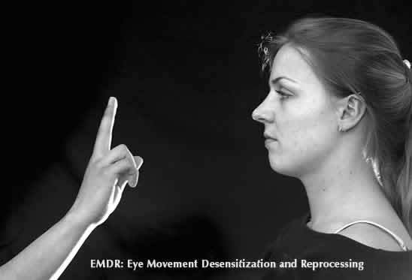
BLS can also be simulated while holding pulsating devices (tactile)
Light bars are often used to simulate the BLS (visual)
The client can also listen to music alternating from ear to ear (auditory)
Finger puppets are often used for BLS with children

Slide 28
Additional Neurobiological Strategies
Breathing
Yoga
Mindfulness (also see “viewing”)
Smelling essential oils
Suggest changes in sensory attention
Thought Field Therapy (TFT) or Emotional Freedom Techniques (EFT)
Clinical Hypnosis
Vagus nerve stimulation

Slide 29
Thought Field Therapy (TFT)
Find target memory or symptom
Get SUDS rating (1-10)
Tap selected points
Do 9-gamut treatment
Tap selected points
Treat for reversal (if necessary)
Get new SUDS rating
* See handout

Slide 30
Emotional Freedom Techniques (EFT)
Complete the setup
Complete the “sequence”
Complete 9-gamut procedure
Repeat the “sequence”
* See handout

Slide 31
Clinical Hypnosis
Provides insights into subjective experience.
Enhances one’s sense of personal control.
Multi-dimensional applications.
Enhances cognitive, behavioral, and emotional flexibility.
Hypnosis is now well-integrated into the fields of psychotherapy and behavioral medicine based on substantive empirical evidence for its efficacy.

Slide 32
Is Hypnosis a Therapy? There are good arguments to both yes and no. My view is that hypnosis is a tool, an experiential vehicle for stimulating new, therapeutic associations in the client.

Slide 33
What Does Hypnosis Do? It amplifies and/or de-amplifies specific elements of experience. It generates associations and dissociations.

Slide 34
Think in these terms: What frame of mind does someone need to be in in order to achieve the goal? Hypnosis is about building frames of mind.

Slide 35
The Salient Question… Is not, “Does hypnosis cure problem X?” Rather, “If one applies therapy approach Y without hypnosis and applies therapy approach Y with hypnosis, will the addition of hypnosis to the process likely enhance the treatment outcome?” The evidence suggest the answer is yes.

Slide 36
General Ways to Use Hypnosis
Symptom management strategies (e.g., enhancing sleep, reducing anxiety)
Skill-building/resource accessing (e.g., enhancing cognitive flexibility, building problem-solving skills)
De-framing and reframing (e.g., “It’s not you, it’s the way you go about it”
Association and dissociation (e.g., shifting focus away from feelings to action, shifting focus from past to future)

Slide 37
Indication – Contraindication
Indicated
Somatic/physiological difficulties unresponsive to medical interventions
Experiential difficulties
Obsessive automatic thinking
Affective difficulties
Hallucinations/flash-backs
Contraindicated
Actions
Interactions
Deliberate (non-automatic) thoughts

Slide 38
Language and Focus
Permissive rather than authoritarian
Offer choices rather than direction
Use permission not prediction
Create possibilities rather than mind-reading
Internally rather than externally-driven
Answers evoked from within rather than ideas and solutions given from outside
Not based on "positive thinking" or affirmations

Slide 39
Symptomatic and Healing Trances
Symptomatic Trance
Invalidation; blame; violating boundaries
Mystification; binds; double binds
Coalitions; secrets; negative dissociation
Predictions of failure or trouble; threats
Rigid role assignment; mind reading
Repetition of negative experiences/injurious/self-injurious behavior
Negative injunctions (You can’t, you shouldn’t you will, you are)
Repression; amnesia
Healing Trance
Validation; permission; respecting boundaries
Possibility words and phrases
Helpful distinctions
Post-hypnotic suggestions; presuppositions of health/healing
Positive attributions; avoidance of intrusive interpretations
Opening possibilities for changes in experience or behavior
Empowering/permissive affirmations (you can, it’s okay, you may, you could, you have the ability to)
Flexible remembering and forgetting

Slide 40
Induction Techniques by Age
Ages 4-6
Ages 7-11
Ages 12-18
Blowing breath out
Favorite place
Flower garden
Storytelling
Coin watching
Letter watching
Pop-up books
Television fantasy
Video
Bouncing ball
Finger lowering
Playground activity
Favorite place
Favorite activity
Cloud gazing
Flying blanket
Videogames
Riding a bike
Arm lowering
Blowing breath out
Favorite music
Listening to self on tape
Coin watching
Fixation at point on hand
Hands (or fingers) moving together
Arm rigidity
Favorite place/activity
Sports activity
Arm catalepsy
Following breathing
Videogames
Computer games
Eye fixation on hand
Driving a car
Playing or listening to music
Hand levitation
Hands (or fingers) moving together
Fantasy games

Slide 41
Problems to Solutions
Turn problem into processes
Focus/presenting problem
How does the person do the problem?
What type of solution is the client seeking?
What is the opposite class of experience (ability) that would solve this type of problem?

Slide 42
Problems to Solutions: Intervention
Design an intervention
Use an analogy
Tell a story
Agree on a task or action
Evoke a hypnotic shift in automatic experience
Evoke some experience interpersonally

