Slide 1
Youth In Need, Inc.
Feedback-Informed Treatment (FIT)
An Evidence-Based Approach
Bob Bertolino, Ph.D.
Codirector Clinical Mental Health Counseling Program, Maryville University-St. Louis
Professor of Psychology, Maryville University-St. Louis
Sr. Clinical Advisor, Youth In Need, Inc.
Sr. Associate, International Center for Clinical Excellence

Slide 2




Tidbits
For copyright reasons and confidentiality some of PowerPoint slides may be absent from your handouts.
To download a copy of this presentation, please go to: www.bobbertolino.com.
Please share the ideas from this presentation. You have permission to reproduce the handouts. I only ask that you maintain the integrity of the content.
Contact: bertolinob@cs.com; 314.852.7274
bobbertolino.com

Slide 3


Slide 5

Slides from training
SSFC

Slide 6
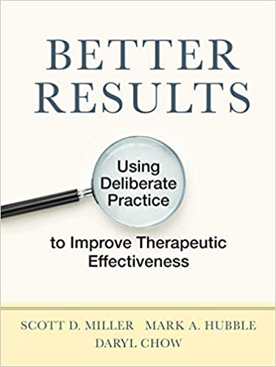

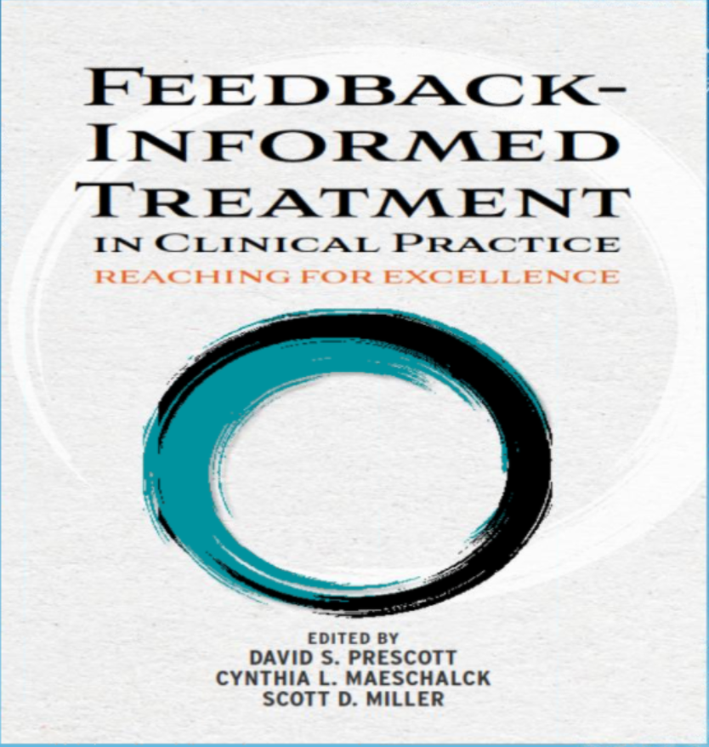

Slide 7




Slide 8
Five Challenges to Effectiveness of Psychotherapy

Slide 9
Challenge #1
No improvement in outcomes in 40 years. Despite a substantial increase in diagnostic categories and a proliferation of treatment approaches and specialized techniques, the effect size of psychotherapy has not improved since the first meta-analytic studies in 1977 (Bertolino, Bargmann, & Miller, 2013).
Bertolino, B., Bargmann, S., & Miller, S. D. (2013). Manual 1: What works in therapy: A primer. The ICCE manuals of feedback
informed treatment. Chicago, IL: International Center for Clinical Excellence.
Wampold, B. E. (2001). The great psychotherapy debate: Models, methods, and findings. New Jersey: Lawrence Erlbaum.

Slide 10

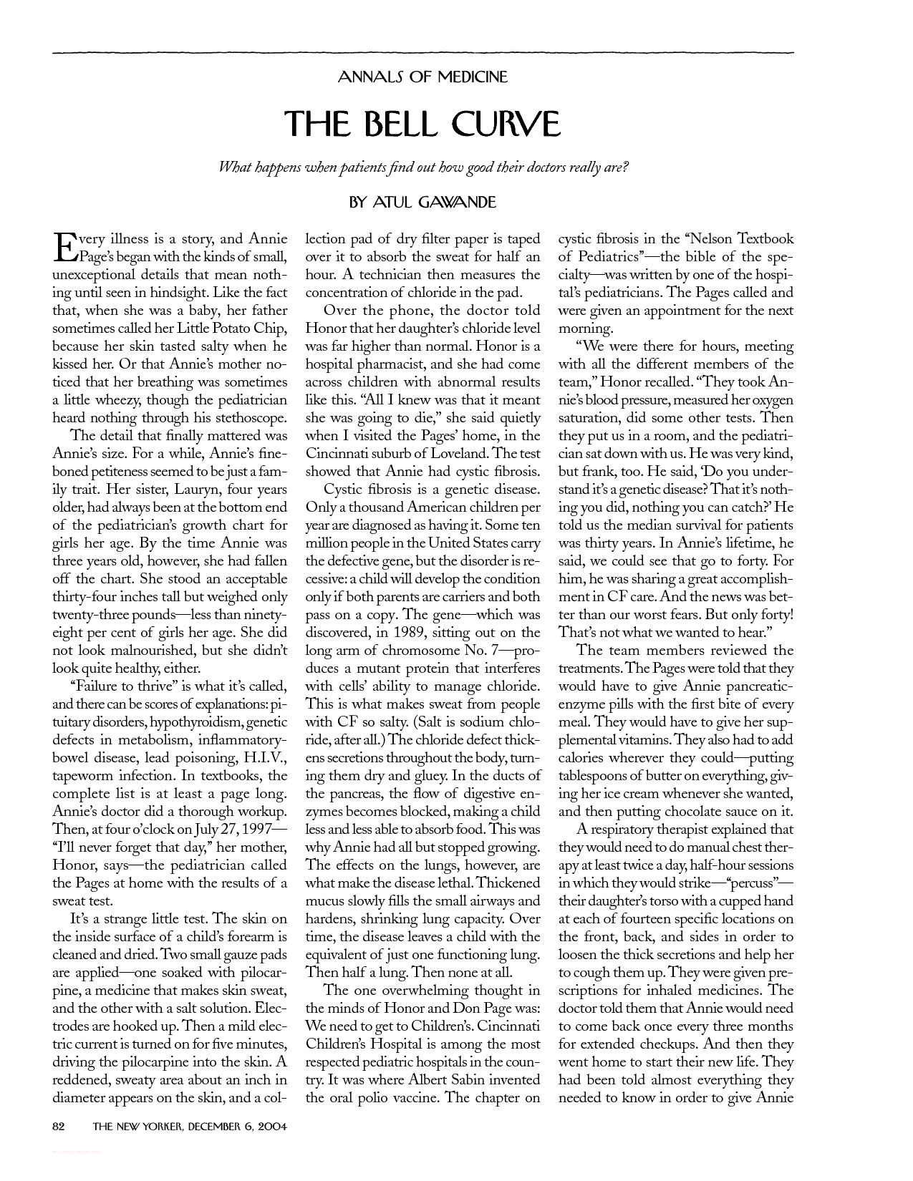

Slide 11





Slide 12
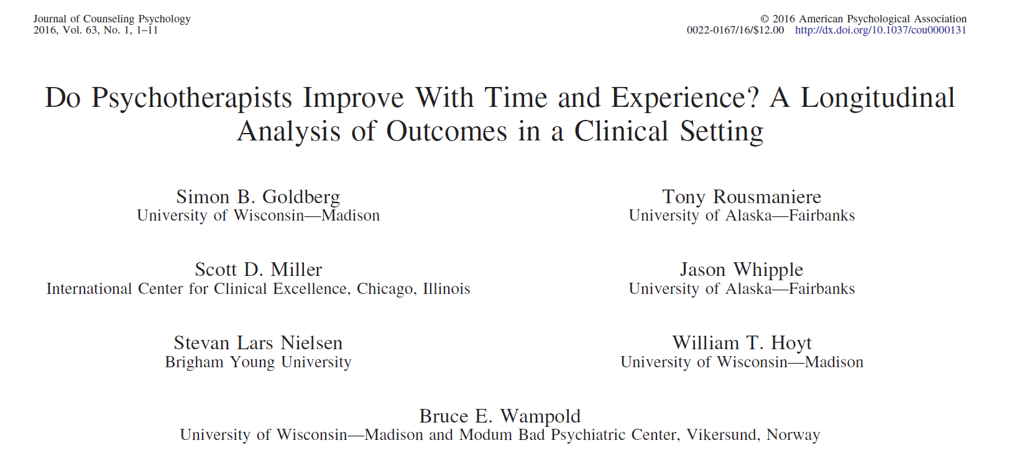
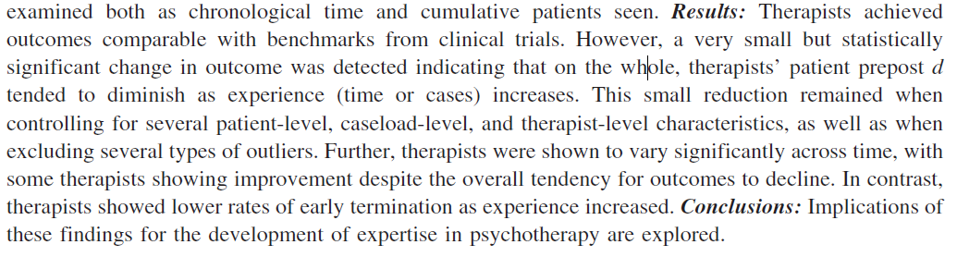
Therapist Improvement with Time and Experience
The largest study to date on the effect of experience on outcome.
170 therapists followed for 17 years.
Question: Do therapists improve over time in terms of effectiveness with more experience and training?
The answer: No.
On average therapists’ outcomes declined over time.

Slide 13
Challenge #2
The failure to address dropout in services.
Dropout: the unilateral decision by clients to end therapy—averages are between 20% to 47% (Swift et al., 2012; Wierzbicki & Pekarik, 1993). For children and adolescents the range varies from 28% to 85% (Garcia & Weisz, 2002).
Garcia, J. A., & Weisz, J. R. (2002). When youth mental health care stops: Therapeutic relationships problems and other reasons
for ending youth outpatient treatment. Journal of Consulting and Clinical Psychology, 70(2), 439-443.
Swift, J. K., Greenberg, R. P., Whipple, J. L., & Kominiak, N. (2012). Practice recommendations for reducing premature termination
in therapy. Professional Psychology: Research and Practice, 43(4), 379-387.
Wierzbicki, M., & Pekarik, G. (2002). A meta-analysis of psychotherapy dropout. Professional Psychology: Research and Practice,
24(2), 190-195.

Slide 14
Challenge #3
Providers routinely fail to identify which consumers of behavioral health will not benefit and which will deteriorate while in services.
  30% to 50% of clients do not benefit from therapy (Lambert, 2010).
  Deterioration rates among adult clients: 5%-10% (Hansen, Lambert, & Forman, 2002; Lambert & Ogles, 2004); Children and adolescents:12%-20% (Warren et al., 2010).
  It is estimated that the clients who do not benefit or deteriorate while in psychotherapy are responsible for 60-70% of the total expenditures in the health care system (Miller, 2010).
  Clinicians routinely fail to identify clients who are not progressing, deteriorating, and at most risk of dropout and negative outcome (Hannan et al., 2005).
Hannan, C., Lambert, M. J.,Harmon, C., Nielsen, S. L., Smart, D. W., Shimokawa, K., et al. (2005). A lab test and algorithms for identifying clients at risk for treatment failure. Journal of
Clinical Psychology: In Session, 61, 155-163.
Hansen, N., Lambert, M. J., & Forman, E. M. (2002). The psychotherapy dose-response effect and its implication for treatment delivery services. Clinical Psychology: Science and Practice,
9(3), 329–343.
Lambert, M. J. (2010). Prevention of treatment failure: The use of measuring, monitoring, and feedback in clinical practice. Washington, DC: American Psychological Association.
Miller, S. D. (2010). Psychometrics of the ORS and SRS. Results from RCT’s and Meta-analyses of Routine Outcome Monitoring & Feedback. The Available Evidence. Chicago, IL.
http://www.slideshare.net/scottdmiller/measures-and-feedback-january-2011.
Warren, J. S., Nelson, P. L., Mondragon, S. A., Baldwin, S. A., & Burlingame, G. A. (2010). Youth psychotherapy change trajectories and outcomes in usual care: Community mental health
versus managed care settings. Journal of Consulting and Clinical Psychology, 78(2), 144-155.

Slide 15
Challenge #4
Providers lack knowledge regarding their rate of effectiveness and the tendency of average providers to overestimate.
  The majority of therapists have never measured their effectiveness (Hansen, Lambert, & Forman, 2002; Sapyta, Riemer, & Bickman, 2005). It is impossible to improve without this knowledge.
  Therapists are subject to self-assessment bias in terms of comparing their own skills with those of colleagues and in estimating improvement or deterioration rates (Lambert, 2010; Walfish, McAllister, O’Donnell & Lambert, 2012).
Hansen, N., Lambert, M. J., & Forman, E. M. (2002). The psychotherapy dose-response effect and its implication for treatment delivery
services. Clinical Psychology: Science and Practice, 9(3), 329–343.
Lambert, M. J. (2010). Prevention of treatment failure: The use of measuring, monitoring, and feedback in clinical practice. Washington,
DC: American Psychological Association.
Sapyta, J., Reimer, M., & Bickman, L. (2005). Feedback to clinicians: Theory, research, and practice. Journal of Clinical Psychology,
62, 145-153.
Walfish. S., McAlister, B., O’Donnnell., & Lambert, M. J. (2012). An assessment of self-assessment bias in mental health providers.
Psychological Reports, 110(2), 639-644.

Slide 16
Challenge #5
There is substantial variation in outcomes between providers with similar training and experience.
  Some therapists have better outcomes, regardless of diagnoses, age, developmental stage, medication status, or severity of their clients. (Wampold & Brown, 2005)
  Clients of the most effective therapists improve at a rate at least 50% higher and drop out at a rate at least 50% lower than those of less effective therapists. (Wampold & Brown, 2005)
  97% of the difference in outcome between therapists is in the differences in their ability to form alliances with clients. (Anderson et al., 2009; Baldwin, Wampold, & Imel, 2007)
  Provider effectiveness tends to plateau over time in the absence of concerted efforts to improve it. (Hubble et al., 2010)
Anderson, T. Ogles, B. M., Patterson, C. L., Lambert, M. J., & Vermeersch, D. A. (2009). Therapist effects: Facilitative interpersonal skills as a predictor of
therapist effects. Journal of Clinical Psychology, 65(7), 755-768.
Baldwin, S. A., Wampold, B. E., & Imel, Z. E. (2007). Untangling the alliance-outcome correlation: Exploring the relative importance of therapist and patient
variability in the alliance. Journal of Consulting and Clinical Psychology, 75(6), 842–852.
Hubble, M. A., Duncan, B. L., Miller, S. D., & Wampold, B. E. (2010). Introduction. In B. L. Duncan, S. D. Miller, B. E. Wampold, & M. A. Hubble
(Eds.), The heart and soul of change: Delivering what works in therapy (2nd ed.)(pp. 23-46). Washington, DC: American Psychological
Association.
Wampold, B. E., & Brown, G. S. (2005). Estimating variability in outcomes attributable to therapists: A naturalistic study of outcomes in managed care.
Journal of Consulting and Clinical Psychology, 73(5), 914–923.

Slide 17
How to Improve the Effectiveness of Psychotherapy

Slide 18
How to Improve the Effectiveness of Psychotherapy
Evidence-Based Practice (EBP)
1
Routine Outcome Management (ROM)
2
Four Strategies to Improve Effectiveness (and Outcomes)
3

Slide 19
Evidence-Based Practice (EBP)

Slide 20
Empirically-Supported Treatments (ESTs) vs. Evidence-Based Practice (EBP)
  ESTs: “Clearly specified psychological treatments shown to be efficacious in controlled research with a delineated population" (Chambless & Holon, 1998, p. 7).
  EBP is inclusive of meta-analyses, naturalistic, process-outcome, and correlational studies and delved into a broad array of factors such as the therapeutic relationship, client and therapist effects, and other elements thought to influence therapeutic outcomes.
  Professionals often cannot distinguish between the ESTs and EBP.
  In a survey of clinical psychology graduate students, the majority identified EBP as synonymous with empirically supported treatments (Luebbe, Radcliffe, Callands, Green, & Thorn, 2007).
  This confusion is easily corroborated through an internet search of the terms “empirical-supported treatments” and “evidence-based practice.” Many sites either inaccurately define the terms, describe them as the same, or use the terms interchangeably.
Chambless, D. L., & Hollon, S. D. (1998). Defining empirically supported therapies. Journal of Consulting and Clinical Psychology, 66, 7–18.
Luebbe, A. M., Radcliffe, A. M., Callands, T. A., Green, D., & Thorn, B. E. (2007). Evidence-based practice in psychology: Perceptions of graduate
students in scientist practitioner programs. Journal of Clinical Psychology, 63, 643–655.

Slide 21
EBP in Behavioral Health & Health
  APA: “The integration of the best available research with clinical expertise in the context of patient characteristics, culture, and preferences.” (1)
  SAMHSA: “EBPs integrate clinical expertise; expert opinion; external scientific evidence; and client, patient, and caregiver perspectives so that providers can offer high-quality services that reflect the interests, values, needs, and choices of the individuals served.” (3)
  IOM: “Evidence based medicine is the conscientious, explicit, and judicious use of current best evidence in making decisions about the care of individual patients. The practice of evidence based medicine means integrating individual clinical expertise with the best available external clinical evidence from systematic research.” (3)
(1) APA Presidential Task Force on Evidence-Based Practice. (2006). Evidence-based practice in psychology. American Psychologist, 61(4), 271–285.
(2) Sackett, D. L., Rosenberg, W. M. C., Muir Gray, J. A., Haynes, R. B., & Richardson, W. S. (1996). Evidence based medicine: What it is and what it
isn't: It's about integrating individual clinical expertise and the best external evidence. BMJ: British Medical Journal, 312(7023), 71-72.
(3) SAMHSA. (2016, January 6). Evidence-based practices web guide. https://www.samhsa.gov/ebp-web-Guide

Slide 22
Evidence-Based Practice (EBP)
“The integration of the best available research with clinical expertise in the context of patient characteristics, culture, and preferences.” (p. 273)
APA Presidential Task Force on Evidence-Based Practice. (2006). Evidence-based practice in psychology. American
Psychologist, 61(4), 271–285.

Slide 23
Evidence-Based Practice (EBP)
“The integration of the best available research with clinical expertise in the context of patient characteristics, culture, and preferences.” (p. 273)
APA Presidential Task Force on Evidence-Based Practice. (2006). Evidence-based practice in psychology. American
Psychologist, 61(4), 271–285.

Slide 24
Best Available Research
The Variance in Psychotherapy Outcome
Client/Extratherapeutic Factors = 80-87%
Treatment Effects = 13-20%
  Therapist Effects = 4-9%
  The Alliance = 5-8%
  Expectancy, Placebo, and Allegiance = 4%
  Model/Technique = 1%
Bertolino, B., Bargmann, S., & Miller, S. D. (2013). Manual 1: What works in therapy: A primer. The ICCE manuals of feedback informed
treatment. Chicago, IL: International Center for .Clinical Excellence.
Wampold, B. E., & Brown, G. S. (2005). Estimating variability in outcomes attributable to therapists: A naturalistic study of outcomes in
managed care. Journal of Consulting and Clinical Psychology, 73(5), 914-923.

Slide 25
Evidence-Based Practice (EBP)
“The integration of the best available research with clinical expertise in the context of patient characteristics, culture, and preferences.” (p. 273)
APA Presidential Task Force on Evidence-Based Practice. (2006). Evidence-based practice in psychology. American
Psychologist, 61(4), 271–285.

Slide 26
Clinical Expertise
The APA Task Force on EBP
“Clinical expertise… entails the monitoring of patient progress (and of changes in the patient’s circumstances—e.g., job loss, major illness) that may suggest the need to adjust treatment… If progress is not proceeding adequately, the psychologist alters or addresses problematic aspects of the treatment (e.g., problems in the therapeutic relationship or in the implementation of the goals of the treatment) as appropriate” (2006, pp. 280, 276-277).
APA Presidential Task Force on Evidence-Based Practice. (2006). Evidence-based practice in psychology. American Psychologist,
61(4), 271–285.
Lambert, M. J., Bergin, A. E., & Garfield, S. L. (2004). Introduction and overview. In M. J. Lambert (Ed.), Bergin & Garfield’s
handbook of psychotherapy & behavior change (5th
ed.)(pp. 3-15). New York: Wiley.
Warren, J. S., Nelson, P. L., Mondragon, S. A., Baldwin, S. A., & Burlingame, G. A. (2010). Youth psychotherapy change trajectories
and outcomes in usual care: Community mental health versus managed care settings. Journal of Consulting and Clinical
Psychology, 78(2), 144-155.

Slide 27
Evidence-Based Practice (EBP)
“The integration of the best available research with clinical expertise in the context of patient characteristics, culture, and preferences.” (p. 273)
APA Presidential Task Force on Evidence-Based Practice. (2006). Evidence-based practice in psychology. American
Psychologist, 61(4), 271–285.

Slide 28
Patient (Client) Characteristics,
Culture, and Preferences
  Client characteristics (i.e., age, gender, gender identity, ethnicity, race, social class, disability status, sexual orientation, developmental status, life stage, etc.).
  Strengths, resources, beliefs, and factors that can influence change.
  Understanding of the local knowledge and culture.
  Personal preferences, values, and preferences related to treatment (e.g., goals, beliefs, worldviews, treatment expectations).

Slide 29
Routine Outcome
Measurement (ROM)
Why Does it Matter?

Slide 30

Notes:
EBP is the language of the land. And

Slide 31
Why Measure Outcome?
Accrediting bodies including The Joint Commission, Council on Accreditation (COA), and the Commission on Accreditation of Rehabilitation Facilities (CARF) have employed standards related to reliable and valid measurement of outcomes.
For example, The Joint Commission state: “Organizations will be required to assess outcomes through the use of a standardized tool or instrument. Results of these assessments would then be used to inform goal, and objectives identified in individual plans of care, treatment, or services as needed, and evaluate outcomes of care, treatment, or services provided to the population(s) served.”
Areas of emphasis include:
  The impact of services on clients
  The quality of service delivery

Slide 32
Four Strategies to Improve Effectiveness (and Outcomes)

Slide 33
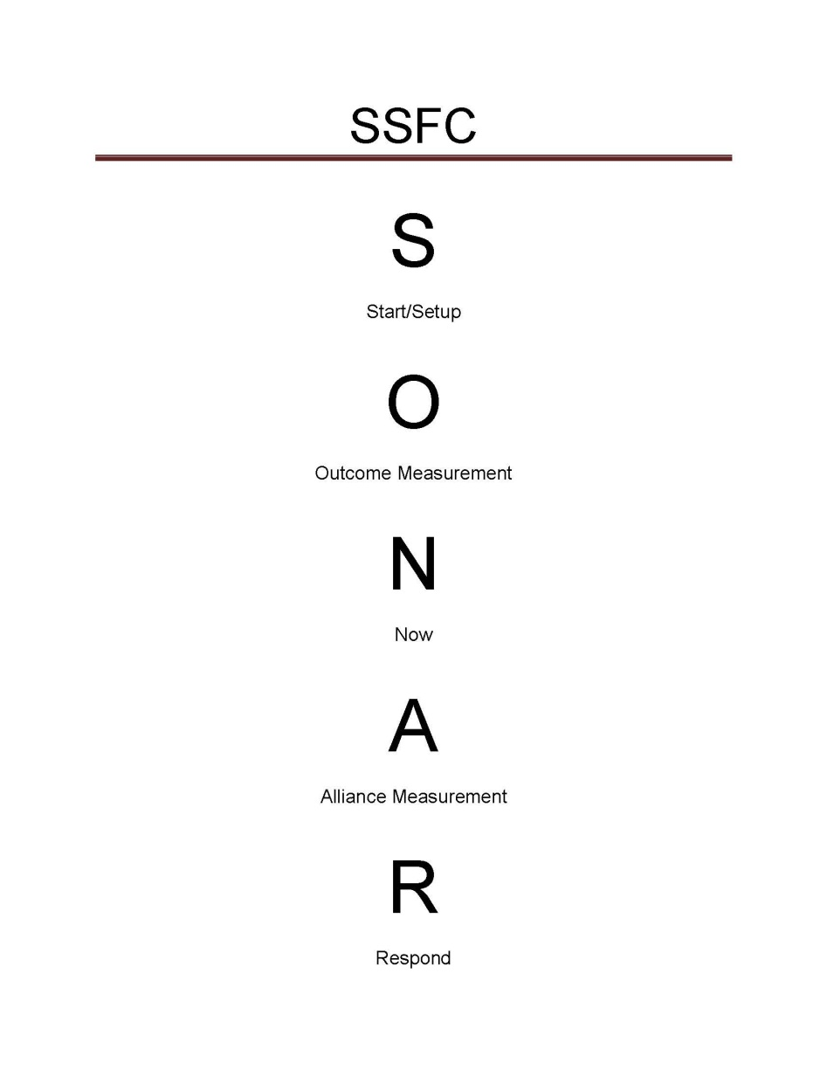
SONAR SFC
SSFC: Sonar Session Feedback Checklist
A guide for clinicians interested in eliciting feedback to measure the fit of their approach with clients and the effect of those efforts have on outcomes and the benefit of services.
The full SSFC with instructions is available for free at: https://www.bobbertolino.com/handouts

Slide 34
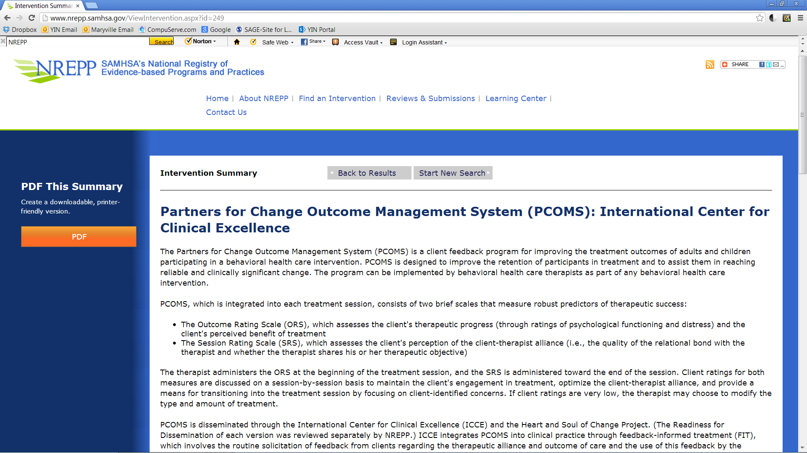

Slide 35
Strategy #1
Monitor the Client’s Distress from the Outset
More so than diagnosis, the severity of the client’s distress at intake predicts eventual outcome. Clients with higher levels of distress are more likely to show measured benefit from treatment than those with lower levels or who present as non-distressed (Duncan, Miller, Wampold, & Hubble, 2010). Knowledge about client distress can inform decisions regarding the dose and intensity of services.
Duncan, B. L., Miller, S. D., Wampold, B. E., & Hubble, M.A. (Eds.), (2010). The heart and soul of change: Delivering what works in therapy
(2nd, Ed.). Washington, DC: American Psychological Association.

Slide 36
The Outcome Rating Scale (ORS)
A 40-point measure with 4 subscales
Two versions can be scored: ORS & CORS
Higher score indicate lower levels of distress; lower scores indicate higher levels of distress
Clinical Cutoffs: 25 (> Age 19); 28 (Ages 13-19); 32 (≤ Age 12)
Reliable Change Index (RCI): 5
Complete at the beginning of session
Takes less than 1 minute to administer
Paper/pencil and electronic scoring systems
Can plot personal data on Excel spreadsheet

Slide 37
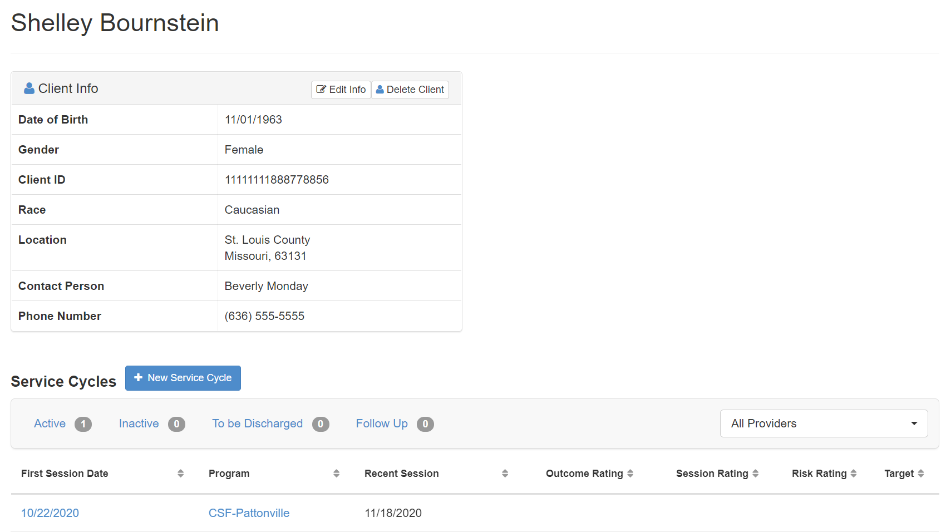

Slide 38
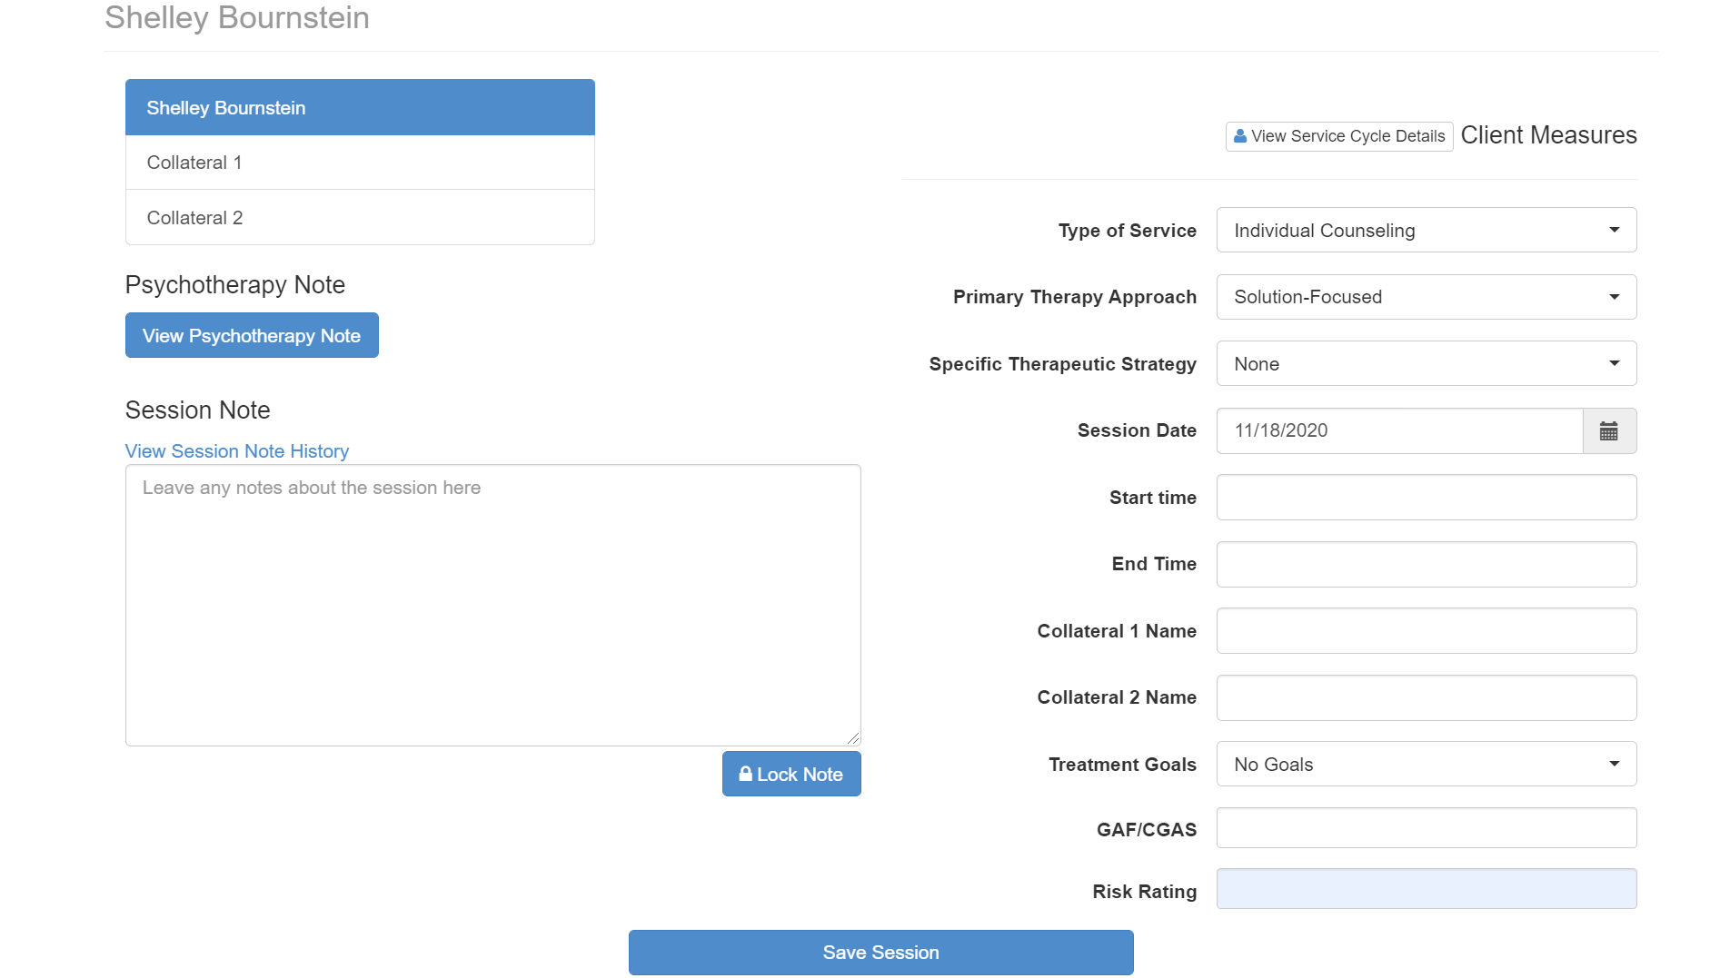

Slide 39
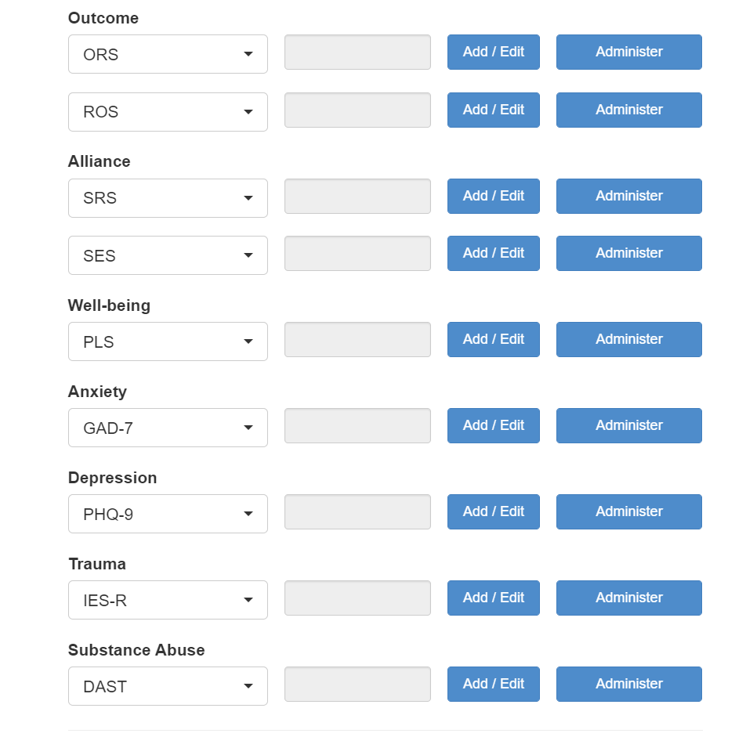

Slide 40
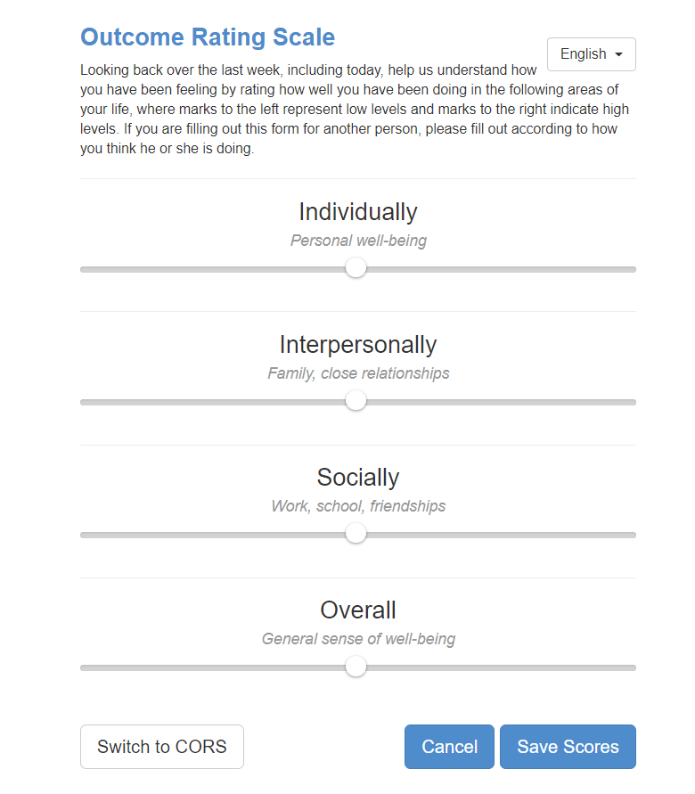
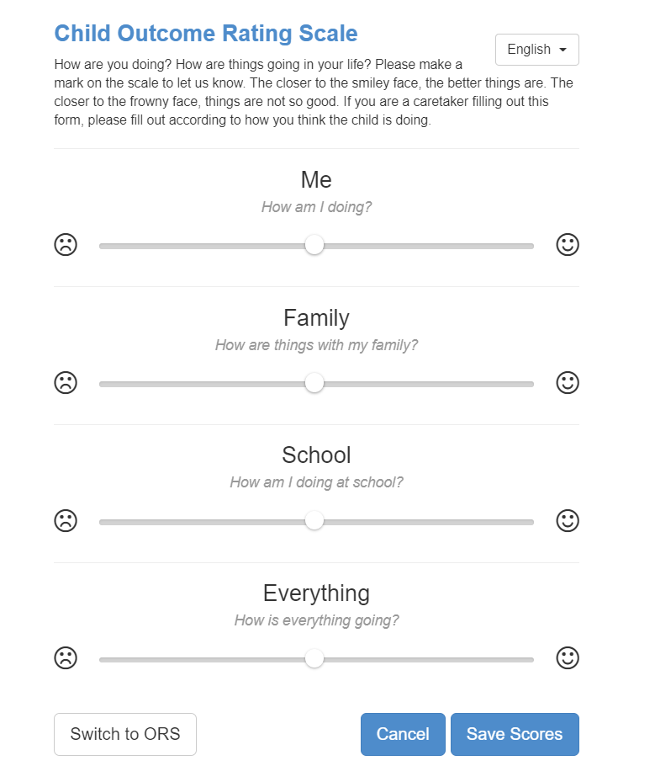

Slide 41
ORS – Individual
  + Self-esteem
  + Self-perception
  + Sense of Self
  + Internal Strengths
  + Healthy activities and behaviors
  + Coping Skills
  + Safety
  - Anxiety
  - Depression
  - Substance Abuse
  - Somatic problems (i.e., sleep, headaches, etc.)

Slide 42
ORS – Interpersonal
  + Close Relationships
  + Romantic Relationships
  + Family
  + Close Friends
  + Stable Living Environment
  + Conflict Resolution
  + Safety
  - Violence
  - Mystification
  - Disconnection

Slide 43
ORS – Social Role
  + Other Friends and Supports
  + Community Connections (to individuals, groups, and the
  community at-large)
  + Education (School, GED, Job Skills Programs)
  + Employment
  + Volunteering
  + Feeling Valued and Empowered as a Member of a Community
  (there can be more than one)
  + Safety
  - Feeling Isolated (disconnection)
  - Lack of Acceptance
  - Lack of Opportunity

Slide 44
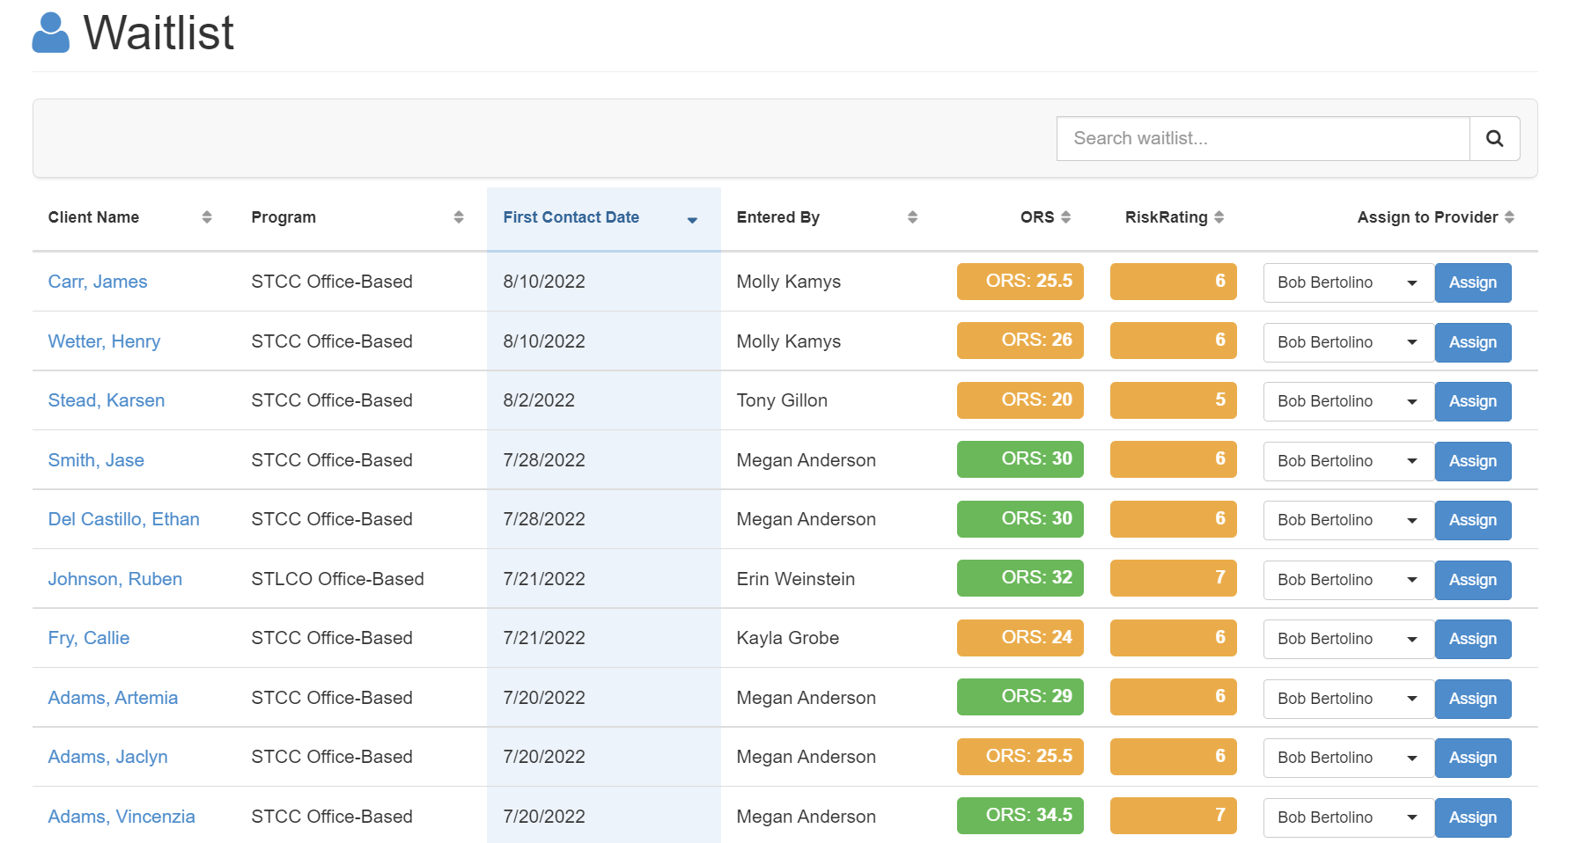

Slide 45
Strategy #2
Focus on Engagement
Orlinsky, Rønnestad, and Willutzki (2004) observe, “The quality of the patient’s participation… [emerges] as the most important [process] determinant in outcome” (p. 324). Clients who are more engaged and involved in therapy are likely to receive greater benefit from therapy.
Next to the level of functioning at intake, the consumer’s rating of the alliance is the best predictor of treatment outcome and is more highly correlated with outcome than clinician ratings (Martin, Garske, & Davis, 2000; Norcross, 2011). Better client-therapist alliances lead to better outcomes whereas clients of therapists with weaker alliances tend to drop out at higher rates and experience poorer outcomes (Hubble et al., 2010; Lambert, 2010).
Emphasis is on an “error-centric” culture in which negative client feedback is sought as a means of learning about what is not working and/or failing and then responding to that feedback.
Hubble, M. A., Duncan, B. L., Miller, S. D., & Wampold, B. E. (2010). Introduction. In B. L. Duncan, S. D. Miller, B. E. Wampold, & M. A. Hubble (Eds.), The heart and soul of change:
Delivering what works in therapy (2nd ed.)(pp. 23-46). Washington, DC: American Psychological Association.
Lambert, M. J. (2010). Prevention of treatment failure: The use of measuring, monitoring, and feedback in clinical practice. Washington, DC: American Psychological Association.
Martin, D. J., Garske, J. P., & Davis, M. K. (2000). Relationship of the therapeutic alliance with outcome and other variables: A meta-analytic review. Journal of Consulting and Clinical
Psychology, 68(3), 438–450.
Norcross, J. C. (Ed.). (2011). Psychotherapy relationships that work: Evidence-based responsiveness (2nd ed.). New York: Oxford.
Orlinsky, D. E., Rønnestad, M. H., Willutzki, U. (2004). Fifty years of psychotherapy process-outcome research: Continuity and change. In M. J. Lambert (Ed.), Bergin and Garfield’s
handbook of psychotherapy and behavior change (5th ed.)(pp. 307-390). New York: Wiley.

Slide 46
What is the Therapeutic Alliance?
The therapeutic alliance refers to the quality and strength of the collaborative relationship between the client and therapist and is comprised of four empirically established components:
agreement on the goals, meaning or purpose of the treatment;
agreement on the means and methods used;
the client’s view of the relationship (including the therapist being perceived as warm, empathic, and genuine); and,
accommodating the client’s preferences.
Consumer
Preferences
Goals,
Meaning or Purpose
Means or Methods
Client’s View of the
Therapeutic Relationship

Slide 47
Session Rating Scale (SRS)
A 40-point measure with 4 subscales
Three versions can be scored: SRS, CSRS, GSRS
Complete near the end of session (last 5-10 minutes)
Overall scores below 36 or any subscale below 8 should be discussed with clients
Lower scores at the beginning of services can mean very different things
Lower scores as services progress are 4x likely to contribute to dropout
Takes less than 1 minute to administer
Paper/pencil and electronic scoring systems
Can plot personal data on Excel spreadsheet

Slide 48
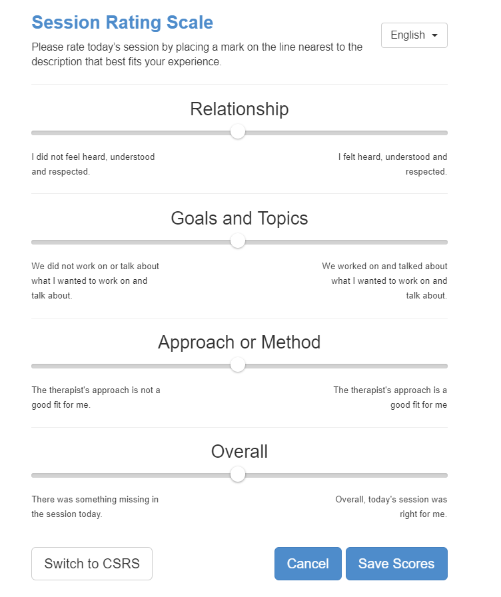
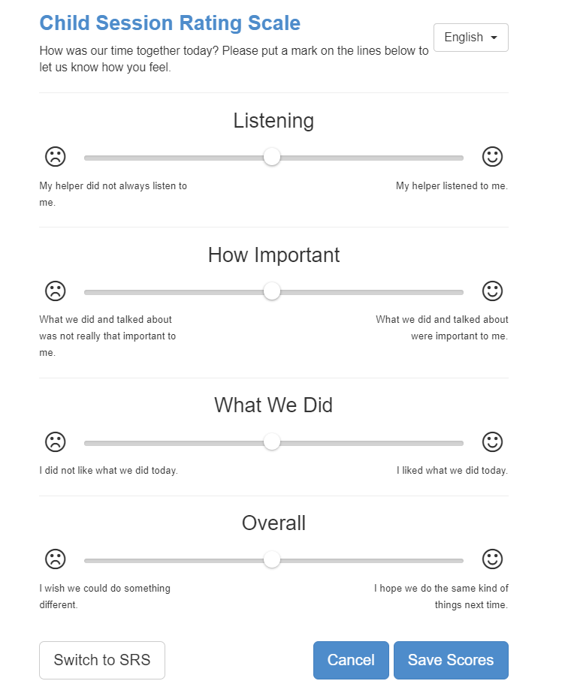

Slide 49
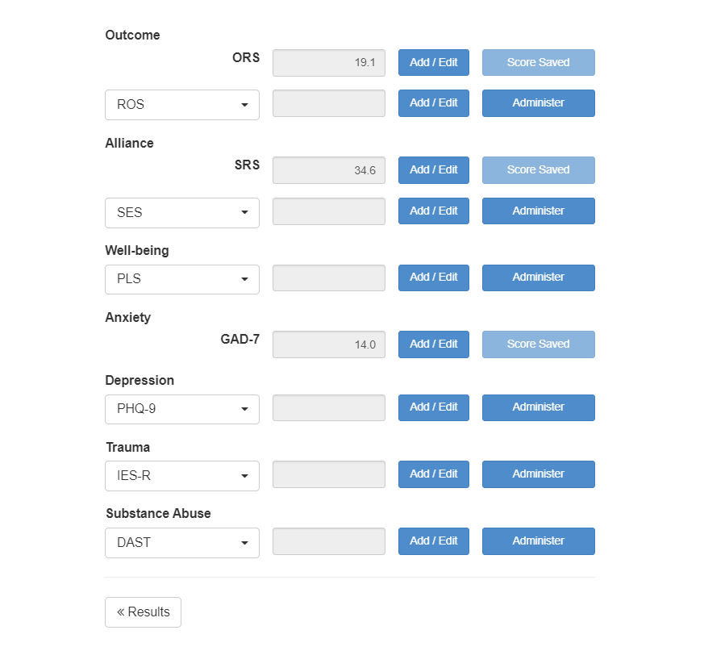

Slide 50
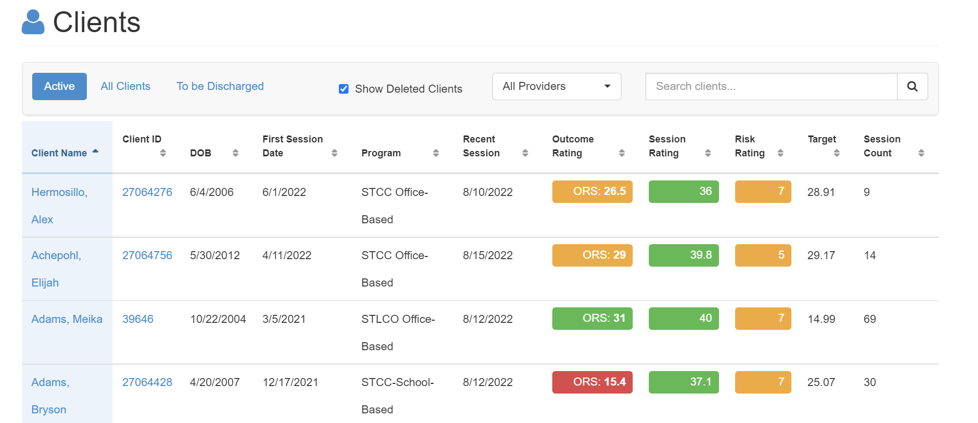

Slide 51
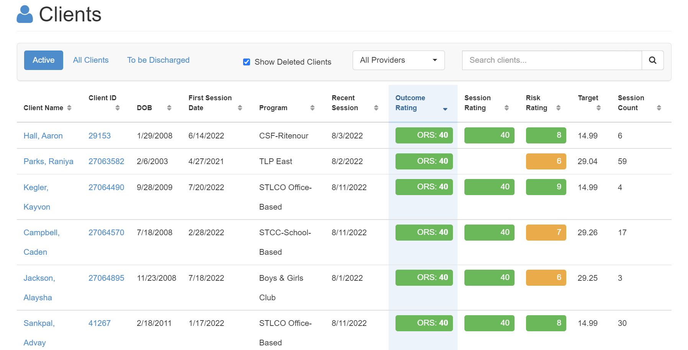

Slide 52
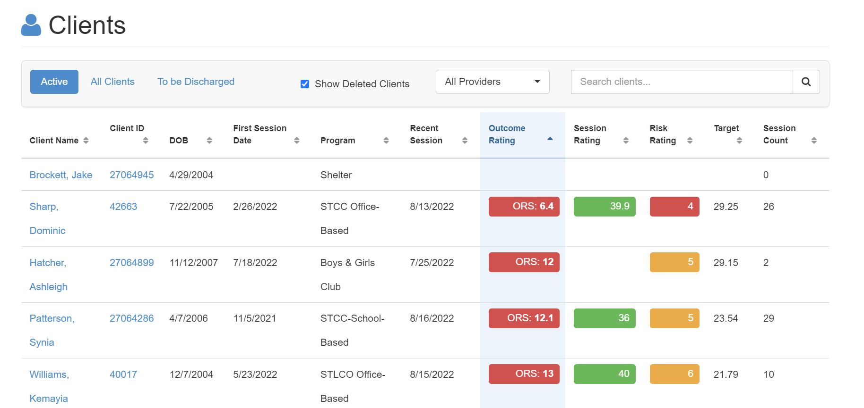

Slide 53
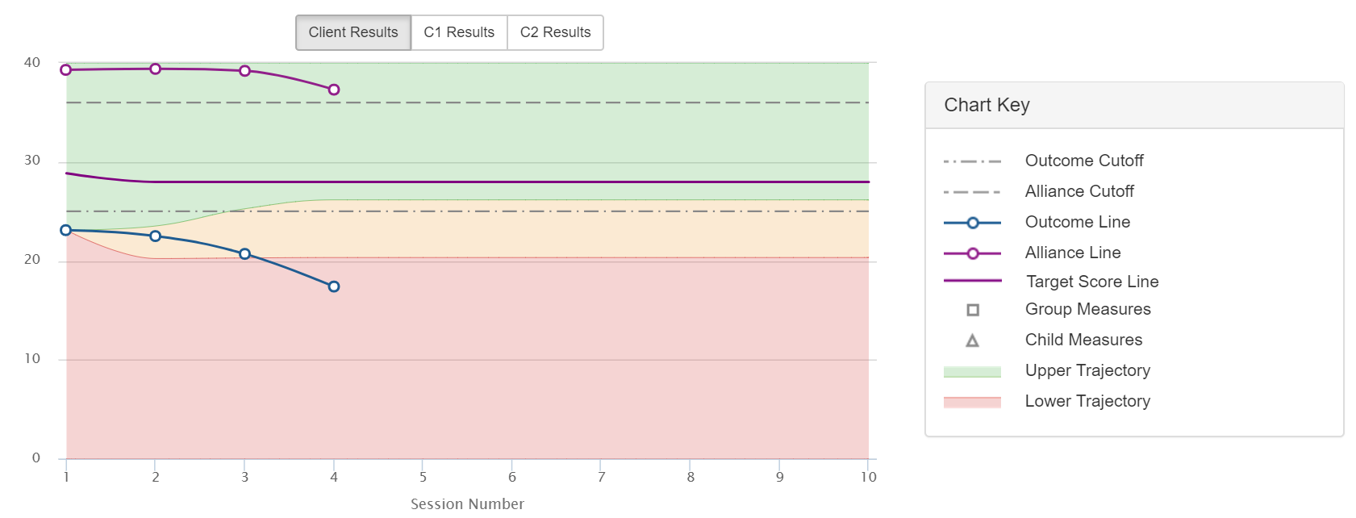
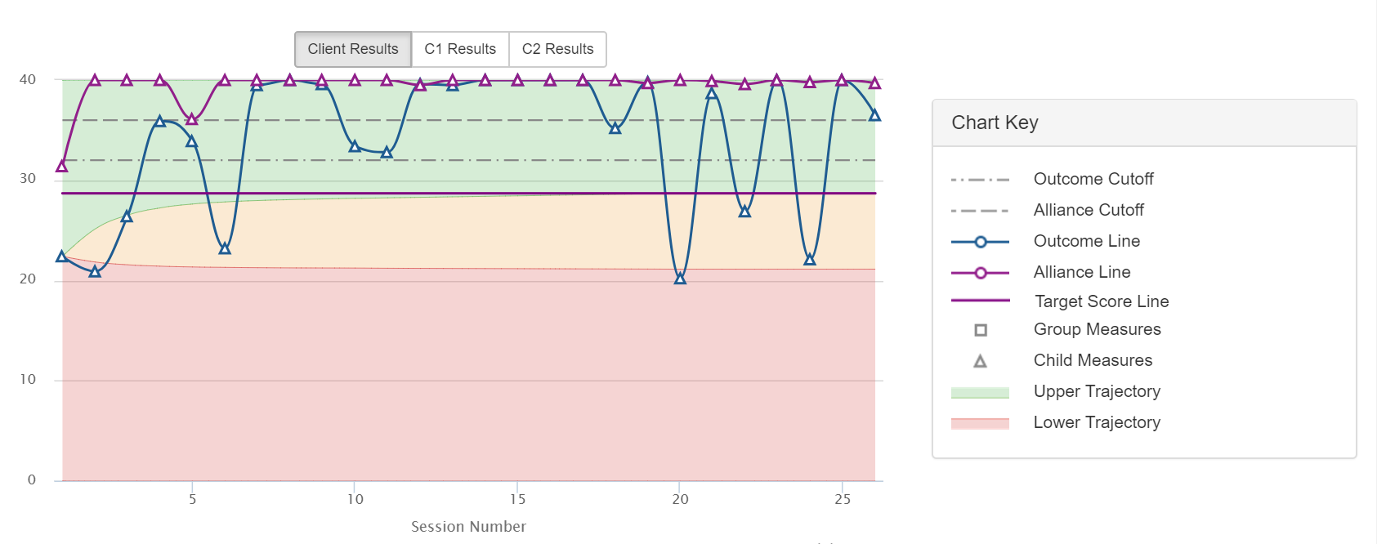
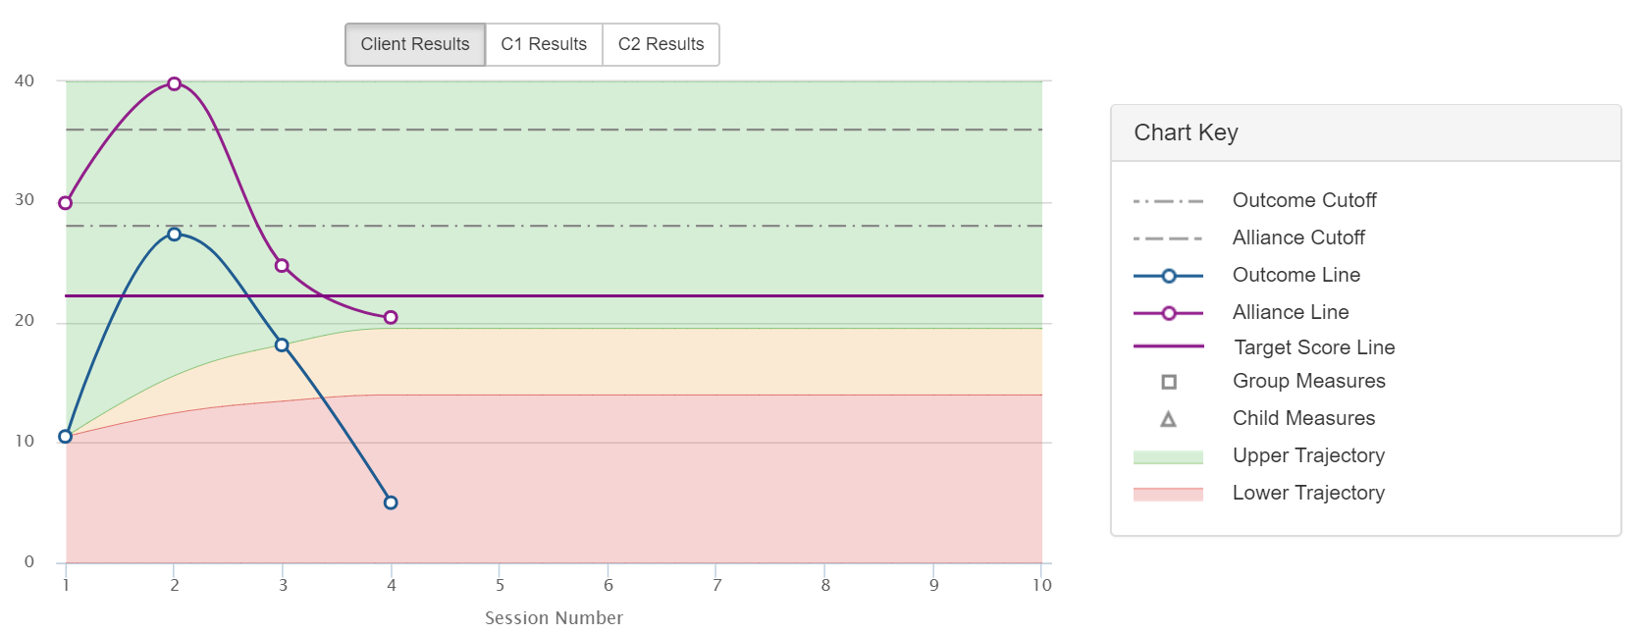
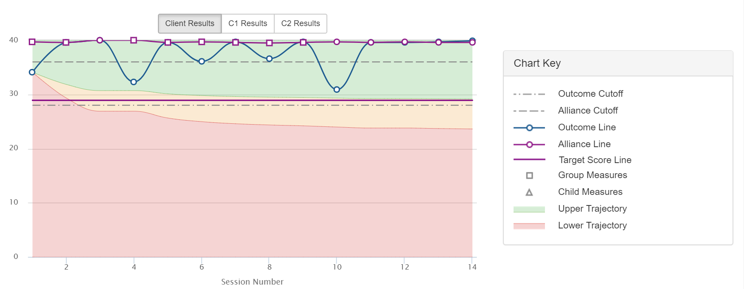
Bleeding
Seesawing/fluctuating
Dipping
Plateauing

Slide 54
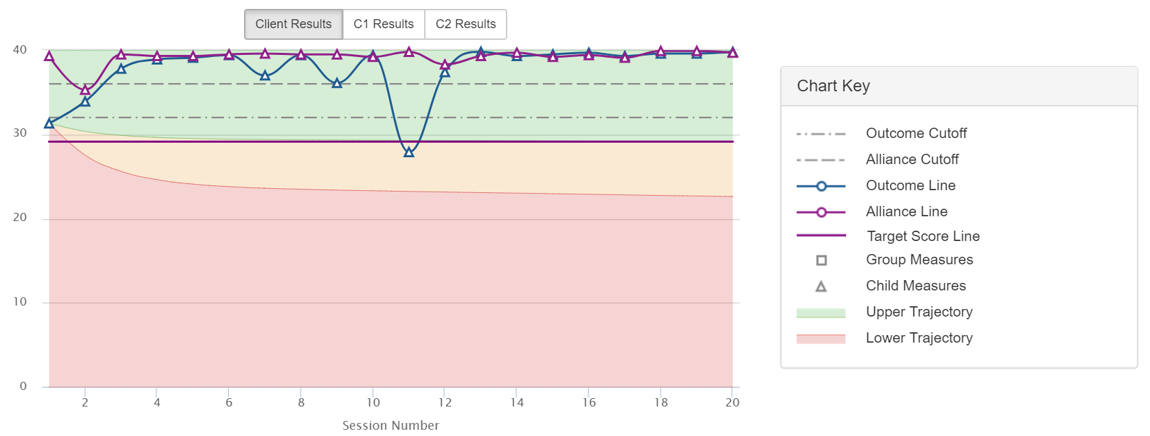
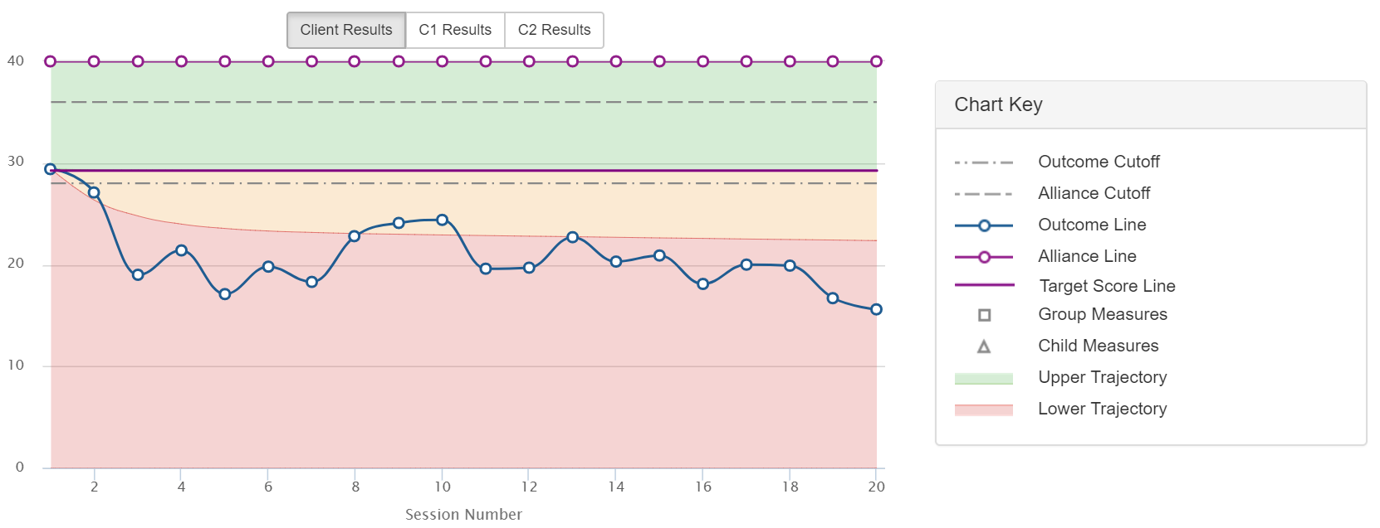
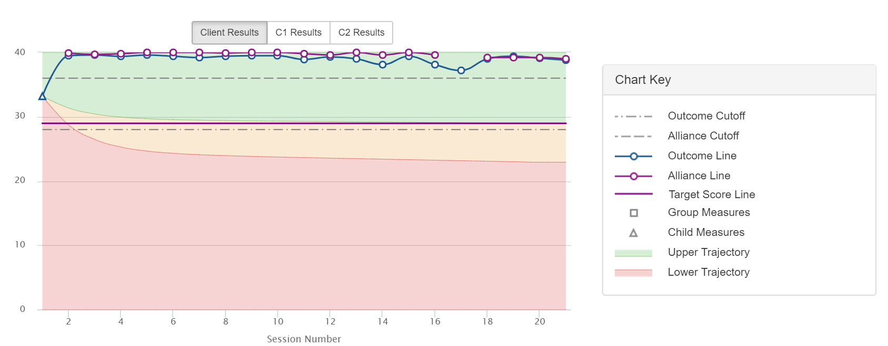
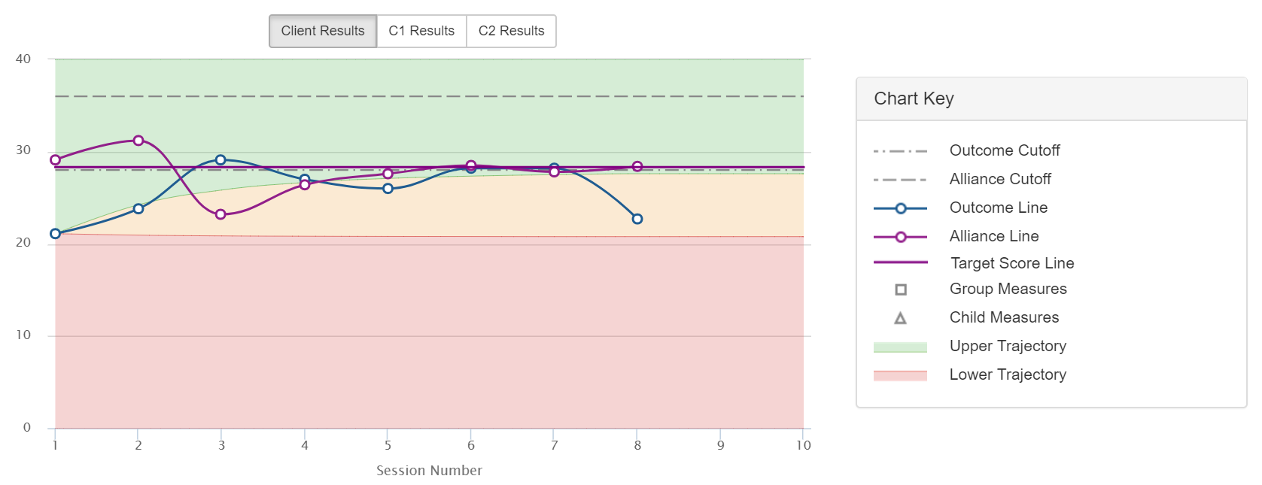
Plan?
Plan?
Plan?
Plan?

Slide 55
Strategy #3
Engage in Routine and Ongoing Client Feedback
Seeking and obtaining valid, reliable, and feasible feedback from consumers regarding the alliance and outcome as much as doubles the effect size of treatment, cuts dropout rates in half, and decreases risk of deterioration. Routine and ongoing monitoring of the alliance through real-time client feedback processes helps to both identify potential ruptures and create opportunities for clinicians to take corrective steps (Anker, Duncan, & Sparks, 2009; Anker et al., 2010). In addition, improvements in the alliance (intake to termination) are associated with better outcomes and lower dropout rates (Duncan, Miller, Wampold, & Hubble, 2010; Harmon et al., 2007; Lambert, 2010, Miller, Hubble, & Duncan, 2007).
APA Presidential Task Force on Evidence-Based Practice. (2006). Evidence-based practice in psychology. American Psychologist, 61(4), 271–
285.
Duncan, B. L., Miller, S. D., Wampold, B. E., & Hubble, M.A. (Eds.), (2010). The heart and soul of change: Delivering what works in therapy (2nd.
Ed.). Washington, DC: American Psychological Association.
Lambert, M. J. (2010). Prevention of treatment failure: The use of measuring, monitoring, and feedback in clinical practice.. Washington, DC:
American Psychological Association.

Slide 56
Strategy #4
Focus on Early Change and Respond to Lack of Progress
The dose-effect relationship in psychotherapy; approximately 30% of clients improve by the second session, 60% to 65% by session seven, 70% to 75% by six months, and 85% by one year (Howard, Kopta, Krause, & Orlinksy, 1986). Early response in therapy is strong indicator of eventual outcome, making the monitoring of improvement from the start of therapy essential. The longer clients attend therapy without experiencing a positive change the greater the likelihood that they will experience a negative or null outcome or drop out. (Duncan, Miller, Wampold, & Hubble, 2010)
Duncan, B. L., Miller, S. D., Wampold, B. E., & Hubble, M.A. (Eds.), (2010). The heart and soul of change: Delivering what works in therapy (2nd, Ed.).
Washington, DC: American Psychological Association.
Howard, K. I., Kopte, S. M., Krause, M. S., & Orlinsky, D. E. (1986). The dose-effect relationship in psychotherapy. American Psychologist, 41(2), 159–
164.

Slide 57
Selecting and Matching Interventions
Fit and Effect
Fit: The degree to which a way of working with a client matches his or her worldview, culture, and ideas about change.
  Consider assessment processes, diagnosis, the use of interventions, etc.
  Feedback that focuses on the alliance assists with increasing fit.
Effect: Did the intervention, at minimum, benefit the client, and at best contribute to a positive, measurable outcome?
  Feedback that focuses on the client’s subjective interpretation of the benefit of services assists with increasing effect.

Slide 58
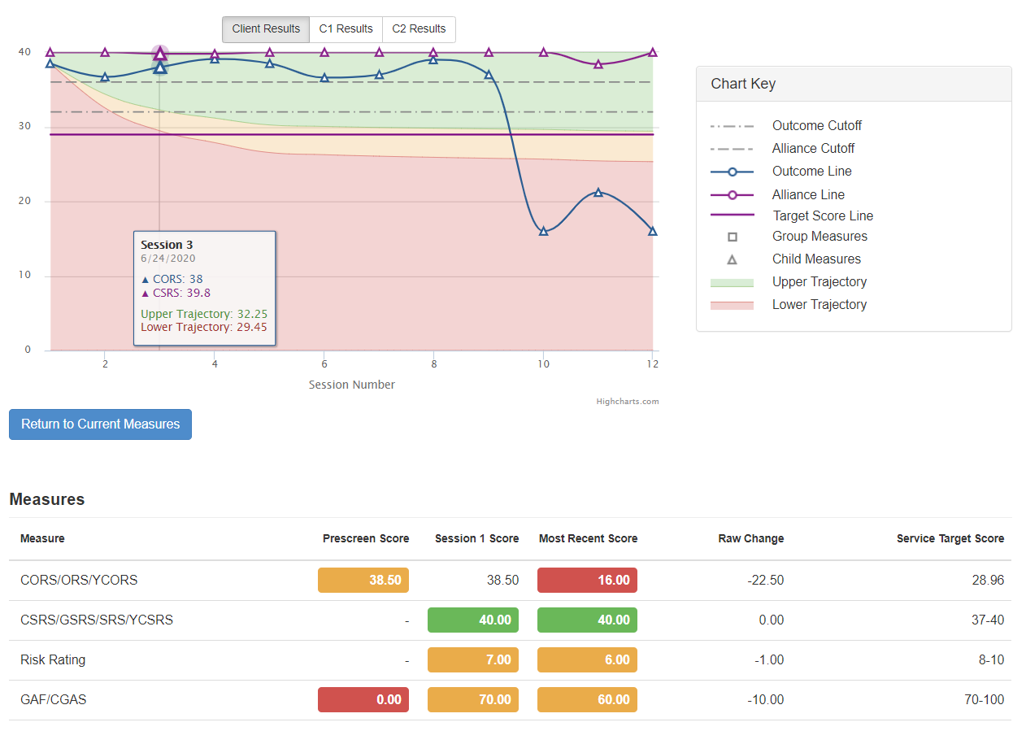

Slide 59
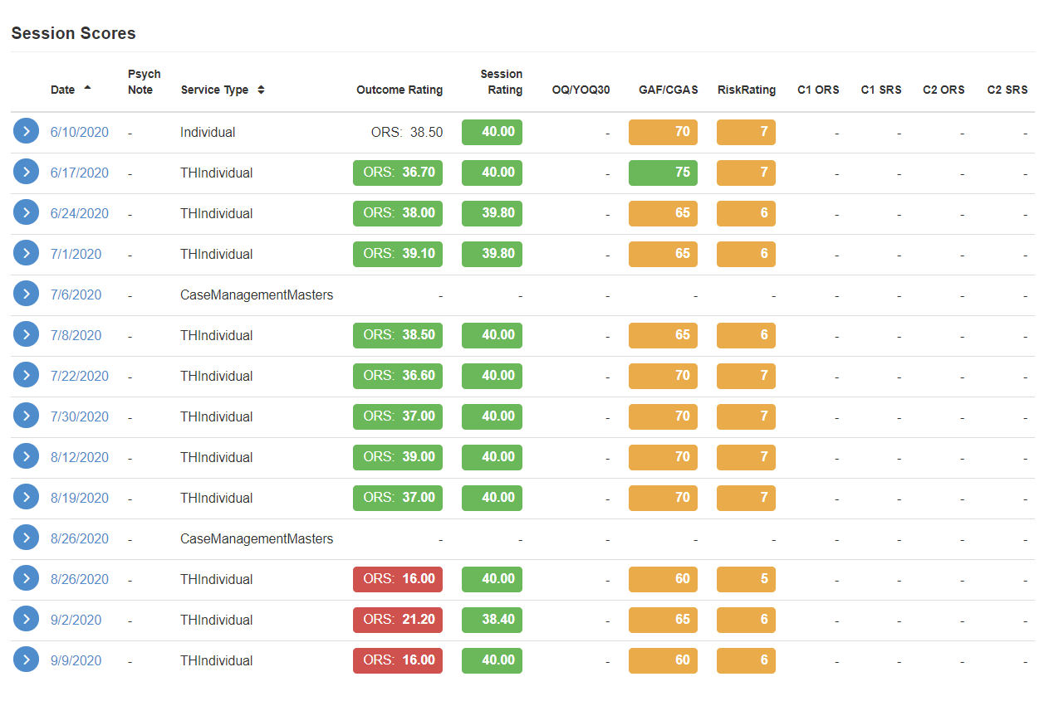

Slide 60
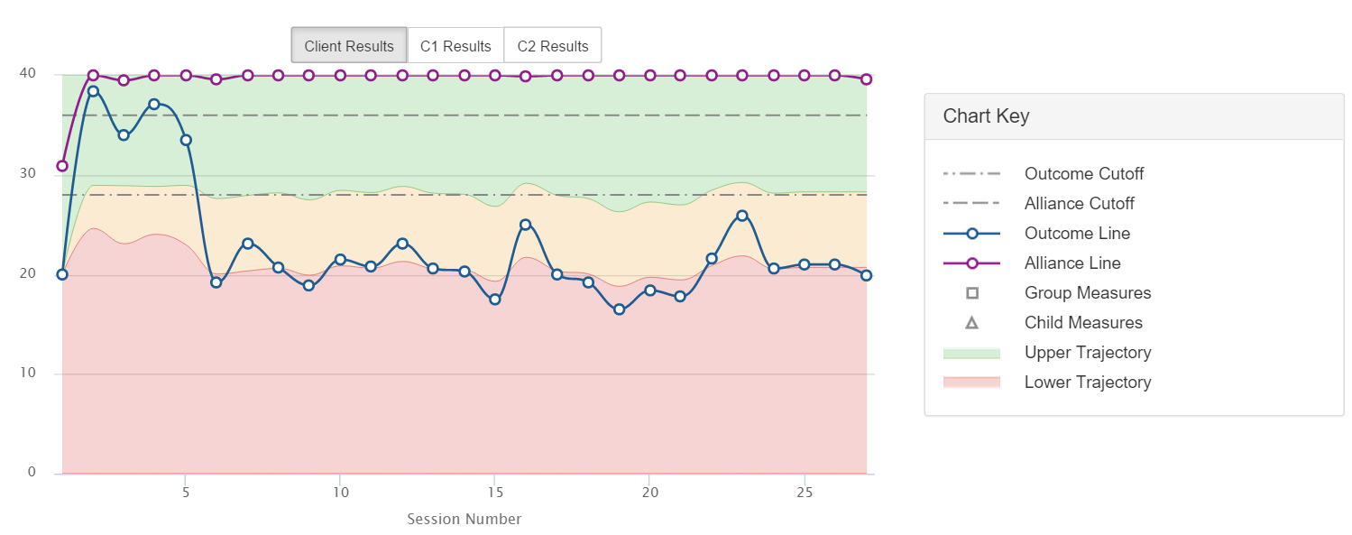
Imagine OMS – https://www.bobbertolino.com/imagine-oms

Slide 61
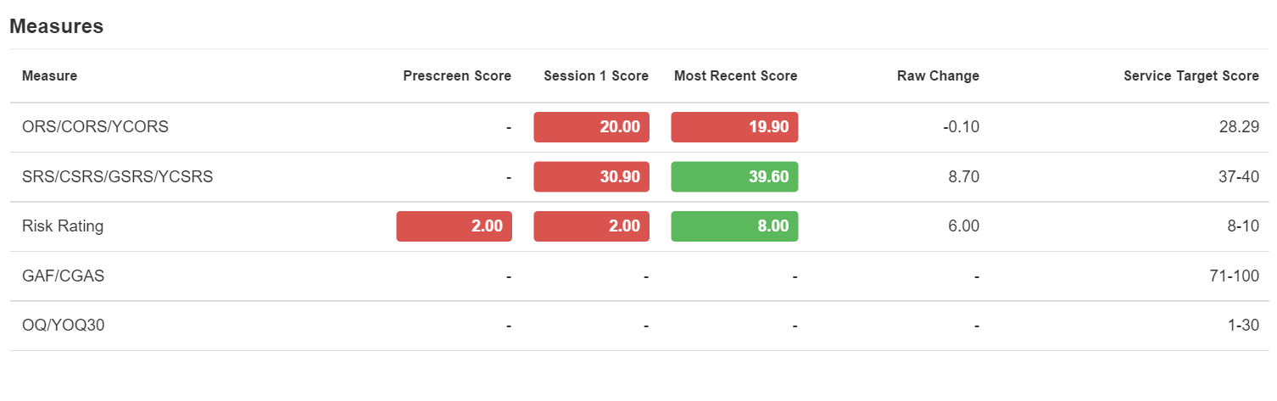
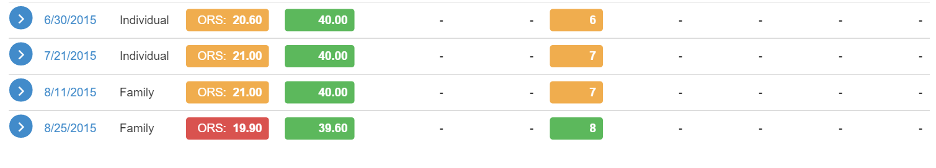
Imagine OMS – https://www.bobbertolino.com/imagine-oms

Slide 62
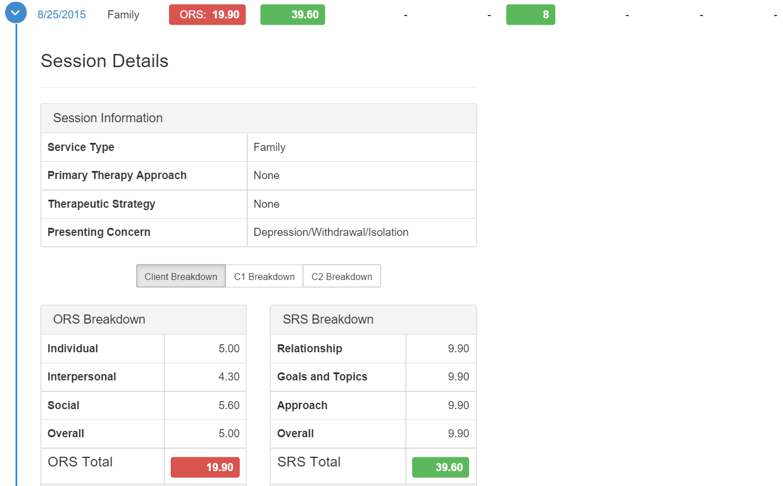
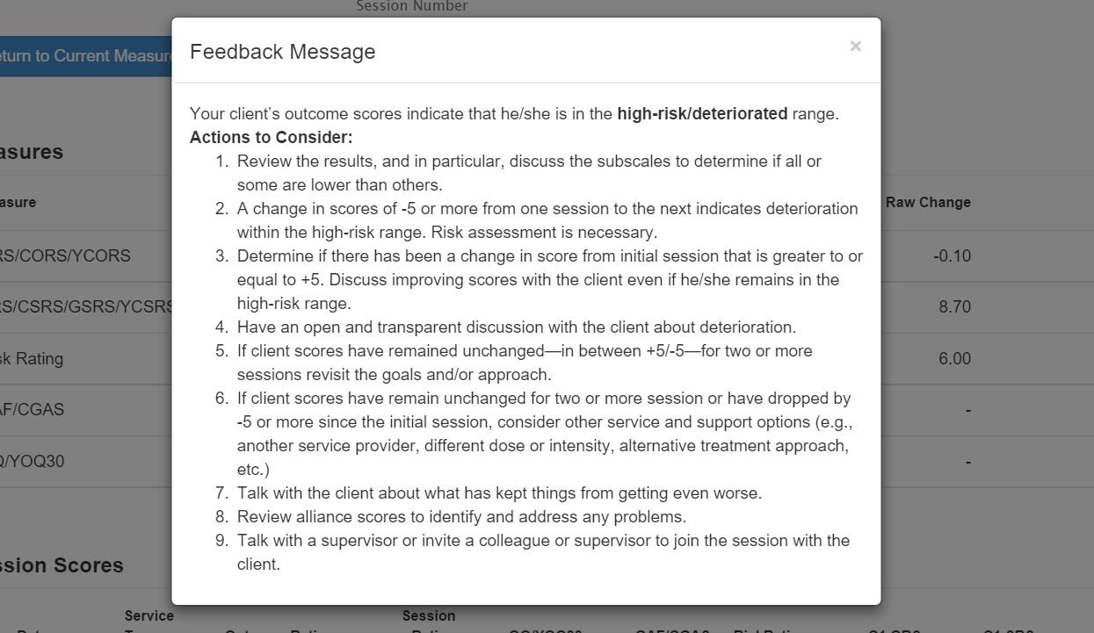
Imagine OMS – https://www.bobbertolino.com/imagine-oms

Slide 63
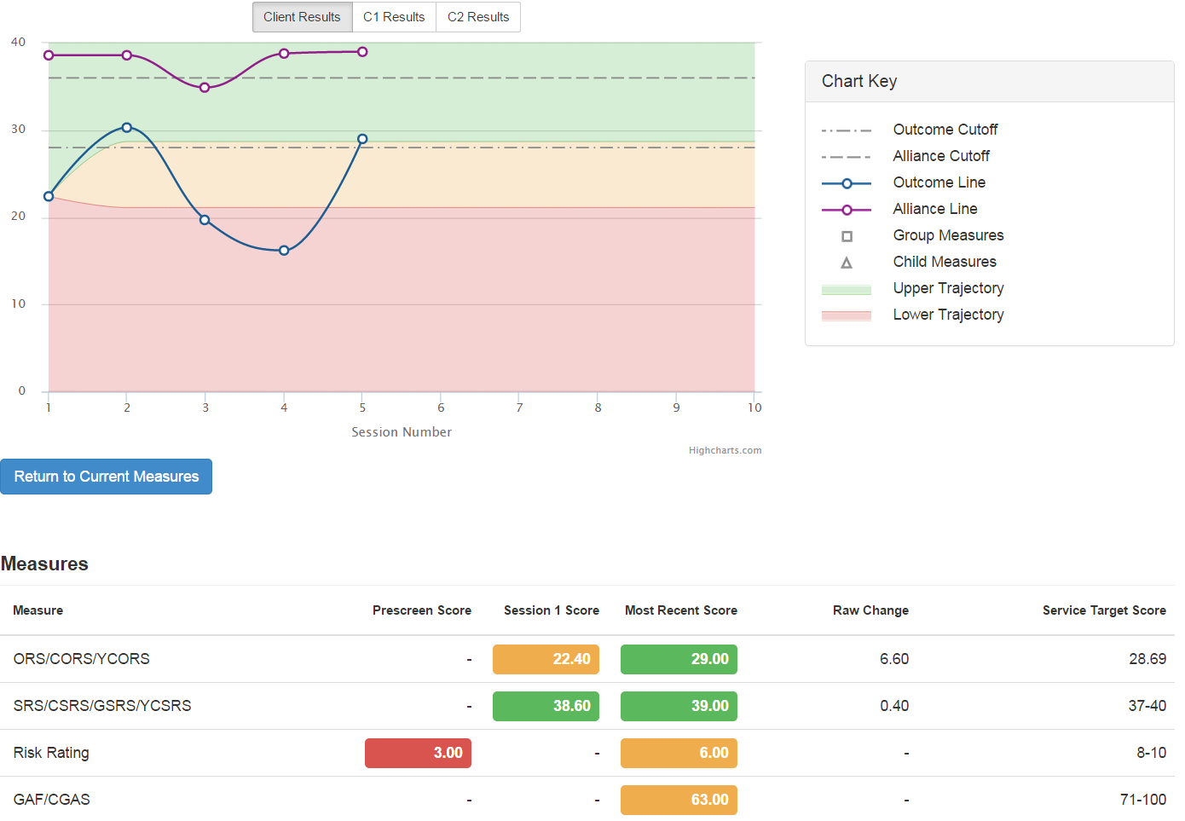
Imagine OMS – https://www.bobbertolino.com/imagine-oms

Slide 64
At-Risk Cases
Refer to ICCE Manual 3.
Scores at or above the clinical cut-off.
Lack of progress on the ORS.
Fluctuating ORS scores (see-saw, bleeding, ditching).
Problematic alliance scores.

Slide 65
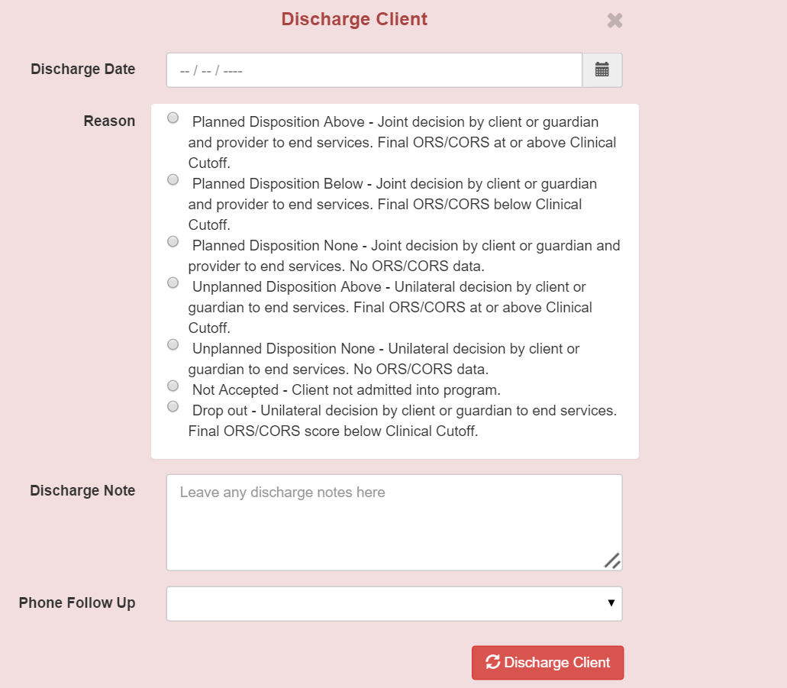
Imagine OMS – https://www.bobbertolino.com/imagine-oms

Slide 66
Imagine OMS – https://www.bobbertolino.com/imagine-oms

Slide 67
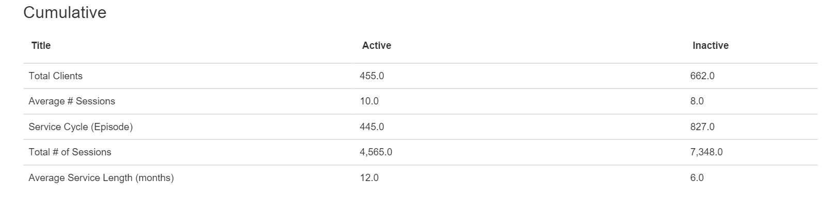
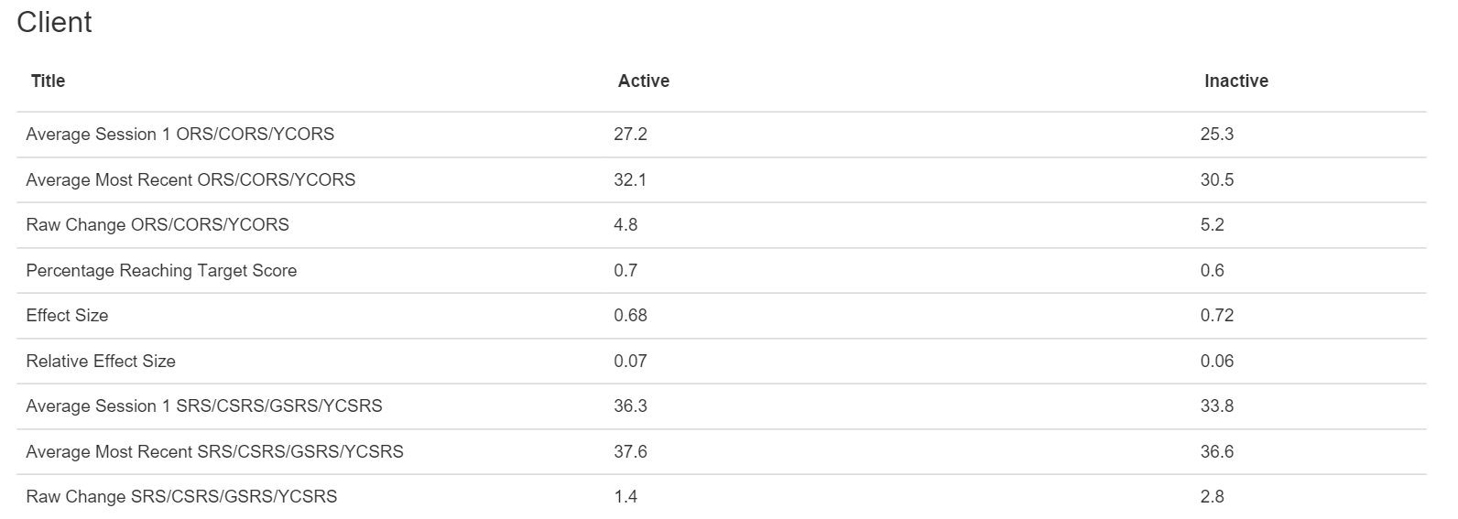

Slide 68
Outcomes Indicators
What statistics are most meaningful in terms of outcomes?
  Clinical Cutoffs
  Reliable Change Index
  Clinical Significance
  Effect Sizes
  Service Targets/Predictive Trajectories

Slide 69
Clinical Cutoffs
Clinical cutoff (CC) for an outcome measure: (1) Defines the boundary between a normal and clinical range of distress; and (2) Provides a reference point for evaluating the severity of distress for a particular client or client sample.
  CCs for ORS/CORS measure: 25 (>19); 28 (13-19); 32 (≤12)
  Note: 25-33% of people presenting for treatment score above the CC at intake

Slide 70
Reliable Change Index
Reliable Change Index (RCI): A measure used to assess the magnitude of change necessary to be considered statistically reliable and not due to chance, maturation (the passage of time), or measurement (statistical) error. It is an average based on the reliability or consistency of an instrument.
  The RCI for the ORS is 5-point increase between two scores

Slide 71
Clinical Significance
Clinical significance (CS) or clinically significant change, refers to reliable improvement (i.e., 5 points or more on the ORS) that is beyond a trivial amount of “day-to-day” fluctuation and also corresponds to a change in clinical status—movement from a clinical (i.e., distressed) range to a nonclinical (non-distressed, functional) range.

Slide 72
Standard Effect Size (ES)
Pre-Post Effect Size
Measure of change from point A to Point B. Estimates client progress compared to no treatment controls. ES for no treatment is typically reported to be around .20 and for therapy around .80; therefore an ES >.20 indicates client improvement is better that no treatment. ES will be lower for active clients than inactive clients in the data base because they have not completed service. The larger the number of clients in the data pool the more confidence in the Effect Size (need at least 30-40).
Average: .80 - 1.02

Slide 73
Relative Effect Size
Also referred to as comparative or corrected effect size.
Compares client progress to progress of clients in the normative sample who have the same intake score (compares like to like).
A corrected ES of 0.0 indicates change is average; above 0.0 is better than average; less than 0.0 is below average. The larger the number of clients in the data pool the more confidence in the Corrected Effect Size.
-.3 - .3 (0 is average)

Slide 74
Target Scores & Predictive Trajectories
Target Scores are the best way of determining the actual benefit of services.
Service Targets/Predictive Trajectories
  Require comparative samples and are most often produced by computerized statistical packages
  The service target is the highest score of the expected treatment response (ETR) based on the intake score;
  The % reaching targets will typically be lower for active clients than inactive clients because active clients have not completed service;
  Normally will be between 64-74% for inactive clients;
  If higher than 74% then data can be suspect.

Slide 75
Supervision to Support Clinicians with
Improving Outcomes

Slide 76
Achieving Better Outcomes
Remain aware of three inherent risks: Failure to identify client deterioration, overprediction of client improvement, and therapist self-assessment bias.
Begin using Routine Outcome Management (ROM).
Discuss choices of models/approaches and offer further training.
Discuss the use of additional measurement when clients are not progressing or deteriorating.
Begin by scheduling time every day, if possible, but no less than 3x per week, to practice new skills.

Slide 77
Achieving Better Outcomes
Use deliberate practice—individualized training activities designed to improve specific aspects of performance through repetitive and successive refinement.
Examples of DP activities: Reviewing video recorded sessions, simulation-based learning, behavioral rehearsal, provider-client engagement role plays, and reading case studies.

Slide 78
Model | Experiential | Cognition and Views | Action and Interaction | Neurobiology
Acceptance and Commitment Therapy (ACT) | ✓ | ✓ | ✓
Adlerian Therapy (Individual Psychology) |  | ✓ | ✓
Behavior Therapies |  |  | ✓
Cognitive (CT) and Cognitive Behavioral Therapies (CBT) | ✓ | ✓ | ✓
Dialectical Behavior Therapy (DBT) | ✓ | ✓ | ✓ | ✓
Existential Therapy | ✓ | ✓
Eye Movement Desensitization and Reprocessing (EMDR) | ✓ | ✓ |  | ✓
Gestalt Therapy | ✓ | ✓
Hypnosis | ✓ | ✓ |  | ✓
Interpersonal Therapy | ✓ | ✓ | ✓
Jungian Analysis | ✓ | ✓
Motivational Interviewing (MI) |  | ✓ | ✓
Narrative Therapy |  | ✓
Neuro-Linguistic Programming (NLP) | ✓ | ✓
Person-Centered Therapy | ✓ | ✓ | ✓
Psychoanalysis and Psychodynamic Therapies | ✓ | ✓
Rational-Emotive Behavior Therapy | ✓ | ✓ | ✓
Reality Therapy |  | ✓ | ✓
Solution-Focused Brief Therapy (SFBT) |  | ✓ | ✓
Strategic and Structural Family Therapies |  |  | ✓
Model Selection
Some clinicians choose to adhere to one or two specific models.
Other consider themselves “eclectic,” however, one cannot be eclectic unless he or she knows numerous models well.
Studies demonstrate that most therapists know 2-3 models.
Consider using a “Practice-Based Evidence” approach.
Doing so involves matching the approach with clients based on the evidence that emerges from each interaction.

Slide 79

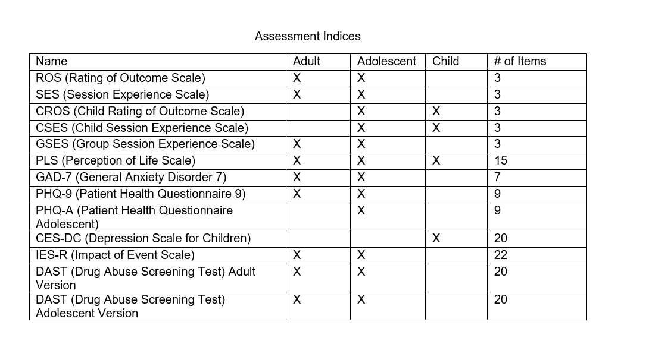

Slide 80
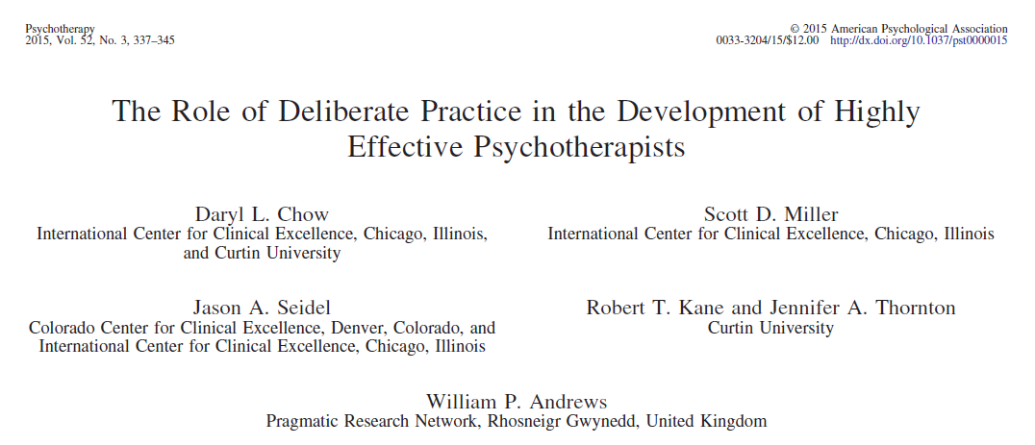
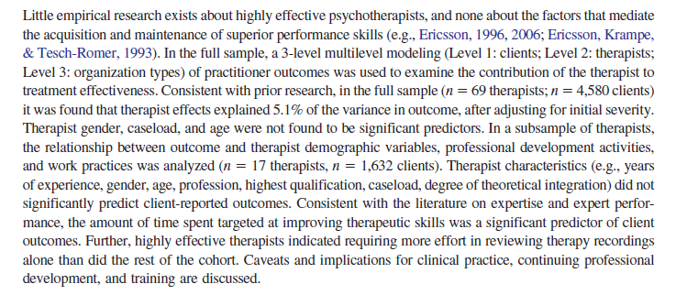
How Do Therapists Achieve Better Outcomes?
The findings from Chow and colleagues’ study showed a correlation between the time therapists spent on activities intended to improve their ability and their outcomes.
The top performers spent 2.5 to 4.5 more hours reflecting on actions, consulting about cases, reading, attending professional development activities, planning, and engaging in other learning activities than average therapists.
Researchers also estimated that that “the accumulative time spent by the top quartile (most effective therapists) was, on average, about 2.8 times more hours per week engaged in DP activities aimed at improving effectiveness than the rest of the other therapists” (p. 341).

Slide 81
Deliberate Practice
Zone of “Proximal Development”:
Reliable performance inconsistent
Identification of errors, misperceptions
Setting small process and outcome objectives
Involves planning, rehearsal, reflection
Edge of Ability
Too Easy
Too Difficult
Realm of “Reliable” Performance:
Processes executed quickly, automatically
Involves recognition, retrieval, execution
Ambit of Admiration:
Abilities of others appear flawless, magical, dramatic
Effort and attention focused on easily recognized, but non-causal factors and/or processes (superstition)
Risk of failure and injury high

Slide 82
Panic
Zone
Learning Zone
Comfort Zone

Slide 83
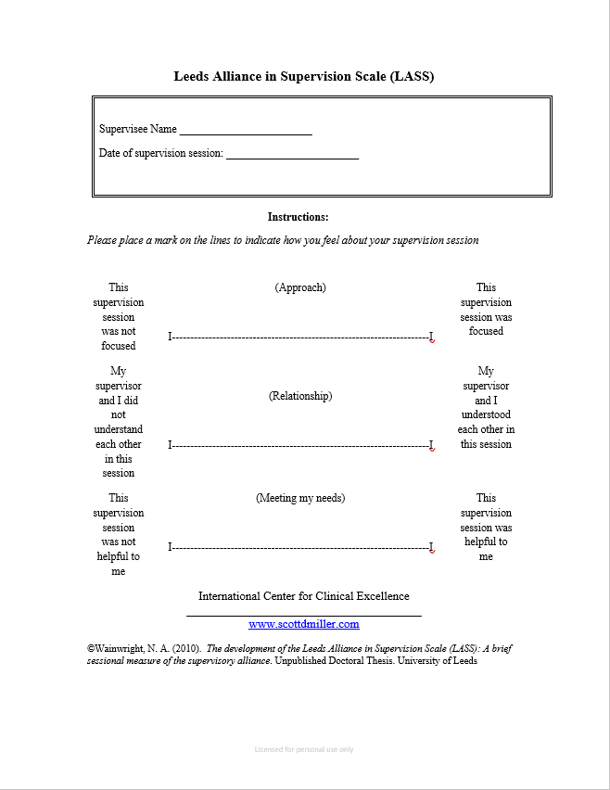

Slide 84
How Do We Improve? (Revisited)
Choose a skill to improve on.
Practice it routinely.
Use feedback.
Get coaching.
  Be clear about what you want help with;
  Someone who gives short, clear directions;
  Someone who loves teaching fundamentals;
  Willing to analyze your game;
  More corrective than critical;
  Process versus technique/tricks;
  An authority, not authoritarian;
  Able to distinguish when any challenges encountered are a result of you and your growth edge, or the coaching;
  How to become a better version of you, not a version of the coach.
  Help you stay at your growth edge.

