Slide 1
Frozen in Time
Advances in the Treatment of
Sexual Abuse and Trauma
Bob Bertolino, Ph.D.
Professor, Maryville University
Sr. Clinical Advisor, Youth In Need, Inc.
Sr. Associate, International Center for Clinical Excellence

Slide 2




Tidbits
For copyright reasons and confidentiality some of PowerPoint slides may be absent from your handouts.
To download a copy of this presentation, please go to: www.bobbertolino.com.
Please share the ideas from this presentation. You have permission to reproduce the handouts. I only ask that you maintain the integrity of the content.
Contact: bertolinob@cs.com; 314.852.7274
bobbertolino.com

Slide 3
Trauma Defined (SAMHSA)
“Trauma results from an event, series of events, or set of circumstances that is experienced by an individual as physically or emotionally harmful or threatening and that has lasting adverse effects on the individual’s functioning and physical, social, emotional, or spiritual well-being.”
A traumatic experience can be a single event, a series of events, and/or a chronic condition (e.g., childhood neglect, domestic violence).
Traumas can affect individuals, families, groups, communities, specific cultures, and generations.

Slide 4
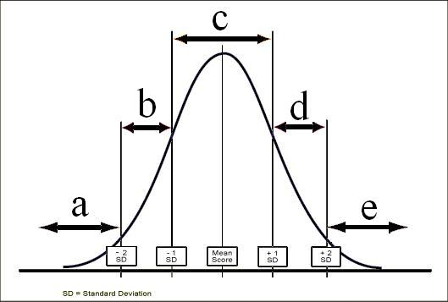

Slide 5
Posttraumatic Stress Disorder (Trauma and Stressor-Related Disorders)

Slide 6
A Theory of Response to Trauma

Slide 7

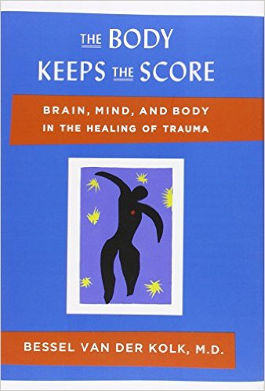
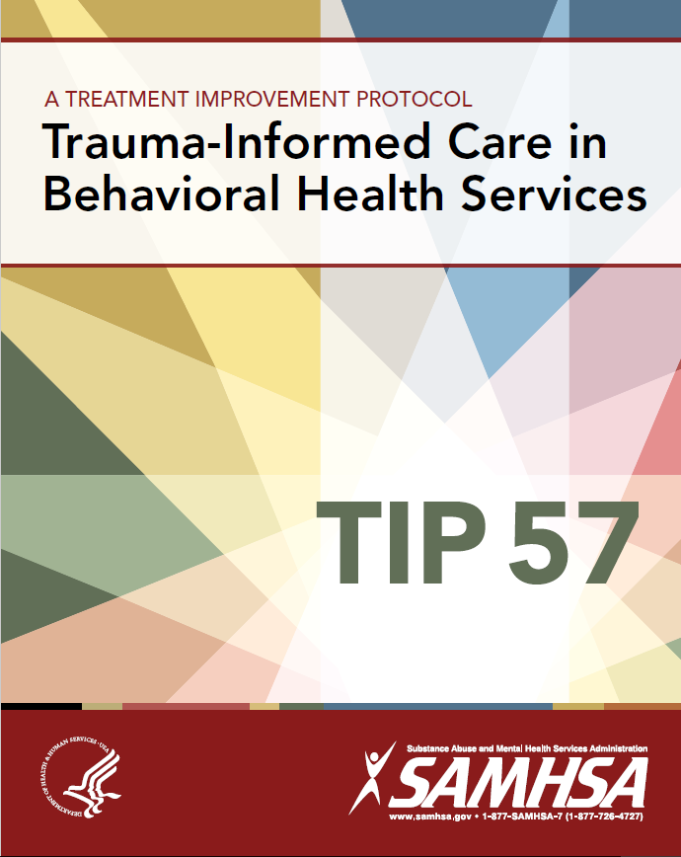

Slide 8
The 360° Self
Thoughts
Sensations
Memories
Feelings
Fantasies

Slide 9
Intrusion, Devaluation, and Attribution
Sexual/physical intrusion
Devaluing
Undifferentiated
Self
Attribution of experience

Slide 10
Intrusion, Devaluation, and Attribution
Sexual/physical intrusion
Devaluing
Undifferentiated
Self
Leads to
3-D effect
Attribution of experience

Slide 11
Aftereffects in 3-D:
Dissociated, Disowned, Devalued

Slide 12
Dissociated/Disowned/Devalued
Aspects of Self
Unowned/“bad” feelings, thoughts, sensations, memories, fantasies, desires, aspects of self
Aspects of experience with which the person identifies

Slide 13
Intrusion or Inhibition
Devalued aspect is either inhibited, suppressed and numbed or becomes intrusive, dominant or compulsive

Slide 14
Inhibition and Intrusion
Polarities of Troublesome Aftereffects of Trauma
Inhibited/Lacking
No physical or sexual response/sensations
No anger
No memories (might be lacking only visual, auditory, gustatory, olfactory, or kinesthetic, or some combination)
No body awareness; lack of connection with certain body parts (e.g., the arms)
Intrusive/Compulsive
Compulsive/“addictive” sexuality
Rage
Flashbacks (might be visual, auditory, gustatory, olfactory, or kinesthetic, or some combination)
Somatic/medical symptoms; eating disorders; self-mutilation

Slide 15
Symptomatic and Healing Trances
Symptomatic Trance
Invalidation; blame; violating boundaries
Mystification; binds; double binds
Coalitions; secrets; negative dissociation
Predictions of failure or trouble; threats
Rigid role assignment; mind reading
Repetition of negative experiences/injurious/self-injurious behavior
Negative injunctions (You can’t, you shouldn’t you will, you are)
Repression; amnesia
Healing Trance
Validation; permission; respecting boundaries
Possibility words and phrases
Helpful distinctions
Post-hypnotic suggestions; presuppositions of health/healing
Positive attributions
Possibilities in views and actions
Empowering/permissive affirmations (you can, it’s okay, you may, you could, you have the ability to)
Flexible remembering and forgetting

Slide 16
Signs of Dissociation
Fixed or “glazed” eyes
Sudden flattening of affect
Long periods of silence
Monotonous voice
Stereotyped movements
Responses not congruent with the present context or situation
Excessive intellectualization
Briere, J. (1996). Therapy for adults molested as children: Beyond survival (2nd ed.). New York: Springer.

Slide 17
The Influence of Trauma
Theorists contend that trauma disrupts the central nervous system and keeps people from processing and integrating trauma memories into conscious mental frameworks.
Brain scans of patients exposed to scripted versions of their traumatic memories indicate that the areas of the right hemisphere, especially around the amygdala which are associated with emotional states and autonomic arousal, “light up.” In contrast, there is a left frontal cortex shut down—the center of speech.

Slide 18
The Influence of Trauma (cont.)
In effect, trauma remains “stuck” in the brain’s nether regions—amygdala, thalamus, hypothalamus—and is not accessible to the frontal lobes—which involves understanding, thinking, and reasoning.
In sum, when people relive trauma the frontal lobes become impaired and as a result, they have trouble thinking and speaking.
Studies suggest that the people process their trauma from the bottom up—body to mind—not top down.
This further suggests that words and language alone, hence talk therapy, isn’t always enough.

Slide 19
The Influence of Trauma (cont.)
An issue for therapists, then, is to help clients to not become so aroused that they shut down physiologically—this can help them to process the trauma themselves.
Doing so involves helping clients to regulate their physical states in order to get their minds to work. Once they shift their physiological patterns, their thinking can change
“There is still the issue with traumatized people—they see and feel only their trauma, or they see and feel nothing at all; they’re fixated on their traumas or they’re somehow psychically absent.” – Bessel van der Kolk

Slide 20
Summary
A person is intruded upon experientially, psychologically, and/or physically.
One or more aspects (i.e., perceptions, thoughts, memories, sensations, or feelings) are split off from self.
These aspects are not only split off but are disowned (“not me”), and are devalued (“it’s bad”).
Through relationships, social interactions, sensory experiences, or other contextual cues people are induced or triggered into negative or symptomatic trances.

Slide 21
Summary (cont.)
Unintegrated aspects then become intrusive (e.g., flashbacks), inhibited (e.g., diminished feelings), or both and become destructive in relation to self.
The result is that people experience the aftereffects of trauma over and over again and become frozen in their experiences.
People who are experiencing this freezing present with symptoms (e.g., “He has fits of rage,” “I don’t feel anything”).
Because of the effects of trauma, therapy often involves moving from body to mind as opposed to mind to body.

Slide 22
Traditional Treatment Ideas
What was unexperienced needs to experienced no matter how uncomfortable or disruptive it may to the person.
Prolonged-Exposure Therapy – traumatized clients continue to recount their traumas until they lose their disturbing power
Healing must involve intense emotional catharsis.
Have to get to the “root” of the abuse and/or trauma.
Therapy is long-term (i.e., beyond 12-16 sessions).
Therapy is past-oriented.

Slide 23
Do Approaches to the Treatment of PTSD Vary in Efficacy?
Benish, S., Imel, Z. E., & Wampold, B. E. (2008). The relative efficacy of bona fide psychotherapies of post-traumatic stress disorder: A meta-analysis of direct comparisons. Clinical Psychology Review, 28, 746-758.
Models studied: PET, EMDR, CBT, TFCBT, Stress Inoculation, Trauma Management
All models studied demonstrated benefit to participants
No differences in the effectiveness of approaches studied.

Slide 24
Bona fide Treatment Approaches
Bona fide approaches are:
(1) intended to be therapeutic (has a theoretical base and associated techniques);
(2) considered viable by the psychotherapeutic community (e.g., through professional books or manuals);
(3) delivered by trained therapists; and,
(4) contain ingredients common to all legitimate psychotherapies (e.g., therapeutic relationship)
Bertolino, B., Bargmann, S., & Miller, S. D. (2012). Manual 1: What works in therapy: A primer. The ICCE manuals of
feedback informed treatment. Chicago, IL: International Center for Clinical Excellence.
Wampold, B. E. , Mondin, G. W., Stich, F., Benson, K., & Ahn, H. (1997). A meta-analysis of outcome studies comparing
bona fide psychotherapies: Empirically, “All must have prizes.” Psychological Bulletin, 122(3), 203-215.

Slide 25
TBCBT: An Example
In one study, children were randomly assigned to the intervention group or a group receiving nondirective supportive therapy. Children in the intervention group had a statistically significant decrease in behavior problems from pre- to posttreatment relative to those in the comparison group (all p values < .05).
In another study, children and their female guardian were randomly assigned to one of three intervention groups--child only, guardian only, or guardian and child—or to a comparison group receiving standard community care. Guardians receiving the intervention (i.e., those in the guardian-only group and guardian and child group) rated their child as exhibiting significantly fewer behavior problems at posttreatment than did those assigned to the child-only group or the comparison group (p < .05).
In a third study, children and their female or male guardian were randomly assigned to the intervention group or a group receiving child-centered therapy. Children in the intervention group demonstrated significantly greater reductions in behavior problems from pre- to posttreatment relative to those in the comparison group (p < .05).

Slide 26

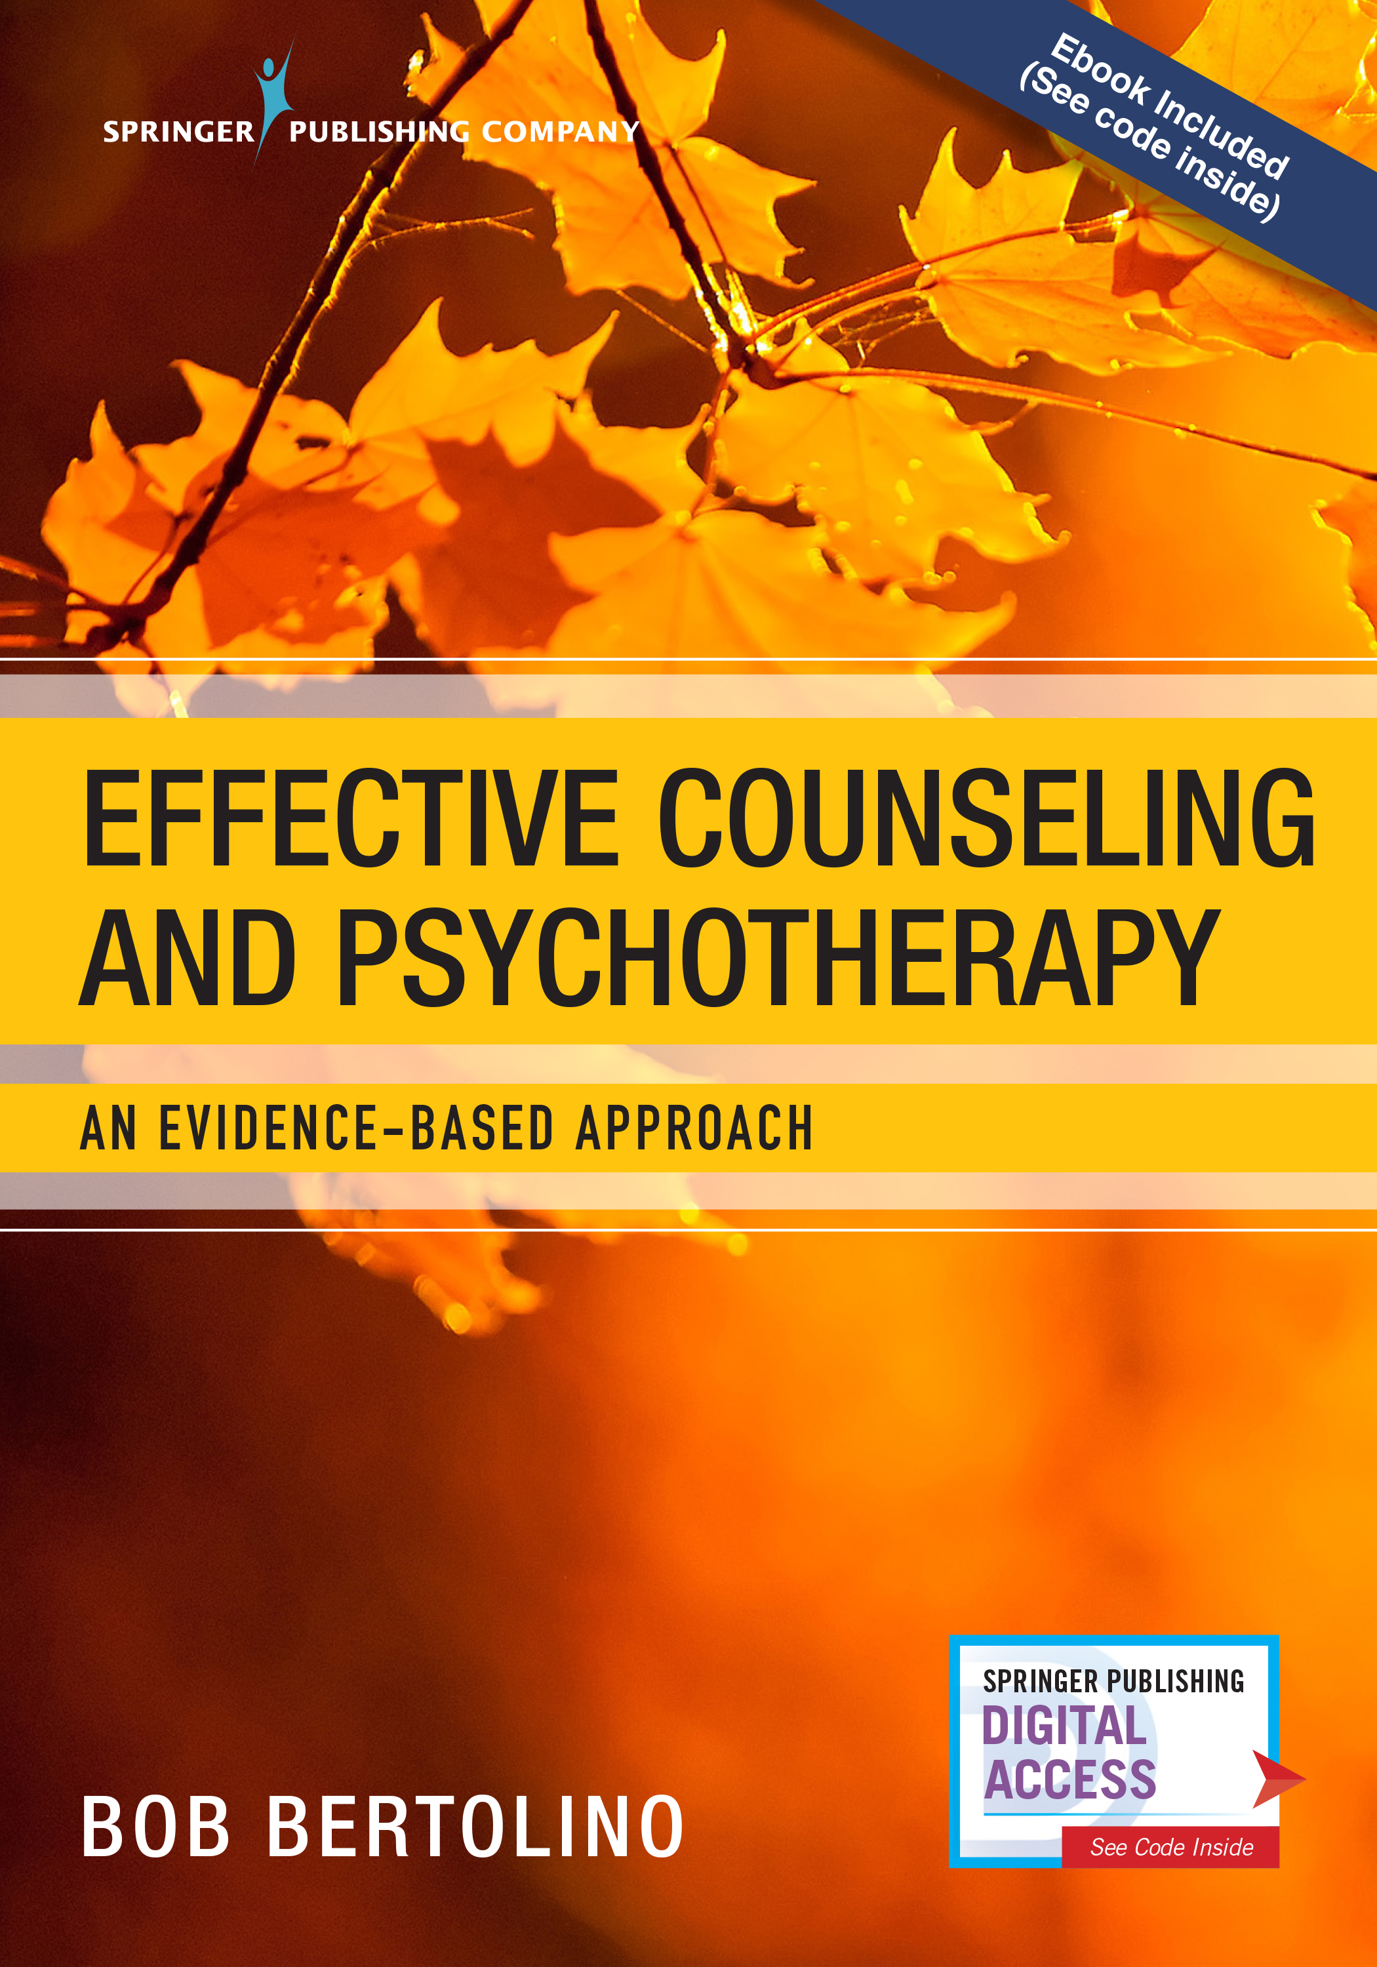
Outcomes?
As is stated in virtually every research study, “More research is needed.”
To date, no psychotherapy model has been shown to be more effective in comparative analyses between bona fide approaches.
The most reliable method of determining the benefit of treatment is through the use of routine outcome measurement (ROM).
ROM addresses three risks to all therapists:
  Overprediction of client improvement
  Failure to identify client deterioration
  Self-assessment bias

Slide 27
Why Measure Outcomes?
Seeking and obtaining valid, reliable, and feasible feedback though routine outcome measurement (ROM) regarding the alliance and outcome:
As much as doubles the effect size of treatment, cuts dropout rates in half, and decreases risk of deterioration.
Assists with both identification of potential alliance ruptures and creates opportunities for clinicians to take corrective steps (Anker, Duncan, & Sparks, 2009; Anker et al., 2010).
Improvements in the alliance (intake to termination) are associated with better outcomes and lower dropout rates (Duncan, Miller, Wampold, & Hubble, 2010; Harmon et al., 2007; Lambert, 2010, Miller, Hubble, & Duncan, 2007).
APA Presidential Task Force on Evidence-Based Practice. (2006). Evidence-based practice in psychology. American Psychologist, 61(4), 271–285.
Duncan, B. L., Miller, S. D., Wampold, B. E., & Hubble, M.A. (Eds.), (2010). The heart and soul of change: Delivering what works in therapy (2nd. Ed.).
Washington, DC: American Psychological Association.
Lambert, M. J. (2010). Prevention of treatment failure: The use of measuring, monitoring, and feedback in clinical practice.. Washington, DC: American
Psychological Association.

Slide 28
Why Measure Outcome? (cont.)
Accrediting bodies including The Joint Commission, Council on Accreditation (COA), and the Commission on Accreditation of Rehabilitation Facilities (CARF) have employed standards related to reliable and valid measurement of outcomes.
For example, The Joint Commission state: “Organizations will be required to assess outcomes through the use of a standardized tool or instrument. Results of these assessments would then be used to inform goal, and objectives identified in individual plans of care, treatment, or services as needed, and evaluate outcomes of care, treatment, or services provided to the population(s) served.”
Areas of emphasis include:
  The impact of services on clients
  The quality of service delivery

Slide 29
Fit and Effect
Fit: The degree to which a way of working with a client matches his or her worldview, culture, and ideas about change.
  Consider assessment processes, diagnosis, the use of interventions, etc.
  Feedback that focuses on the alliance assists with increasing fit.
Effect: Did the intervention, at minimum, benefit the client, and at best contribute to a positive, measurable outcome?
  Feedback that focuses on the client’s subjective interpretation of the benefit of services assists with increasing effect.

Slide 30
Fit: Engagement is Critical to Outcome
Most providers do not actively address the risk of dropout in services. Dropout: the unilateral decision by clients to end therapy—averages are between 20% to 47% (Swift et al., 2012; Wierzbicki & Pekarik, 1993). For children and adolescents the range varies from 28% to 85% (Garcia & Weisz, 2002).
Garcia, J. A., & Weisz, J. R. (2002). When youth mental health care stops: Therapeutic relationships problems and other reasons
for ending youth outpatient treatment. Journal of Consulting and Clinical Psychology, 70(2), 439-443.
Swift, J. K., Greenberg, R. P., Whipple, J. L., & Kominiak, N. (2012). Practice recommendations for reducing premature
termination in therapy. Professional Psychology: Research and Practice, 43(4), 379-387.
Wierzbicki, M., & Pekarik, G. (2002). A meta-analysis of psychotherapy dropout. Professional Psychology: Research and Practice,
24(2), 190-195.

Slide 31
Fit: Strengthening Engagement
Orlinsky, Rønnestad, and Willutzki (2004) observe, “The quality of the patient’s participation… [emerges] as the most important [process] determinant in outcome” (p. 324). Clients who are more engaged and involved in therapeutic processes are likely to receive greater benefit from therapy.
Next to the level of functioning at intake, the consumer’s rating of the alliance is the best predictor of treatment outcome and is more highly correlated with outcome than clinician ratings (Martin, Garske, & Davis, 2000; Norcross, 2011). Better client-therapist alliances lead to better outcomes whereas clients of therapists with weaker alliances tend to drop out at higher rates and experience poorer outcomes (Hubble et al., 2010; Lambert, 2010).
Hubble, M. A., Duncan, B. L., Miller, S. D., & Wampold, B. E. (2010). Introduction. In B. L. Duncan, S. D. Miller, B. E. Wampold, & M. A. Hubble (Eds.), The heart and soul of change:
Delivering what works in therapy (2nd ed.)(pp. 23-46). Washington, DC: American Psychological Association.
Lambert, M. J. (2010). Prevention of treatment failure: The use of measuring, monitoring, and feedback in clinical practice. Washington, DC: American Psychological Association.
Martin, D. J., Garske, J. P., & Davis, M. K. (2000). Relationship of the therapeutic alliance with outcome and other variables: A meta-analytic review. Journal of Consulting and Clinical
Psychology, 68(3), 438–450.
Norcross, J. C. (Ed.). (2011). Psychotherapy relationships that work: Evidence-based responsiveness (2nd ed.). New York: Oxford.
Orlinsky, D. E., Rønnestad, M. H., Willutzki, U. (2004). Fifty years of psychotherapy process-outcome research: Continuity and change. In M. J. Lambert (Ed.), Bergin and Garfield’s
handbook of psychotherapy and behavior change (5th ed.)(pp. 307-390). New York: Wiley.

Slide 32
Effect: Focus on Early Change and
Respond to Lack of Progress
The dose-effect relationship in psychotherapy; approximately 30% of clients improve by the second session, 60% to 65% by session seven, 70% to 75% by six months, and 85% by one year (Howard, Kopta, Krause, & Orlinksy, 1986). Early response in therapy is strong indicator of eventual outcome, making the monitoring of improvement from the start of therapy essential. The longer clients attend therapy without experiencing a positive change the greater the likelihood that they will experience a negative or null outcome or drop out. (Duncan, Miller, Wampold, & Hubble, 2010)
Duncan, B. L., Miller, S. D., Wampold, B. E., & Hubble, M.A. (Eds.), (2010). The heart and soul of change: Delivering what works in therapy (2nd, Ed.).
Washington, DC: American Psychological Association.
Howard, K. I., Kopte, S. M., Krause, M. S., & Orlinsky, D. E. (1986). The dose-effect relationship in psychotherapy. American Psychologist, 41(2), 159–
164.

Slide 33
Evidence-Based Practice in Health & Behavioral Health
  APA: “The integration of the best available research with clinical expertise in the context of patient characteristics, culture, and preferences.” (1)
  SAMHSA: “EBPs integrate clinical expertise; expert opinion; external scientific evidence; and client, patient, and caregiver perspectives so that providers can offer high-quality services that reflect the interests, values, needs, and choices of the individuals served.” (3)
  IOM: “Evidence based medicine is the conscientious, explicit, and judicious use of current best evidence in making decisions about the care of individual patients. The practice of evidence based medicine means integrating individual clinical expertise with the best available external clinical evidence from systematic research.” (2)
(1) APA Presidential Task Force on Evidence-Based Practice. (2006). Evidence-based practice in psychology. American Psychologist, 61(4), 271–285.
(2) Sackett, D. L., Rosenberg, W. M. C., Muir Gray, J. A., Haynes, R. B., & Richardson, W. S. (1996). Evidence based medicine: What it is and what it
isn't: It's about integrating individual clinical expertise and the best external evidence. BMJ: British Medical Journal, 312(7023), 71-72.
(3) SAMHSA. (2016, January 6). Evidence-based practices web guide. https://www.samhsa.gov/ebp-web-Guide

Slide 34
Ideas for Trauma Treatment

Slide 35
Trauma-Informed (SAMHSA)
A program, organization, or system that is trauma-informed:
Realizes the widespread impact of trauma and understands potential paths for recovery;
Recognizes the signs and symptoms of trauma in clients, families, staff, and others involved with the system;
Responds by fully integrating knowledge about trauma into policies, procedures, and practices; and
Seeks to actively resist re-traumatization.

Slide 36
From Pathology to Strengths
“What we have learned over 50 years is that the disease model does not move us closer to the prevention of these serious problems. Indeed the major strides in prevention have largely come from a perspective focused on systematically building competency, not correcting weakness. Prevention researchers have discovered that there are human strengths that act as buffers against mental illness: courage, future-mindedness, optimism, interpersonal skill, faith, work ethic, hope, honesty, perseverance, the capacity for flow and insight, to name several. Much of the task of prevention in this new century will be to create a science of human strength whose mission will be to understand and learn how to foster these virtues in young people… We need now to call for massive research on human strength and virtue. We need to ask practitioners to recognize that much of the best work they already do in the consulting room is to amplify strengths rather than repair the weaknesses of their clients.” (p. 6-7)
Seligman, M. E. P., & Csikszentmihalyi, M. (2000). Positive psychology: An introduction. American Psychologist, 55(1),
5–14.

Slide 37

Strengths-Based Defined
A strengths-based perspective emphasizes the abilities and resources people have within themselves and their support systems to more effectively cope with life challenges. When combined with new experiences, understandings and skills, these abilities and resources contribute to improved well-being and outcome, which is comprised of three areas of functioning: individual, interpersonal relationships, and social role. Strengths-based practitioners value relationships and convey this through respectful, culturally-sensitive, collaborative, practices that support, encourage and empower. Routine outcome monitoring (ROM) is used to create and maintain a culture of feedback—a responsive, consumer-driven climate to ensure the greatest benefit of services.
Bertolino, B. (2018). Effective counseling and psychotherapy: An evidence-based approach. New York:
Springer
Bertolino, B. (2014). Thriving on the front lines: Strengths-based youth care work. New York: Routledge.

Slide 38
Strengths-Based Principles
Clients are the Most Significant Contributors to Service Success.
  Maximize client contributions to change
The Therapeutic Relationship Makes Substantial and Consistent Contributions to Outcome
  Engage clients through the working alliance
Culture Influences and Shapes All Aspects of Clients’ Lives
  Convey respect for the clients and his or her culture

Slide 39
Strengths-Based Principles (cont.)
Effective Services Promote Growth, Development, and Well-Being
  Utilize strategies that empower clients
Expectancy and Hope are Catalysts of Change
  Demonstrate faith in the restorative effects of services

Slide 40
Strengths-Based and Trauma
  The brain-disease model overlooks four fundamental truths:
  Our capacity to destroy one another is matched by our capacity to heal one another. Restoring relationships and community is central to restoring well-being;
  Language gives us power to change ourselves and others by communicating our experiences, helping us to define what we know, and finding a common sense of meaning;
  We have the ability to regulate our own physiology, including some of the so-called involuntary functions of the body and brain, through such activities as breathing, moving, and touching; and,
  We can change social conditions to create environments in which children and adults feel safe and where they can thrive.
van der Kolk, B. (2014). The body keeps the score: Brain, mind, and body in the healing of trauma. New York: Viking.

Slide 41
Posttraumatic Stress Disorder (Trauma and Stressor-Related Disorders)
Notes:
Comprehensive Soldier Fitness – Efforts to shift the curve to the right.

Slide 42
0
Notes:
Comprehensive Soldier Fitness – Efforts to shift the curve to the right.

Slide 43
Posttraumatic Growth
Notes:
Comprehensive Soldier Fitness – Efforts to shift the curve to the right.

Slide 44
Post-Traumatic Growth
Only a percentage of people who experience serious distress and/or traumatic events develop symptoms of PTSD.
Examples include: Bereavement, bone marrow transplantation, breast cancer, chronic illness, heart attack, military combat, natural disaster, physical assault, and refuges displacement.
Most, cope sufficiently, having various ups and downs but few catastrophic lows.
And, a percentage of people actually grow from their traumatic experiences.

Slide 45
Post-Traumatic Growth (cont.)
Growth from events that traumatic situations and conditions has been referred to as Adversarial Growth or Post-Traumatic Growth (Calhoun & Tedeschi, 2013; Tedeschi, Park, & Calhoun, 1998).
What kind of growth do people experience?
  Spirituality
  Compassion for others
  Openness
  Even, eventually, overall life satisfaction
Calhoun, L. G., & Tedeschi, R. G. (2013). Posttraumatic growth in clinical practice. New York: Routledge.
Tedeschi, R. G., Park, C. L., & Calhoun, L. G. (1998). Posttraumatic growth: Positive changes in the aftermath of crisis. New Jersey: Lawrence Erlbaum.

Slide 46
Post-Traumatic Growth (cont.)
What distinguishes the people who find growth in traumatic experiences from those who do not?
Mindset: How people conceive of the cards they have been dealt.
Positive reinterpretation of the situation or event.
Optimism.
Acceptance.
Focusing on the problem head-on (rather than trying to avoid it).
Calhoun, L. G., & Tedeschi, R. G. (2013). Posttraumatic growth in clinical practice. New York: Routledge.
Tedeschi, R. G., Park, C. L., & Calhoun, L. G. (1998). Posttraumatic growth: Positive changes in the aftermath of crisis. New Jersey: Lawrence Erlbaum.

Slide 47
The Role of the Therapist

Slide 48
The Role of the Therapist
Therapy begins with a concern or complaint—avoid vague goals such as “working on childhood sexual abuse issues”—gain clear descriptions of what individuals want to be different).
Safety first: address self-harming behavior and potential thereof (acknowledge, validate, and give permission for all internal experience, not all actions).
Determine what aspect(s) have been dissociated, disowned, and devalued and how these aspect repeat in clients’ experiences.
Exercise patience and understanding.

Slide 49
The Role of the Therapist (cont.)
Clarify for the client what to expect in therapy.
Approach the client in a matter-of-fact, yet supportive manner.
Respect the client’s personal space.
Adjust tone and volume of speech to suit the client’s level of engagement and degree of comfort in the interview process.
Provide culturally appropriate symbols of safety in the physical environment.
Be aware of one’s own emotional responses to hearing clients’ trauma histories.

Slide 50
The Role of the Therapist (cont.)
Elicit only the information necessary for determining a history of trauma and the possible existence and extent of traumatic stress symptoms and related disorders.
Give the client as much personal control as possible during the assessment.
Use self-administered, written checklists rather than interviews when possible to assess trauma.
Allow time for the client to become calm and oriented to the present if he or she has very intense emotional responses when recalling or acknowledging a trauma.
Avoid phrases that imply judgment about the trauma.

Slide 51
A Framework to Develop a Relationship with Aspects of Self
Don’t lead clients on a voyage to discover, uncover, or recover memories.
People can remember without reliving.
Help clients to remain present and in their bodies.
Check in regularly—elicit and respond to feedback.

Slide 52
A Framework to Develop a Relationship with Aspects of Self (cont.)
Acknowledge the existence of the aspect or experience that has been dissociated, disowned, and devalued.
Make room for the aspect or experience; allowing it to exist within the boundaries of self (integration).
The Antidote: The Inclusive Self – Create a context where clients can incorporate aspects of self that have been dissociated, disowned, and devalued.

Slide 53
The Antidote:
The Inclusive Self
Nature
Spirituality
Future selves
Exceptions
Resources
Alien voices
(society’s/others)
Devalued aspects
(Disidentified Self)
Alternative
Stories
Identified Self
(Identity Story)
Community
Previous
solutions
Polarities
(Non-identified self)

Slide 54
The Antidote: The Inclusive Self
Unowned/“bad” feelings, thoughts, sensations, memories, fantasies, desires, aspects of self
Aspects of experience with which the person identifies

Slide 55
Treatment Strategies

Slide 56
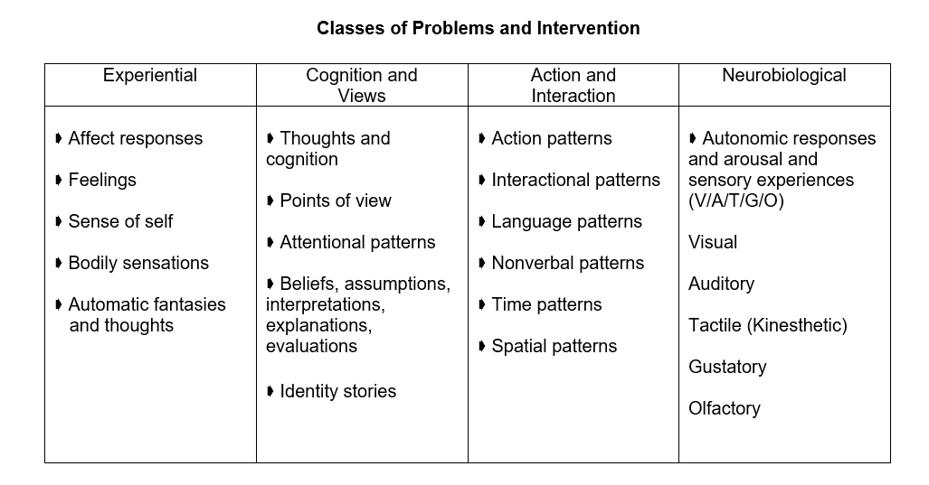

Slide 57
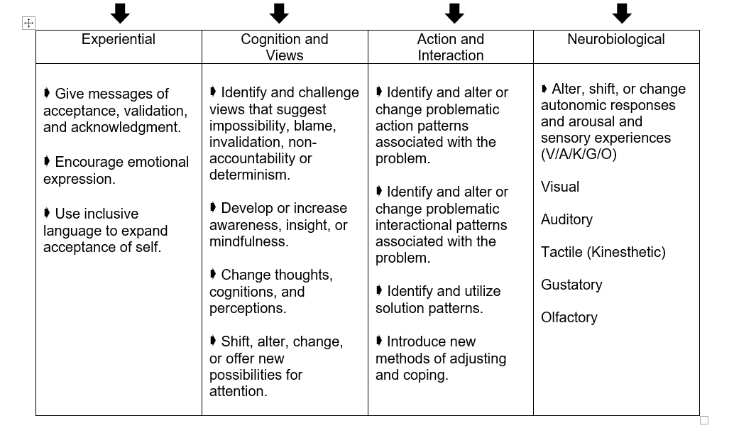

Slide 58
Internal Experience
Avoid platitudes and glib explanations
Acknowledgement and validation
Listen deeply and sit with clients’ pain and suffering
Give permission for all internal experience, not all actions
Address binds and injunctions in internal experience (Trance Logic: Permission and Inclusion)

Slide 59
Possibility Language
Dissolving Impossibility Talk
Reflect client statements in the past tense.
  From: “It’s always that way.”
  To: “It’s been that way.”
Move from global (“everybody,” nobody,” “always,” “never”) to partial (“recently,” “somewhat more,” “a lot”).
  From: “I’m always in trouble.”
  To: “You’ve been in trouble a lot.”
Move from truth/reality to perception (“It seems to you,” “You’ve gotten the idea”).
  From: “Things will never get better.”
  To: “It really seems to you that it will never get better.”

Slide 60
Possibility Language
Future Talk: Acknowledgment and a Vision for the Future
Assume the possibility of future change and/or solutions by using words such as “yet” and “so far.”
  From: “It’s always going to be this way.”
  To: “So far you haven’t found any evidence that things will be different than the way they are
  now.”
Recast the problem statement into a statement about a preferred future or goal.
  From: “I’ll never be able to have the life I really want.”
  To: “So you’d like to be able to move toward the life you really want.”
Presuppose that changes and progress toward goals will occur by using words such as “when” and “will.”
  From: “No one wants to be around me.”
  To: “So when you begin to notice that there are people who enjoy your company and want
  to be around you what will be different for you?”
Notes:
Exercise

Slide 61
Possibility Language
Giving Permission
Give permission “to,” “not to have to,” and both
  From: “I shouldn’t be angry.”
  To: “It’s okay to be angry.”
  From: “People keep saying that it really should make me angry.”
  To: “It’s okay to not be angry about it.”
  From: “Sometimes I’m angry and sometimes I’m not. I must be crazy!”
  To: “It’s okay to be angry and you don’t have to be angry and you’re not crazy.”

Slide 62
Strategies for Changing Views
Search for counterevidence, exceptions, and unique outcomes
Find alternative stories, interpretations, or frames that fit the same evidence or facts
Resilience – Listen for and evoke coping skills, protective factors (including social support systems), resilient qualities and actions associated with those qualities
Listen for and evoke meaning-making influences and resources (culture, ethnicity, spirituality, family, etc.) that have gone unnoticed or underutilized
Create or rehabilitate a vision of the future
Use self-disclosure, metaphor, stories, and music
Suggest changes in sensory attention

Slide 63
Cognitive Triad of Traumatic Stress

Slide 64
Five Pillars of Well-Being (PERMA)
(Intentional Activities)
Positive Emotion: Happiness (and lastingly happier); Joy; Life Satisfaction
Engagement: “Being at one” with some absorbing activity (Flow)
Relationships: Building positive relationships and social connections
Meaning: Using what is best inside you to belong to and serve something bigger than you are (the “larger” world and society)
Accomplishments: Achievement, Competence, Mastery, Development of New Skills over life span
Seligman, M. E. P. (2011). Flourish: A visionary new understanding of happiness and well-being. New York: The Free Press.

Slide 65
Past, Present, and Future
Think of an event, situation, or experience from the past that you have good memories about.
Take a deep breath or two and immerse yourself as much as possible on the event.
Focus on your sensations. What you can see, hear, taste, smell, and/or feel in your body. Also notice your emotions.
Stay with and savor those pleasant sensations and emotions and develop them as much as you can.
Try to remain in the experience for 3-5 minutes.
Repeat the exercise by focusing on the present, and more recent or current experiences. Then do the same with future and “hoped-for” experiences.

Slide 66
What Went Well?
For one week, identify and write down three good things that went well each day;
Write down what influenced those things;
At the end of the week reflect on the collection of good things and if comfortable, share your experience with another person.

Slide 67
VIA Signature Strengths
Wisdom and Knowledge: Cognitive strengths that entail the acquisition and use of knowledge
Courage: Emotional strengths that involve the exercise of will to accomplish goals in the face of opposition, external or internal
Humanity: Interpersonal strengths that involve “tending and befriending” others
Justice: Civic strengths that underlie healthy community life
Temperance: Strengths that protect against excess
Transcendence: Strengths that forge connections to the larger universe and thereby provide meaning

Slide 68
Character Strengths and Posttraumatic Growth
Character Strengths found to predict Posttraumatic Growth:
  Bravery
  Gratitude
  Hope
  Kindness
  Religiousness
Character Strengths found to be important mediators of success in situations characterized by significant cognitive, emotional, and physical challenges:
  Courage
  Honesty
  Leadership
  Optimism
  Self-regulation
  Teamwork
Mathews, M. D. (2008). Positive psychology: Adaptation, leadership, and performance in exceptional circumstances. In P. A. Hancock & J. L. Szalma
(Eds.), Performance under stress (pp. 163-180). Aldershot, England: Ashgate.

Slide 69
Character Strengths and Common Concerns
Presenting Problem | Potential Character Strength Utilized
Effective prevention of depression relapse | Perspective, Curiosity, Judgment, Spirituality
Residual depressive symptoms | Curiosity, Perseverance
Anxiety | Self-Regulation, Bravery, Fairness, Curiosity
Body-image issues | Gratitude, Kindness
Drug Use | Self-Regulation, Bravery
Trauma | Perseverance, Bravery, Hope
Improved attention and working memory | Self-Regulation, Love of Learning
Reduced anxiety; adaptive learning dealing with threat | Self-Regulation, Curiosity, Perspective
Improved romantic relationships | Love, Kindness, Social Intelligence
Decreased negative self-focused attention | Zest, Humor
Decreased negative affect | Zest, Hope
Rashid, T. (2009). Positive interventions in clinical practice. Journal of Clinical Psychology: In Session, 65(5), 461-466.

Slide 70
Finding Life Purpose or Direction
Four signals or life energies:
Blissed
Blessed
Pissed
Dissed
Adapted from the work of Bill O’Hanlon

Slide 71
Blissed
Steve Jobs
“You’ve got to find what you love. And that is true for your work as it is for your lovers. Your work is going to fill a large part of your life, and the only way to be satisfied is to do what you believe is great work. And the only way to do great work is to love what you do. If you haven’t found it yet, keep looking. Don’t settle. As with all matters of the heart, you’ll know it when you find it.”
Your time is limited, so don’t waste it living someone’s life. Don’t be trapped by dogma–which is living with the results of other people’s thinking. Don’t let the noise of others’ opinions drown out your own inner voice. And most important, have the courage to follow your heart and intuition. They somehow already know what you truly want to become. Everything else is secondary.”

Slide 72
Blessed
Identify people who believed in you, encouraged you or told you you were good at something or could do something.
Consider talents, developed or natural, that you have.
Reflect on incidents of good luck (being in the right place at the right time-and taking advantage of that luck).

Slide 73
Pissed (Righteous Indignation)
The Key: Transform the “negative” energy of anger and hurts into positive energy
What would you talk about if given an hour of prime time television to influence the nation or the world?
What pisses you off that you would like to correct in the world or other people?
What can’t you sit still for?

Slide 74
Dissed (Wounded)
The Key: Transform the “negative” energy of anger and hurts into positive energy
Ann Rice’s daughter who died of leukemia at 5. Rice wrote a novel that featured a 5-year-old who could never die. (Interview with a Vampire)
U2 singer Bono’s mother died when he was 14. He has written a series of songs to help transform his hurt. In reference to the most recent one, “Iris,” Bono has said that although the song came from wound it represents his mom’s positive energy.

Slide 75
Further Strategies to Change Views
Gratitude
Altruism
Volunteering
Letter to Future Self
Savoring
Mindfulness
Forgiveness
Exercise

Slide 76
Strategies for Changing Action and Interaction
DEPATTERNING: Find and alter repetitive patterns of action and interaction that are involved with the problem (Aspects of Context)
  Change the frequency
  Change the timing
  Change the duration
  Change the location
REPATTERNING: Find and use solution patterns of action and interaction
  Find out about any helpful changes that have happened before treatment began (pretreatment change)
  Find out what happens when the problem ends or starts to end
  Search for contexts in which the youth, family member, or other feels competent and has good problem-solving or creative skills
  Find out why the problem isn’t worse

Slide 77
Rituals of Continuity and Connection
Recall some regular, consistent habit or activity from the time before the trauma or disruption that helped connect the client to self or others. If the client cannot recall any or the ones recalled are not appropriate, create a habit or activity for connection
Make (daily, weekly, seasonally, yearly, etc.) habit of doing the activity. It may need to be scheduled it until it becomes habitual

Slide 78
Neurobiological Strategies
Breathing
Yoga
Mindfulness (also see “viewing”)
Smelling essential oils
Suggest changes in sensory attention
Hypnosis
Neuro-Linguistic Programming (NLP)
Eye Movement Desensitization and Reprocessing (EMDR)
Thought Field Therapy (TFT) or Emotional Freedom Techniques (EFT)
Vagus nerve stimulation

