Slide 1
Maryville IPE Grand Rounds
Spring 2024
Words Matter: How Language Influences Mental Health
Bob Bertolino, Ph.D.
Professor, Maryville University-St. Louis
Sr. Clinical Advisor, Youth In Need, Inc.

Slide 2




Tidbits
For copyright reasons and confidentiality some of PowerPoint slides may be absent from your handouts.
To download a PDF of this presentation, please go to: www.bobbertolino.com.
Please share the ideas from this presentation. You have permission to reproduce the handouts. I only ask that you maintain the integrity of the content.
Contact: rbertolino@maryville.edu; 314.529.9659
bobbertolino.com

Slide 3

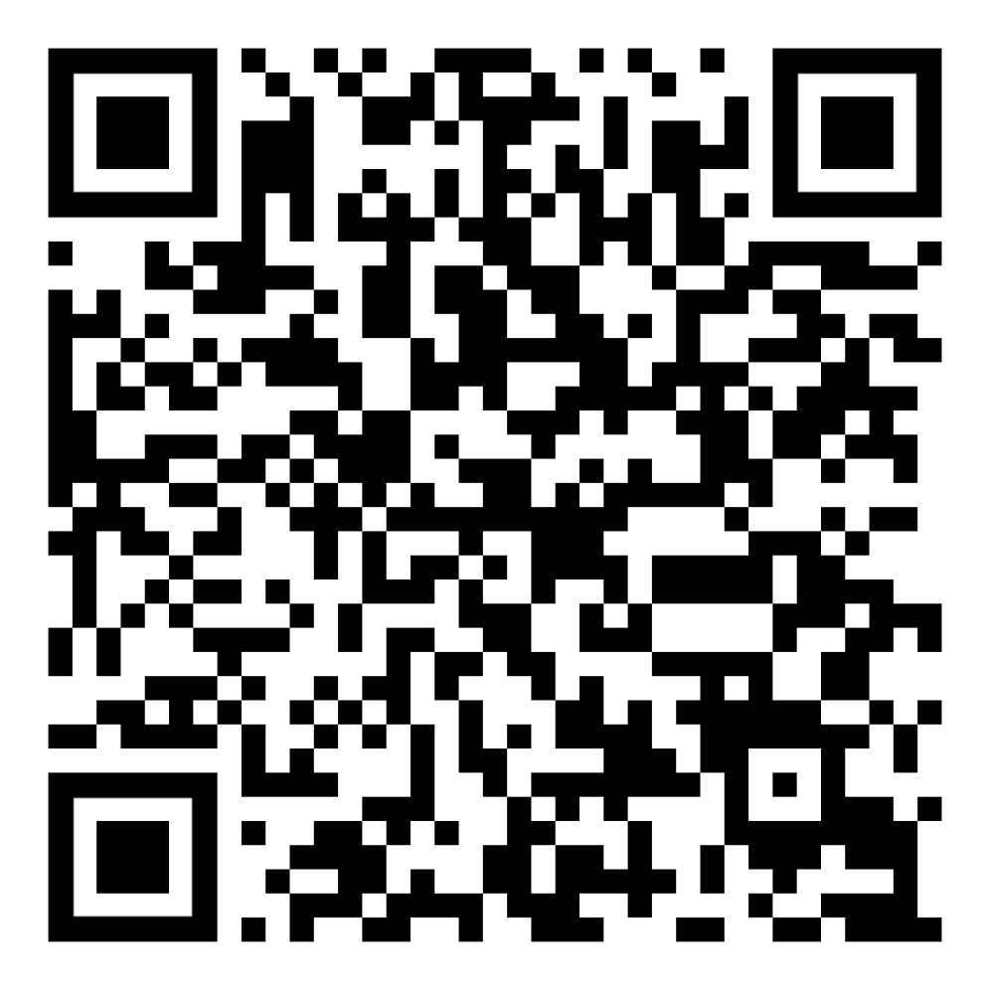

Slide 4
Expected Learner Outcomes
At the end of the presentation, participants will be able to:
Identify two ways that language influences people
Describe two examples of negative rhetoric
List two ways that language can be used in health and mental health to promote positive change

Slide 5
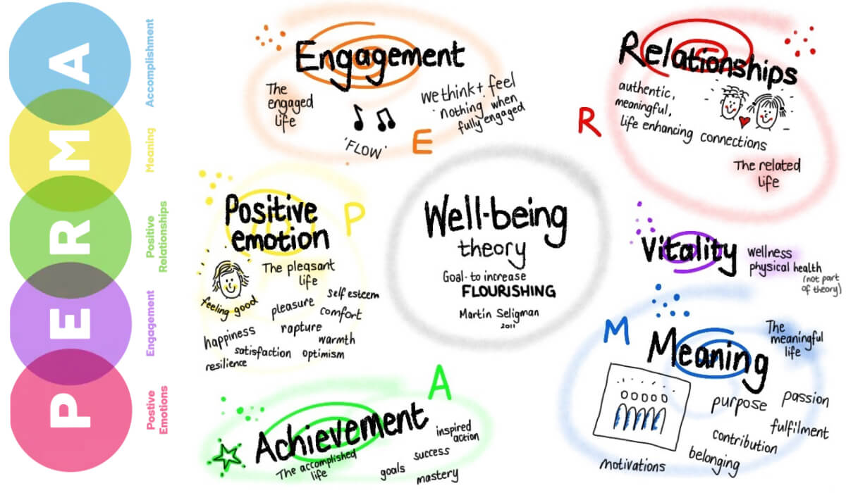

Slide 7
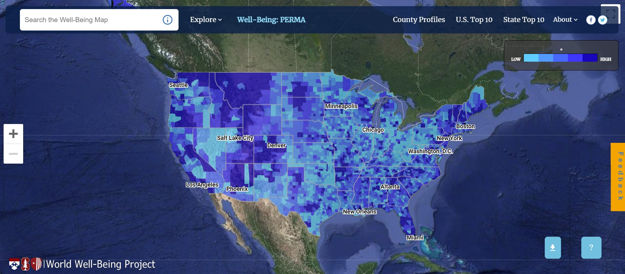

Slide 8
World Well-Being Project (WWBP)
January 2015 researchers published a proof-of-concept paper evaluating more than 100 million tweets from some 1,300 counties across the U.S., a sample of public data available from Twitter. They discovered that the preponderance of negative tweets—particularly those expressing anger or hostility—in a given location reliably predicted rates of death from heart disease there. Many other findings have piled up that reveal associations between the language in tweets or Facebook posts and traits that include age, gender, personality and income level, as well as mental illness and physical ailments.
Using these methods, researchers are finding a wide range of revealing associations between social media posts and personality, mental health, and even physical conditions such as heart disease.
Eichstaedt, J. C. (2016). Status Update: Stressed, Angry, at Risk? Scientific American Mind, 27(2), 62-67.

Slide 9
Language in an Ever-Evolving World
We are not on a new path. We have been here before, and there have been consequences.
But the path is far wider than ever due to the rise of social media, which has forever changed our world.
Social media data has become the largest cross-sectional and longitudinal dataset on human emotions, cognitions, behaviors, and health in human history.
  A zero-sum game
  Diminishment of social skills
Dunning-Kruger Effect
  Confirmation bias

Slide 10
“The moment we want to believe we suddenly use all the arguments for it, and become blind to the arguments against it.”
– George Bernard Shaw

Slide 11
How Language Influences
Physiological arousal and psychological shutdown (Gottman, 1999)
The frontal cortex of the brain, which is responsible for thinking, speech, and language, becomes inhibited, thereby limiting a person’s ability to reason and articulate thoughts. At the same time, portions of the area around the brain stem, including the amygdala and hypothalamus, which that are responsible for physiological reactions, become increasingly active (van der Kolk, 1994)
Gottman, J. M. (1999). The marriage clinic. New York : Norton.
van der kolk, B. A. (1994). The body keeps score: Memory and the emerging psychobiology of post traumatic stress. Harvard Review of Psychiatry, 1, 253–265

Slide 12
How Language Influences (cont.)
The Messages from Water
Masaru Emoto (2004) discovered that crystals formed in frozen water reveal changes when specific, concentrated thoughts are directed toward them. He found that water from clear springs and water that has been exposed to loving words shows brilliant, complex, and colorful snowflake patterns. In contrast, polluted water, or water exposed to negative thoughts, forms incomplete, asymmetrical patterns with dull colors. (see Radin et al., 2006)
Emoto, M. (2004). The hidden messages in water. Hillsboro, OR: Beyond Words Publishing.
Radin, D., Hayssen, G., Emoto, M., & Kizu, T. (2006). Double-blind test of the effects of distant intention on water crystal formation. Explore, 2(5):408-11.

Slide 13
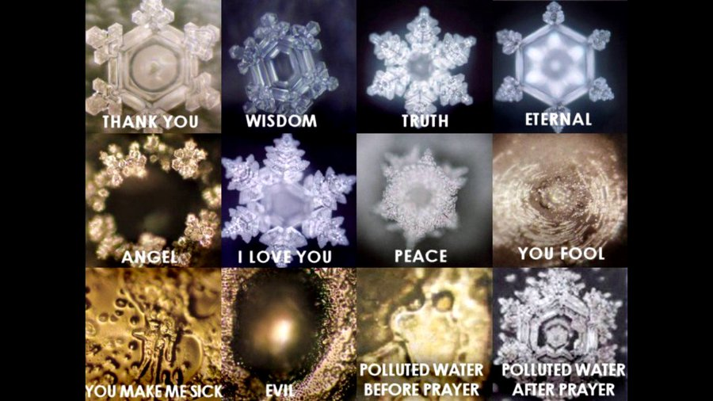

Slide 14
How Language Influences (cont.)
Health & Mental Health
A growing body of research has demonstrated correlations between language and health and mental health (Eichstaedt, et al., 2015a, 2015b; Ireland, Schwartz, Chen, Ungar, & Albarracin, 2015)
Examples vary from the stigmatizing, discriminatory effects of language to its healing properties
Language has been shown to effect mood, problem-solving, create barriers, separate, and promote hierarchical power (Richards, 2018)
Language can also persuade humans on political issues (Bai, Voelkel, Eichstaedt, & Willer, 2023)
Bai, H., Voelkel, J. G., Eichstaedt, J. C., & Willer, R. (2023). Artificial Intelligence Can Persuade Humans on Political Issues. OSF Preprints.
Eichstaedt, J. C., Schwartz, H. A., Kern, M. L., Park, G., Labarthe, D. R., Merchant, R. M., Jha, S., Agrawal, M., Dziurzynski, L. A., Sap, M., Weeg, C., Larson, E. E., Ungar, L. H.,
& Seligman, M. E. P. (2015a). Psychological language on Twitter predicts county-level heart disease mortality. Psychological Science, Vol 26(2), 159-169.
Eichstaedt, J. C., Schwartz, H. A., Kern, M . L., Labarthe, D. L., Merchant, R. M.,Jha, S., Agrawal, M., Dziurzynski, L. A., Sap, M., Weeg, C., Larson, E. E., Ungar, L. H., &
Seligman, M. E. P. (2015b). Psychological language on Twitter predicts county-level heart disease mortality. Psychological Science, 1-11.
Ireland, M. E., Schwartz, H. A., Chen, Q., Ungar, L. H., & Albarracin, D. (2015). Future-oriented tweets predict lower county-level HIV prevalence in the United States. Health
Psychology, 34, 1252-1260.
Richards, V. (2018). The importance of language in mental health care. Lancet Psychiatry, 5(6), 460-461.

Slide 15
Language: Costs?
Research shows that extensive discussions of problems and encouragement of ‘‘problem talk,’’ rehashing the details of problems, speculating about problems, and dwelling on negative affect in particular, leads to a signiﬁcant increase in the stress hormone cortisol, which predicts increased depression and anxiety over time. (Byrd-Craven, Geary, Rose, & Ponzi, 2008)
People who are in a more positive mood are better liked by others and more open to new ideas and experiences. (Fredrickson, 1998)
Byrd-Craven, J., Geary, D. C., Rose, A. J., & Ponzi, D. (2008). Co-ruminating increase stress hormone levels in women. Hormones and
Behavior, 53, 489–492.
Fredrickson, B. (1998). What good are positive emotions? Review of General Psychology, 2, 300-319.

Slide 16
Language: Costs? (cont.)
Recent studies by the University of Pennsylvania demonstrated a link between language used on social media (i.e., Facebook, Twitter, etc.) and heart disease—expressions of negative emotions such as anger, stress and fatigue in tweets were associated with higher heart disease risk. (Eichstaedt, et al., 2015a, 2015b)
The same researchers also found that positive emotions like excitement and optimism were associated with lower risk of heart disease. (Eichstaedt, et al., 2015a, 2015b)
Ireland, Schwartz, Chen, Ungar, and Albarracin (2015) studied HIV prevalence and learned that sexually transmitted infection rates and references to risky behavior on Twitter were associated with higher HIV prevalence in all counties except those with high rates of future orientation.
Eichstaedt, J. C., Schwartz, H. A., Kern, M. L., Park, G., Labarthe, D. R., Merchant, R. M., Jha, S., Agrawal, M., Dziurzynski, L. A., Sap, M., Weeg,
C., Larson, E. E., Ungar, L. H., & Seligman, M. E. P. (2015a). Psychological language on Twitter predicts county-level heart disease mortality.
Psychological Science, Vol 26(2), 159-169.
Eichstaedt, J. C., Schwartz, H. A., Kern, M . L., Labarthe, D. L., Merchant, R. M.,Jha, S., Agrawal, M., Dziurzynski, L. A., Sap, M., Weeg, C., Larson,
E. E., Ungar, L. H., & Seligman, M. E. P. (2015b). Psychological language on Twitter predicts county-level heart disease mortality. Psychological
Science, 1-11.
Ireland, M. E., Schwartz, H. A., Chen, Q., Ungar, L. H., & Albarracin, D. (2015). Future-oriented tweets predict lower county-level HIV prevalence in
the United States. Health Psychology, 34, 1252-1260.

Slide 17
Language: Costs? (cont.)
Across 13 outcomes, language-based personality estimates replicated patterns that have been observed in individual-level and geographic studies, including higher Republican vote share in less agreeable counties and increased life satisfaction in more conscientious counties. (Giorgi et al., 2021)
Researchers found through preregistered confirmatory behavioral experiments found that overperception of individuals’ moral outrage causes over-perception of collective moral outrage and inflates beliefs about hostile communication norms, group affective polarization and ideological extremity. Together, these results highlight how individual-level overperceptions of online moral outrage produce collective over-perceptions that have the potential to warp our social knowledge of moral and political attitudes. (Brady et al., 2023)
Brady, W. J., McLoughlin, K. L., Torres, M. P., Luo, K. F., Gendron, M., & Crockett, M. J. (2023). Overperception of moral outrage in online social
networks inflates beliefs about intergroup hostility. Nature Human Behaviour. https://doi.org/10.1038/s41562-023-01582-0
Giorgi, S., Nguyen, K L., Eichstaedt, J. C., Kern, M. L., Yaden, D. B., et. (2021). Regional personality assessment through social media language.
Journal of Personality, 1-21. DOI: 10.1111/jopy.12674

Slide 18
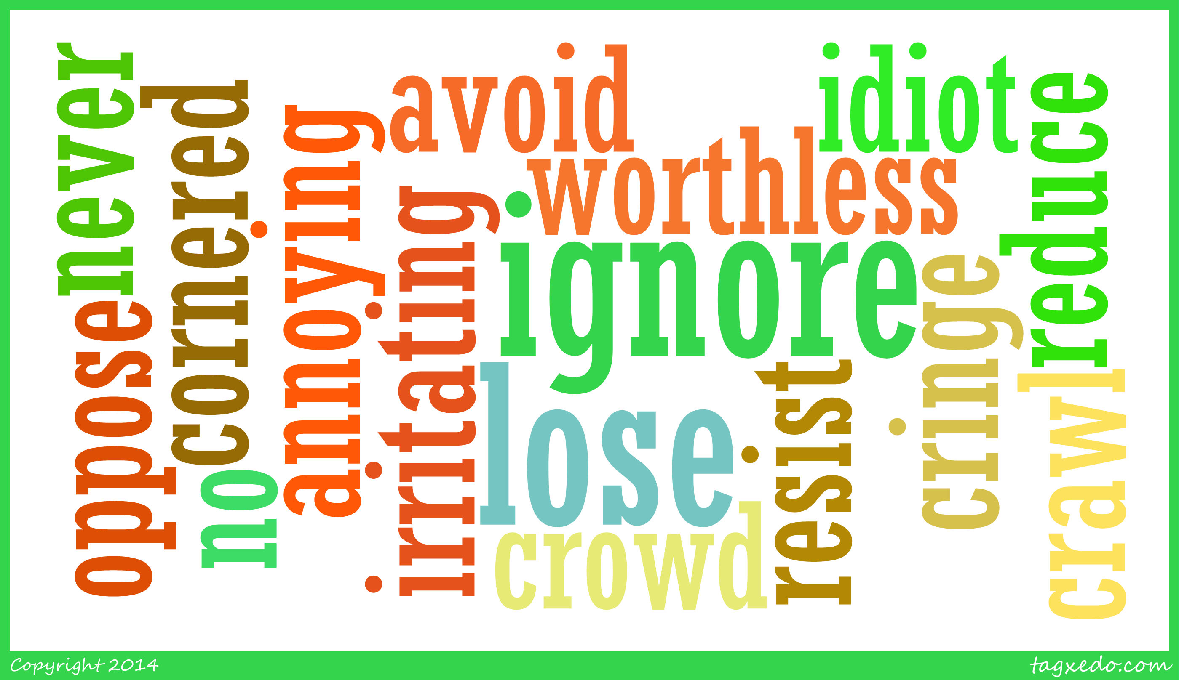
Common Words Associated with Risk

Slide 19
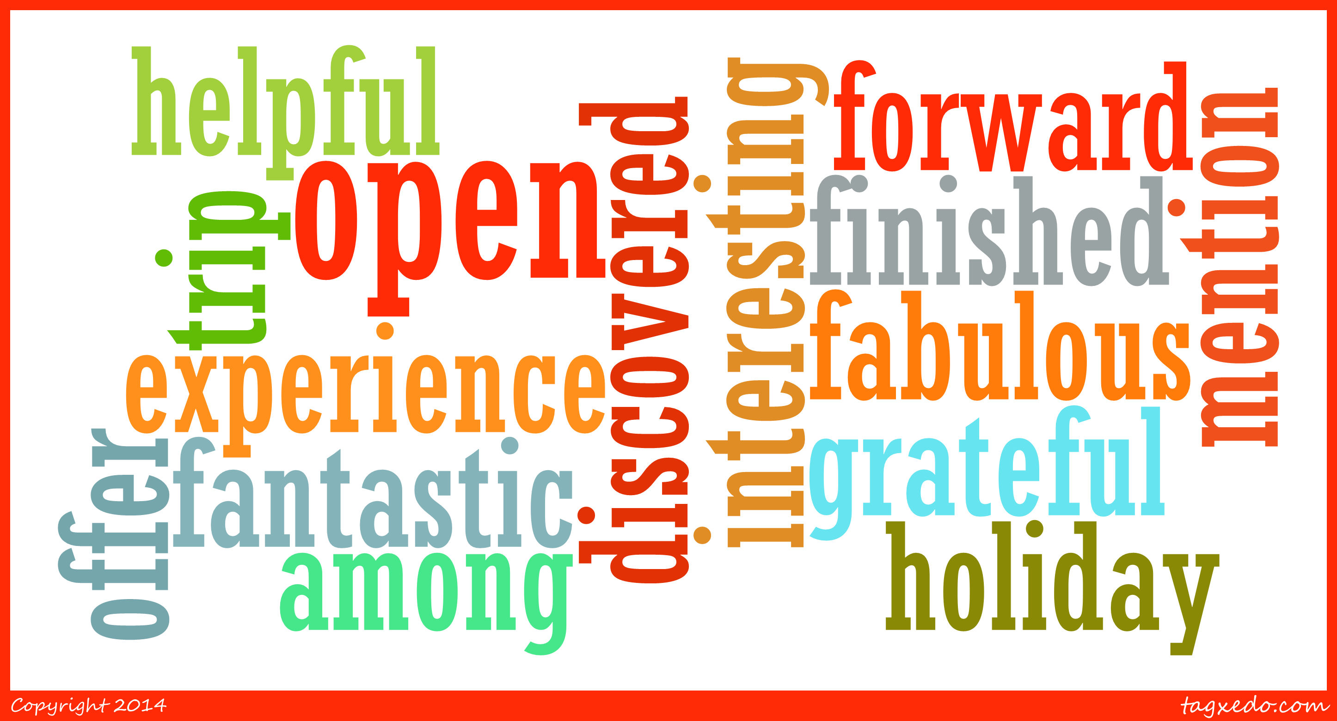
Common Words That Have Protective Qualities

Slide 20
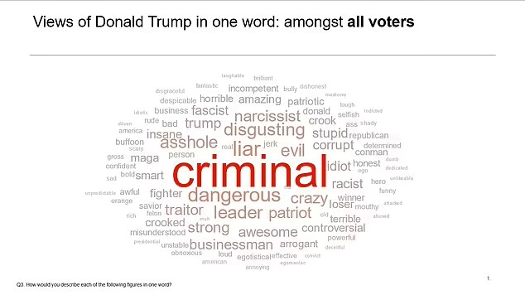

Slide 21
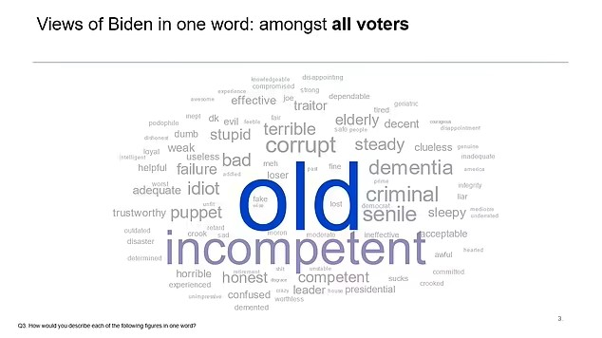

Slide 22
Examples of Negative Rhetoric
Blame others (with a common theme of dividing among racial lines)
Demonize those seen as the opposition
Attack the objective truth (which include refuting mainstream science)
Attack the mainstream media
Attempt to blur reality and convince others to spread those blurred realities
Embrace extremes
Attack domestic democratic processes
Rejection of international norms
Attack the judiciary and rule of law

Slide 23
Lessons Learned
Sticks and stones can break bones AND words do hurt. The consequences are greater than we knew.
More talk isn’t always better.
We should step into conversations when those conversations have can harm.

Slide 24
Have We Not Learned?
Frustrated with Thomas A. Becket, Archbishop of Canterbury, King Henry II uttered, “Will no one rid me of this meddlesome priest” (1170, Dec. 29th) (Littleton, 1772, p. 353).
Becket was subsequently murdered by four knights.
This phrase is commonly used in modern-day contexts to express that a ruler’s wish may be interpreted as a command by their subordinates.
Littleton, G. (1772). History of the life og King Henry the Second (Vol. 4). London: Dodstey.

Slide 25
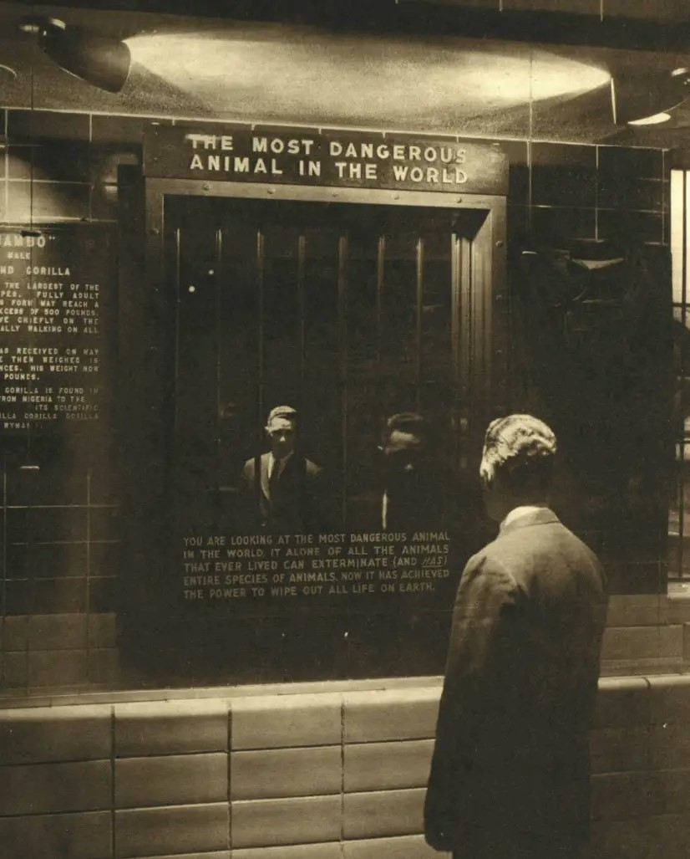
1963 Bronx Zoo Exhibit
“You are looking at the most dangerous animal in the world. It alone of all the animals that ever lived can exterminate (and has) entire species of animals. Now it has the power to wipe out all life on earth.”

Slide 26
“I swore never to be silent whenever and wherever human beings endure suffering and humiliation. We must always take sides. Neutrality helps the oppressor, never the victim. Silence encourages the tormentor, never the tormented.”
– Elie Wiesel
1986 Noble Peace Prize Acceptance Speech

Slide 27
“Our capacity to destroy one another is matched by our capacity to heal one another.”
– Bessel van der Kolk
2014, The Body Keeps the Score

Slide 28
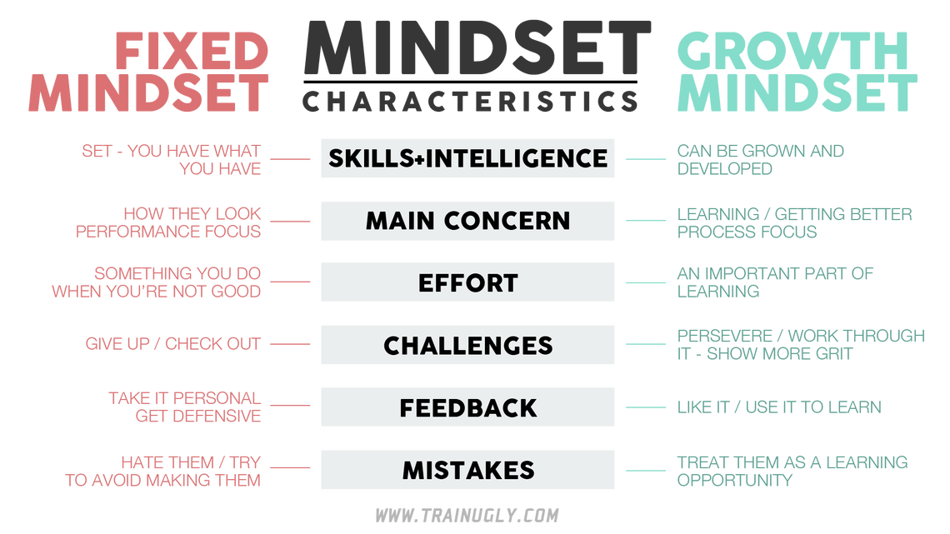

Slide 29
An Implication of Mindset
Surgeon Atul Gawande (2007) has written about the implications of hope in medicine. Dr Gawande stated that the worst thing a physician can do is give up hope on a patient.
In an interview, Emil “Jay” Freireich, who helped discover a cure for childhood leukemia, Dr. Freireich remarked:
  There’s no possibility of being pessimistic when people are dependent on you for their only optimism. On Tuesday morning, I make teaching rounds, and sometimes medical fellows say, “This patient is eighty years old. It’s hopeless.” Absolutely not! It’s challenging. It’s not hopeless. You have to come up with something. You have to figure out a way to help them, because people must have hope to live. (quoted in Gladwell, 2013, p. 139)
Gawande, A. (2007). Better: A surgeon’s notes on performance. New York: Henry Holt and Company.
Gladwell, M. (2013). David and Goliath: Underdogs, misfits, and the art of battling giants. New York: Little, Brown.

Slide 30
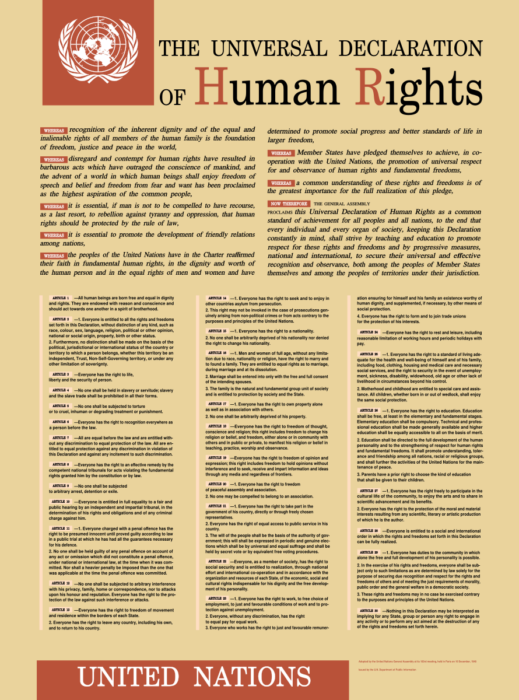
The Universal Declaration of Human Rights (UDHR) is a milestone document in the history of human rights was drafted by representatives with different legal and cultural backgrounds from all regions of the world.
The Declaration was proclaimed by the United Nations General Assembly in Paris on 10 December 1948 (General Assembly resolution 217 A) as a common standard of achievements for all peoples and all nations.
It sets out, for the first time, fundamental human rights to be universally protected.

Slide 31
How to Use Language As a Vehicle for Change in Health & Mental Health
Use person-first language
Develop a relational (alliance) focus
Empathy, positive regard, and genuineness
Express gratitude
Focus on the future (e.g., presuppositional language, mindfulness, etc.)
Commit to the “formula for viral kindness”

Slide 32
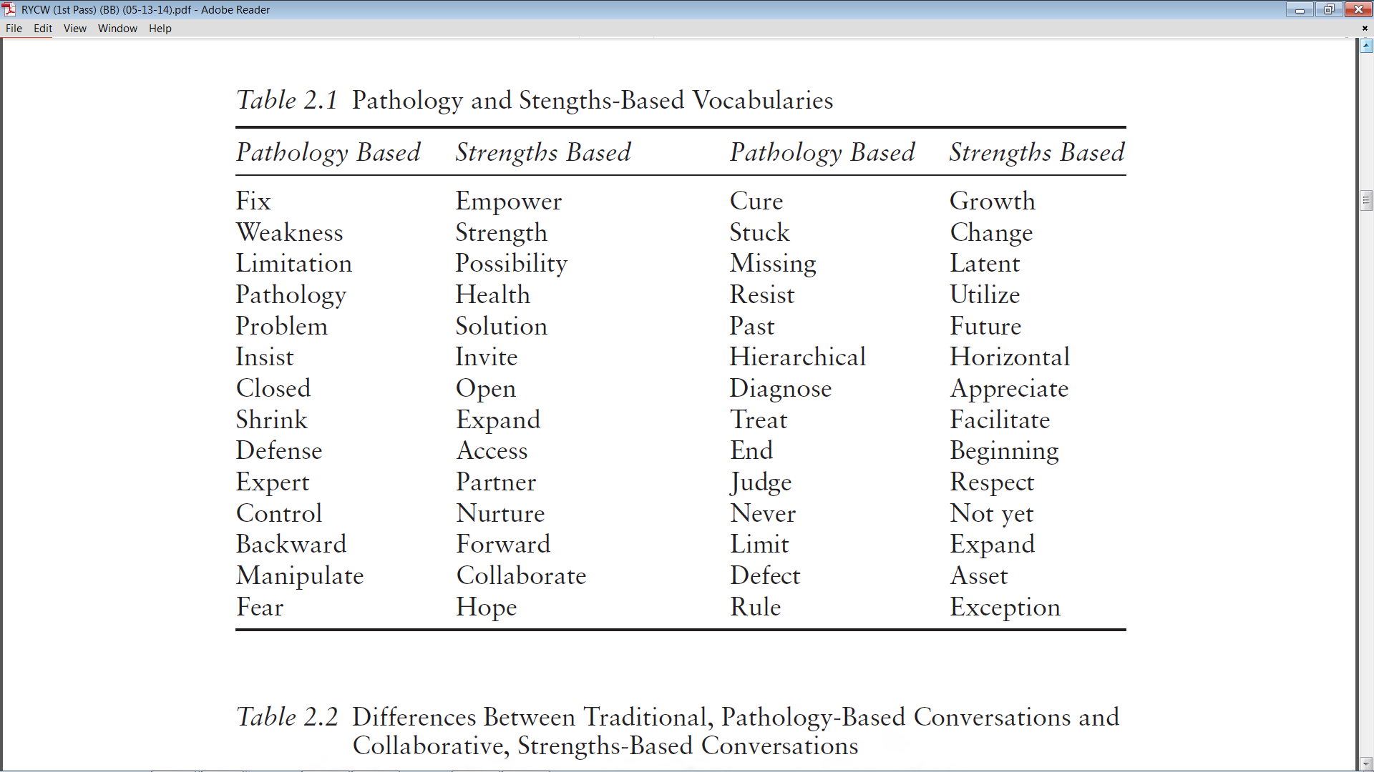
Bertolino, B. (2015). The residential youth care worker in action: A collaborative, strengths-based approach.
New York: Routledge.

Slide 33
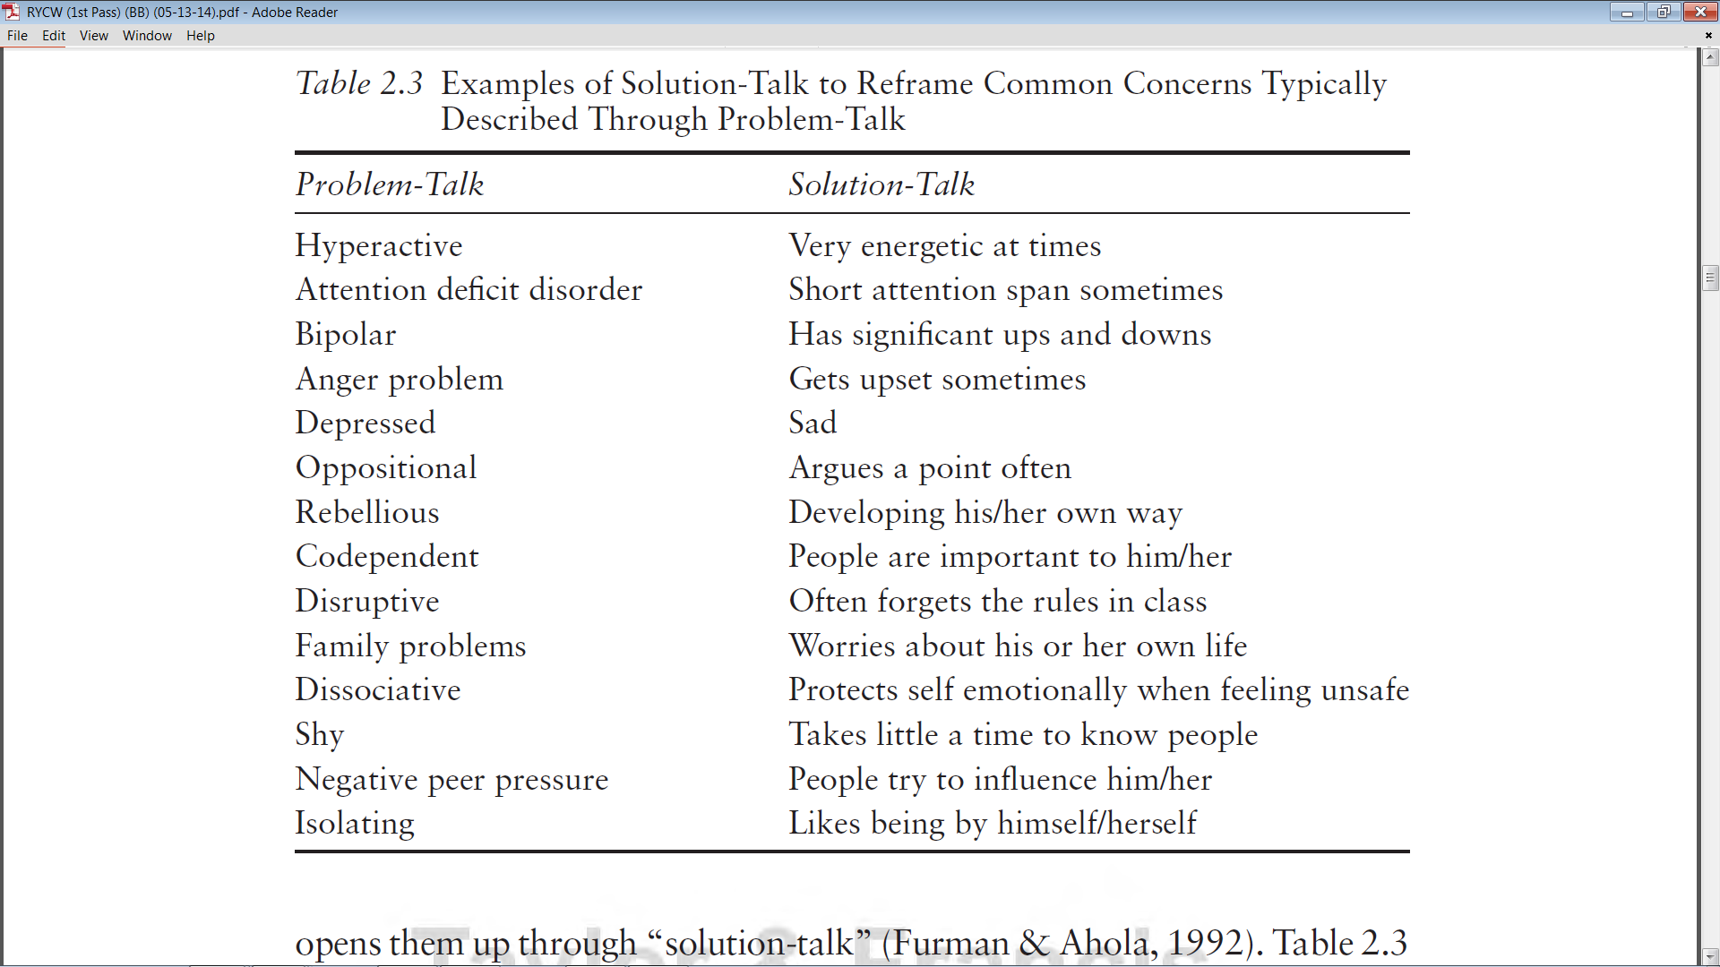
Bertolino, B. (2015). Working with children and adolescents in residential care: A strengths-based approach. New York: Routledge.

Slide 34

Formula For Viral Kindness
Professor Anette Hosoi
The Neil and Jane Pappalardo Professor of Mechanical Engineering and Mathematics at MIT
1:1.1

